Slide 1
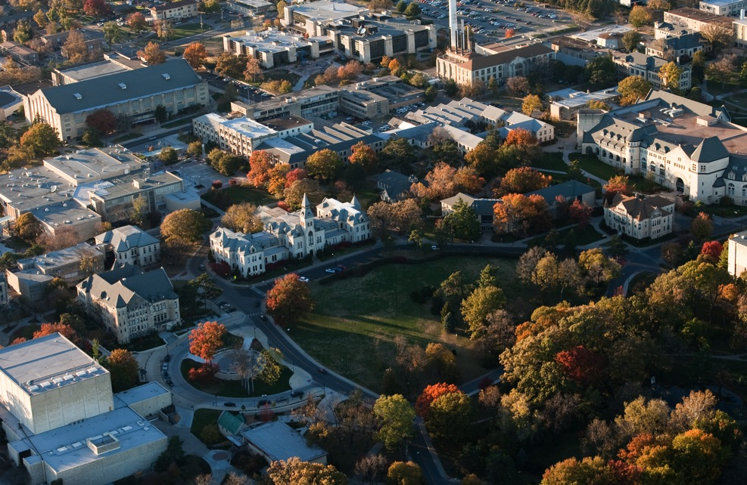
Bet ter pictures for the web
Some easy ways to improve image impact

Slide 2
About me
K-State graduate
University photographer since Oct 2008
15 Years in newspapers

Slide 3
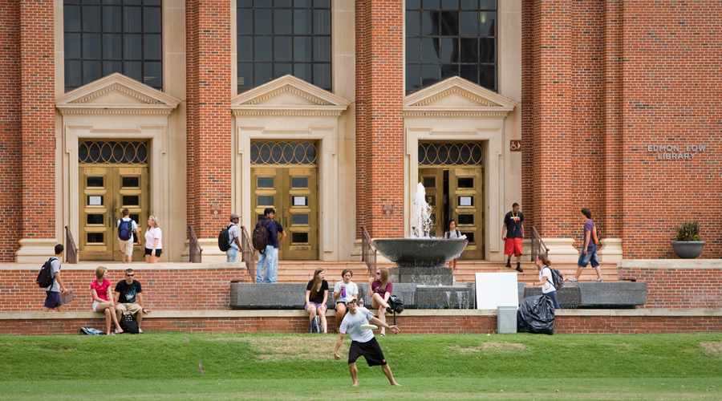
Help the viewer
Pictures have better effect if you don’t have to hunt to find out what’s going on.

Slide 4
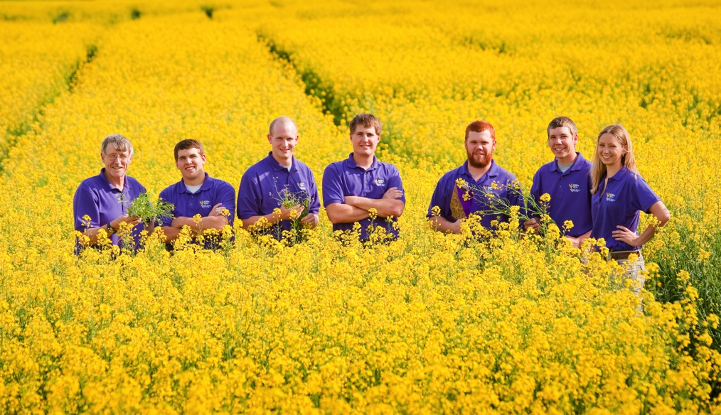
Clean up the background
A quick and easy way to put the focus where you want it.
Long lenses help. Angle is also critical.

Slide 5
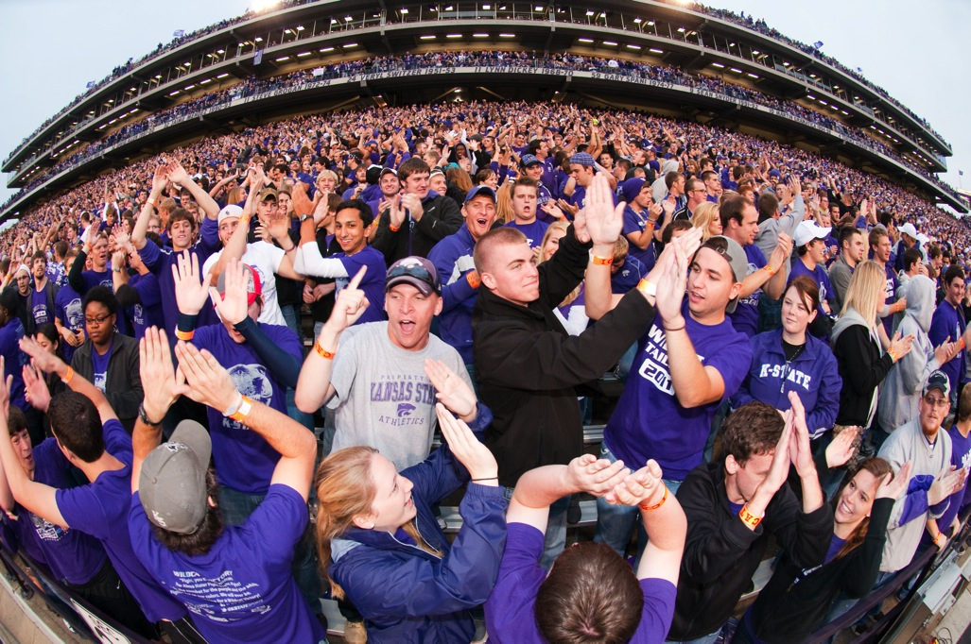
Get the best angle
Be creative

Slide 6
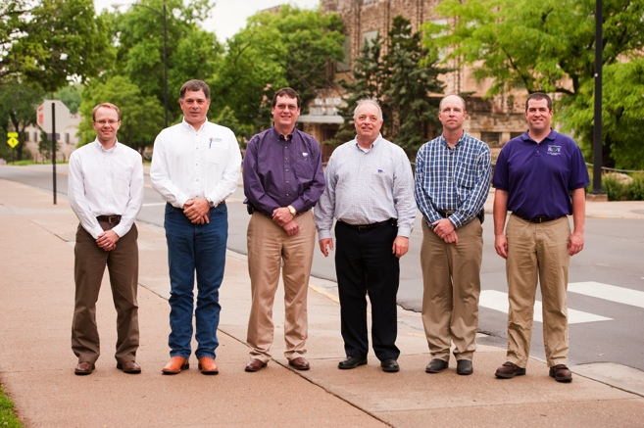
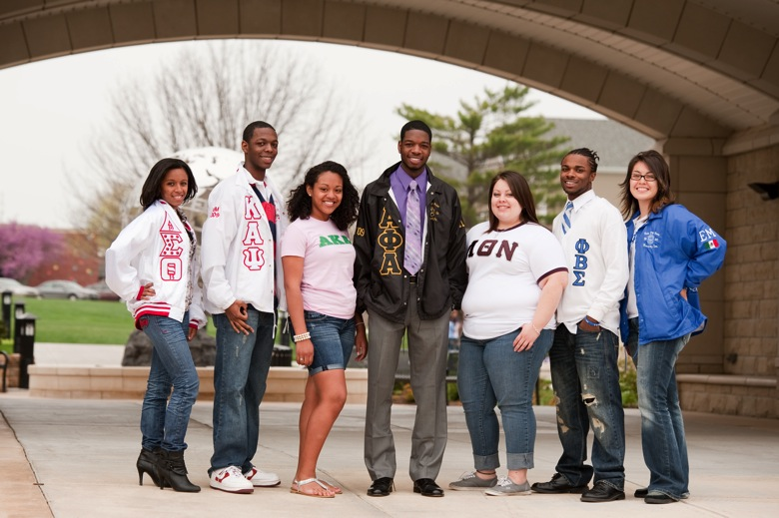
Bet ter group pictures
A variety of shoulder angles and hand positions helps.
Don’t let them ‘fig-leaf’.

Slide 7
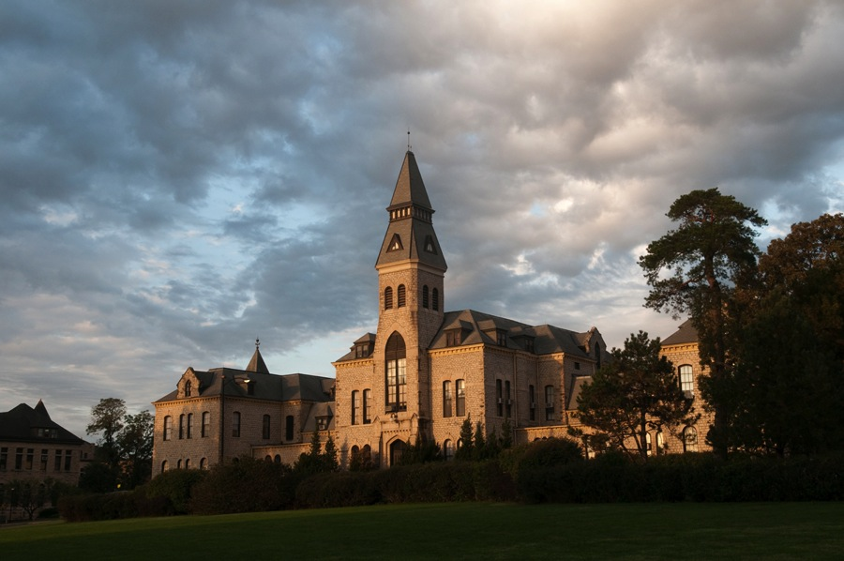
Don’t f ight the light
Use natural light to your advantage

Slide 8
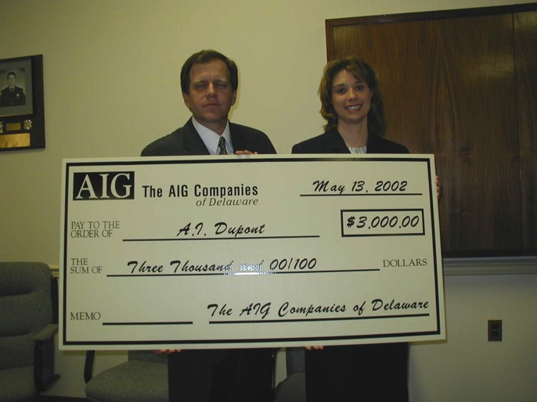
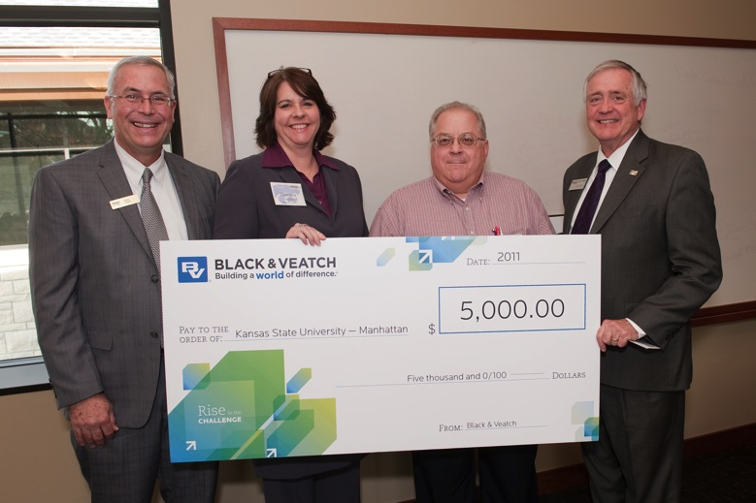
Don’t f ight the light II
If you have to point the flash right at them, bounce it!
Don’t point the flash right at them.

Slide 9
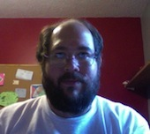
Leave the mug shots to the police

Slide 10
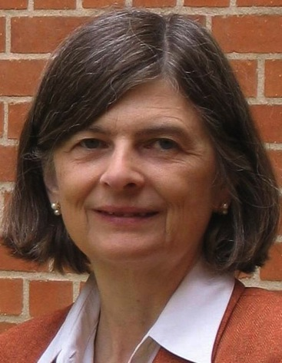
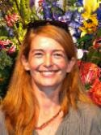
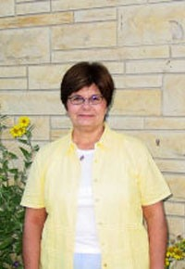
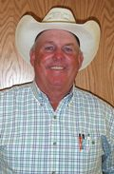

Get them away from the wall.
And the plants. And everything.

Slide 11
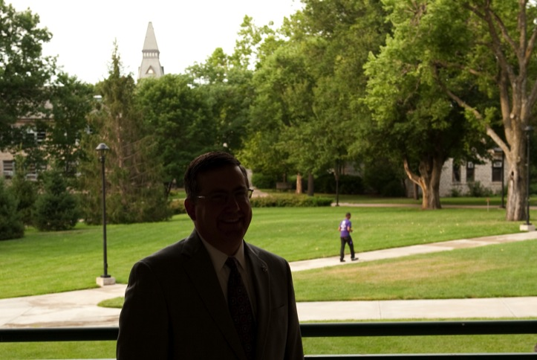
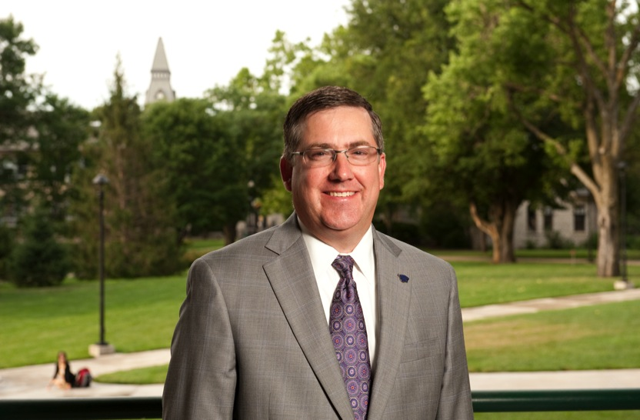
Don’t f ight the light III
Use fill-flash to balance outdoor lighting.

Slide 12
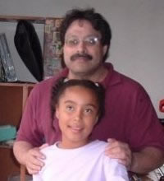
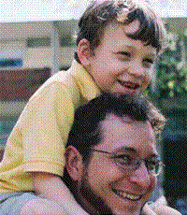
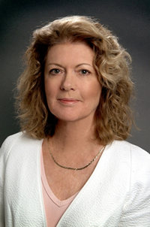
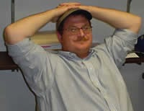
Keep it professional

Slide 13
How to make head and shoulders shots look like a Million Dollars.
For a nickel.

Slide 14
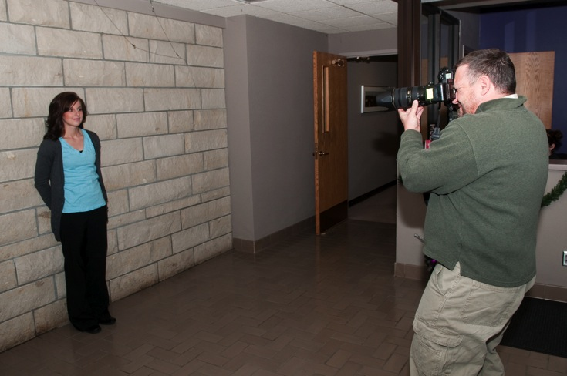
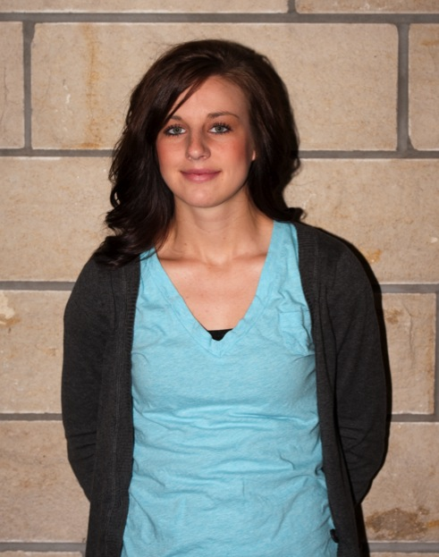
How most people do it
Subject is against the wall and flash is direct.

Slide 15
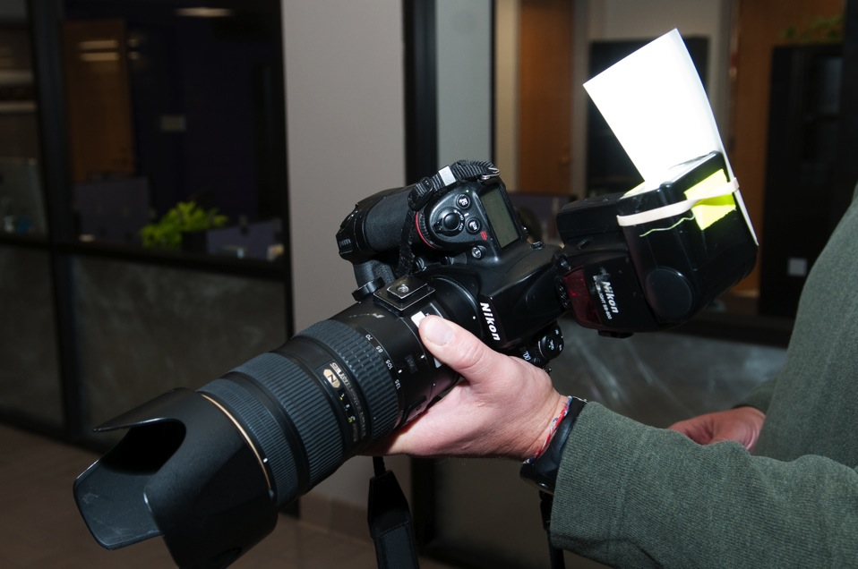
The f ix
An index card and a rubber band.

Slide 16
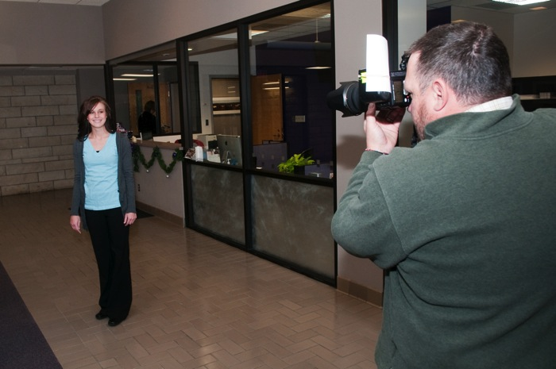
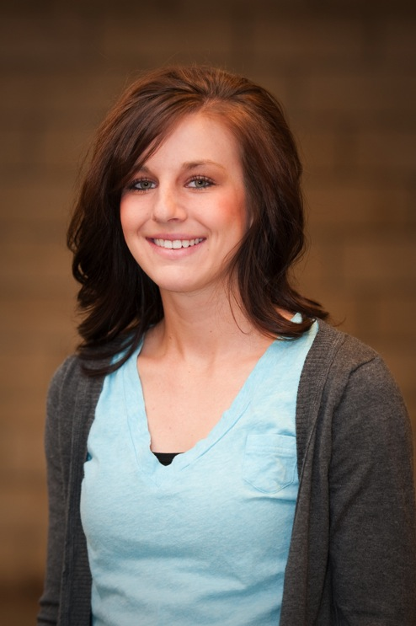
How the pros do it
Move the subject away
from the wall.
Bounce the flash.

Slide 17
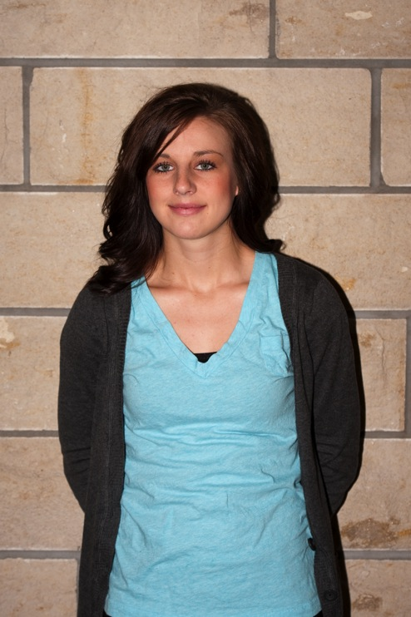
Before and after

Slide 18
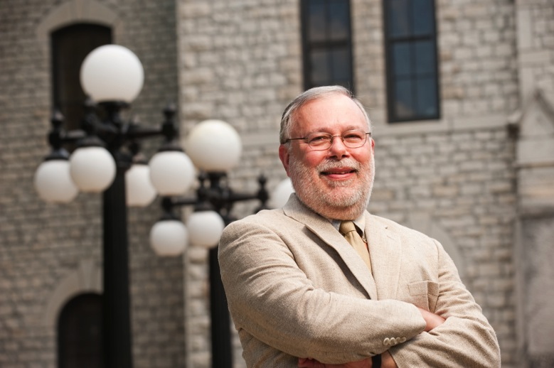
Head and shoulders vs. environmental portrait
If your photo will be used in a large space, an environmental portrait adds depth
If it’s going to be small, use the head and shoulders.

Slide 19
The quickest, easiest way to get better images: Call us.
Our services are free.
Portraits shot for faculty and staff twice per month on walk-in basis. Other times by appt.
Working with the library to get all old negatives into digital format.

Slide 20
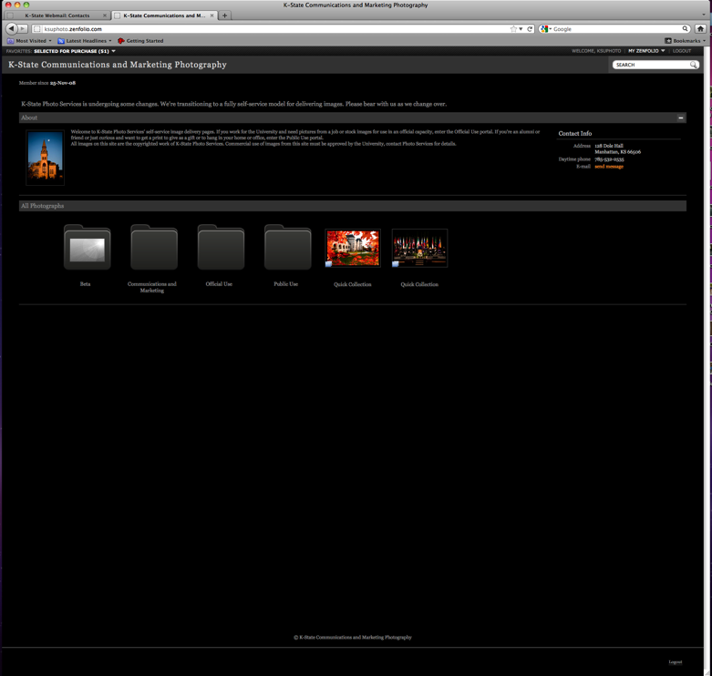
Get t ing pictures from us
Website: ksuphoto.zenfolio.com
Email
Disk.

