Slide 1
You Should Be Writing! Tips for Consistency and Success
@don_saucier
#ITeachAtKState
Don Saucier
University Distinguished Teaching Scholar
Professor of Psychological Sciences
Faculty Associate Director of the Teaching & Learning Center
TLC Professional Development Series

Slide 2
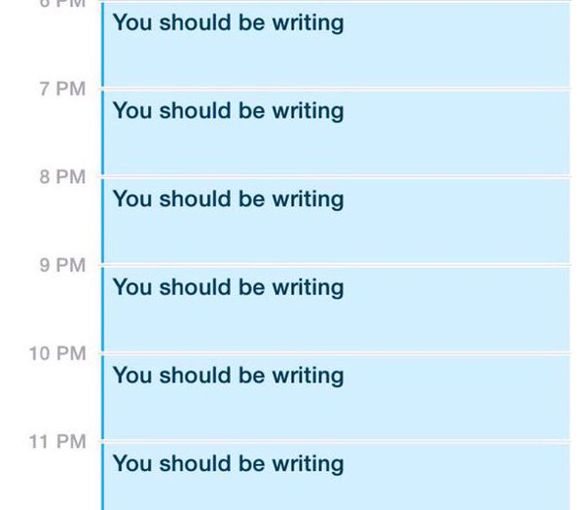

Slide 3
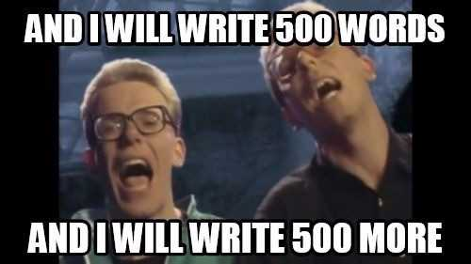

Slide 4
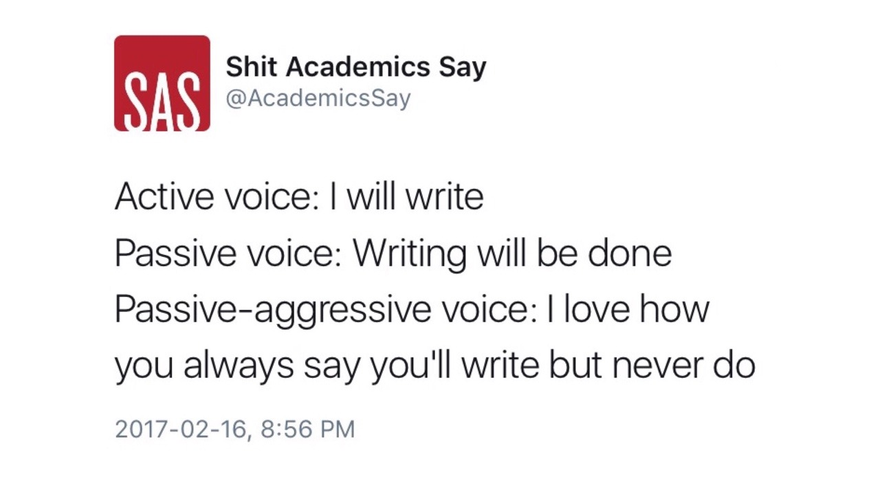

Slide 5
Why Should We Write (More)?

Slide 6
Why Don’t We Write (More)?

Slide 8
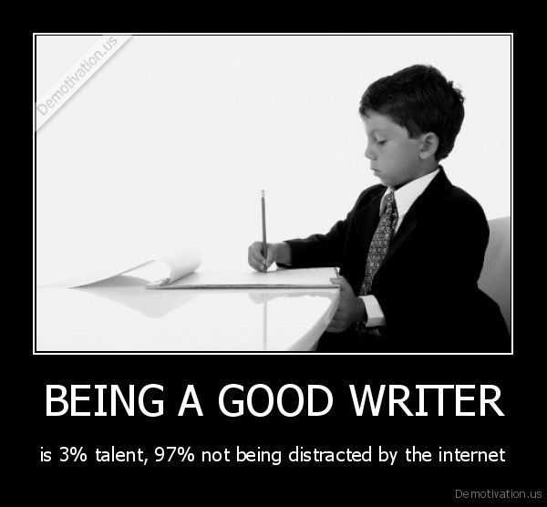

Slide 10
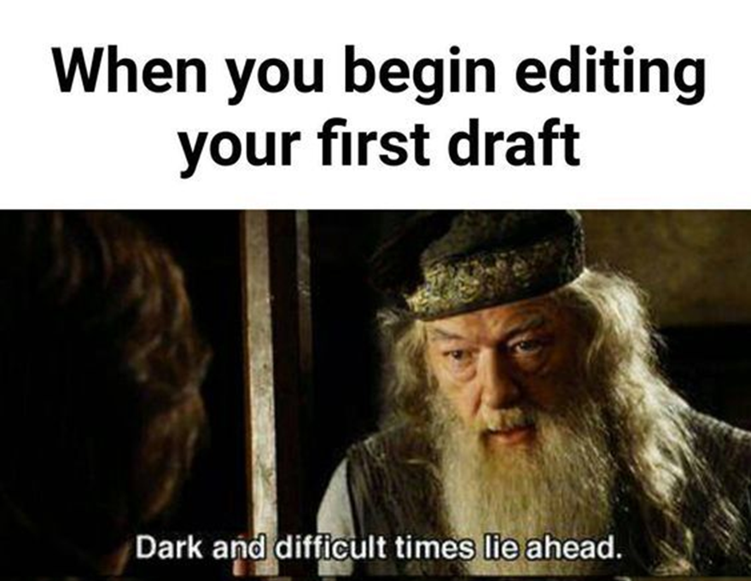

Slide 12
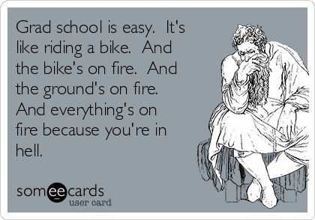

Slide 13
Our Goals
Make writing a consistent priority
Reduce binge-writing tendencies
Increase productivity
Of things people would want to read!
Allow ourselves to engage in the writing process

Slide 14
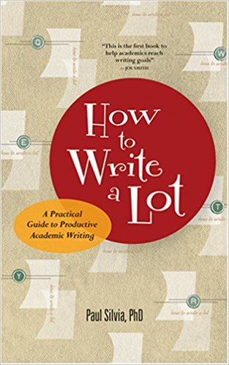
How to Write a Lot (Silvia, 2007)

Slide 15
Silvia’s Top Fundamental Recommendations
Make and use a schedule during working hours
People who write a lot, plan a lot
Track your progress toward your goals
Choose good, simple words
Write first, revise later
Make and use outlines

Slide 16
Silvia’s Top Surprising Recommendations
Writing should be mundane and boring
Never reward writing with not writing
Don’t discuss obvious limitations of your work
Write to achieve success, not to avoid failure
Rejections are the sales tax of publication
You can’t introduce something you haven’t read

Slide 17
My Reservations
Overall, writing does not have to be horrible!
Setting up a self-fulfilling prophecy to hate it?
Hard lines with collaborators and refusing to budge the writing schedule as an emerging scholar?
The recommendation about censoring your publication efforts could be misinterpreted
I agree you shouldn’t publish anything you would not want your name on
But young scholars need to publish A LOT!
No expressed understanding of actual family responsibilities
And of course, “such that” and “individuals”

Slide 18
My Additional Recommendations
Beware the myth that you need a lot of time to write
Beware the myth of the Muse
Don’t reject yourself
Adhere to the Four Cs of Writing
Schedule your writing and write consistently
Start with the easy stuff

Slide 19
My Additional Recommendations
Write something you would want to read
Set yourself up for success for your future writing sessions
Get an accountability partner
Get feedback on your writing
Reward yourself for writing (and let it be its own reward)
Get something on the page
Maybe teach a writing seminar?

Slide 20
Designing a Writing Seminar
PSYCH 959: Graduate Seminar in Social Psychology
(Social Psychology Writing Practicum)
Taught in Spring 2017

Slide 21
Course Description
“Publish or perish.” “You should be writing.” These clichés highlight (and satirize) the weight that is placed on the ability to publish your research findings in academia. Succeed, and you substantially increase your chances of getting a job, earning tenure and promotion, etc. Fail, and the field may lose another promising scholar with great potential, but a short CV. As stated recently at the SPSP Teaching Preconference by one of the keynote speakers, “Not everyone gets to pub.” Our goal this semester is to increase your chances of success in publication and to keep you from being lost.
This seminar will consist of a writing practicum in which faculty and students will devote their time and effort to the creation of written research products that empirically investigate issues related to social psychological research. Thus, the work will be focused on manuscript and/or research proposal writing, with the ultimate goal being the completion of work that may either be submitted for publication or provide the basis for future research studies. Formal and informal peer reviewing, as well as formal and informal presentations, will also be used throughout the semester to optimize the quality of this written work.

Slide 22
Student Learning Outcomes
Upon successful completion of this course, you will be able to:
Critique the theoretical foundations, methods, results, and conclusions of research products.
Provide critical feedback on research products to colleagues professionally and constructively.
Receive critical feedback on research products from colleagues professionally and constructively.
Lead and facilitate discussions on primary literature, research products, and future research directions.
Prepare and deliver conference-style oral presentations of research proposal ideas and/or research results and answer audience questions professionally.

Slide 23
Student Learning Outcomes
Upon successful completion of this course, you will be able to:
Prepare formal peer reviews of research proposals and/or manuscripts.
Prepare APA-style research proposals and/or manuscripts that incorporate feedback from peer reviews.
Design programmatic research studies to extend the social psychological research literature.
Discover, practice, and archive recommendations and best practices for increasing the likelihood of successful publication to inform ourselves as well as those we mentor and teach.
Implement and evaluate strategies to become a more productive writer.

Slide 24
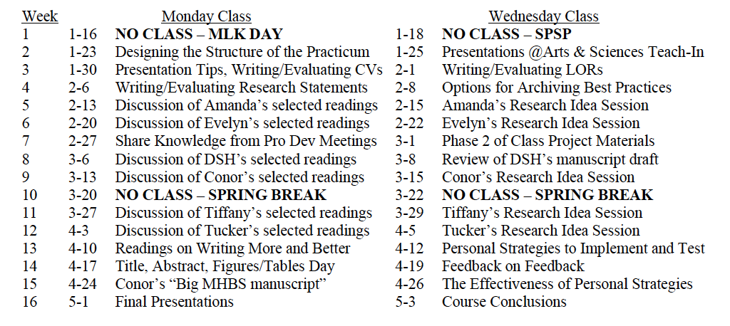
Topic Schedule

Slide 25
A Key Outcome: Developing Personal Strategies
My Personal Strategy:
I will open a manuscript document everyday when I get to my office
I will make a noticeable change to a manuscript or research presentation (or complete a manuscript review) everyday
I will spend at least 30 minutes writing each day (as a primary manuscript author)
I will record my progress in a spreadsheet

Slide 26
What I Record(ed) in My Spreadsheet
The year, month, week, date, and day
The manuscript I worked on
The section or task I worked on
The number of words I wrote
Whether or not I met my daily goal
Whether or not I had “windfall time” (more than 30 minutes)
My satisfaction with my progress
From 1 (not all satisfied) to 5 (satisfied) to 9 (very satisfied)
Whether or not I engaged in writing on collaborative products
The collaborative products I worked on

Slide 27
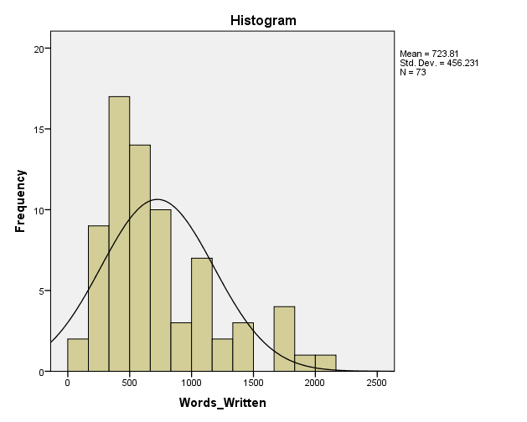
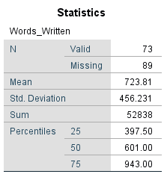
The Next ~6 Months
Goal met on 89% of Weekdays
Mean (all days) = 326 words written

Slide 28
My Lab’s Progress in the Next ~6 Months
I revised a manuscript I had been sitting on
We submitted five new manuscripts
We submitted revised versions of eleven manuscripts

Slide 29
My Publication Record
Writing Seminar
2001 to 2017 (17 years): N = 50 (2.94/year)
2018 to 2022 (5 years): N = 39 (7.80/year)
265% increase in yearly productivity!

Slide 30
Where I Still Want to Improve
Reviews…
Staying on target
Embracing revisions
Finding that 30 minutes

Slide 31
Faculty Focus
A Potential Outlet for Your Teaching Ideas and Practices

Slide 32
Submitting to Faculty Focus
Please send us your best strategies regarding course design, active learning, class participation, assignments and activities, online teaching, diversity and inclusion, grading and feedback, teaching with technology, and other topics of interest to today’s college faculty.
Submissions should be approximately 900 to 1,300 words in length, not counting references.
Submissions should consist of no more than 25% theoretical information; the rest should be practical advice for teachers to use.
Due to the nature of online newsletters, authors are encouraged to adopt a more practical and informal tone than is expected in academic journals.
Articles should not have been registered for copyright or published elsewhere (either on paper or electronically) prior to publication here.
The review process takes 5-6 weeks. Please be patient.
Once you’ve written your article, please send it as a Word doc to: tierney.king@magnapubs.com
Please include a brief bio (not your entire CV) with your submission.

Slide 33
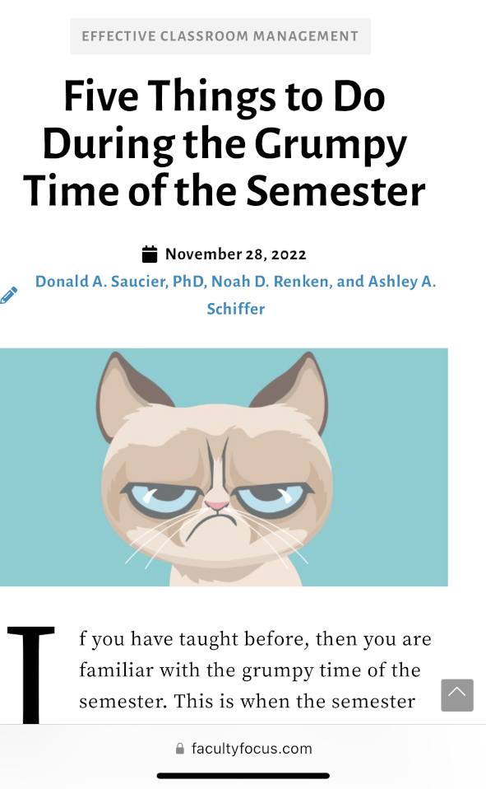
Just this past Monday!

Slide 34
Bem (1995): “End with a bang, not a whimper”
Stick the landing and drop the mic!
You should be writing
You should want to be writing
You should prioritize writing
You should develop a plan that works for you
Writing is awesome
So…

Slide 35
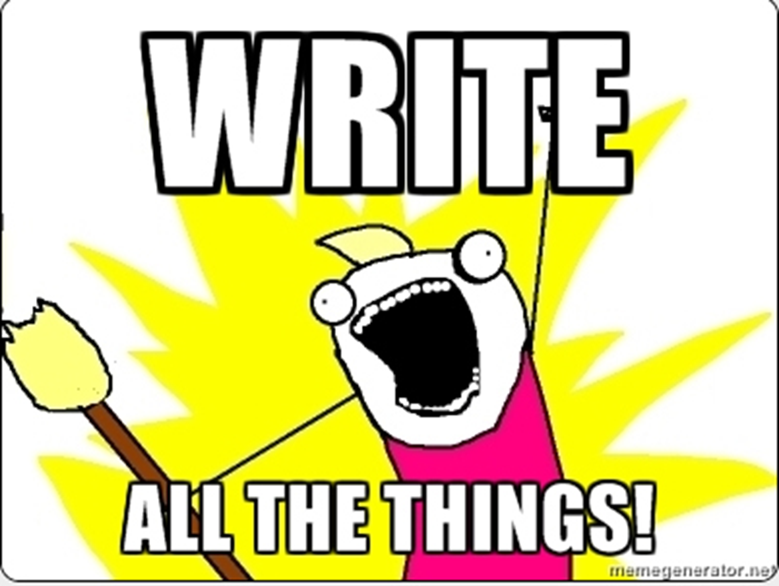

Slide 36
What Will You Take Away?
saucier@ksu.edu
#ITeachAtKState
What is one concrete take-away from our conversation today that you will use to write more consistently and successfully?

Slide 37
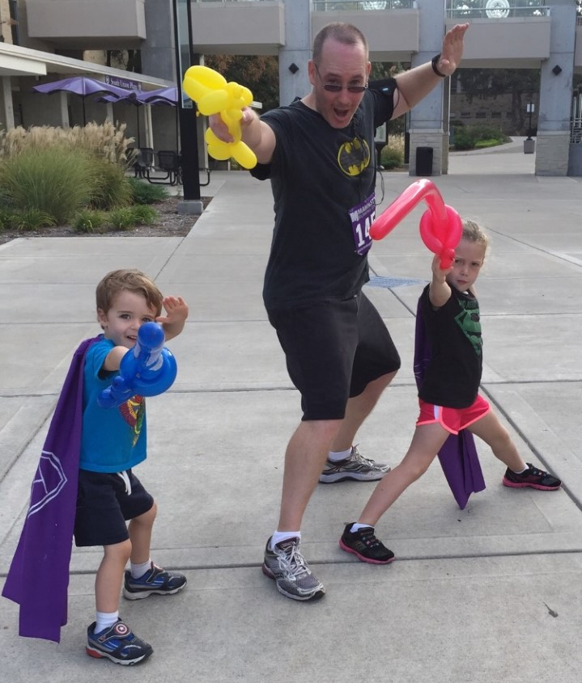
What Questions Do You Have?
@don_saucier
#ITeachAtKState
Further questions and/or a copy of this presentation or the syllabus for my 2017 writing seminar:
Email Don Saucier at saucier@ksu.edu
Thank you!
Please submit a Post-Event Survey!

