Slide 1
Welcome to the TLC Professional Development Series!
saucier@ksu.edu
#ITeachAtKState
Every Wednesday from 12 noon to 1PM
Zoom link: https://ksu.zoom.us/j/91717057640
All events recorded and archived on Canvas
TLC Professional Development Certificates and Fellows
TLC Professional Development Series

Slide 2

Tips for Successful Lectures
saucier@ksu.edu
#ITeachAtKState
Don Saucier
University Distinguished Teaching Scholar
Professor of Psychological Sciences
Faculty Associate Director of the Teaching & Learning Center
TLC Professional Development Series

Slide 3
My Objectives Today
saucier@ksu.edu
#ITeachAtKState
Discuss what “lecture” is (and isn’t)
Discuss simple strategies to make our lectures more successful
Discuss your ideas for how to make our lectures more successful
Model how to give a successful lecture

Slide 4
Questions To Get Us Thinking:
saucier@ksu.edu
#ITeachAtKState
What do you want to learn today?
What is “lecture”?
  What is the first word that comes to mind?

Slide 5

Questions To Get Us Thinking:
saucier@ksu.edu
#ITeachAtKState
What makes a lecture “successful”?
What are challenges to successful lecturing?

Slide 6
Lecture Is NOT:
saucier@ksu.edu
#ITeachAtKState
Merely listing and defining bold-faced terms
Reading the textbook on PPT slides

Slide 7
Lecture Is a Valuable Teaching Tool
saucier@ksu.edu
#ITeachAtKState
Efficient way to provide information
Works well to set up active learning
Lecture introduces content
Active Learning deepens understanding

Slide 8
In Reality…
saucier@ksu.edu
#ITeachAtKState
This is a false dichotomy
Active learning can and should be infused in our lectures
“Interactive” or “Dynamic” Lecturing
Be necessary, not redundant!

Slide 9
Tips for Successful Lectures
saucier@ksu.edu
#ITeachAtKState

Slide 10
Optimize Your Experience
saucier@ksu.edu
#ITeachAtKState

Slide 11
Optimize Your Experience
saucier@ksu.edu
#ITeachAtKState
Embrace your Excite-Nerve
Treat the classroom as the Oasis
Engage yourself first

Slide 12
The Trickle Down Engagement Model
saucier@ksu.edu
#ITeachAtKState
Teacher Engagement
Student Engagement
Student Learning
Notes:
Makes sense and is clear,

Slide 13
Optimize Your Students’ Experience
saucier@ksu.edu
#ITeachAtKState

Slide 14

Optimize Your Students’ Experience
saucier@ksu.edu
#ITeachAtKState
Bring PEACE to the Classroom
P = Preparation
E = Expertise
A = Authenticity
C = Caring
E = Engagement

Slide 15
Optimize Your Students’ Experience
saucier@ksu.edu
#ITeachAtKState
Start strong
  Gratitude
  Interactive announcements and/or review
    Prime thinking and participation
  Engagement trigger/hook

Slide 16
Optimize Your Students’ Experience
saucier@ksu.edu
#ITeachAtKState
Empathize with the student experience
Make the classroom the Oasis for them, too

Slide 17
Streamline the Content
saucier@ksu.edu
#ITeachAtKState

Slide 18
Streamline the Content
saucier@ksu.edu
#ITeachAtKState
Teach less better
Have clear goals and a clear flow to the content
Use PPT well
  Don’t firehose!

Slide 19
Streamline the Content
saucier@ksu.edu
#ITeachAtKState
Teach only content that is:
  Important
  Interesting
Remember why you are teaching it
  And make that clear

Slide 20
Bring the Content to Life
saucier@ksu.edu
#ITeachAtKState

Slide 21
Bring the Content to Life
saucier@ksu.edu
#ITeachAtKState
Share your stories
Make the content interesting and relevant
End strong
  Summary, conclusion, foreshadowing, exit ticket, gratitude

Slide 22
Infuse Active Learning
saucier@ksu.edu
#ITeachAtKState

Slide 23
Infuse Active Learning
saucier@ksu.edu
#ITeachAtKState
Teach and reinforce participation
Encourage thinking
Encourage questions

Slide 24
Infuse Active Learning
saucier@ksu.edu
#ITeachAtKState
Keep activities as short and focused as possible
Provide clear instructions
Inspire products that adhere to the Four Cs
  Clear, Complete, Concise, Compelling

Slide 25
In Conclusion
saucier@ksu.edu
#ITeachAtKState
Our lectures will be more successful when we:
Optimize our own experience
Optimize our students’ experience
Streamline the content
Bring the content to life
Infuse active learning
You got this!

Slide 26
What Will You Take Away?
saucier@ksu.edu
#ITeachAtKState
What is one concrete take-away from our conversation today that you will use to make your lectures more successful?

Slide 27
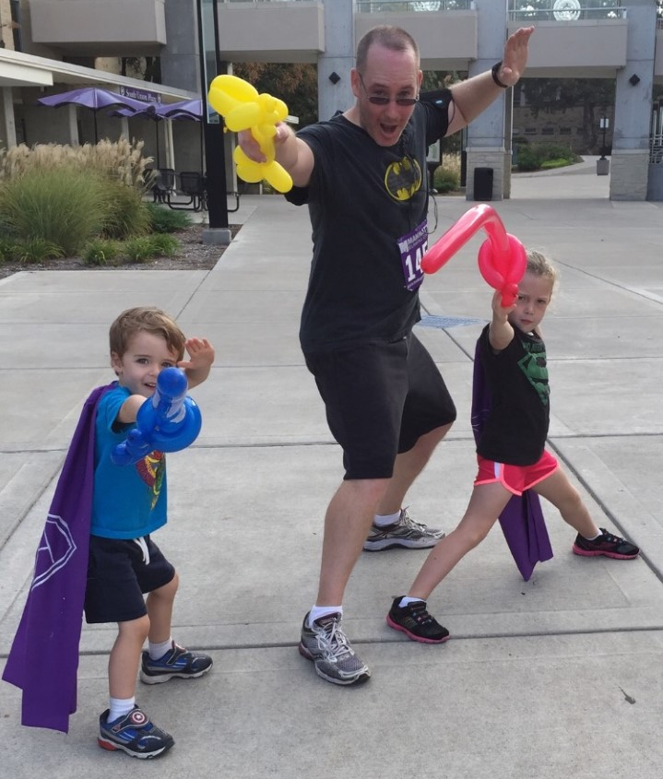
What Questions Do You Have?
saucier@ksu.edu
#ITeachAtKState
Further questions and/or a copy of this presentation:
Email Don Saucier at saucier@ksu.edu
Thank you!
Please submit a Post-Event Survey!

Slide 28
“Engage the Sage” YouTube Channel
saucier@ksu.edu
#ITeachAtKState
Videos on teaching philosophy and practices
Over 100 videos on many “teaching” topics
Short videos (usually < 10min)

Slide 29
Just In Time Videos
saucier@ksu.edu
#ITeachAtKState
Rocking the First Day
Ending Class Effectively
Five Things to Do Mid-Semester
It’s On the Syllabus
Managing End of the Semester Chaos
Rocking the Last Day
Evaluating Teaching Evaluations
Learning From Your Evaluations

Slide 30
Videos About Active Learning
saucier@ksu.edu
#ITeachAtKState
The Value of Active Learning
Top Ten Tips for Using Active Learning
Making Simple Concepts More Nuanced Through Interactive Storytelling
Using Students’ Stories in Class
Mad-Lib Response Style

Slide 31
Presentation Tips Videos
saucier@ksu.edu
#ITeachAtKState
Rocking Your Academic Presentations
Top 10 Tips for Using PowerPoint While Teaching
Effective Storytelling
The Art of Answering Questions
Why Your Should Firehose Your Students with Content
Don’t Start Your Classes Like This
50 Ways to Disengage Your Students
Lecturing Into the Void

Slide 32
Assignment Idea Videos
saucier@ksu.edu
#ITeachAtKState
Homework for Life
Using Pop-Up Presentations
Students Writing Their Own Exams
The Value of Extra Credit
Top Things Learned This Semester

Slide 33
Demonstrating Your Teaching Excellence
saucier@ksu.edu
#ITeachAtKState
Writing Excellent Statements of Your Teaching Philosophy
Demonstrating Your Teaching Excellence: Part 1
Demonstrating Your Teaching Excellence: Part 2
Top 10 Ways to Get Teaching Jobs and Awards
The Four Cs of Writing

Slide 34
Broader Professional Development Videos
saucier@ksu.edu
#ITeachAtKState
You Should Be Writing
Managing Opportunities
Lessons Learned as a Faculty Senate President
Bring PEACE and Empathy to Your Research Lab
Creating an Excellent CV
Rocking Your Interviews
Tips for Empathetic Meetings
Being Clear in Your Communication

Slide 35
Time Saver Videos
saucier@ksu.edu
#ITeachAtKState
Not So Fast on Those Emails
Thank You for Your Message, I Hope All Is Well
Getting the Maximum Out of Our Students
Productive Procrastination
Teach Less Better

Slide 36
Pep Talk Videos
saucier@ksu.edu
#ITeachAtKState
Excite-Nerve
Teaching Through Failure
Reflecting on Your Wins
Five Things to Do During the Grumpy Time of the Semester
You Cannot Succeed for Your Students
Are You in Teaching Shape?
When You’re Having an Off Day in Class

Slide 37
Student-Facing Videos
saucier@ksu.edu
#ITeachAtKState
Excellent Email Etiquette for Students & Instructors
Top 10 Ways to Succeed in College Classes (as a Student)
Rocking Your Academic Presentations
The Four Cs of Writing
Writing Excellent Personal Statements
Requesting a Letter of Recommendation
Creating an Excellent CV
Rocking Your Interviews

Slide 38
Fun Videos
saucier@ksu.edu
#ITeachAtKState
A Day in the Life of a Remote Teacher
Don (Actually Loves His Students)
Being Flexible for Our Students (Literally & Figuratively!)
“We’ll Be Back” (A Hamilton Parody)
My Disengage Student (The Bumblebee Story)
Five Minutes of Don’s ETS Recording Fails
One of Don’s Remote Teaching Fails
Behind the Scenes

Slide 39
Empathetic Course Design Perspective
saucier@ksu.edu
#ITeachAtKState
Infuse empathy into all aspects of your courses:
Empathetic Syllabus Statements (7:05)
Empathetic Zoom Approach (6:04)
Empathetic Course Structure and Policies (12:29)
Empathetic Assignments & Assessments (7:58)
The Problem with Academic Rigor (7:29)
Strive to be supportive and to develop community

