Slide 1
Making active learning accessible

Slide 2

Who are you?
Have navigated higher ed as a disabled student and instructor
Returned to grad school in my 40s to earn a MAS in human factors specializing in accessible and inclusive design
Multiple publications and presentations on accessibility and instruction
  Latest is a reflective essay on what I’ve learned about library instruction as a visually impaired student and instructor

Slide 3
Biases and assumptions
I advocate for the social justice model of accessibility
  The focus should be a on removing barriers and creating shared experience rather than “fixing” disabled students
  Dignity and autonomy matter
Library Instruction is library marketing
  It’s possible that I am too nice
  I would argue that a lot of service courses are also marketing for your department
I use and prefer identity first language

Slide 4
What I want you to get from this
Please ask questions!
How to think about accessibility in teaching techniques
A few practical tips
If you forget everything else I say, please remember that I am a resource and feel free to send me questions.

Slide 5
Challenges
It is always hard to guess how much knowledge I should assume when I don’t know who is going to show up.
There are gray areas around teaching techniques and accessibility. Especially when it comes to formation of professional identities.
I cannot offer definitive solutions for every situation.

Slide 6
Focus
There are a lot of active learning techniques I am focusing on the two that provide the most challenges to accessibility
  Flipped classroom videos
  Gamification

Slide 7
Flipped classroom:the promise
Materials provided outside of class give students the option to look at materials multiple times in a way that is often more approachable than a textbook
The focus on problem solving and practice allows students to be more engaged with the material

Slide 8
Flipped Classroom:the Peril
Videos without closed captioning are not useful to Deaf students and those with several learning disabilities
  Please make sure closed captions can be turned off because they can be problematic for other disabilities
Videos without adequate audio descriptions of visual content leave visually impaired students behind

Slide 9
Possible solutions
Put subtitles on all videos
  https://www.k-state.edu/mediasite/help/add-closed-captions.html
  YouTube’s auto captions are decent
Describe what you are doing verbally
If you put together a script or outline for videos provide it (with relevant screen shots) as an accessible PDF.

Slide 10
Creating accessible PDF
Big picture
  Don’t break built in accessibility
  Keep it simple
Resources
  https://www.section508.gov/create/pdfs/
  https://www.k-state.edu/it/software/software-licenses/read-write-gold/index.html

Slide 11
Task analysis
Breaking down a task into smaller steps in order to understand the user’s journey
  https://www.nngroup.com/articles/task-analysis/
  It’s easy to get lost in the weeds, so focus on the practical ramification
    How would a student with a disability participate in this activity in a dignified manner that allows them autonomy on par with other students.

Slide 12
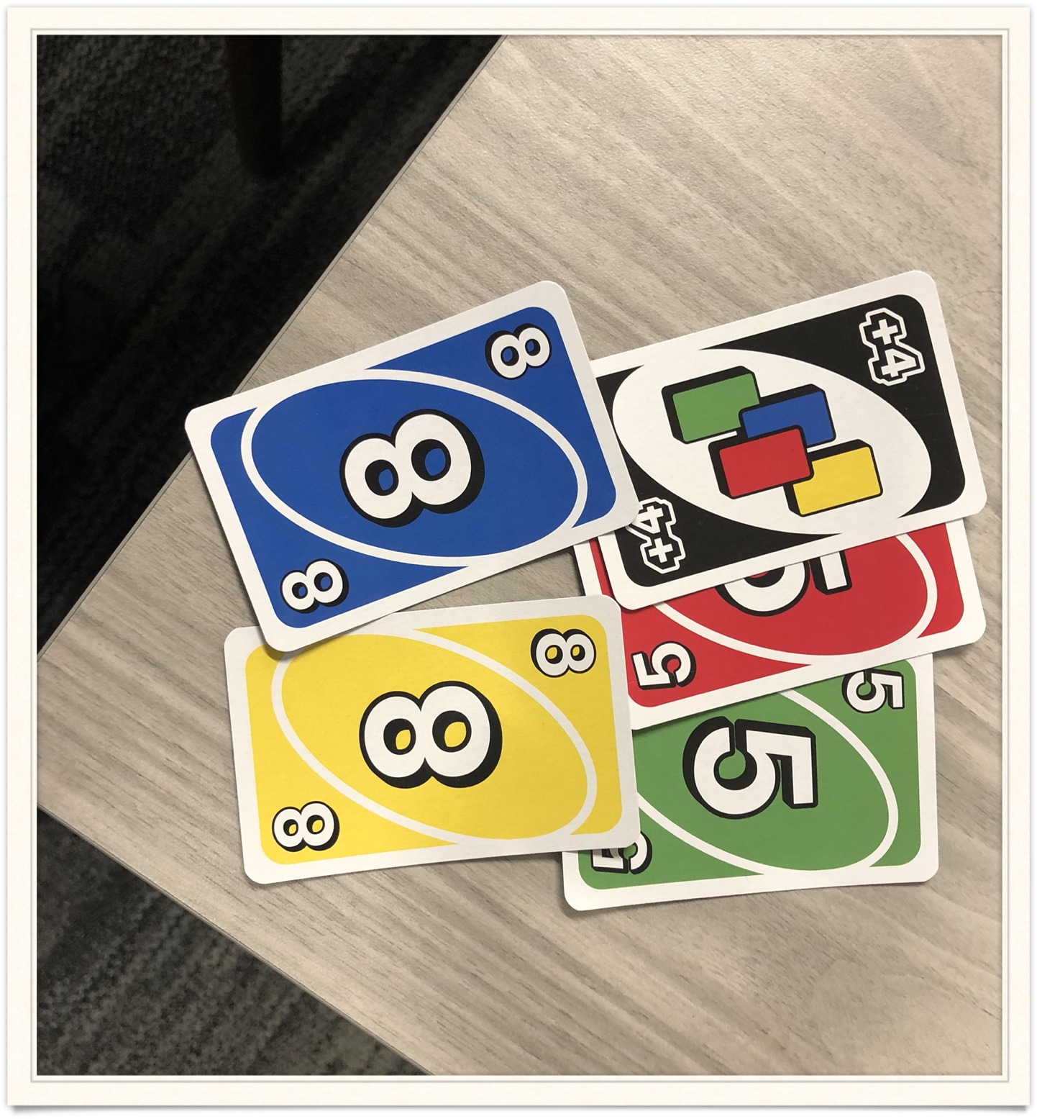
Let’s Practice
UNO

Slide 13
Possible Problems
Requires color vision (CVD friendly version is almost impossible to find right now)
Requires vision (though Brailled versions are not expensive)
Requires dexterity to hold cards (though card holders are available)
Requires dexterity to draw and play cards

Slide 14
Pratical example: Scavenger Hunt
Still a staple of library introductions for 100 levels classes in library instruction
Faculty still assign them here at K-State
Lot’s of variations, so I’ll pull from multiple examples

Slide 15
Problems
Navigating a new space can be even more challenging for a disabled student
Spaces or resources might not actually be accessible

Slide 16
How do you choose
Please don’t throw things
Consider using a random list generator like http://www.random.org
Please do not send a student to a space or resource that you know is not accessible.

Slide 17
Competition and teams
If a student feels their disability creates a disadvantage for their team, this can be harmful.
Would you willingly enter a contest you knew you would lose, possibly even badly?

Slide 18
Things to consider
Can a student who uses a wheelchair or cannot otherwise navigate stairs get to the space?
  The library stacks are not wheelchair friendly but they are structural
Is that resource accessible to a screen reader user?
  Of the over 300 resources the library has, I am sure at least one is not accessible.

Slide 19
Making it better
Be sure that students are aware of alternatives and services
Offer demos or walking tours of physical spaces before hand

Slide 20
Gray areas
What really matters in this case?
When can I be flexible and when is tough love needed?
Is this something students will have to navigate professionally?
  How do I navigate students who fear public speaking?

Slide 21
Encourage Communication
Give students a peak behind the curtain
  Why are you using this technique?
Be willing to express your own struggles
  Be willing to talk about something that was difficult for you to learn.

Slide 22
Angie Brunk
abrunk@ksu.edu

