Slide 1


Getting engaged in the Scholarship of Teaching and Learning?
A Discussion About Things to Know Getting Started
The Teaching & Learning Center Professional Development Series
February 23, 2021

Slide 2
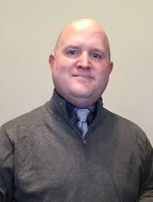
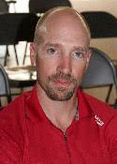
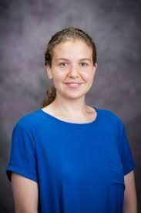
Presenters
Jason Bergtold, Professor
Agricultural Economics
Heath Ritter, Director
University Research Compliance Office
Shams El-Adawy, Physics Education Research Graduate Student, Physics

Slide 3

Purpose and Objectives
Purpose: What do I need to think about when beginning to engaged in Scholarship of Teaching and Learning?
Key Take Home Points:
    Human Subjects and FERPA
    Get plugged into training and workshop opportunities (TLC & PEER Program)
    Where to look for ideas an Editor’s persepctive

Slide 4
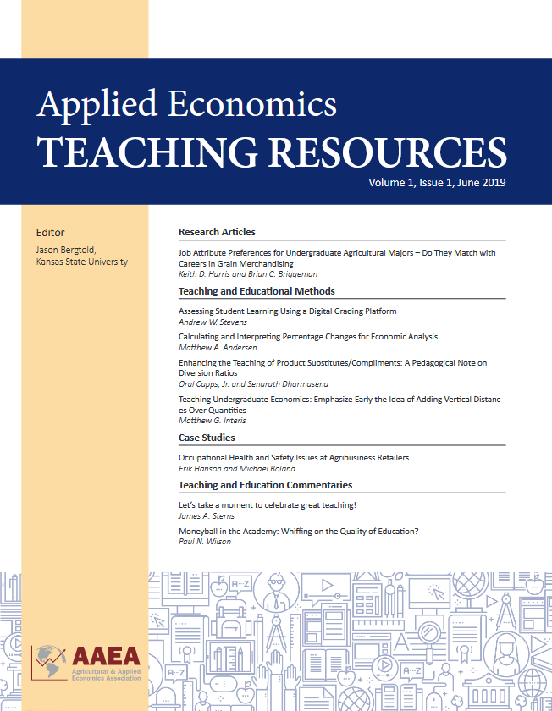
Editorial Considerations
Applied Economics Teaching Resources
Open Access Journal published by the AAEA (https://www.aaea.org/publications/applied-economics-teaching-resources)
AIM: To provide an inclusive outlet for research, teaching and Extension education scholarship encompassing but not limited to research articles, case studies, classroom games, commentaries, experiential learning, and pedagogy.

Slide 5
Types of Projects/Publications
Publication Types (What can I write about?)
Traditional Research Article
Commentaries
Methods
Case Studies
(Teaching Notes/Supplementary Documents)
Sample (Target Group or Audience?)
Undergraduate
Graduate
Instructors
Adult Education
Extension

Slide 6
Things to Think About
Human Subjects Research
FERPA
Permissions (Case Studies)
Talk with the Editor
Teaching Notes/Supplementary Documents
Impact

Slide 7
Ideas – Your Own Classroom
What problems have you encountered in your own classroom?
How you solve or approach that problem could provide avenues for SOTL research or could be shared?
Example: AETR Article: So You Want to Run A Classroom Experiment Online? The Good, The Bad, and the Different
(Stephen Morgan, Misti Sharp and Kelly Grogan)
Link: https://www.aaea.org/UserFiles/file/AETR_2020_028RRProofFinal-issue_v2.pdf.

Slide 8
Ideas – Your Own Experience
How do your own experiences influence how you teach and approach challenges in the classroom?
Your approaches and solutions can provide avenues of exploration for SOTL.
Example: PLOS One: Spatial Dynamics in the Classroom: Does Seating Choice Matter
(Jason Bergtold, Elizabeth Yeager, Terry Griffin)
Link: https://journals.plos.org/plosone/article?id=10.1371/journal.pone.0226953.

Slide 9
Ideas – Get Involved
Workshops and Training (e.g. PEER Program: https://peerinstitute.org/)
TLC: Professional Development Series, EDCI943 (Principles of College Teaching)
Conferences (e.g. North American Colleges and Teachers of Agriculture (NACTA))
Look to the Literature
Example: Facilitating Faculty Getting Started in SoTL: Reflections of Two Carnegie Scholars
(Jacqueline Dewar and Kathleen Perkins)
Link: https://files.eric.ed.gov/fulltext/EJ1303356.pdf.

