Slide 1
Welcome to the TLC Professional Development Series!
saucier@ksu.edu
#ITeachAtKState
Every Wednesday from 12 noon to 1PM
Zoom link: https://ksu.zoom.us/s/99521236699
All events recorded and archived on Canvas
TLC Professional Development Certificates and Fellows
TLC Professional Development Series

Slide 2

Sustainable Excellence in Teaching
saucier@ksu.edu
#ITeachAtKState
Don Saucier
University Distinguished Teaching Scholar
Professor of Psychological Sciences
Faculty Associate Director of the Teaching & Learning Center
TLC Professional Development Series

Slide 3
My Objectives Today
saucier@ksu.edu
#ITeachAtKState
Discuss obstacles to sustainable excellence in teaching
Discuss how to achieve excellence in teaching
Discuss how to sustain excellence in teaching

Slide 4
Disclaimers
saucier@ksu.edu
#ITeachAtKState
I will share my perspectives and experiences
I have many privileges
    I am a straight, White, cisgender, middle-aged man, etc.
I may have succeeded despite (not because of) what I did
Disregard recommendations that do not work for you
Seek others’ perspectives to complement my talk

Slide 5
What are some obstacles…
saucier@ksu.edu
#ITeachAtKState
To achieving excellence in teaching?
To sustaining excellence in teaching?

Slide 6
Ten Ways to Promote Sustainable Excellence in Your Teaching
saucier@ksu.edu
#ITeachAtKState

Slide 7
Develop and Refine an Excellent Teaching Philosophy
saucier@ksu.edu
#ITeachAtKState

Slide 8
Teaching Starts with Teachers
saucier@ksu.edu
#ITeachAtKState
Our teaching personas and philosophies…
  … provide the foundations for teaching and learning
  … dictate our teaching practices
  … are intentional, purposeful, and dynamic

Slide 9
Achieving Teaching Excellence
saucier@ksu.edu
#ITeachAtKState
Teaching Persona
  How you decide to present yourself to your students
Teaching Philosophy
  How you personally conceptualize the process of teaching and learning

Slide 10
What single word…
saucier@ksu.edu
#ITeachAtKState
… would you want your students to use to describe you “in class”?
Please type that word in the chat – but wait for the “waterfall”!

Slide 11
Starting Points for Your Teaching Philosophy
saucier@ksu.edu
#ITeachAtKState
Be the teacher you want to learn with
Promote student learning and success
Teach people (not just content)

Slide 12
Starting Points for Your Teaching Philosophy
saucier@ksu.edu
#ITeachAtKState
Teach whole people
Teach inclusively
Your practices should be inspired by these goals

Slide 13
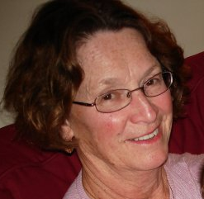
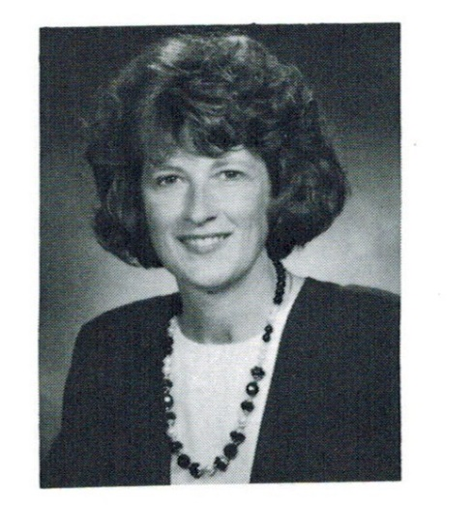

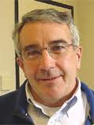
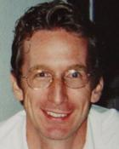
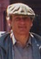
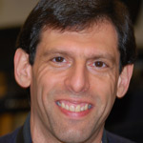
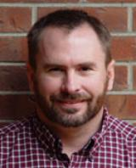
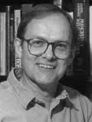
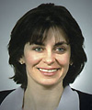
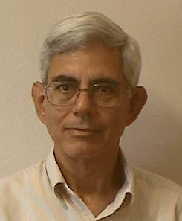
When I Engaged and Learned Best as a Student
saucier@ksu.edu
#ITeachAtKState
Notes:
Like it! Good transition to your ideas

Slide 14
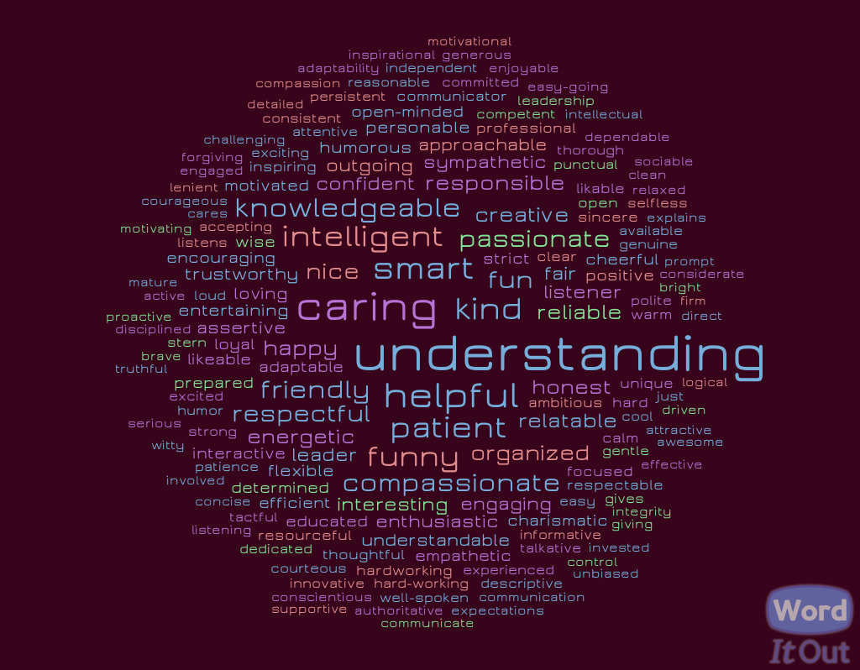
What do students want in their teachers?
saucier@ksu.edu
#ITeachAtKState
N = 355 General Psychology students
Notes:
Nice!

Slide 15
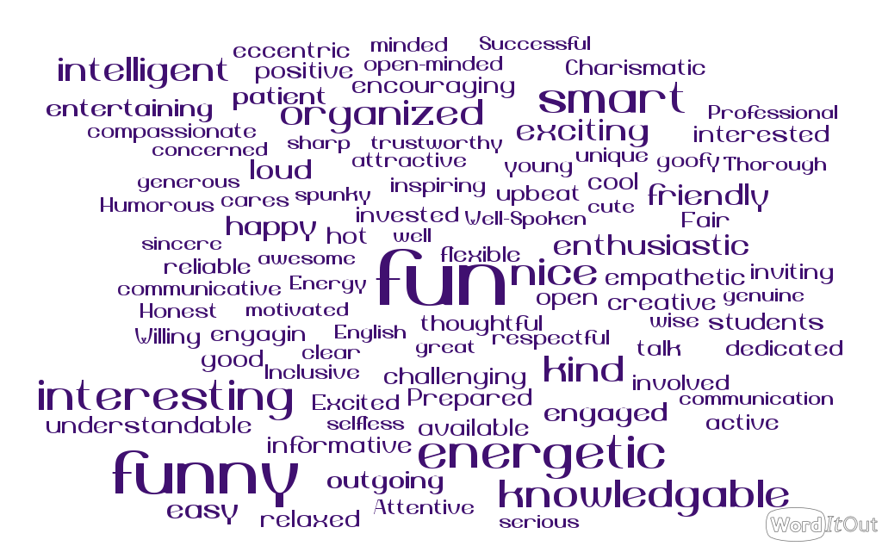
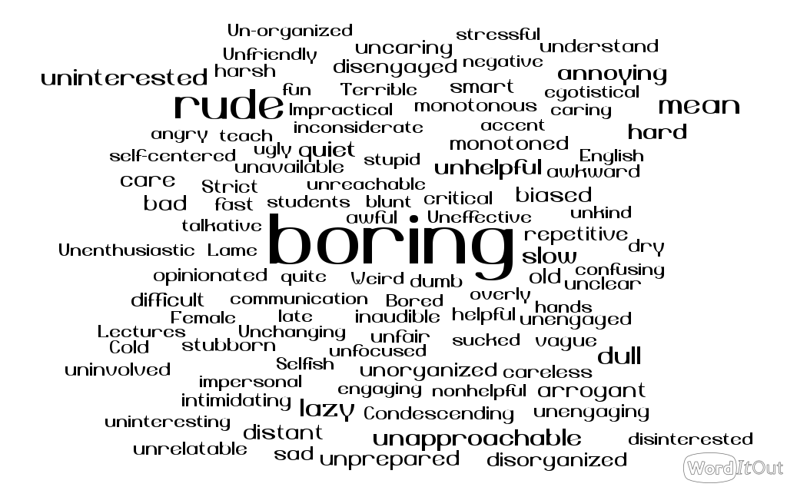
How Students Describe Their Favorite/Least Favorite College Teacher
saucier@ksu.edu
#ITeachAtKState
N = 215 K-State undergraduate students
Notes:
Engaging was referenced 90 times

Slide 16
My Teaching Philosophy
saucier@ksu.edu
#ITeachAtKState
Trickle Down Engagement
  Engage the Sage
We should focus on our own experience first

Slide 17
The Trickle Down Engagement Model
saucier@ksu.edu
#ITeachAtKState
Teacher Engagement
Student Engagement
Student Learning
Notes:
Makes sense and is clear,

Slide 18

A Foundation for Our Teaching Philosophies
saucier@ksu.edu
#ITeachAtKState
Bring PEACE to the Classroom
P = Preparation
E = Expertise
A = Authenticity
C = Caring
E = Engagement

Slide 19
Using Your Teaching Philosophy
saucier@ksu.edu
#ITeachAtKState
Let this dictate your teaching practices
Teach your various courses in similar ways
  Similar structures, policies, assessments
Adjust and adapt as necessary

Slide 20
Use Your Resources
saucier@ksu.edu
#ITeachAtKState

Slide 21
Use Your Resources
saucier@ksu.edu
#ITeachAtKState
Your mentors and colleagues
The TLC staff
Workshops and professional development events
Video resources

Slide 22
saucier@ksu.edu
#ITeachAtKState
TLC Professional Development Series
Upcoming Events
August 23rd: Don Saucier – Sustainable Excellence in Teaching
August 30th: Teaching CHAT – Choosing Course Materials
September 6th: Andy Thompson – Supporting K-State Students
September 13th: Sarina Maneotis – Excellence in Online Teaching
September 20th: Fred Burrack – Overview of Assessment at K-State
September 27th: Teaching CHAT – Active Learning Techniques
October 4th: Camilla Roberts – Honor & Integrity at K-State
October 11th: Alex Red Corn – Education and Indigenous Communities
Notes:
Don
Fred Burrack – Overview of Assessment at K-State

Slide 23
saucier@ksu.edu
#ITeachAtKState
TLC Professional Development Series
Upcoming Events
October 18th: Clarissa Steele – ChatGPT Week
October 25th: Andie Faber – Equity in Assessment
November 1st: Teaching CHAT – Peer Observation & Ways to Improve Teaching
November 8th: Don Saucier – TEVALs 101
November 15th: Fred Burrack – Assessment Sharing Day
November 29th: Ryan Staley – Promoting Mental Health
December 6th: Teaching CHAT – Revising Your Syllabi and Wrapping Up the Semester
Notes:
Don

Slide 24
“Engage the Sage” YouTube Channel
saucier@ksu.edu
#ITeachAtKState
Videos on teaching philosophy and practices
Over 100 videos on many “teaching” topics
Short videos (usually < 10min)

Slide 25
Just In Time Videos
saucier@ksu.edu
#ITeachAtKState
Rocking the First Day
Ending Class Effectively
Five Things to Do Mid-Semester
It’s On the Syllabus
Managing End of the Semester Chaos
Rocking the Last Day
Evaluating Teaching Evaluations
Learning From Your Evaluations

Slide 26
Videos About Active Learning
saucier@ksu.edu
#ITeachAtKState
The Value of Active Learning
Top Ten Tips for Using Active Learning
Making Simple Concepts More Nuanced Through Interactive Storytelling
Using Students’ Stories in Class
Mad-Lib Response Style

Slide 27
Presentation Tips Videos
saucier@ksu.edu
#ITeachAtKState
Rocking Your Academic Presentations
Top 10 Tips for Using PowerPoint While Teaching
Effective Storytelling
The Art of Answering Questions
Why Your Should Firehose Your Students with Content
Don’t Start Your Classes Like This
50 Ways to Disengage Your Students
Lecturing Into the Void

Slide 28
Assignment Idea Videos
saucier@ksu.edu
#ITeachAtKState
Homework for Life
Using Pop-Up Presentations
Students Writing Their Own Exams
The Value of Extra Credit
Top Things Learned This Semester

Slide 29
Demonstrating Your Teaching Excellence
saucier@ksu.edu
#ITeachAtKState
Writing Excellent Statements of Your Teaching Philosophy
Demonstrating Your Teaching Excellence: Part 1
Demonstrating Your Teaching Excellence: Part 2
Top 10 Ways to Get Teaching Jobs and Awards
The Four Cs of Writing

Slide 30
Broader Professional Development Videos
saucier@ksu.edu
#ITeachAtKState
You Should Be Writing
Managing Opportunities
Lessons Learned as a Faculty Senate President
Bring PEACE and Empathy to Your Research Lab
Creating an Excellent CV
Rocking Your Interviews
Tips for Empathetic Meetings
Being Clear in Your Communication

Slide 31
Time Saver Videos
saucier@ksu.edu
#ITeachAtKState
Not So Fast on Those Emails
Thank You for Your Message, I Hope All Is Well
Getting the Maximum Out of Our Students
Productive Procrastination
Teach Less Better

Slide 32
Pep Talk Videos
saucier@ksu.edu
#ITeachAtKState
Excite-Nerve
Teaching Through Failure
Reflecting on Your Wins
Five Things to Do During the Grumpy Time of the Semester
You Cannot Succeed for Your Students
Are You in Teaching Shape?
When You’re Having an Off Day in Class

Slide 33
Student-Facing Videos
saucier@ksu.edu
#ITeachAtKState
Excellent Email Etiquette for Students & Instructors
Top 10 Ways to Succeed in College Classes (as a Student)
Rocking Your Academic Presentations
The Four Cs of Writing
Writing Excellent Personal Statements
Requesting a Letter of Recommendation
Creating an Excellent CV
Rocking Your Interviews

Slide 34
Fun Videos
saucier@ksu.edu
#ITeachAtKState
A Day in the Life of a Remote Teacher
Don (Actually Loves His Students)
Being Flexible for Our Students (Literally & Figuratively!)
“We’ll Be Back” (A Hamilton Parody)
My Disengage Student (The Bumblebee Story)
Five Minutes of Don’s ETS Recording Fails
One of Don’s Remote Teaching Fails
Behind the Scenes

Slide 35
Streamline Your Structure and Content
saucier@ksu.edu
#ITeachAtKState

Slide 36
Streamline Your Structure
saucier@ksu.edu
#ITeachAtKState
Recurring assignments on a regular schedule
  Be predictable
Create a rhythm for your course
1000 points

Slide 37
Streamline Your Content
saucier@ksu.edu
#ITeachAtKState
Teach what is important and necessary
Teach what is personally relevant and interesting
Let your course breathe

Slide 38
Focus (and Spread Out) Your Assessments
saucier@ksu.edu
#ITeachAtKState

Slide 39
Focus Your Assessments
saucier@ksu.edu
#ITeachAtKState
Assess what you need to assess
  Directly, fairly, and succinctly
Make these valuable
Make these exciting for you

Slide 40
Spread Out Your Assessments
saucier@ksu.edu
#ITeachAtKState
More frequent lower stakes assignments
  Scaffold to higher stakes assignments
Allow student choice or assign to batches
Everything you assign will come back
  Don’t overwhelm the end of the semester

Slide 41
Get the Maximum From Your Students
saucier@ksu.edu
#ITeachAtKState

Slide 42
Get the Maximum From Your Students
saucier@ksu.edu
#ITeachAtKState
Shorten the assessments
This is win-win for you and your students

Slide 43
Use Personalized Assessments
saucier@ksu.edu
#ITeachAtKState

Slide 44
Use Personalized Assessments
saucier@ksu.edu
#ITeachAtKState
More interesting for you
Harder to cheat
Crowd sources examples for your class
Deepens learning for your students

Slide 45
Infuse Empathy into Your Courses
saucier@ksu.edu
#ITeachAtKState

Slide 46
Empathetic Course Design Perspective
saucier@ksu.edu
#ITeachAtKState
Infuse empathy into all aspects of your courses:
Empathetic Syllabus Statements (7:05)
Empathetic Zoom Approach (6:04)
Empathetic Course Structure and Policies (12:29)
Empathetic Assignments & Assessments (7:58)
The Problem with Academic Rigor (7:29)
Strive to be supportive and to develop community

Slide 47
Use Student Feedback as Informative
saucier@ksu.edu
#ITeachAtKState

Slide 48
Use Student Feedback as Informative
saucier@ksu.edu
#ITeachAtKState
Don’t overreact to student feedback
Let the feedback inform your course decisions
You are not obligated to make every suggested change

Slide 49
Tweak Your Classes for Next Time
saucier@ksu.edu
#ITeachAtKState

Slide 50
Tweak Your Classes for Next Time
saucier@ksu.edu
#ITeachAtKState
Make small, subtle adjustments
  Don’t overhaul
Good programmatic research design
  You can’t change all the variables and then know what did and did not work

Slide 51
Focus on Maximizing Your Experience
saucier@ksu.edu
#ITeachAtKState

Slide 52
Focus on Maximizing Your Experience
saucier@ksu.edu
#ITeachAtKState
The key to achieving and sustaining teaching excellence is:
Making the experience positive and fulfilling for you!

Slide 53
In Conclusion
saucier@ksu.edu
#ITeachAtKState
To achieve and sustain excellence in teaching:
Create your excellent teaching philosophy
Use it to inspire your practices
Use your resources and these operational suggestions
And enjoy the process!
You got this!

Slide 54
What Will You Take Away?
saucier@ksu.edu
#ITeachAtKState
What is one concrete take-away from our conversation today that you will use to achieve and sustain your teaching excellence?

Slide 55
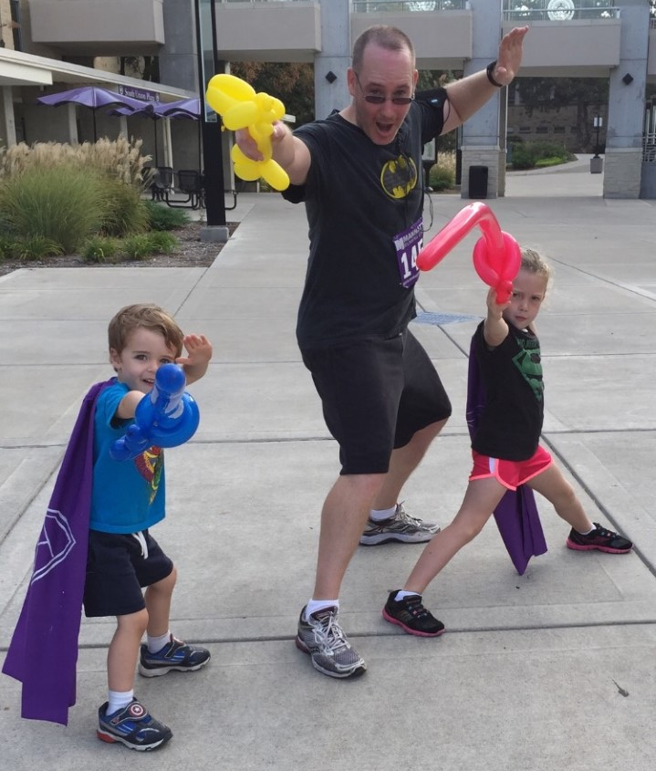
What Questions Do You Have?
saucier@ksu.edu
#ITeachAtKState
Further questions and/or a copy of this presentation:
Email Don Saucier at saucier@ksu.edu
Thank you!
Please submit a Post-Event Survey!

