Slide 1
Supporting Students and Ourselves: What Makes This Hard and How Do We Do It?
Ryan Staley, PsyD, LP
Assistant Director/Training Director
Counseling and Psychological Services

Slide 2
Mental Health Needs in College Students on the Rise (Healthy Minds Study 2022-23 Data Report)
Sample of 76,000 plus college students invited to complete various measures assessing various mental health issues/concerns, level of impairment, hx of mental health, lifestyle behaviors, and attitudes toward mental health.
Large proportion of students’ responses to screeners indicated challenges with depression (41%), anxiety (36 %), Self-Injury (29 %), Suicidal Ideation (14 %), Eating Disorders (14 %)
On clinically validated mental health screening instruments: 42% of student respondents reported S/I or sxs suggestive of dep., anx., ED, or NSSIBs if were seen by a clinician.
Among students struggling w/ mental health problems, 45%are not receiving services/tx
77% of students reported that emotional or mental health difficulties negatively affected academic performance 1 or more days a week.
Another Study showed more than 60 % of colleges students met criteria for at least 1 mental health disorder during the 2020-21 school year; 50 % increase from 2013 (Lipson, S. K., et al., Journal of Affective Disorders, Vol. 306, 2022)
Studies show all races affected by mental health issues, but White students are much more likely than students of other race/ethnicities to seek services. May be related to lack of diversity among college counseling center staff; we need staff the more accurately reflect the ethnic/racial make up of student body.

Slide 3
Barriers to Seeking Mental Health Resources for Students: Top 3 Reasons “ as cited in” Wiest, L. R. & Treacy, A. C. (2019). Faculty Preparation to Work with College Students with Mental Health Issues. Educational Research: Theory and Practice, 30(1), 46-50.
Stigma (self and perceived stigma of others)- 41 % of respondents in Health Minds Study indicated a belief that other people would think less of them if they sought mental health services.
Insufficient Mental Health Support- Increased demand for mental health services has impacted students’ ability to obtain timely help.
Cost-Some students are without health insurance and don’t make enough money to cover basic needs in addition to rising tuition costs.
Other Barriers Identified by students in other studies: Preference for dealing with MH problems on own, lack of time, skeptical about effectiveness of MH tx, problems will get better on their own.

Slide 4
Role of Faculty in Supporting Student Mental Health
According to Health Minds Network Survey: 1685 faculty members at 12 different colleges/universities across country
87% believed student mental health worsened during the pandemic,
73% would welcome additional professional development on topic of student mental health,
80% had 1 on1 conversations with students in the past 12 months.
61%believed it should be mandatory that all faculty receive basis training in how to respond to students experiencing mental or emotional distress
Other considerations:
Faculty in a unique position to observe students’ functioning (Gatekeeper)
Students tend to seek support from other non-mental health professionals first, such as family, friends, clergy, professors/teachers, romantic partners

Slide 5
Challenges Faced by Faculty in Supporting Students and Themselves
Feeling ill-equipped to help students with mental health issues
Requires additional time to support student on top of an already demanding schedule
Increasing expectations from University leaders and students to address mental health of students
Lack of support for their own mental well being
Feeling of responsibility to help students
Surveys indicate a large number of Latinx/Black faculty believe their institutions are “hostile” or “somewhat hostile” toward students of color-
Surveys of faculty also revealed that many believe supporting students mental health has taken a toll on their own.

Slide 6
So How Can Faculty Support Both Students and Themselves?
What have you found works?
What have your learned about what doesn’t work?

Slide 7
Ways to Support Students
Be flexible about deadlines as appropriate/needed when students communicate with you about personal challenges impacting academics
Include a statement on mental health in course syllabus: helps set the expectation/normalize the need to seek help and highlights link between mental health and academic performance.
Offer mental health days: Build into course requirements
Provide information to students about resources on campus and in the community; consider having various student wellbeing offices present info. about services during a class.
Be open about your own efforts to care for yourself/cope with challenges-students need role models to learn ways to cope/view help seeking as strength
Establish class conditions and norms that are conducive to self-care and promoting help seeking- See above (due dates, MH days, flexible deadlines)
Know common signs of student distress and connect help connect students to appropriate resources/services.
Be willing to talk openly with students about any concerns you may have about them.

Slide 8
Common Indicators of Distress
Student appears or often conveys they are overwhelmed
Significant change in academic performance/behavior: missing classes, not completing work, declining grades
Physical changes: hygiene, fatigue, dramatic weight loss/gain
Behavior that is unusual or not characteristic of the student
Intense emotional reactions
Requesting/needing an inordinate amount of support
Agitation/Anger outbursts
Disjointed thoughts-Not clearly connected
Rapid/Slowed speech
Tearfulness
Communicating threatening statement about self/others
Other faculty/staff/students expressing concerns/complaints
Withdrawal
Dramatic Mood changes

Slide 9
How to Talk To Students of Concern
Talk: to student in private when you both have time so not rushed.
Listen: with sensitivity, validation, empathy, and in a nonthreatening way. Discuss your observations in behavioral/nonjudgmental terms. “I’ve noticed you’ve missed class a lot lately and I am concerned.”
Communicate: understanding by repeating back in your own words what student has said. Include both feelings and content
Give Hope: assure student that help is available. Help student ID options for action and explore possible consequences.
Maintain: clear and consistent boundaries/expectations. Be direct/honest with student about your ability to help.
Refer: when problem is more serious than you feel comfortable handling or other expertise/support is needed beyond what you can provide.

Slide 10
Referral to CAPS and What to Expect
First step would be to provide student with information about CAPS, ways we can be helpful and encourage them to stop by for a walk-in consultation appointment.
The student can expect to complete a few brief surveys upon arrival at CAPS. Responses to the screeners/surveys helps the front desk staff determine with whom the student will meet for an initial appointment.
The initial appointment will be focused on assessing the students immediate needs/concerns and discussing a plan for care moving forward that may include CAPS, campus, and community resources/services.

Slide 11
A Little about KSU CAPS
Located at 1105 Sunset Ave., Rm. 101, Manhattan, KS 66502-Lower level of Lafene Health Center
Services provided include individual/group therapy, skills workshops, ADHD evaluation, and crisis services
Services offered at CAPS, with the exception of ADHD evaluations, are covered by student fees
Students are afforded 8 individual therapy sessions per semester and unlimited group therapy session
Mental health support is available to students after hours and on weekends by calling 785-532-6927
Clinicians are available to faculty and staff for consultation as needed to support students of concern.

Slide 12
Campus Resources
Student Success and Accountability
Student Access Center
KSU Counseling and Psychological Services
Lafene Health Center
Center for Advocacy Response and Education
KSU Police Department
KSU LGBTQ Resource Center
International Student and Scholar Services
Power Cat Financial
Cats’ Cupboard
Office of Institutional Equity
Academic Achievement Center

Slide 13
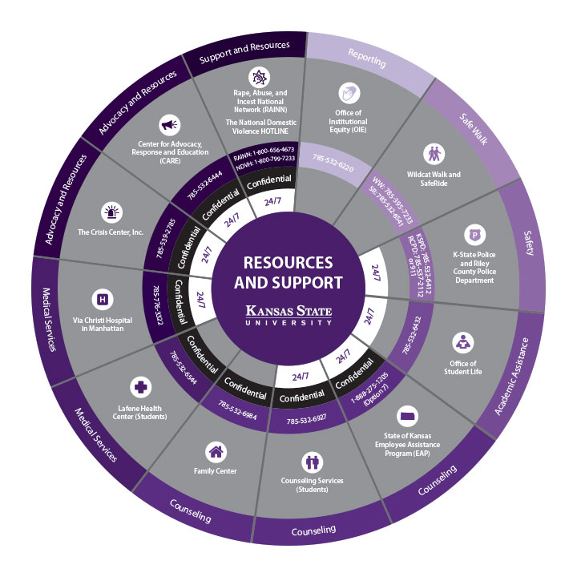
Resource Wheel

Slide 14
What About You?
What are ways you care for yourselves?
What are barriers to effectively care for and meeting your personal needs?
How have you tried to overcome these barriers?

Slide 15
Ways to Care for/Support You
Sleep, eat, and move
Time management: prioritized task lists, be proactive about a plan for completing tasks
Build in time for restorative/enjoyable activities
Address problems/challenges as they arise and seek help when needed
Make time for social connection/utilize social support
Use professional resources as needed: EAP (https://www.k-state.edu/hr/benefits/perks-programs/eap.html), regular medical check-ups, and use of medical services when ill
Consult, seek help from, other professional/personal resources (i.e., colleagues, family/friends, supervisors, spiritual leader/clergy, medical/mental health)
Engage in relaxation exercises
Set boundaries clear boundaries w/ others and in various life domains to a help live a more balance life.
Practice mindfulness.

Slide 16
References
Ableson, S. (2019) 4 Ways Faculty Can Be Allies for Student Mental Health. Association for College and University Educators. https://acue.org/blog/4-ways-faculty-can-be-allies-for-college-student-mental-health
Flaherty, C. (2021, April 20) Faculty: ‘Gate Keepers of Students Mental Health.’ Inside Higher Education. https://www.insidehighered.com/news/2021/04/08/faculty-gatekeepers-student-mental-health
Healthy Minds Network (2023). Health Minds Study among Colleges and Universities, year (2022-2023) [Data set]. Health Minds Network, University of Michigan, University of California Los Angeles, Boston University, and Wayne State Universtity.
Healthy Minds Network (2021). Healthy Minds Study among Colleges and Universities, year (2013-2021) [Data set]. Healthy Minds Network, University of Michigan, University of California Los Angeles, Boston University, and Wayne State University. https://healthymindsnetwork.org/research/data-for-researchers
Vyletel, B., Voichoski, E., Lipson, S., & Heinze, J. (2023) Exploring faculty burnout through 2022-2023 HMS faculty/staff survey. American Psychological Association. https://www.apa.org/ed/precollege/psychology-teacher-network/introductory-psychology/faculty-burnout-survey
Wiest, L. R. & Treacy, A. C. (2019). Faculty Preparation to Work with College Students with Mental Health Issues. Educational Research: Theory and Practice, 30(1), 46-50.

