Slide 1
Supporting Student Workers
Small Shifts That Make Large Impacts on College Success
Melissa Glaser

Slide 2
Agenda
My Teaching & Supervising Experiences
Why Student Workers Need Support
The Value of Work
Shifts in Mindset, Behavior, & Course Design and Their Impacts on Students
Tips for Supervisors

Slide 3
Teaching & Supervising Experiences

Slide 4
My experiences
Teaching
Supervising
Student success courses
Individualized support for writing
English courses
K-State First
Peer Assistants (tutors)
Learning Assistants
Recruitment & Admissions Service Team

Slide 5
Current roles
Engagement Coordinator, Office of Recruitment and Admissions
Instructor for K-State First (Writing Life Connections Course)

Slide 6
Why Student Workers Need Support

Slide 7
Challenges Student Workers Face
Lack of positive support (unlike other busy students, e.g., athletes)
High demands on time
Full schedule between class and work
Less flexibility for studying at ideal/focused times
Last-minute work not due to procrastination but due to lack of time
May have more than 1 job and/or other commitments
May lack time for involvement in social or other activities
High stress
Financial stress
Work stress
Academic stress
Family and social stress
Constant shifting between environments and roles/tasks (mindset challenge, and for some, a social energy challenge)

Slide 8
Why Student Workers Need Support
For what additional reasons do student workers need support?
Please share your ideas in the chat.

Slide 9
The Value of Work

Slide 10
Work may be necessary to obtain an education.
Supporting student workers is an issue of equity and accessibility to education, including many lower- and middle-income students and non-traditional students.
College is expensive!
In-state tuition/fees for 120 credit hours = $47,504
Out-of-state tuition/fees for 120 credit hours = $113,392
Estimated books/supplies for 4 years = $4,224
Median cost for on-campus housing/dining for 1 year = $12,020
Estimated off-campus housing/food for 1 year = $9, 392
Average estimated cost for 4 years (without any other expenses)
= $101,316 for in-state students
= $167,204 for out-of-state students
Source: https://www.k-state.edu/sfa/cost/manhattan-campus-costs/undergraduate.html

Slide 11
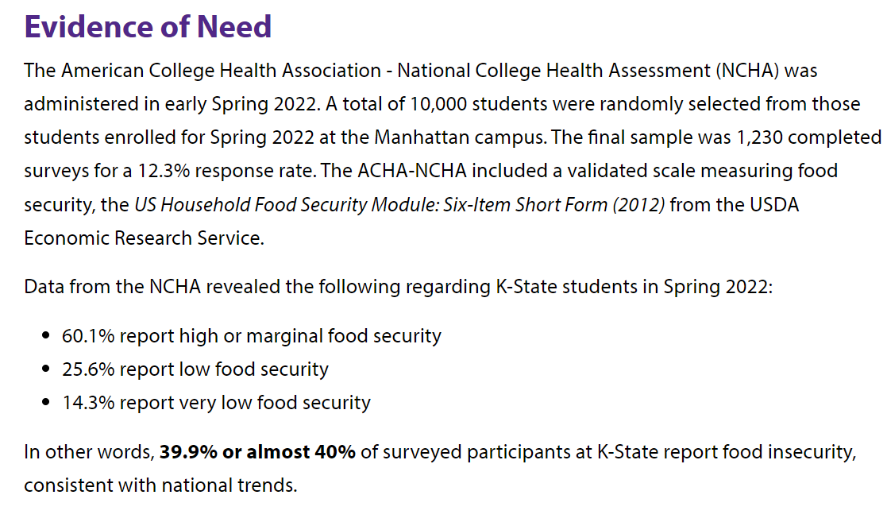
Work may be necessary to obtain an education.
Source: https://www.k-state.edu/cats-cupboard/about/

Slide 12
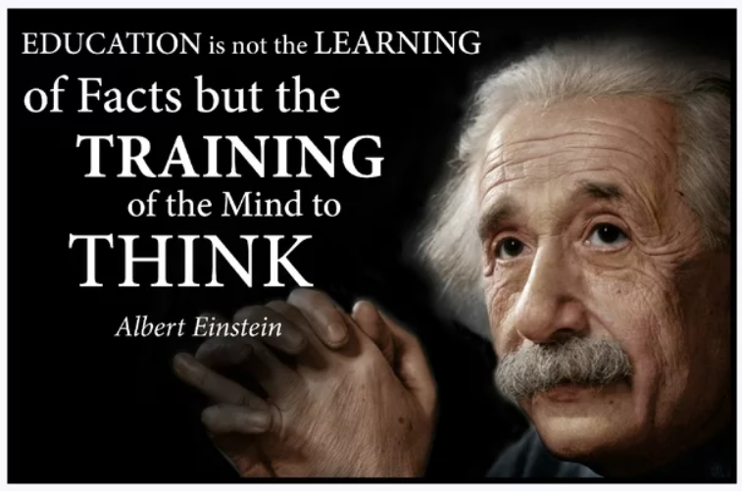

Slide 13
Work can be an integral part of a student’s eduation.
Additional Skills and Knowledge → academics & career
Communication
Leadership
Self-awareness
Time and energy management through structure, consistency, and discipline
Preparation for “real world” through additional demands (keeping in mind that students may be busier than “real world”)
Problem-solving skills
Critical thinking skills
Experience with diverse populations
Experience with software (e.g. CRM, MS Teams)
Experience with customer service in person/via phone
Other professional development, networking, and experiences

Slide 14
Work can offer support needed to obtain an eduation.
Social, Emotional, and Academic Support → retention & success
Community, belonging, and social value
Relationships and decreased loneliness
Work as a “third space” (outside of school and home) may fill an important need for a student
Additional resources for students from supervisors and coworkers both directly and through referral
Sense of purpose, value, and contribution
On-campus jobs offer connection with other students, faculty, and staff along with convenience and flexibility
Off-campus jobs offer connection with the Manhattan/surrounding community

Slide 15
The Value of Work
What additional value does work offer?
Please share your ideas in the chat.

Slide 16
Shifts in Mindset, Behavior, & Course Design and Their Impacts on Students

Slide 17
Small shifts → large impacts 3 areas to consider
Mindset
Behavior
Course Design
What are our attitudes and judgements about students working?
What knowledge and awareness do we have about students’ work experiences?
How do we interact with students inside the classroom?
How do we interact with students outside of the classroom?
How might our course requirements and expectations affect students?
What policies work best for students?

Slide 18
Our mindset about work impacts our students.
Be aware that many students work, out of need and/or choice.
Value students’ work and recognize related benefits.
Remember that students have many commitments outside of class…and value them all.
Trust that students who are busy are being responsible, too.
Realize that work schedules may be out of a student’s control.
Recognize that students don’t want special treatment; they need support that allows for success.
Ask questions, listen, and strive to understand.
Maintain high expectations so that students rise to meet them.
Provide motivation to catalyze perseverance and hard work.
Communicate your (supportive) views to students.

Slide 19
Our behaviors impact our students.
Be available to students.
Respond to emails (and tell them when to expect responses).
Offer office hours by appointment and/or offer many choices.
(Call them “student hours.”)
Be approachable.
Actively encourage students to reach out.
Clearly communicate that you want to help them.
Present a friendly and open demeanor.
Remain open to questions and suggestions.
Get to know your students.
Ask students if they work, and show curiosity about their job.
Notice if a student misses class, changes behavior, and/or is struggling…and then email/talk to them.
Relate class material and/or assignments to their work experiences.

Slide 20
Our behaviors impact our students.
Offer empathy and flexibility.
Accommodate reasonable requests when possible, and be proactive in offering flexible options to all students.
Communicate growth mindset so that students know that not only do you expect mistakes, you realize they are valuable for learning.
Recognize the impacts of work on a student’s schedule and life.
Allow for a wide variety of engagement:
Offer students a “pass” when called on.
Recognize active listening as engagement.
Consider both introverts and extroverts.
Encourage students to relate work experiences to course content.
BRING FOOD TO CLASS.

Slide 21
Our course design impacts our students.
General Expectations and Goals
Consider the culture that exists in your department/field/class, and continually evaluate if that culture is best for students.
Ensure that expectations are known, accepted, and supported by students.
Set reasonable expectations and communicate them clearly.
Hold students accountable, remaining flexible when possible, and communicating acceptable ranges for meeting expectations.
Remember that students DO put academics first…they just need flexibility and understanding so that they can succeed academically and in their work.
Course Materials
Avoid requiring expensive materials.
Help students access more affordable options and/or share materials.
Determine if a new edition of a textbook justifies the higher cost.

Slide 22
Our course design impacts our students.
Deadlines
Give students ample time to complete assignments, and provide clear, thorough, detailed instructions well in advance of deadlines.
Offer flexible deadlines, time/date ranges, and/or grace periods.
Offer extensions (proactively!) to everyone.
Remember the purpose of deadlines and make decisions accordingly.
Recognize that the “real world” has flexible deadlines too.
Ensure that you’re available for questions before assignments are due.
Avoid having several assignments due at the same time/date.
Maintain a consistent deadline schedule for small/regular assignments.
With large assignments, consider having optional/flexible check-in assignments to help students stay on track and learn time management.
Attendance
Have a clear and reasonable policy so that students can plan.
Minimize out-of-class requirements and/or offer flexibility/alternatives.

Slide 23
Our course design impacts our students.
Assignments
Avoid assignments that may be “busy work.”
Consider both frequency and low/high stakes benefits/drawbacks in terms. of students’ time management and stress levels.
Consider contract grading and/or choices in assignments.
Provide options that relate to what students are already doing at work.
Group Projects
Consider alternatives unless necessary or if the benefits outweigh the cost.
Keep groups smaller (scheduling needs).
Give time in class for communication and/or working.
Avoid requiring out-of-class meetings at specific times.
Check in with groups to ensure all members are contributing.
Give students the opportunity to share feedback about group members.
Consider individual grades (rather than group grades).

Slide 24
Shifts in Mindset, Behavior, & Course Design
What additional shifts in these areas might help students?
Please share your ideas in the chat.

Slide 25
Impacts on Students

Slide 26
Small Shifts → Big Impacts
Academic success
Student retention and graduation
Career preparation
Better relationships with students
Lowered stress and improved mental health
Increased motivation
Framework catalyzes possibilities for success
Reinforces wholistic approach
Supports all students, not just student workers

Slide 27
Impacts on Students
In what additional ways might small shifts make large impacts on students?
Please share your ideas in the chat.

Slide 28
Tips for Supervisors

Slide 29
If you supervise student workers:
Communicate that academics are top priority.
Set schedules based on classes, exams, studying, etc.
Share schedules well in advance for planning purposes.
Allow students to study at work (when possible).
Honor requests for time off within a clear attendance policy.
Create a supportive environment.
Build community, allow socializing, and encourage friendships.
Recognize that work limits time for other social needs (family, friends, community, rest, alone time, etc.).
Know your students well (professionally, academically, and personally), and recognize differences in values and needs.
Provide support and constructive feedback.
Provide professional development for the job and for their futures.
Approve raises and additional work shifts (if helpful to students).
PROVIDE FOOD AT WORK.

Slide 30
Tips for Supervisors
What additional tips might supervisors implement to support student workers?
Please share your ideas in the chat.

Slide 31
3 Key takeaways
Value students’ work experiences.
Be flexible.
Keep high standards and offer support proactively.

Slide 32
THANK YOU!
Melissa Glaser
msg@ksu.edu
Office of Recruitment & Admissions
Engagement Coordinator

