Slide 1
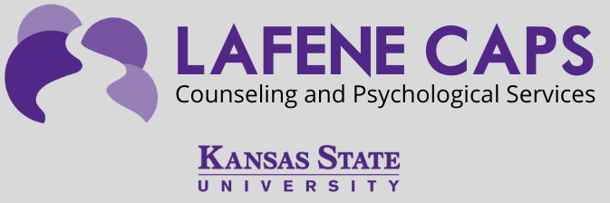
Mental Health Awareness and Stress Managment
Marcos Mendez, PhD. LCMFT
Karan Bhatia, MS. LPC
11/20/2024

Slide 2
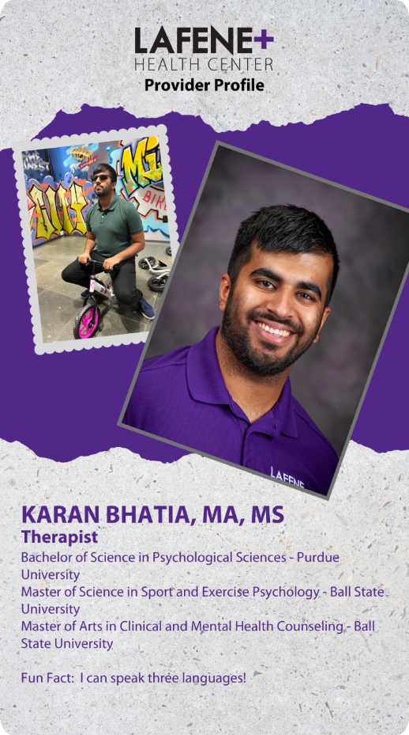
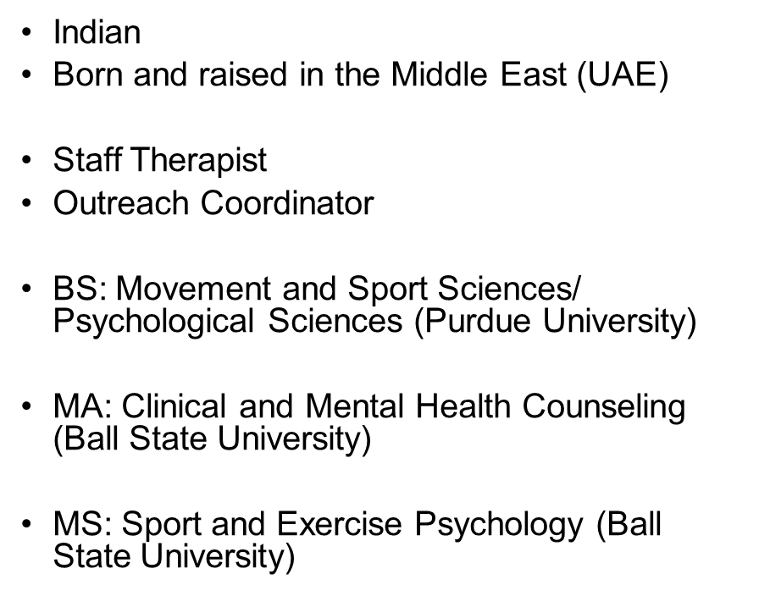
Karan Bhatia

Slide 3

Marcos Mendez
From Argentina
He/him/his
Staff Therapist
MS. In Marriage and Family Therapy
PhD. In Marriage and Family Therapy

Slide 4
Content
What is stress?
Coping skills
How to better support students with mental health concerns
When to seek professional help
How to connect with Counseling and Psychological Services (CAPS) at K-State
Additional resources

Slide 5
What is Stress?
The technical definition of stress is the body’s nonspecific response to any demand – pleasant or unpleasant. (The American Institute of Stress)
Most people consider the definition of stress to be something that causes distress. However, stress is not always harmful since increased stress results in increased productivity/performance.
Notes:
Marcos Slides 5-8

Slide 6
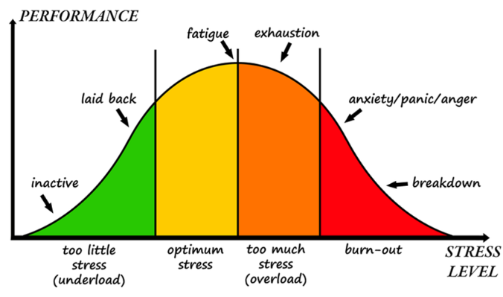
One Way to Look at Stress!

Slide 7
Levels of Stress
Eustress
  Optimal levels of stimulation
  Elicits a positive stress response
  Challenging, attainable, and enjoyable or worthwhile tasks
  Generating a sense of fulfillment, growth, development, mastery, and higher levels of performance
Distress
  Too much stimulation
  Elicits a negative stress response
  Feelings of overwhelm, lack of control, and threat
  Physiological responses pose health risk
  May be associated with maladaptive ways of coping
Notes:
chrome-extension://efaidnbmnnnibpcajpcglclefindmkaj/https://www.apa.org/ed/precollege/topss/lessons/activities/critical-thinking-exercise-distress-eustress.pdf

Slide 8
What are some current sources of stress for you? Can you differentiate them between eustress and distress?

Slide 9
Common Sources Of Stress For Students
Separation from family
Lack of social support
Interpersonal relationships conflicts
  Family, friends,
  Colleagues, professors, advisors
  Romantic
Cultural experiences
  Discrimination; “-isms”
  Marginalization
Academic demands
Peer pressure
Competition
Work-related concerns
Lack of balance
Increased freedom and responsibilities
Over-involvement
Notes:
Karan- Slides 9 - 15
"America's culture of hyperachievement" and "the pressure to be effortlessly perfect."

Slide 10
Additional Sources of Stress for International Students
Language Barriers
Cultural Shock
  Initial euphoria
  Culture Shock
  Adaptation
  Adaptation and Mastery
Reverse Cultural Shock
Lack of social support

Slide 11
Sociocultural Factors
Some identities are more likely to experience higher risk for distress and symptoms of depression and anxiety
  Low-income students
  Students of color
  Female students
  Students who identify as LGBTQ
  Students who are caregivers for children or other adults Mayo Clinic, July 2022

Slide 12
Awareness of Stressors
How do you know you are being impacted by distress?
How does distress impact...
  Your thoughts?
  Your body?
  Your feelings/emotions?
  Your actions/behaviors?

Slide 13
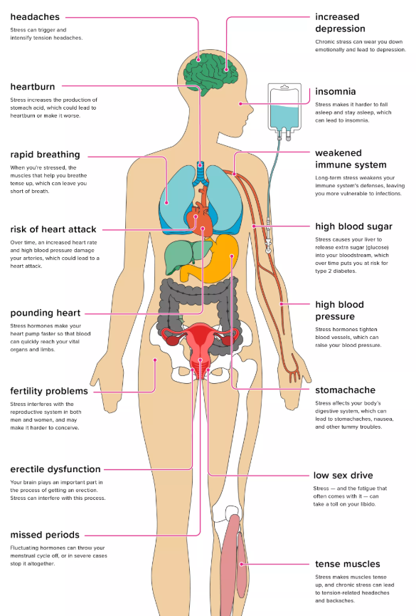
Distress affects your body and mind!

Slide 14
Symptoms of Distress
Cognitive indicators (thoughts)
  Self-criticism
  Low self-esteem
  Fear of failure
  Difficulty making decisions
  Difficulty concentrating
Physical indicators
  Tension
  Headaches
  Sleep disturbances
  Appetite/Weight change
  Fatigue
  Illness
Notes:
Stress can be experiences in many ways.

Slide 15
Symptoms of Distress Cont.
Emotional indicators
  Sadness
  Irritability/Anger
  Worry/Fear
Behavioral indicators
  Withdrawing from others
  Working more
  Getting less done
  Distracting yourself (scrolling on phone)
  Impulsive behaviors (shopping)
  Interpersonal conflict
  Using substances (coffee, alcohol, nicotine, cannabis)

Slide 16
Practice Self-Awareness
What is my level of stress?
How is stress impacting me?
How am I dealing with stress?
What can I do?
Notes:
Marcos – Slides 16 - 21

Slide 17
Reducing our vulnerability to distress

Slide 18
What are some coping skills you use to manage distress?

Slide 19
Coping Techniques
Basic self-care and vulnerability factors
We are more likely to increase stress in our bodies and affect our mental health when we neglect:
  Sleep hygiene (sleep routine)
  Healthy consumption of food and water
  Physical activity
  Social support

Slide 20
Coping Techniques
Deep breathing
Listen to music
Arts and crafts
Laugh
Meditate or pray
Develop self-compassion
Help someone else
  Bandana Project
  Thrive Navigators
Talk to someone who is supportive
Manage your time with a schedule
Set a routine
Make lists with priorities
Journal
Write what you are grateful about
Take breaks
Take a mental health day or vacation
Spend time with nature

Slide 21
Coping Techniques
Physiological Sigh
Put cold water on your face
Five senses:
  5 things you see
  4 things your body feels
  3 things you hear
  2 things you smell
  1 thing you taste
Take a cold shower

Slide 22
How could you recognize if your student/peer is in distress?
Marked changes in academic performance or behavior
Uncharacteristically poor performance and preparation
Excessive absences or tardiness
Repeated requests for special consideration especially when this represents a change from previous functioning
Avoiding or dominating discussions
Excessively anxious when called upon
Disruptive classroom behavior
Intense emotion or inappropriate responses
Notes:
Karan- Slides 22-26

Slide 23
How could you recognize if your student/peer is in distress?
Behavioral or Interpersonal Problems
Asking instructor for help with personal problems
Complaints from other students
Hyperactivity or very rapid speech
Tearfulness
Irritability or angry outbursts
Problems with roommate or family
Change in personal hygiene or dress
Dramatic weight loss or gain
Disjointed thoughts

Slide 24
How could you recognize if your student/colleague is in distress?
References to Suicide, Homicide or Death
Expressed thoughts of helplessness or hopelessness
Overt references to suicide
Isolation from friends or family
References to suicide or homicide in verbal statements or writing
You should seek emergency help immediately by calling 911 if a student is talking about direct harm to self or others or acting in a bizarre or disruptive manner.

Slide 25
How to Talk To Students of Concern
Talk: to student in private when you both have time so not rushed.
Listen: with sensitivity, validation, empathy, and in a nonthreatening way. Discuss your observations in behavioral/nonjudgmental terms. “I’ve noticed you’ve missed class a lot lately and I am concerned.”
Communicate: understanding by repeating back in your own words what student has said. Include both feelings and content
Give Hope: assure student that help is available. Help student ID options for action and explore possible consequences.
Maintain: clear and consistent boundaries/expectations. Be direct/honest with student about your ability to help.
Refer: when problem is more serious than you feel comfortable handling or other expertise/support is needed beyond what you can provide.

Slide 26
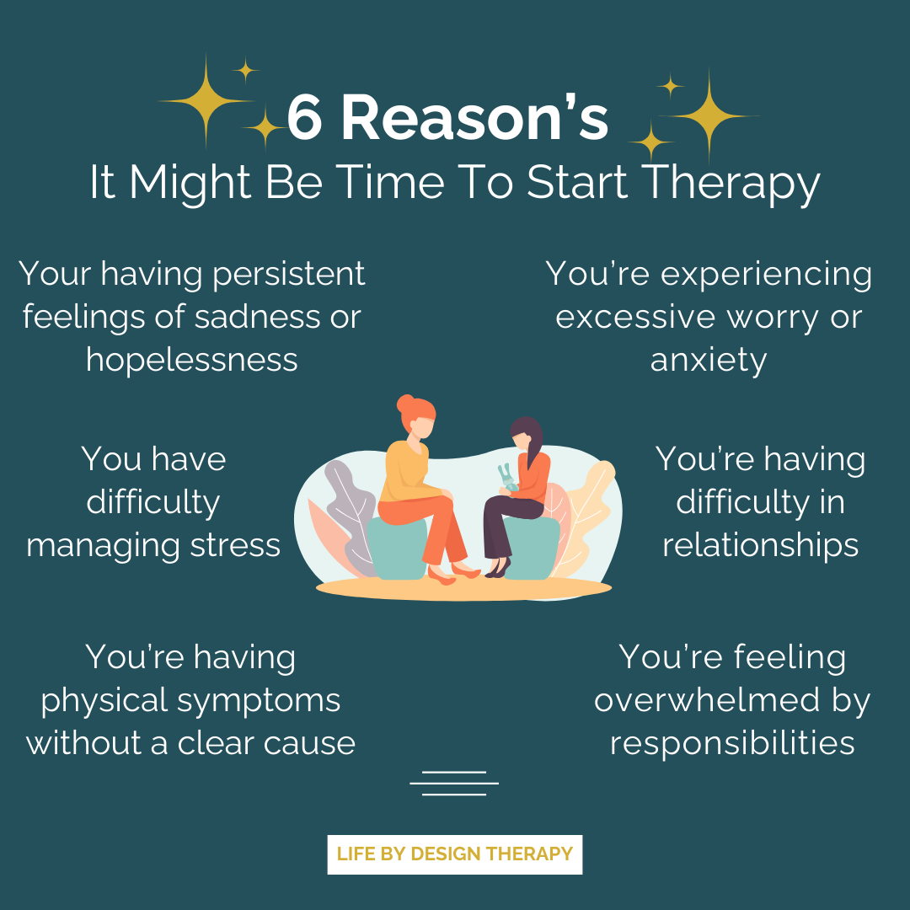
Recognizing When to Ask for Help
Thinking about or coping with the issue takes up at least an hour each day
The issue causes embarrassment or makes you want to avoid others
This issue has caused your quality of life to decrease
The issue has negatively affected school, work, or/and relationships
You’ve made changes in your life or developed habits to cope with the issue

Slide 27
Lafene Health Center
Counseling and Psychological Services (CAPS)
Notes:
Marcos- 28 - 30

Slide 28
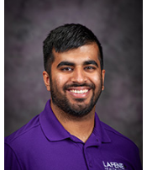





Some of us!

Slide 29
Who are we?
Lafene Counseling and Psychological Services (CAPS)
6 full time psychotherapists and one certified therapy dog.
Confidential and culturally-competent mental health resource for K-State students.

Slide 30
How to connect with K-State CAPS?
Clinical Consultations
  Walk in or by appointment from 8:30 to 3:30pm.
  About 30 minutes long appointment
  To understand client’s concern
  Present with possible services at Lafene CAPS, other K-State office partners, and/or in the community.
Mental Health Crisis Consultation
  In-person (8-5, M-F); Phone (24/7)
  Risk assessment, develop safety plan, and/or refer to Crisis Stabilization Unit, or ER for further assessment.

Slide 31
Services at CAPS
Workshops
    Getting Unstuck
    Anxiety Toolbox
    Rio (recognition, insight, openness)
    Mood Management
    Reset and Thrive (motivation, self-compassion, and resilience)
    Date Yourself
    Bridge (building relationship intimacy and dialogue effectiveness)
    ADHD and Life Skills Series
    Body Image
    Risk and Harm Reduction
    Breakup Bootcamp
Notes:
Karan 31-34

Slide 32
Services Cont.
Group Therapy
  Skills/Support Group.
    Calming the Storm
    Moving naturally through challenges (engage your body and mind to reduce anxiety)
  Process/Support Group
    Spectrum (for LGBTQ+ students)
    Understanding Self & Others
    Graduate and non-traditional

Slide 33
Services Cont.
Short-term Goal Oriented Individual Therapy
  Unlimited sessions per semester
  Most common conditions treated are symptoms of Anxiety and Depression
Relationship Therapy
  Partners must be K-State students and have paid student services fee

Slide 34
Services Cont.
ADHD Assessment
  2 hours initial clinical interview
  1 hour computerized test
  1 hour Feedback (reports)
  416 USD
Outreach
  Presentations
  Tabling events

Slide 35
Services Cont.
Referral to Campus Resources:
  Student Support and Accountability
  Center for Advocacy, Response, and Education
  Office of Institutional Equity
  Academic Achievement Center
  K-State Family Center
  Spectrum Center
Referral to Off Campus resources:
  TelUs App
  Via Christi Hospital
  The Crisis Stabilization Unit
  988 (suicide and crisis lifeline)
Websites:
  Self-compassion
  Positive Psychology
Notes:
Marcos- 35-38

Slide 36
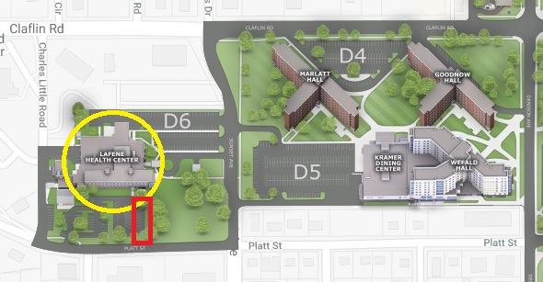
Welcome!
Open Monday-Friday, 8:00 am -5:00 pm
  24/7 for mental health consultation
Call us if you have questions!
  785-532-6927
www.k-state.edu/counseling

Slide 37
Employment Assistance Program (EAP)
Confidential Emotional Support
  Help you or your family members with mental health concerns
Work-Life Solutions
  Finding child and elder care
  Hiring movers or home repair contractors
  Planning events, locating pet care
Legal Guidance
  Talk to our attorneys for a free 30-minute consultation and a 25% reduction in fees.

Slide 38
Employment Assistance Program (EAP)
Financial Resources
  Retirement planning
  Taxes
  Relocation, mortgages, insurance
  Budgeting, debt, bankruptcy

Slide 39
Questions? Comments?

