Slide 1
Social Justice & Course Design
Tanya González | Professor of English | tgonzale@ksu.edu
Teaching & Learning Center | Need to Know Talk | September 16, 2020

Slide 2
Land Acknowledgment

Slide 3
Gratitude

Slide 4
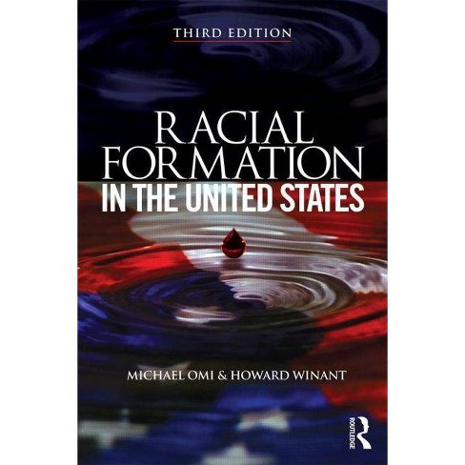
The Plan
1) key terms & markers of racial and social inequity
2) change & universal design
3) reflections: what do / can we do?

Slide 5
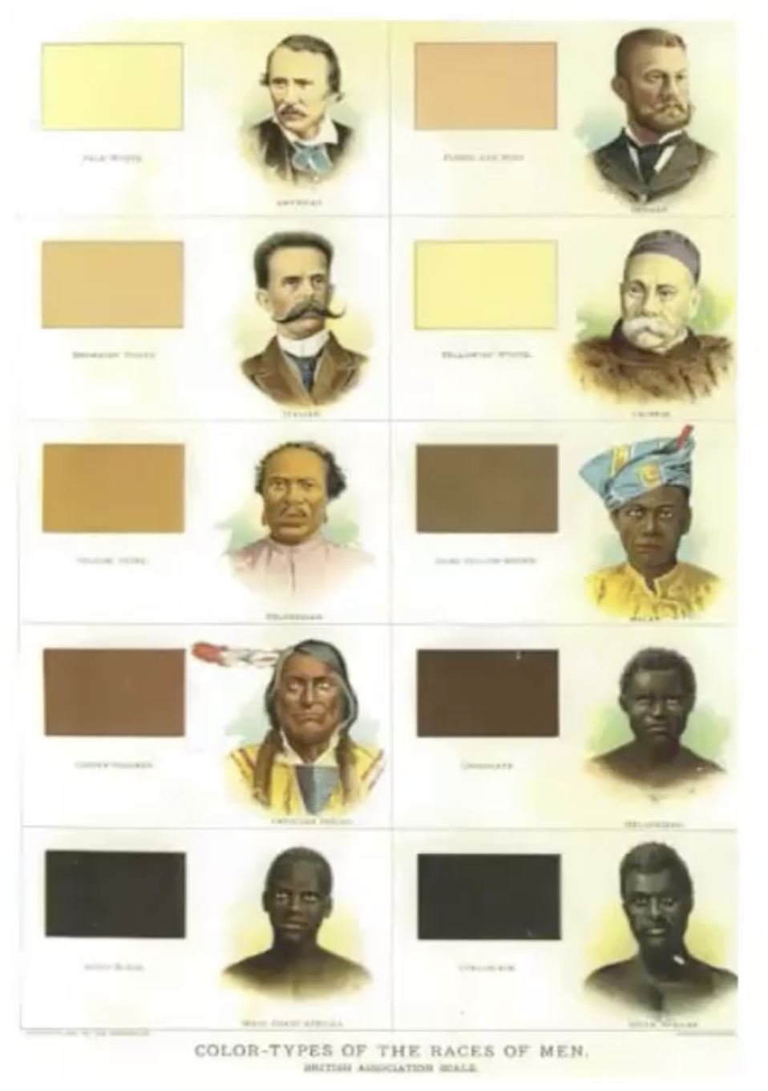
Key Terms
Race & Racism
Race is a conceptualization of human difference that groups persons based on perceived physical differences. … Racial divisions are always socially constructed. (Omi & Winant 1994)
Racism is an ideology that links essentialist representations of human differences to structures of social domination in order to justify racial hierarchies. (Omi & Winant 1994)
Tilley, Alvin. “Promoting Racial Equity: A Guide for Business Leaders” Northwestern University Center for the Study of Diversity and Democracy. 19 Aug. 2020. Webinar.

Slide 6

Key Terms
Institutional & Systemic Racism
Institutional Racism is when the ideology of racism is embedded within the normal operations of an organization (Ture & Hamilton, 1967)
Systemic Racism means that the core racist realities are manifested in each of society’s major parts—the economy, politics, the courts, educational institutions (Feagin, 2014)
Tilley, Alvin. “Promoting Racial Equity: A Guide for Business Leaders” Northwestern University Center for the Study of Diversity and Democracy. 19 Aug. 2020. Webinar.

Slide 7
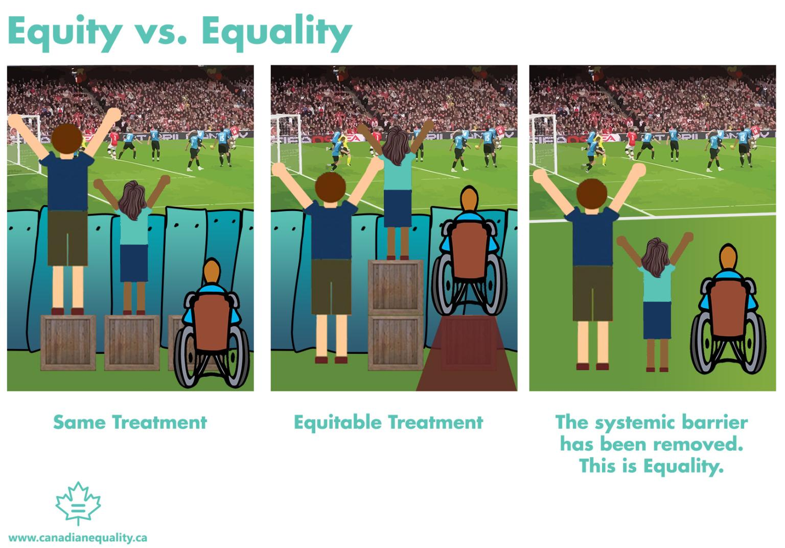

Slide 8
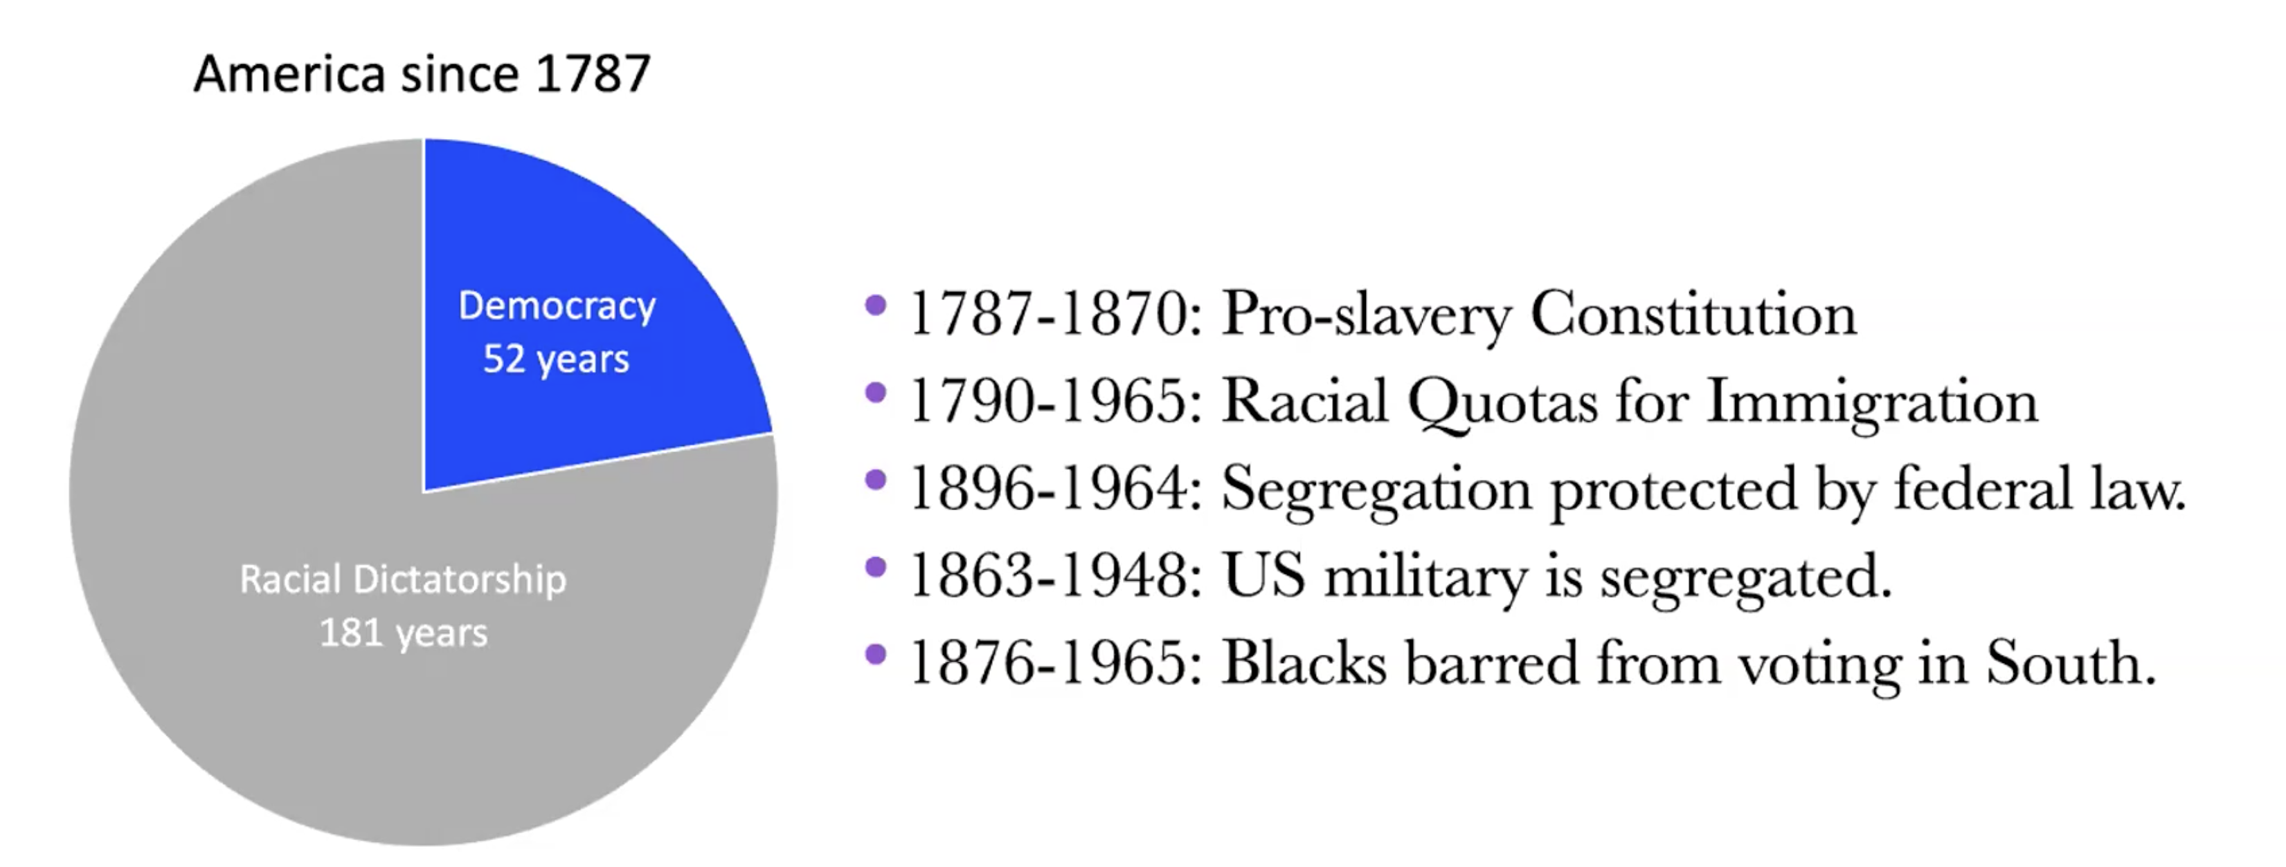
Racial Dictatorship to Racial Democracy
Civil Rights Act of 1964
Voting Rights Act of 1965
Housing Rights Act of 1968
Tilley, Alvin. “Promoting Racial Equity: A Guide for Business Leaders” Northwestern University Center for the Study of Diversity and Democracy. 19 Aug. 2020. Webinar.

Slide 9

Social Justice is
not Black & White
Immigration Policies
LGBTQ Rights
Incarceration Rates & Violence
Pay & Wealth Gaps
Health Care Inequity
Education

Slide 10
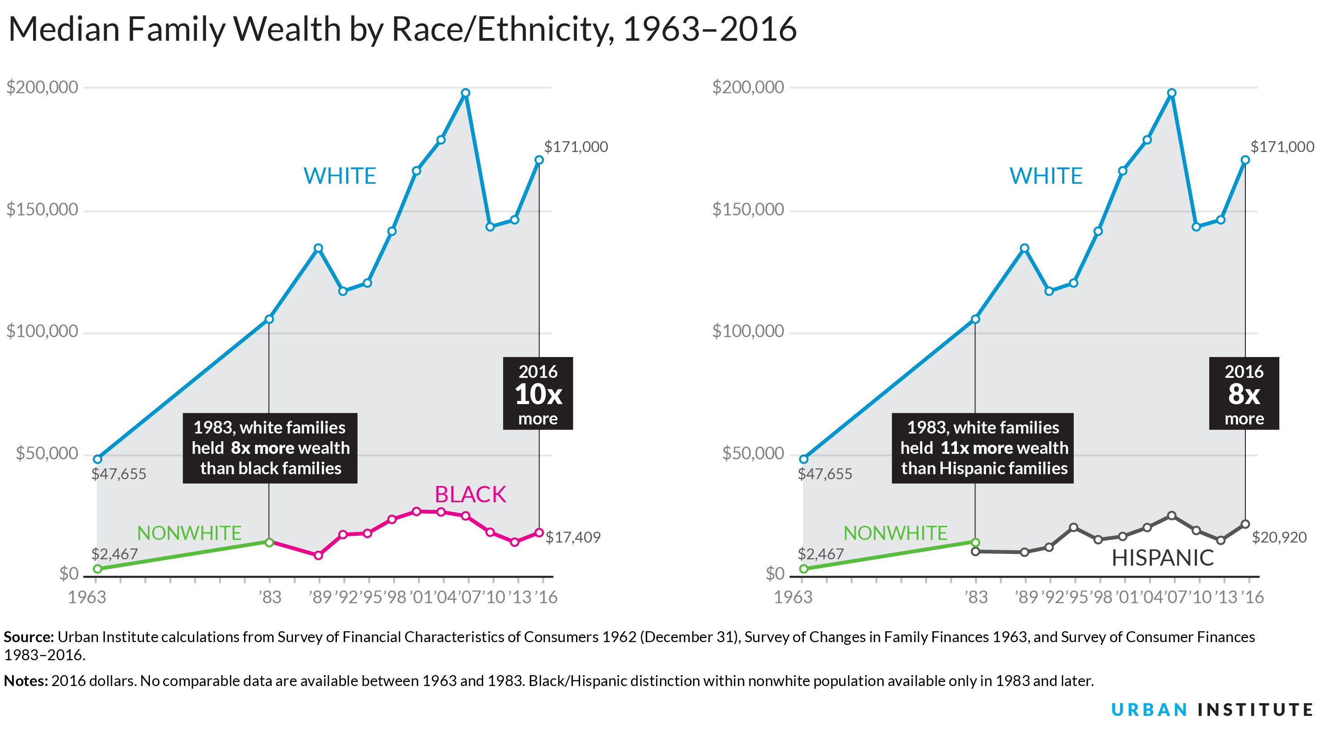

Slide 11
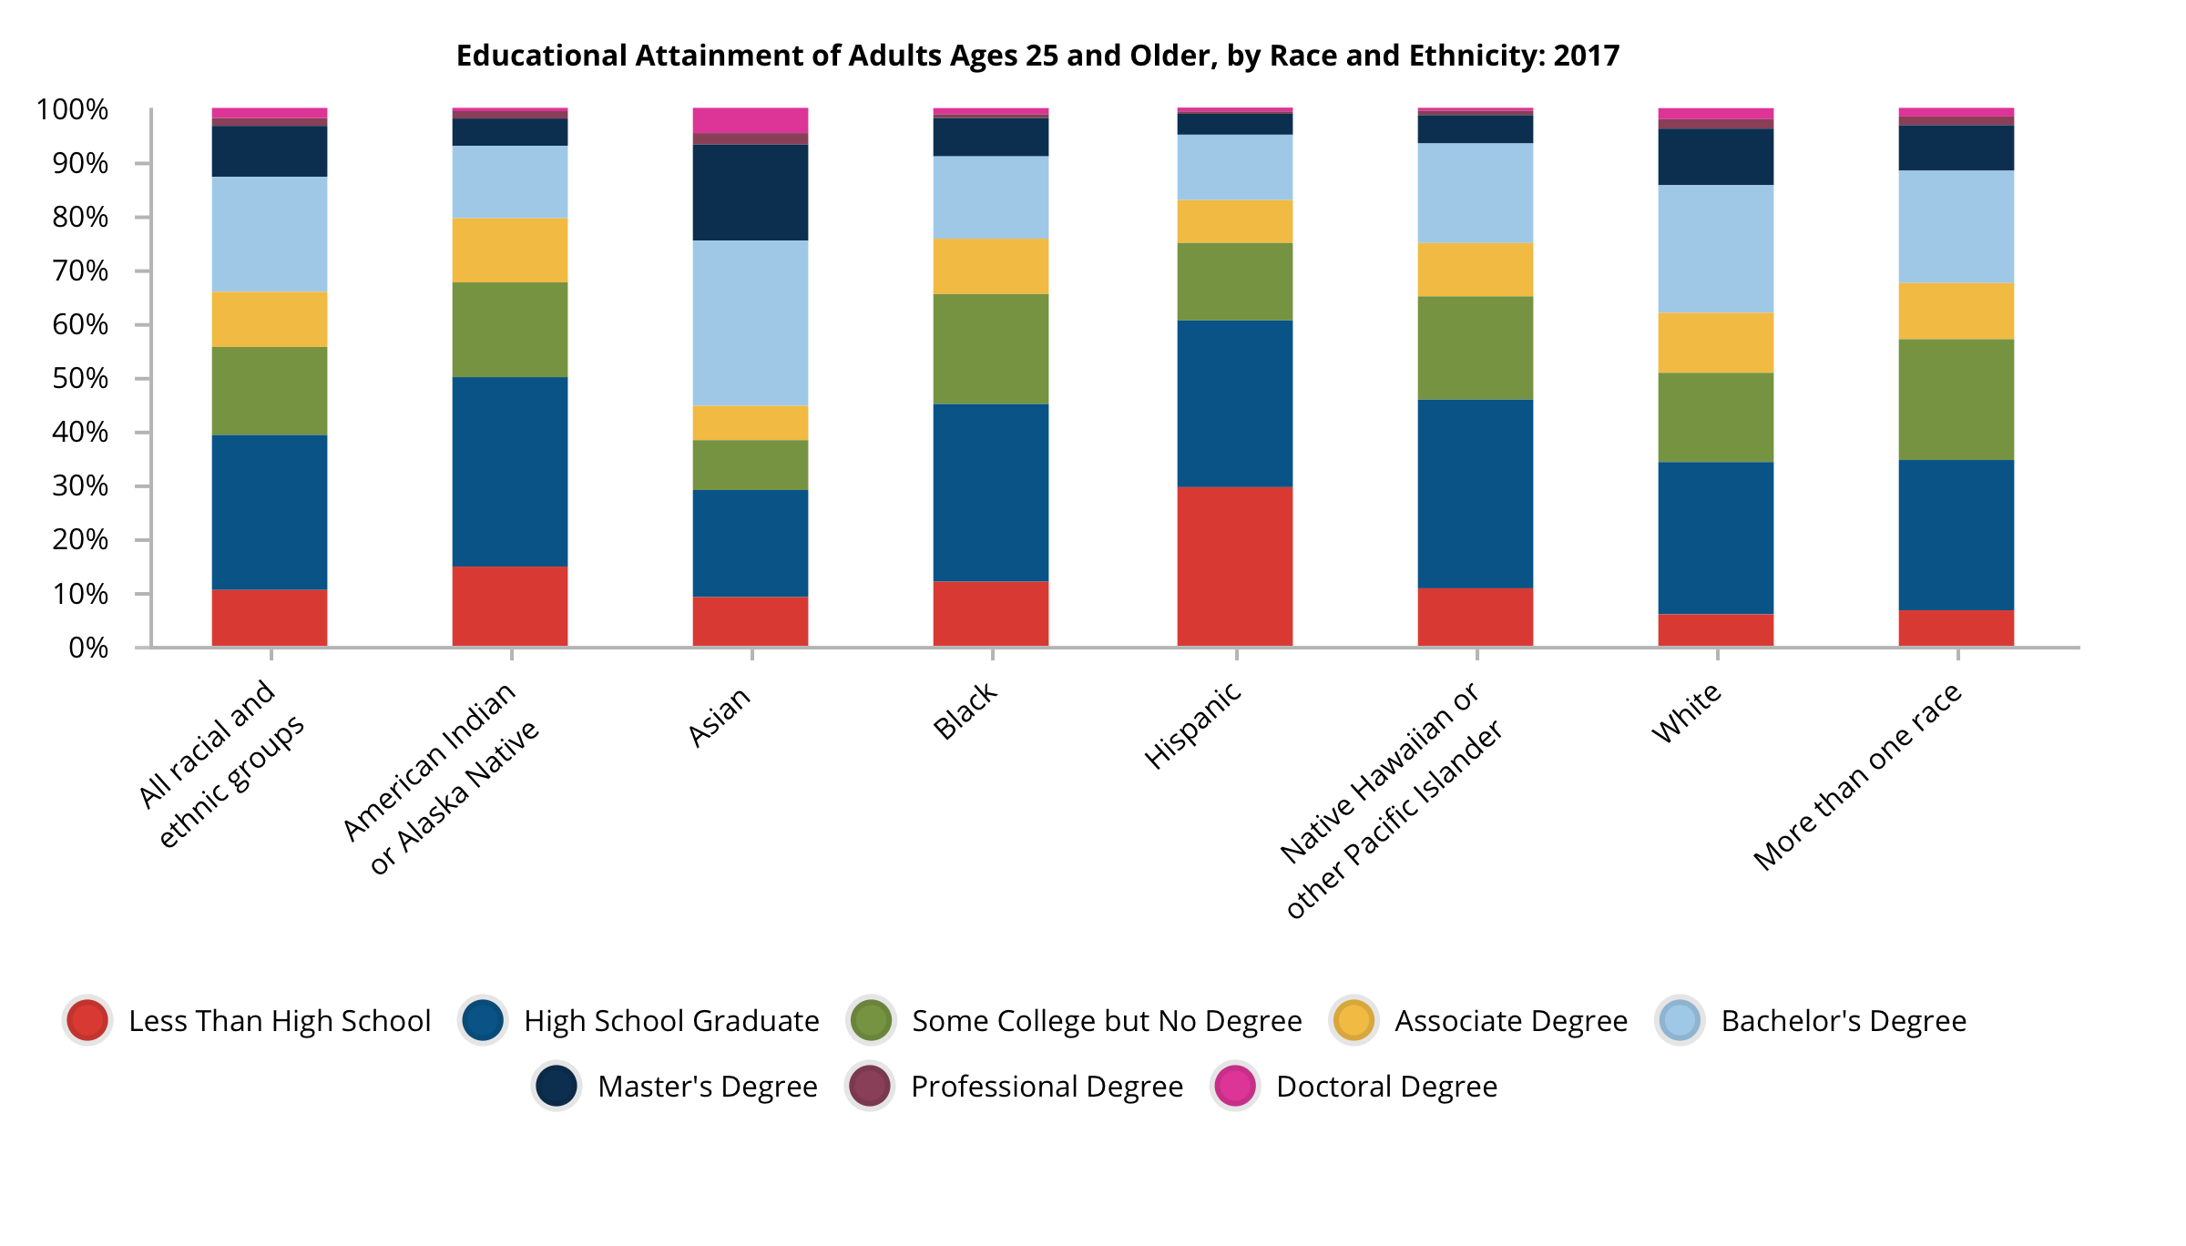
American Council on Education https://www.equityinhighered.org/indicators/u-s-population-trends-and-educational-attainment/educational-attainment-by-race-and-ethnicity/
American Council on Education https://www.equityinhighered.org/indicators/u-s-population-trends-and-educational-attainment/educational-attainment-by-race-and-ethnicity/

Slide 12
Different Approaches
&
Approaching Differently

Slide 13
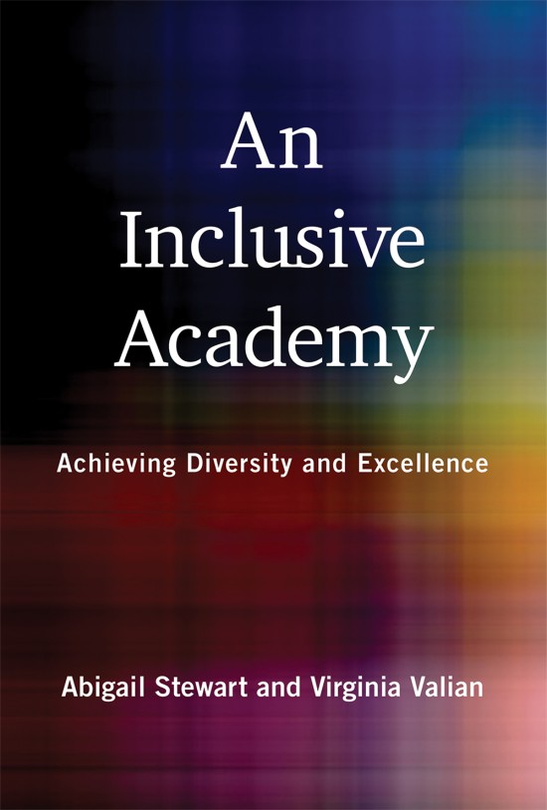
Six Principles
1. Use Universal Design.
2. Maximize individual’s potential.
3. Take a different perspective.
4. Be alert to, and be willing to change, structural factors.
5. Try things out.
6. Hold people accountable.
Steward, Abigail J. And Virginia Valian. An Inclusive Academy: Achieving Diversity & Excellence. Cambridge, MIT Press, 2018. KAWSE Reading Group happening this semester!

Slide 14
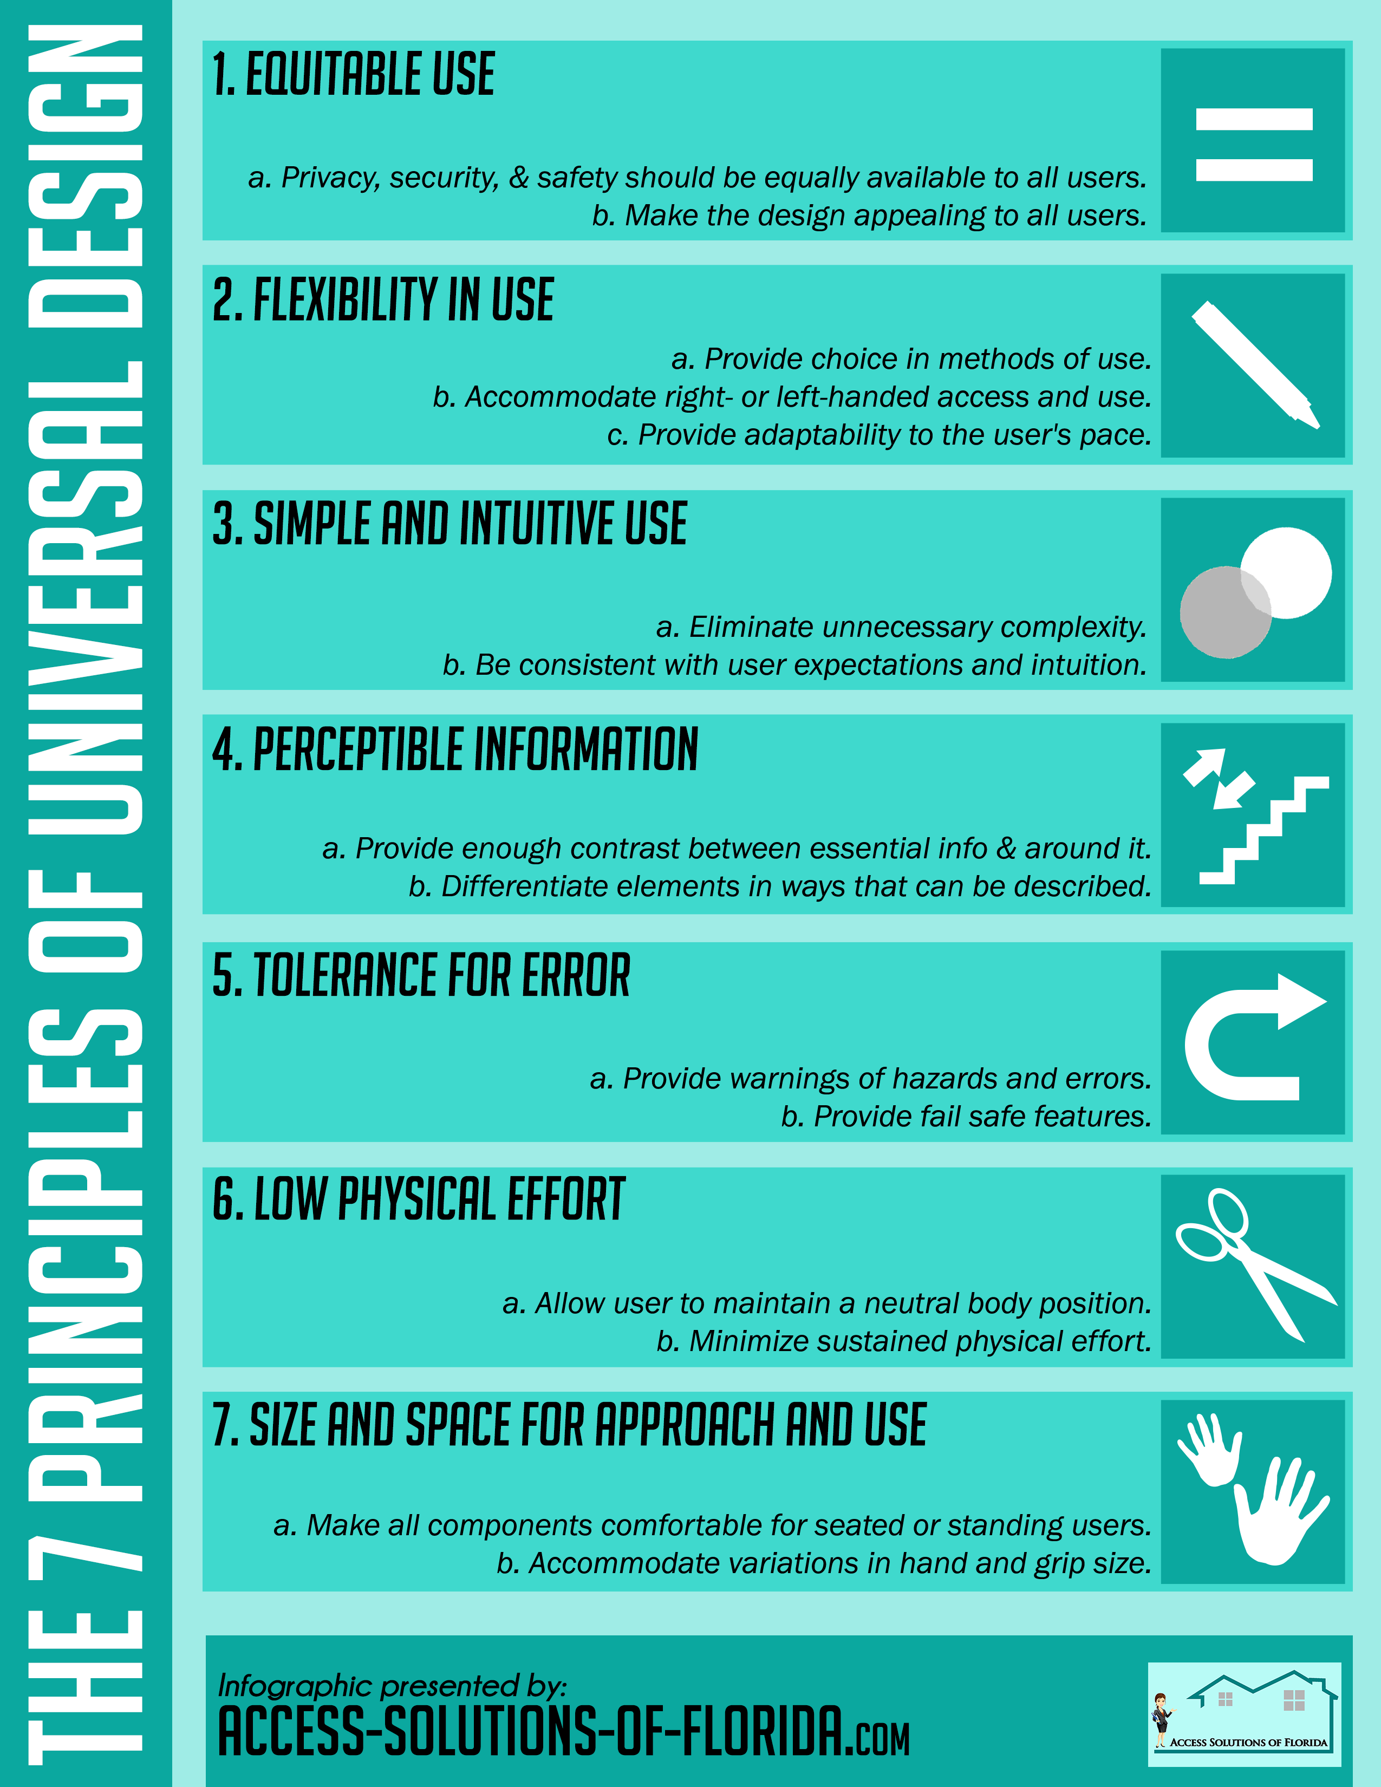
Universal Design
“treating everyone equally, but in a way that is responsive to difference… [M]ake life better for everyone.”
—Stewart & Valian

Slide 15
Social Justice via Course Design
1) Assessing our practices
2) Identifying barriers in our courses (and programs)
3) Adjusting to remove the barriers

Slide 16

Reflections

Slide 17
Thank you.

Slide 18
Recent Articles
So many right now!!! Contact your college diversity committee…
“Is Lecturing Racist?” Inside Higher Ed. 2 Sept. 2020
“More Pandemic Consequences for Underrepresented Students” Inside Higher Ed. 16 Sept. 2020
“Universal Design for Learning” website.
“Beyond Compliance” Inside Higher Ed. 2 Sept. 2020
“Advancing Equity Post-Pandemic” Inside Higher Ed. 16 Sept. 2020
“Race and Ethnicity in Higher Education.” American Council on Education (ACE)

