Slide 1
Bringing PEACE and Empathy to Our Teaching
saucier@ksu.edu
#ITeachAtKState
Don Saucier
Professor of Psychological Sciences
Faculty Associate Director of the Teaching & Learning Center
TLC Professional Development Series

Slide 2
What Do You Hope to Take Away?
saucier@ksu.edu
#ITeachAtKState
What is one thing you want to learn in this session today?
Please type that take away into the chat

Slide 3
What I Hope You Take Away
saucier@ksu.edu
#ITeachAtKState
Practical ways to infuse PEACE and empathy into our teaching to promote better experiences for us and our students
Face-to-face, hybrid/hyflex, and/or online

Slide 4
Disclaimers
saucier@ksu.edu
#ITeachAtKState
Disclaimer #1
Not everything will work in every class!
Disclaimer #2
I have a lot to share today!
Check out our resources

Slide 5
Resources
saucier@ksu.edu
#ITeachAtKState
Engage the Sage YouTube channel
Mindful Returns Toolkit
K-State Keep Teaching website
Remote Teaching Training Schedule
Keep Teaching: Resources for Higher Ed online community
Faculty Checklist in Preparation for Remote Teaching
Videos for Faculty Tips for Teaching Remotely
Options for Teaching Lab Courses Remotely
Teaching & Learning Center social media will highlight information
Facebook, Twitter

Slide 6
Teaching Starts with Teachers
saucier@ksu.edu
#ITeachAtKState
Our personas and perspectives…
… provide the foundations for teaching and learning
… dictate our teaching philosophy and practices
… are intentional, purposeful, and dynamic

Slide 7
Teaching Starts with Teachers
saucier@ksu.edu
#ITeachAtKState
Trickle Down Engagement
Engage the Sage
We should focus on our own experience first

Slide 8
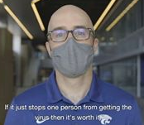
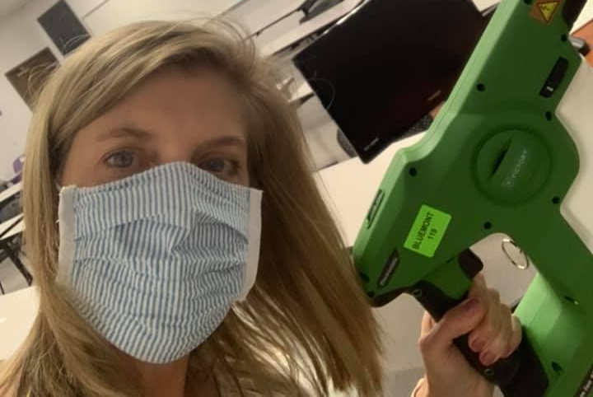
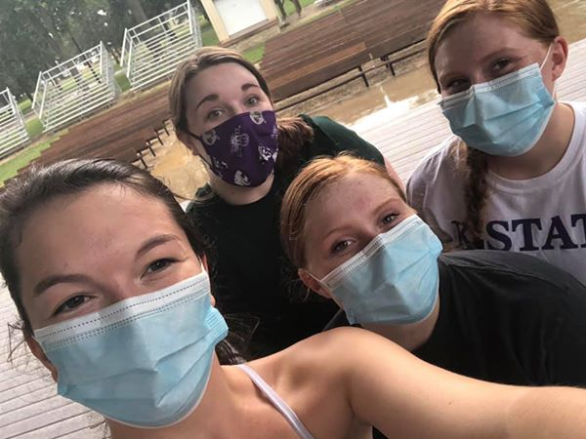
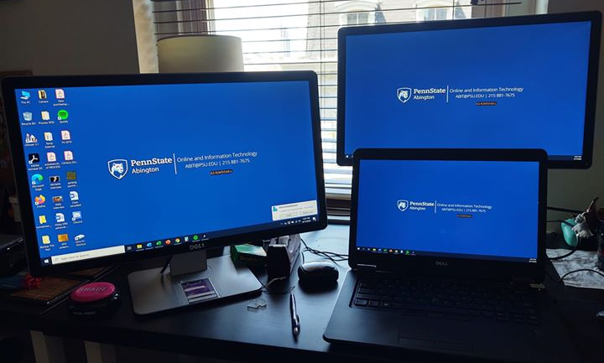
We Have Challenges Right Now!
saucier@ksu.edu
#ITeachAtKState

Slide 9
Bring PEACE to Our Teaching
saucier@ksu.edu
#ITeachAtKState
P = Preparation
E = Expertise
A = Authenticity
C = Caring
E = Engagement

Slide 10
Empathy
saucier@ksu.edu
#ITeachAtKState
Perspective taking
Empathic concern
To promote our collective experiences, we should consider our and our students’ cognitive and emotional perspectives

Slide 11
Empathetic Course Design Perspective
saucier@ksu.edu
#ITeachAtKState
We value and care for ourselves and our students
We believe that empathy is more important than “academic rigor”
We provide flexibility, guidance, and grace

Slide 12
Empathetic Course Design Perspective
saucier@ksu.edu
#ITeachAtKState
We inclusively promote, and remove barriers to, student learning
We make our expectations clear and reasonable
For our students and ourselves
We make the reasons for our practices explicit

Slide 13
Empathetic Course Design Perspective
saucier@ksu.edu
#ITeachAtKState
We provide fair and reasonable ways for students to demonstrate their learning
We seek and use feedback from our students

Slide 14
Empathetic Course Design in Practice
saucier@ksu.edu
#ITeachAtKState
Syllabus statements
Course scheduling
Course structure
Course policies
Assignments and assessments
Being “there” for our students

Slide 15
Empathetic Syllabus Statements
saucier@ksu.edu
#ITeachAtKState
Syllabus statements make our teaching philosophies explicit and set the climate for our courses
Empathy statement
Mutual respect and inclusion statement
Mental health statement

Slide 16
Empathy Statement
saucier@ksu.edu
#ITeachAtKState
Things are different now (during the COVID-19 pandemic) than they were. This is very real for all of us. The “social distancing” and transition to remote education is tough, and frankly it sucks. We are teaching differently and under different circumstances than we were, and you are learning differently and under different circumstances than you were. Please keep connected with us. If you have difficulty with the course content, assignments, deadlines, etc., please reach out and we will try to work with you as best we can. We want you to learn and succeed. We want to have a wonderful experience learning with you. We should be creating “physical distance” right now, not “social distance.” We are here for you.

Slide 17
Mutual Respect and Inclusion in K-State Teaching and Learning Spaces
saucier@ksu.edu
#ITeachAtKState
At K-State, faculty and staff are committed to creating and maintaining an inclusive and supportive learning environment for students from diverse backgrounds and perspectives. K-State courses, labs, and other virtual and physical learning spaces promote equitable opportunity to learn, participate, contribute, and succeed, regardless of age, race, color, ethnicity, nationality, genetic information, ancestry, disability, socioeconomic status, military or veteran status, immigration status, Indigenous identity, gender identity, gender expression, sexuality, religion, culture, as well as other social identities.
Faculty and staff are committed to promoting equity and believe the success of an inclusive learning environment relies on the participation, support, and understanding of all students. Students are encouraged to share their views and lived experiences as they relate to the course or their course experience, while recognizing they are doing so in a learning environment in which all are expected to engage with respect to honor the rights, safety, and dignity of others in keeping with the K-State Principles of Community https://www.k-state.edu/about/values/community/.
If you feel uncomfortable because of comments or behavior encountered in this class, you may bring it to the attention of your instructor, advisors, and/or mentors. If you have questions about how to proceed with a confidential process to resolve concerns, please contact the Student Ombudsperson Office. Violations of the student code of conduct can be reported here https://www.k-state.edu/sga/judicial/student-code-of-conduct.html. If you experience bias or discrimination, it can be reported here https://www.k-state.edu/report/discrimination/.

Slide 18
Mental Health Statement
saucier@ksu.edu
#ITeachAtKState
Your mental health and good relationships are vital to your overall well-being. Symptoms of mental health issues may include excessive sadness or worry, thoughts of death or self-harm, inability to concentrate, lack of motivation, or substance abuse. Although problems can occur anytime for anyone, you should pay extra attention to your mental health if you are feeling academic or financial stress, discrimination, or have experienced a traumatic event, such as loss of a friend or family member, sexual assault or other physical or emotional abuse.
If you are struggling with these issues, do not wait to seek assistance.
Kansas State University Counseling Services (k-state.edu/counseling/) offers free and confidential services to assist you to meet these challenges.
Lafene Health Center (https://www.k-state.edu/lafene) has specialized nurse practitioners to assist with mental health.
The Office of Student Life (k-state.edu/studentlife) can direct you to additional resources.
K-State Family Center offers individual, couple, and family counseling services on a sliding fee scale (https://www.hhs.k-state.edu/familycenter/).
Center for Advocacy, Response, and Education (CARE) provides free and confidential assistance for those in our K-State community who have been victimized by violence (https://www.k-state.edu/care/).

Slide 19
Empathetic Course Scheduling
saucier@ksu.edu
#ITeachAtKState
Provide support and reduce stress by increasing students’ abilities to predict and control
Set up explicit weekly routines (to do lists)
Proactively schedule mental health days, prep days, catch up, and/or reading days
Beware of end of the semester build up

Slide 20
Empathetic Course Structure
saucier@ksu.edu
#ITeachAtKState
Teach our students “where” they are
Hyflex, post videos for asynchronous viewing
Have (some) synchronous contact
Invite our students to keep their videos on

Slide 21
Zoom Policy Statement
saucier@ksu.edu
#ITeachAtKState
For classes that you attend synchronously over Zoom, we expect you will attend with your video on. This will make it easier for us to connect to you and gauge your understanding while we teach. This will also make it easier for you to pay attention and be less distracted by other things. In short, if you attend with your video on, you will engage more in the class, learn more, and help us teach you better. We understand that you may be unable to attend with your video on for a given class for whatever reason – just please let us know.

Slide 22
Empathetic Course Policies
saucier@ksu.edu
#ITeachAtKState
Empathetic late policies
Empathetic attendance policies
“Choice to Learn” framing
Offer “opportunities” (not “requirements”)
Emphasize “earning” (not “losing”) points

Slide 23
Empathetic Course Assignments/Assessments
saucier@ksu.edu
#ITeachAtKState
Understand that everything we assign will come back to us
Provide assignments students will want to do and we will want to grade
Provide opportunities for students to apply and extend their learning in meaningful ways

Slide 24
Empathetic Course Assignments/Assessments
saucier@ksu.edu
#ITeachAtKState
Consider lower stakes assignments
Beware of comprehensive assessment
Offer students choices in assignments
What, when, and/or how
Beware of group work and projects
“Get the maximum” out of our students

Slide 25
Empathetic Course Assignments/Assessments
saucier@ksu.edu
#ITeachAtKState
Reflections (important/surprising/Q)
“Because You Asked”
Weekly “Missions”
“Homework for Life” PSAs
Allow students to create and complete their own assignments and assessments (and even exams)
“Exams By You”

Slide 26
Empathetic Exams
saucier@ksu.edu
#ITeachAtKState
If we use more traditional exams:
Understand the limits of remote proctoring
Allow resources
Prepare our students for the experience
Be clear about what is allowed
See the recent statement about Honor and Integrity

Slide 27
Being “There” for Our Students
saucier@ksu.edu
#ITeachAtKState
Focus on building connections and community
Genuinely care about and empathize with our students’ experiences
Create frequent touch points
Pandemic nicknames to start class

Slide 28
Being “There” for Our Students
saucier@ksu.edu
#ITeachAtKState
Provide regular announcements/to do lists
Respond to weekly reflections
Survey our students
About their course experiences
About internet availability, food/housing security, etc.
Provide resources for mental health and physical health concerns often

Slide 29
Being “There” for Our Students
saucier@ksu.edu
#ITeachAtKState
Provide opportunities for synchronous contact
Conduct “Highlights and Qs” sessions
Provide “How to Succeed” guides/videos

Slide 30
Being “There” for Yourself
saucier@ksu.edu
#ITeachAtKState
Design our courses while anticipating the workload we are putting on ourselves
Understand that we all have limits
Time, emotional energy, competing responsibilities
Design our courses to be fulfilling for us
Ask our students what they learned as a “waterfall” exit ticket in each class
“Top Things Learned” as a concluding assignment

Slide 31
In Conclusion
saucier@ksu.edu
#ITeachAtKState
Bringing PEACE and empathy to our teaching…
Will promote more successful and fulfilling experiences in teaching and learning for our students and for us

Slide 32
What Will You Take Away?
saucier@ksu.edu
#ITeachAtKState
What is one concrete way in which you will infuse PEACE and empathy into your current or future teaching?
Please type your answer into the chat
Don’t press “return” until I say to “waterfall” you answers into the chat!

Slide 33
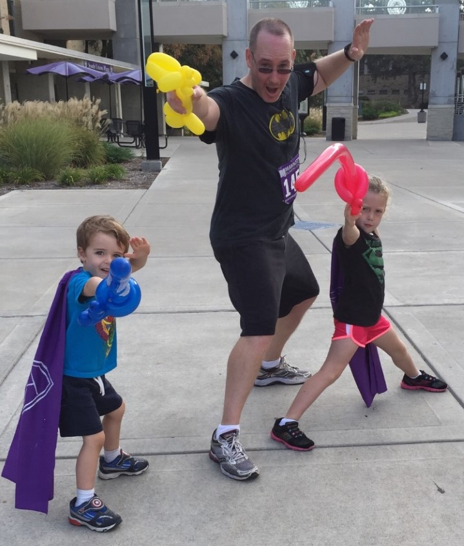
What Questions Do You Have?
saucier@ksu.edu
#ITeachAtKState
Further questions and/or the PPT of this presentation:
Email Don Saucier at saucier@ksu.edu
Thank you!

