Slide 1
Microaggressions and Their Impact
Rebeca Paz
Assistant Director​
Office of First-generation Students
Karina Moncayo-Michel
Program Assistant
Staley School of Leadership
Dr. Graciela Berumen
Assistant Director Of Diversity and Multicultural Student Engagement

Slide 2
Land Acknowledgement​​
​
As the first land-grant institution established under the 1862 Morrill Act, we acknowledge that the state of Kansas is historically home to many Native nations, including the Kaw, Osage, and Pawnee, among others. Furthermore, ​Kansas is the current home to four federally recognized Native nations: The Prairie Band Potawatomie, the Kickapoo Tribe of Kansas, the Iowa Tribe of Kansas and Nebraska, and Sac and Fox Nation of Missouri in Kansas and Nebraska​

Slide 3
Community Agreements
Confidentiality
Respect
Listen to understand
Be open to changing your mind
Value one another's experiences
Own and embrace your feelings
Participate, don’t dominate
Disagree without being disagreeable

Slide 4
Learning Outcomes
Learn and reflect on the concepts of cultural competence and cultural humility
Learn about microaggressions and their impact
Reflect on how to respond to instances of microaggressions

Slide 5
Introductions
Sharing our "Why"​ ​ What drives the work we do?

Slide 6
Cultural Competence
"Cultural competence comprises behaviors, attitudes, and policies that can come together on a continuum that will ensure that a system, agency, program, or individual can function effectively and appropriately in diverse cultural interaction and settings. It ensures an understanding, appreciation, and respect of cultural differences and similarities within, among and between groups. (p. 249S)"
Selig, Tropiano, and Greene-Moton (2006)

Slide 7
Cultural Humility
Cultural humility is a lifelong process of self-reflection and self-critique whereby the individual not only learns about another's culture, but one starts with an examination of her/his own beliefs and cultural identities.
-Tervalon & Murray-Garcia, 1998
“Not a discreet endpoint, but a commitment and active engagement in a lifelong process that individuals enter into on an ongoing basis with participants, communities, colleagues, and with themselves.”
- Leland Brown, 1994

Slide 8
Microaggressions
Definition: Everyday verbal, nonverbal, and environmental slights, snubs, or insults, whether intentional or unintentional, which communicate hostile, derogatory, or negative messages to target persons based solely upon their marginalized group membership. ( Dr. Derald Wing Sue).​
Outside awareness of the perpetrator​
Can be delivered verbally, non-verbally or through behavior.​
Can be disguised as a compliment.

Slide 9
Microaggressions Classifications (Dr. Derald Wing Sue)
Micro insult, when a person intentionally behaves in a discriminatory way while not intending to be offensive.
Microinvalidation Comment or action unintentionally discriminatory​
https://www.youtube.com/watch?v=WXRjO28F_0g ​
Notes:
Insult: you speak good English
Micro invalidation. Are you sure that happened to you?
Micro assaul: intentional meant to hurt, slurs, they have to prove they have a right to exist

Slide 10
Intent vs. Impact
Notes:
What is Intent?
What is impact?

Slide 11
Power of Language
Notes:
What was the intent?
What was the impact?
Was this a micro-aggression? Why?

Slide 12
Reflect and Discuss
How may microaggressions show up in the classroom?
How have you responded when a microaggression happened?

Slide 13
Impact of micro-aggressions
Microaggressions are cumulative. “They occur to people of color from the time they awaken, until they go to bed, from the time they are born until they die,” Sue.
They happen casually and may not have harm intended
They can take a psychological and physical toll on people's health.
Video

Slide 14
Going Forward...​
​
What can I do to mitigate microaggressions?
Notes:
The first think I think of is be aware of them . Think about the impact of the words you are using and how this can be percieved. I think that if you are here its because this is something that is important to you. Many times we hear comments like " that’s a lot of work" or "well that’s not what I ment" but we are in a time where people are speaking up and sharing what "innocent" comments are doing to everyday lives.

Slide 15
First step in moving forward: Apologizing
Take responsibility for your actions
Don’t blame the person that was offended
Acknowledge what you did wrong
Don't try to tell the other person how to feel
Make a commitment to change the behavior

Slide 16
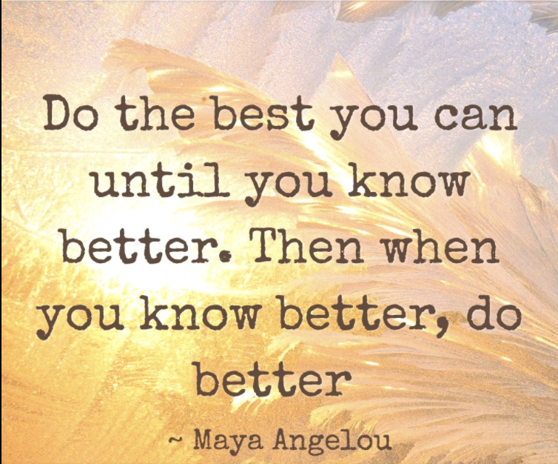
We​​ are Part ​​of the ​Solution​​!

Slide 17
Think About the Action
Behind the Knowledge
Three things I want to remember from today’s session. ​
Three things I can do to apply what I learned today in my work and life ​
Three things I can do for my personal development ​

Slide 18
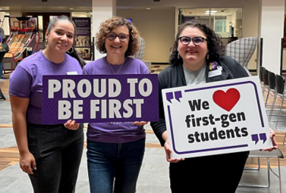
Karina Moncayo-Michel
karinamichel@ksu.edu
Rebeca Paz
rpaz@ksu.edu
Dr. Graciela Berumen
gracie3@ksu.edu
Thank you!

Slide 19
Resources
Cultural Competence or Cultural Humility? Moving Beyond the Debate, Green-Moton et all, Sage Journals, V.21,1, November 2019.
Cultural Humility Versus Cultural Competence: A Critical Distinction in Defining Physician Training Outcomes in Multicultural Education, Melanie Tervalon & Jann Murray-Garcia, Journal of Health Care for the Poor and Underserved, V.9, 2, May 1998 pp.117-125.
Cultural Humility Complete, Vivian Chavez https://www.youtube.com/watch?v=SaSHLbS1V4w
From Deficit-Based to Assets-Based: Breaking Down the Wall one Essential Shift at a Time, Debie Zacarian and Diane Staehr Fenner https://www.languagemagazine.com/2020/01/22/from-deficit-based-to-assets-based-breaking-down-the-wall-one-essential-shift-at-a-time/
Getting Called Out: How to Apologize https://www.youtube.com/watch?v=C8xJXKYL8pU
How did you get into that school https://www.youtube.com/watch?v=WXRjO28F_0g
How Microaggressions are like mosquito bites: https://www.youtube.com/watch?v=hDd3bzA7450
"Microaggressions: More than Just Race", Derald Wing Sue https://www.uua.org/files/pdf/m/microaggressions_by_derald_wing_sue_ph.d._.pdf
Leveraging Students' Community Cultural Wealth: Moving from Deficit to Asset-Based Approaches to Student Success, Equity, Higher Education, Student Success, Summer Meeting. https://urbanuniversity.wordpress.com/2020/07/27/leveraging-students-community-cultural-wealth-moving-from-deficit-to-asset-based-approaches-to-student-success-by-christel-perkins-ed-d-and-andrea-rodriguez/
Reflections on Cultural Humility, American Psychological Association, CYF News, August 2013.
35 Dumb Things Well-Intended People Say, Dr. Maura Cullen, 2008
Unmasking Racial Micro aggressions, Tori DeAngelis, American Psychological Association, February 2009, Vol 40, 2-42

