Slide 1
Keeping a Teaching Journal
Dr. Katie Linder
Executive Director, Global Campus
kelinder@ksu.edu

Slide 2
Today’s Agenda
What experience has everyone had with journaling?
What is a teaching journal?
What are some of the benefits of keeping a teaching journal?
How do I get started with a teaching journal?
What kinds of topics might I journal about?
What are some journaling resources for academics?
Close with reviewing current Keep Teaching resources and offer feedback for resources needed in the future.

Slide 3
What’s your experience with journaling?

Slide 4
What is a teaching journal?
A teaching journal is:
a method for reflecting on pedagogical choices and strategies
a technique for decompressing and processing during a difficult teaching period
a form of “field notes” for our teaching practice
a way of gathering data for future teaching and learning inquiries (Scholarship of Teaching and Learning)
a space to log questions that might lead to future action or course revisions

Slide 5
What are some of the benefits of keeping a teaching journal?
We can see patterns that occur over time that might be hard to recognize without regular reflection
We can experience a feeling of closure after a class session, week of classes, or term is completed
We can consider our teaching in a more formal way that might lead to research or publication on pedagogical topics or data
We can keep all of our teaching thoughts, ideas, and observations in one place for easier retrieval when needed for annual reviews or other documentation
We can release emotions (both positive and negative) associated with teaching and learning

Slide 6
How do I get started with a teaching journal?
Choose a journaling medium (digital or analog)
Syllabus journals (i.e. notes take directly on your syllabus document are a great format for a teaching journal – this can work great in a Google Doc format where you can add notes and comments throughout the term and then easily share with GTAs or other colleagues)
Keep the journal in a place where you are reminded that it exists
Schedule time for consistent reflection (could be after each class, weekly, or a couple of times per month)
Practice journaling realistically (only a couple sentences is okay!)
Consider reviewing your entries periodically to look for patterns

Slide 7
What kinds of topics might I journal about?
How things went the first day of class
New assignments that you are offering for the first time
Any worries or concerns that you have about the upcoming term
What you are most excited about teaching in the upcoming term
Favorite teaching activity & why
What you think will be the hardest material for your students
Aspects of your teaching philosophy that you want to prioritize
Goals that you have for your professional development as a teacher
Best/worst teaching moment & why

Slide 8
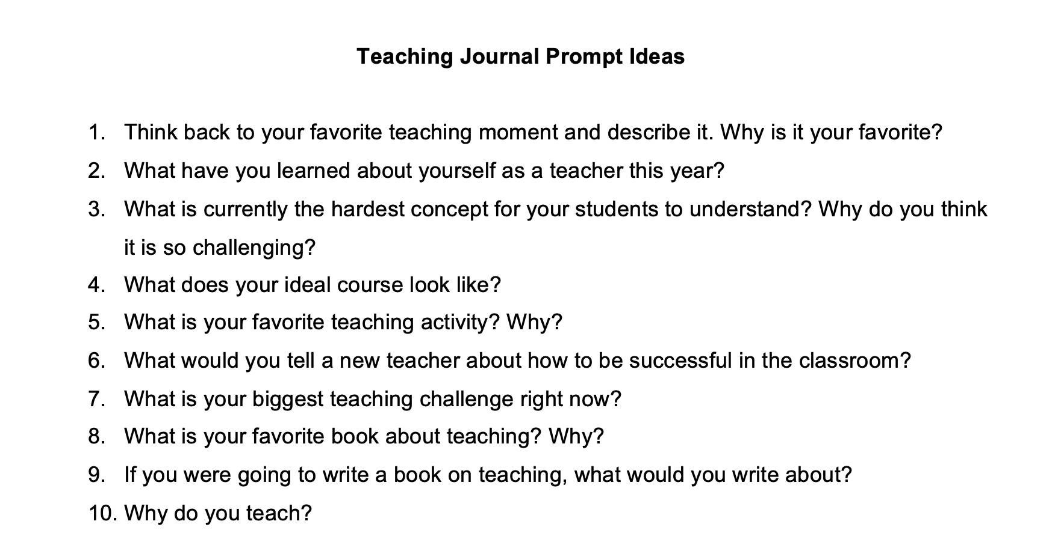
Pick a prompt for 5 minutes of journaling

Slide 9
Debrief your 5 minutes of journaling
What was easy/hard about journaling for 5 minutes?
What takeaways do you have from what you wrote?
What is a journal prompt that you might start with next time?

Slide 10
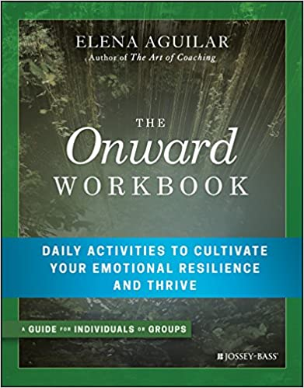
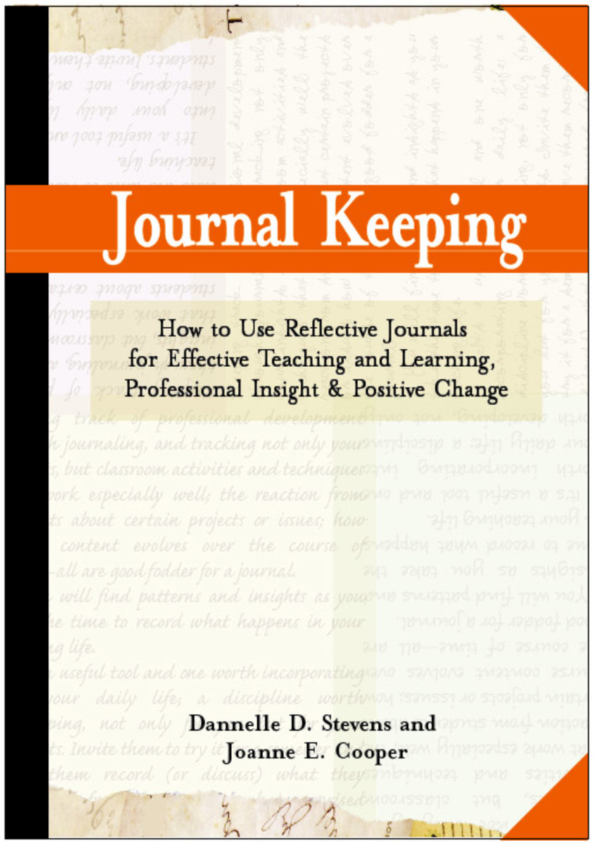
What are some journaling resources?

Slide 11
50+ journaling prompts to get you started

Slide 12
Keep Teaching Resources

