Slide 1
Just in Time: Conversation on Mental Health
Kodee Walls, Ph.D., LP, ABPP
Counseling Services

Slide 2
Before we get started
Acknowledge the reality of this time
Black [& IPOC] Lives [STILL] Matter
COVID is still a thing

Slide 3
Plan for our meeting
Self-compassion
Resilience
Motivation

Slide 4
Self-compassion
What comes to mind when you hear this term?

Slide 5
Self-compassion
IS
IS NOT
Self-kindness
Community/humanity/connection
Mindfulness or being present with reality
Self-esteem
Self-judgment
Isolation
Notes:
Self-compassion is there when you need it! It's unconditional.
Self-esteems depends on comparison to others. Roosevelt is credited with saying "Comparison is the thief of joy."
Self-esteem is also dependent on performance. When our value is only based on accomplishments (or never making mistakes), we are going to believe we're pretty worthless if things don't go the way we planned or hoped.

Slide 6
Science and self-compassion
Self-criticism activates the sympathetic nervous system = stress response.
Self-compassion activates the parasympathetic nervous system = rest and recovery.
Notes:
When we experience stress, it activates the fight-flight-freeze response. When our students engage in self-criticism, they hinder their abilities to engage fully in the tasks. Self-criticisms can come in the form of "I'm so stupid, I knew I would fail this," "I feel too overwhelmed and don't know where to start."
Self-compassion

Slide 7
Truths about self-compassion (Bluth & Phillips, 2016)
We do not lose motivation with increased self-compassion!
Those with greater self-compassion are more productive (Akin, 2014) and procrastinate less (Sirois, 2013)
Self-compassion is NOT self-pity
People with high self-compassion have greater empathy and compassion for others (Gusten & Wagner, 2012; Neff & Pommier, 2012) and have higher quality romantic relationships (Neff & Beretavs, 2013)
Self-compassion strengths many areas of our lives
We can cope better with traumas (Hiraoka et al., 2015; Zeller et al., 2014), divorce (Sbarra, Smith, & Mehl, 2012), chronic pain (Costa & Pinto-Gouveia, 2010), and academic failure (Neff, Hseih, & Dejitthirat, 2005)

Slide 8
Cultivating self-compassion
Encourage students to give themselves grace
Crisis v. opportunity
Challenge negative self-talk
Toxic positivity is not what we're going for here
Self-compassion pause
Notes:
https://communityofmindfulparenting.com/curriculum/week2/S2-MP-4-5-6CompassionPause-Calm.pdf
https://self-compassion.org/category/exercises/

Slide 9
Motivation
Finding the why

Slide 10
What sucks the most
Motivation is fickle!
Notes:
It's our general willingness to engage – but can be highly dependent on a variety of factors. What influences your motivation?
How are students any different?

Slide 11
Motivation
It's about helping people find the "Why?"
It takes knowing the price and being willing pay it
Difference between desire and reality
Intrinsic v. extrinsic
Notes:
1. Rewards and Consequences- you do X you get Y. Short-term benefit
2. Guilt- Feeling of guilt if not done
3. Doing something for a better future or important- They know why and are choosing to do it
4. Do something because you do- Habit over time. Not looking for a reward
5. Do something because you love it- Would do if you had all the time in the world

Slide 12
DECI and Ryan's (1985, 2000) SELF-DETERMINATION THEORY
Competence, Autonomy, and Relatedness (C.A.R.)
Notes:
https://selfdeterminationtheory.org/theory/
Brief synopsis – C.A.R.
Competence (perceived skill level and ability to complete a task), Autonomy (having control over the goals, and outcomes), and Relatedness (feeling a sense of belonging and having a strong support system; meaningful relationships).

Slide 13
Building motivation into courses
· Practice makes permanent
· Keep it simple (Little by little, a little becomes a lot)
· Create an environment where it's okay to fail (learn from it and adapt)
· Keep things in perspective
· Doing something is better than nothing
· Build in practice of self-affirmations or mantras
"It takes as long as it takes."

Slide 14
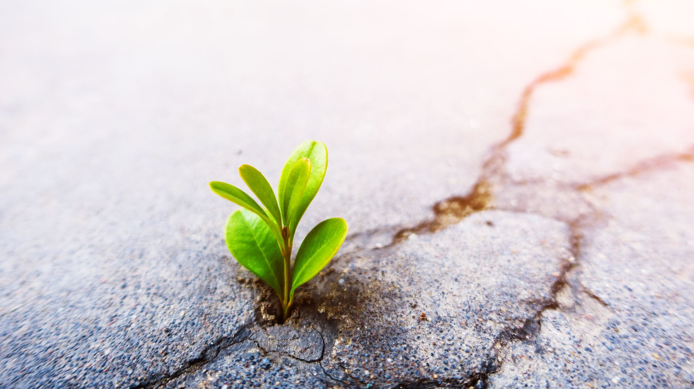
Resilience
What to do when the inevitable happens
Yes, crying is an option

Slide 15
Resilience
Putting all the pieces together to bounce back.
Notes:
Quality of attitude, skills, behaviors, and coping mechanisms that allow us to "bounce back" from adverse experiences.
https://www.apa.org/topics/resilience

Slide 16
Resilience
Developed over time
Something we cultivate
Attitudes and skills that can be learned and practiced
A universal ability to thrive despite setbacks
Notes:
Resilience is not something we're born with, something we can buy, immunity of or absence of pain, loss, or negative emotions, a quick fix, or unique to specific groups of people.

Slide 17
It's in the way we talk to ourselves!
Notes:
“This is hard, but I can get through it.” “I’ve overcome difficulties in the past. I can find a way through this too. “ “I will feel great about myself once this is all over.” “This is a learning process.”
“Why did I put myself through this?” “What’s the point anyway?” “If I can’t do things perfectly, I might as well give up.” “Maybe I don’t belong here.” “I’m not good enough.” “No one understands what I’m going through.”

Slide 18
Practice Resilience
Commitment
Control
Challenge

Slide 19
Commitment
Not so far off from the "why?"
Engage in goals, community, and strive toward growth
Depends heavily on what's important to a person!
Notes:
Commitment is being engaged with your goals, your community, and striving towards growth.
Commitment can be built by considering what is important to you
· Take time to reflect on what is important to you?
· Of these what are my top 3 priorities?
· What accomplishments in these areas am I proud of?
· Gratitude-What am I grateful for in these areas?
Action
· Spending time with important others can increase commitment
· Try new things

Slide 20
Challenge
See change and disruptions as opportunities (crisis v. opportunity)
Problems are part of life.
We're not alone and we can solve them.
Notes:
Challenge-See change and disruptions as opportunities to learn and grow. See problems as part of life and set out to solve them.
Training on how to fail/respond
· How do we want to think, feel, behave?
o Change our relationship with failing
· Attention (what we focus on)
o Putting people on a podium
· Never rise to the occasion, you sink to the level of your training
· Believe in yourself-Positive self-talk
· Ask for help from others: Who can be a mentor? Who can I learn from?
· Be flexible-Delays happen. Be willing to make changes to your goals as needed.
· Take risks, believe in positive outcomes
· Let go of the past
· To increase sense of challenge, make changes.

Slide 21
Control
Accountability with self-compassion
Notes:
Control is the belief that you can control outcomes in your life. Are you willing to make choices and accept responsibility to create the life you would like?
· It is making the best choices and understanding the uncertainty of life.
What is my sense of control now?
Self-Accountability/Compassion
1. How have I contributed to this failure?
o Radical accountability
2. What were the things out of my control?
o Radical self-compassion
3. What will I do differently?
· Control can be built by sleep.
· Focus your time and energy on what you can control? Let go of worries on what ifs, or waiting on things outside of your control-worrying about a grade on an assignment you turned in.
· Work on tasks that are within your control and somewhat difficult-build confidence through completing assignments.
· Plan-Break tasks down into steps, build the skills/gather the tools

Slide 22
Thank You!
someone@example.com

