Slide 1
What Job Design Can Tell Us About Online Teaching and Learning

Slide 2
Overview
A little bit about me
What is job design?
Job design components applied to teaching and learning
Supporting approaches
Q&A
--> but please ask questions throughout!
Limitations

Slide 3
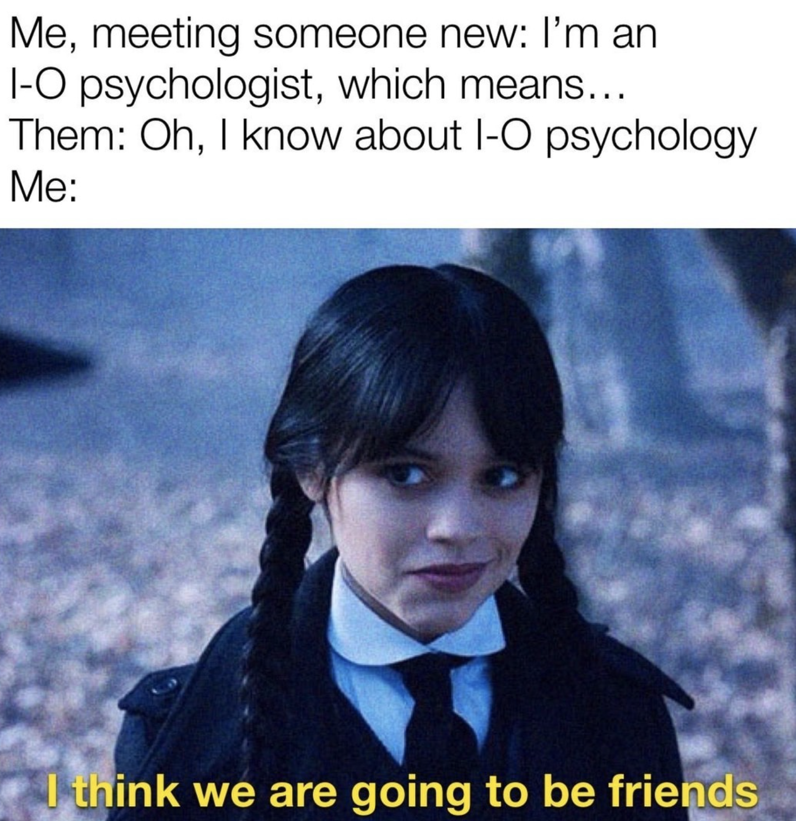
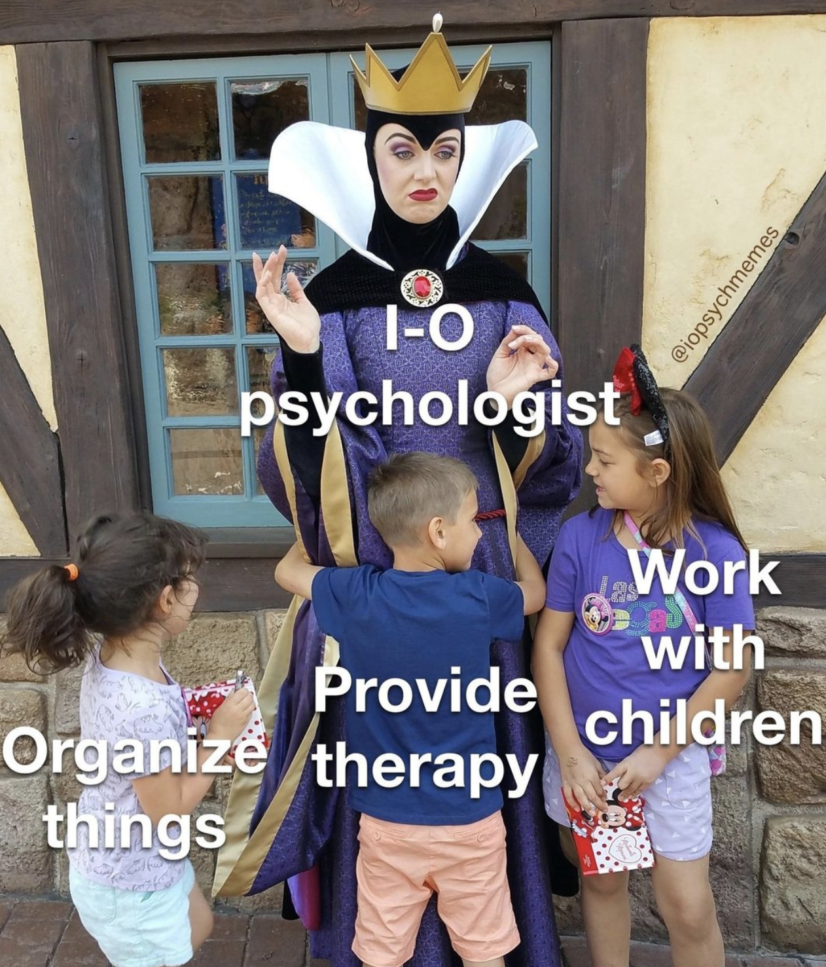
About me
Sarina Maneotis (Man-ee-OH-tis)
PhD in Industrial/Organizational Psychology
Teaching Assistant Professor in Psychological Sciences since 2020
Director of the Master’s in Industrial/Organizational Psychology (MIOP) program
iopsychmemes

Slide 4
What Worries do you have about online teaching and learning?

Slide 5
What is job design?
Rooted in employee motivation
Aims to create or modity jobs that boost satisfaction, intrinsic motivation, and performance
Leadership practices and culture are still important, but the job is generally interesting

Slide 6
Why might job design be helpful?
Organizing framework to help decide how to design and implement your courses
Helps explain why recommendations you’ll hear at the TLC work
Applies to the way you think about students’ experiences and also your own experience as an instructor

Slide 7
Job Design components
Job characteristics
Skill Variety
Task Identity
Task Significance
Autonomy
Feedback

Slide 8
Job Design components
Job characteristics
Psychological States
Skill Variety
Task Identity
Experienced Meaningfulness
Task Significance
Autonomy
Felt Responsibility
Feedback
Knowledge of Results

Slide 9
Job Design components
Job characteristics
Psychological States
Outcomes
Skill Variety
Task Identity
Experienced Meaningfulness
Satisfaction
Intrinsic Motivation
Performance
Decreased Turnover & Absenteeism
Task Significance
Autonomy
Felt Responsibility
Feedback
Knowledge of Results

Slide 10
Skill variety
Requires use of several different skills and/or abilities
Low skill variety – only conducting the literature review for a research project
High skill variety – designing and implementing a research project

Slide 11
For Students
Vary the way students learn the information
Written communications or summaries
PowerPoint/slide recording
Talking head recording
Interviews or guest speakers
YouTube or other created content
Mix-up the type of tasks they complete to earn points
Apply the material to a real-world scenario; create a slideshow to discuss your approach
Use a new technology to craft a response
Some weeks require written responses, some weeks require video responses
Consider:
Bloom’s taxonomy for additional ideas on creating variety
What skills are required for a career in this field, or, for the next course

Slide 12
For instructors
Create variety for yourself by:
Communicating in different mediums
Learning new technologies
Researching new case studies, incorporating new perspectives
Designing several different assignment types
Consider:
The core skills your total job requires and which you can apply to teaching (that you might not be now)
What new skills are you interested in learning? How you can you use teaching to hold yourself accountable?
How can new skills used in teaching carryover to other areas of your role?

Slide 13
Task Identity
Working on an entire task or project, from start to finish
Low task identity – group project where each member works on a different part of the project and combines the pieces at the end
High task identity - designing a student activity, implementing it, and performing the grading and feedback

Slide 14
For students
Use scaffolding so material and assignments build on one another into an identifiable whole
If a large final project is overwhelming, have students work on one part at a time, then polish it together
Zoom out and discuss how the area of focus fits in with the larger field
Allowing student feedback or choices over parts of a whole process that are not feasible for them to complete

Slide 15
For instructors
Be involved in multiple processes of your own course design and implementation
Collaborate with instructors teaching classes that come in sequence before and after yours
Support your TAs to work on whole projects (e.g., not just grading, but developing a module and its assessment)

Slide 16
Task significance
Extent to which the task or project has an observable impact on other people (colleagues, clients, etc.)
Low task significance – individual reflection about a reading
High task significance – service-learning project whose results are used by community members

Slide 17
Students
Highlight Benefits
Incorporate learning materials that demonstrate how this topic has benefitted other learners or populations this career field works with.
Interaction
Build activities that allow students to interact with one another or with others outside of the class. Make the social benefit clear. Students may reflect on this benefit.
Explain
Frame the class at the beginning of the semester in terms of potential benefits to students and others. Summarize at the end of the semester.
Choice
Allow choice of assignment, but ask students to explain how they or others benefited from the topic they picked.

Slide 18
Instructors
The reason we do this!
To help make it clear how you are impacting your learners, ask for feedback (discussions, surveys, etc.)
Create pre- and post-semester assessments to measure learning growth
Build opportunities for communication with students
Create an Outlook folder to save positive student communications
Consider ways you can support colleagues after you are over the initial hurdle of building your first online course/s (e.g., share tips)
Impact
Feedback
Measure
Communicate
Remember
Help others

Slide 19
Autonomy
Extent to which how, when, and what tasks are done can be selected by the individual
Low autonomy – creating a discussion post on a specific topic that must be worked on within a narrow window of time
High autonomy – picking between several topics for a final project and presenting the project in the modality/format of choice

Slide 20
Students
Allow for one or two modules/weeks where students can “choose their own adventure” on what they read or focus on
Create a few assignments where students have more freedom to pick a topic or format for the project
Opportunities for students to become the expert on a topic and create information to share with others

Slide 21
Instructors
Faculty jobs are notoriously high in autonomy, right?
Reminding yourself that you get to decide what your course looks like, policies, etc.
Apply strategies that allow your course to fit in with your other duties (e.g., don’t schedule final papers due in all of your classes the same week)
Balancing what your preferences are with what will work well for students

Slide 22
Feedback
Extent to which information about performance is provided in a clear and timely manner
Low feedback – participation points are awarded at the end of the semester, with no check-in regarding status before then
High feedback – student gets multiple responses, as well as an instructor response, on their discussion post

Slide 23
Students
Aim to provide feedback on assignments in a timely manner
Provide rubric comments or document comments, when possible
Highlight what the students is doing well, in addition to constructive feedback
Remind students to check their feedback and grades so they know where they stand
Compile summary communications about high-level feedback that applies to the class

Slide 24
Instructors
Create opportunities for students to provide you with feedback throughout the semester
Discussions
Surveys
Add open-ended questions to your TEVAL
For example, “what worked well about this class?” and “what would you change about this class?”
Use assignments to gauge how well material is landing, how clear instructions are, etc.

Slide 25
What’s missing? What are the limitations?

Slide 26
Missing
Individual differences
Social components
Stress and burnout

Slide 27
Job Design components
Job characteristics
Psychological States
Outcomes
Skill Variety
Task Identity
Experienced Meaningfulness
Satisfaction
Intrinsic Motivation
Performance
Decreased Turnover & Absenteeism
Task Significance
Autonomy
Felt Responsibility
Feedback
Knowledge of Results

Slide 28
Limitations
More is not always more
Not all components appeal equally to all students or instructors
There is no universally “perfect” way to design a job or a class
It is not always possible for every topic or assignment to contain all of the job design components!

Slide 29
Supporting approaches
Maintain structure and routine
1
Balance this with variety
Set clear expectations
2
Get input through discussion or surveys
3
Attend TLC events to get a sense of the range of options that exist
4
Remember that YOU get to pick what will work for your style and your class (and not everything will)
5

Slide 30
Questions? Comments?

