Slide 1
Equity in Assessment
(Re)evaluating how we evaluate students
Andie Faber
Teaching & Learning Center
Professional Development Series Fall 2023

Slide 2
About me
PhD in Hispanic Linguistics
Department of Modern Languages
Research Areas: Bilingualism, Second Language Acquisition, Language Processing, Language Attitutes, Pedagogy, Ungrading
Coordinate Spanish Language Program (semesters 1-4)
Teach classes in Spanish language, linguistics, and pedagogy

Slide 3
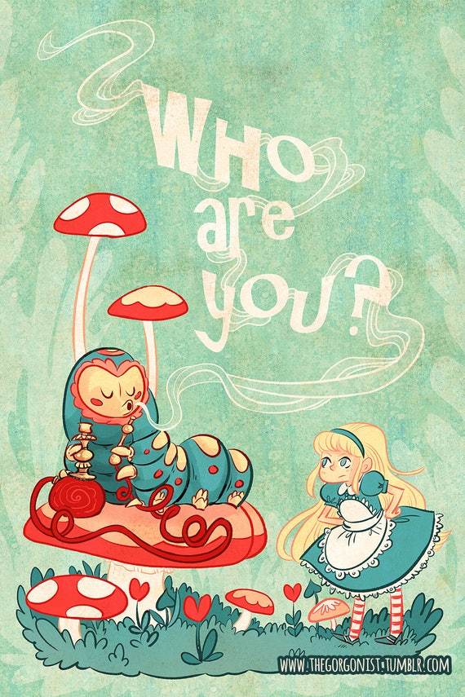
Let’s hear from you!
In the chat, let us know:
Who you are
Where you’re located in K-State
What your teaching context is

Slide 4
Session Overview
Diversity in Language Use
Assessments & Objectives
Motivation & Feedback
Pointless (point-less) Rubrics

Slide 5
A journey down the rabbit hole...

Slide 6
Some stats…
13.2% of Kansans speak a language other than English (2020 census)
There are more than 160 home languages represented in the state of Kansas (Taborda, 2020)
??? dialects spoken in Kansas
971 international students enrolled at K-State (Fall 2023) representing 91 different countries
??? K-State students speak a language other than English at home

Slide 7
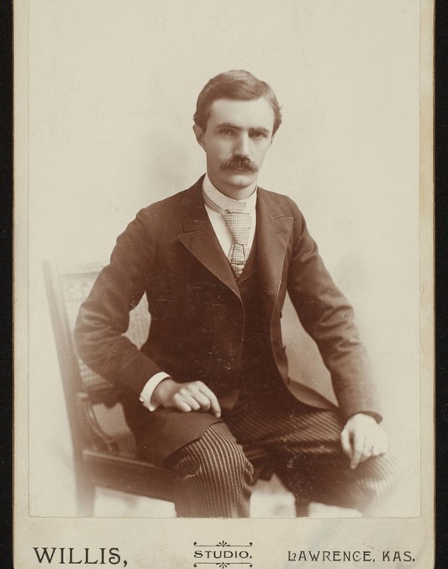
Kansas Language Use
“The remark that there is no such thing as a Kansas dialect rests upon a misapprehension of what is meant by the term. In just the same way that we speak of the flora and fauna of Kansas we may speak of the dialect of Kansas… Standard literary English is always a little behind the times. It is the stuffed and mounted specimen in the museum. Dialect is the live animal on its native heath.”
~William H. Carruth, “Foreign Settlements in Kansas”, Kansas University Quarterly, Vol. I, No. 2 (Oct. 1892)
Notes:
Heath = an area of open, uncultivated land
William H. Carruth, “Foreign Settlements in Kansas,” Kansas University Quarterly, Vol. I, No. 2 (Oct. 1892)

Slide 8
Liberal, Kansas
People in Liberal, Kansas are developing a distinct accent due to the intense contact between English and Spanish (Kohn, 2018)
Notes:
Why does this matter? Because over 30 years ago, linguist François Grosjean said that a bilingual is not two monolinguals in one
Source: microsoft365.com/launch/forms/groupforms?auth=2&groupId=24977507-5c57-4456-acfe-1e34f6d74c3b

Slide 9
1 bilingual ≠ 2 monolinguals
“Neurolinguists beware! The bilingual is not two monolinguals in one person!”
~François Grosjean, 1989!
Notes:
This can also be true of bidialectal speakers
There is a production/comprehension asymmetry meaning that speakers tend to be more conservative in the ways that they produce language – we may not notice these linguistic differences in their production; their interpretation of language may not be what we expect – not that they don’t understand, but that there are multiple interpretations or ambiguities that monolingual speakers may not have access to
There is an excerpt from Sonia Sotomayor’s memoir from her time as a student at Princeton that I think really speaks to this

Slide 10
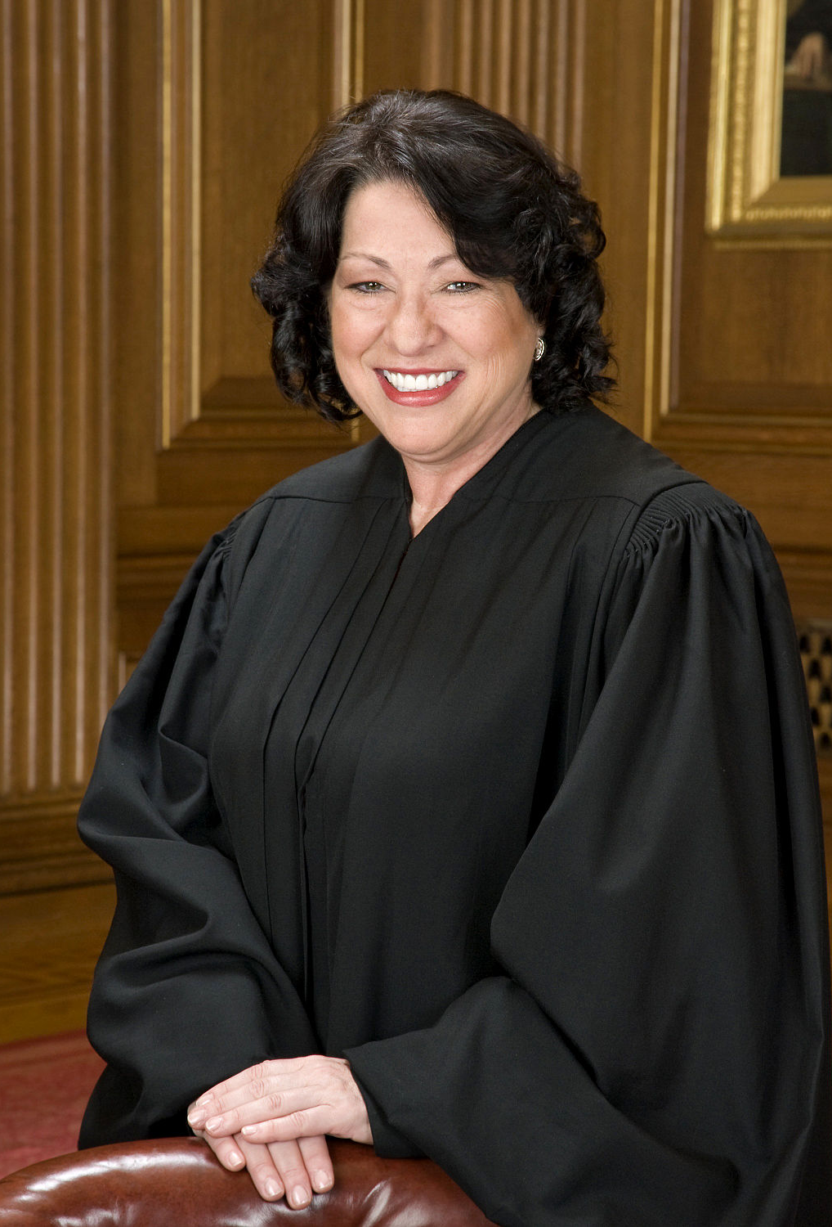
Professor Weiss had minced none of her words informing me that my English was weak: my sentences were often fragments; my tenses erratic, and my grammar just not gramatical. If I could have seen it myself, I would have fixed it, but what was wrong sounded right to me. It wasn’t until the following year, when I took Peter Winn’s contemporary Latin American history, that the roots of my problems were uncovered: my English was riddled with Spanish constructions and usage. I’d say “authority of dictatorship” instead of “disctatorial authority” or “tell it to him” instead of “tell him.”
I came to accept during my freshman year that many of the gaps in my knowledge and understanding were simply limits of class and cultural background, not lack of aptitude or application as I had feared. That acceptance, though, didn’t make me feel les self-conscious and unschooled in the company of classmates who’d had the benefit of much more worldly experience.
~Sonia Sotomayor, My Beloved World, pp. 134-5
Notes:
Sonia Sotomayor on her experience at Princeton University
The message that gets transmitted to bilingual speakers is that they speak both their languages poorly – not all bilinguals are fortunate enough to realize that the gaps in their knowledge (and language use) is the result of culture, not aptitude.

Slide 11
The cycle of linguistic prestige
The dialect taught in schools
The dialect of socially prestigious people
The language forms entered into dictionaries and grammar books

Slide 12
Notes:
Whether our students are bilingual, bidialectal, or monolingual, we want them to be able to use their voice; it is important that we embrace their full identities and that includes their linguistic identity

Slide 13
Embracing linguistic identities
“Use motivating feedback by making your feedback informational rather than controling; giving positive competence feedback, pointing out the value of accomplishment” (Dornyëi, 1994)
Notes:
So lets talk about how we can use assessments to support students’ identities and promote equity

Slide 14
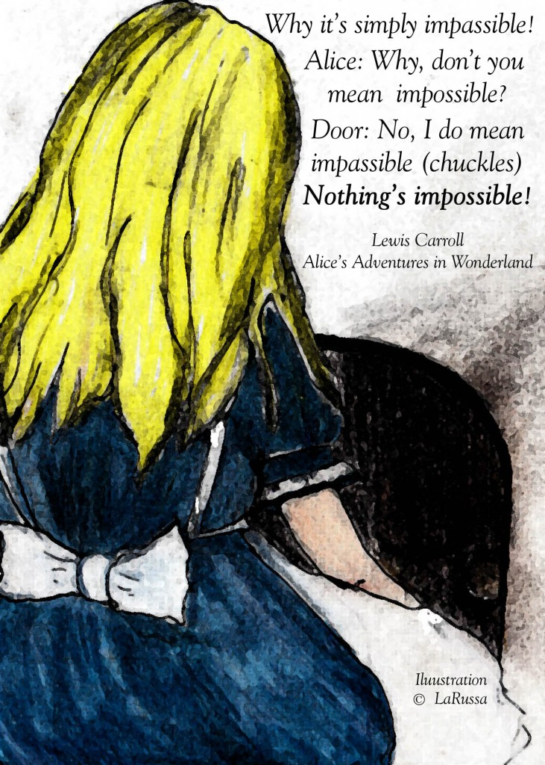
Suggestions
Provide information about industry or genre norms
Indicate when the message lacks clarity and offer suggestions to improve it
Instead of “correct” or “incorrect” consider describing appropriateness

Slide 15
Assessment

Slide 16
Types of Assessment
Diagnostic
When: Before instruction
Why: Identify learners’ current knowledge, attitudes & understanding
Interim
When: Midpoints
Why: Track student learning progress; measure teaching effectiveness
Formative
When: Throughout the course
Why: Monitor learning and provide feedback for growth
Summative
When: At the end of instructional period
Why: Provide evidence of student knowledge and abilities

Slide 17
The 5 Ws of Assessment
Who is the assessment for?
What information do we want to know?
Why do we want this evidence?
When is the assessment taking place?
How is learning being measured?

Slide 18
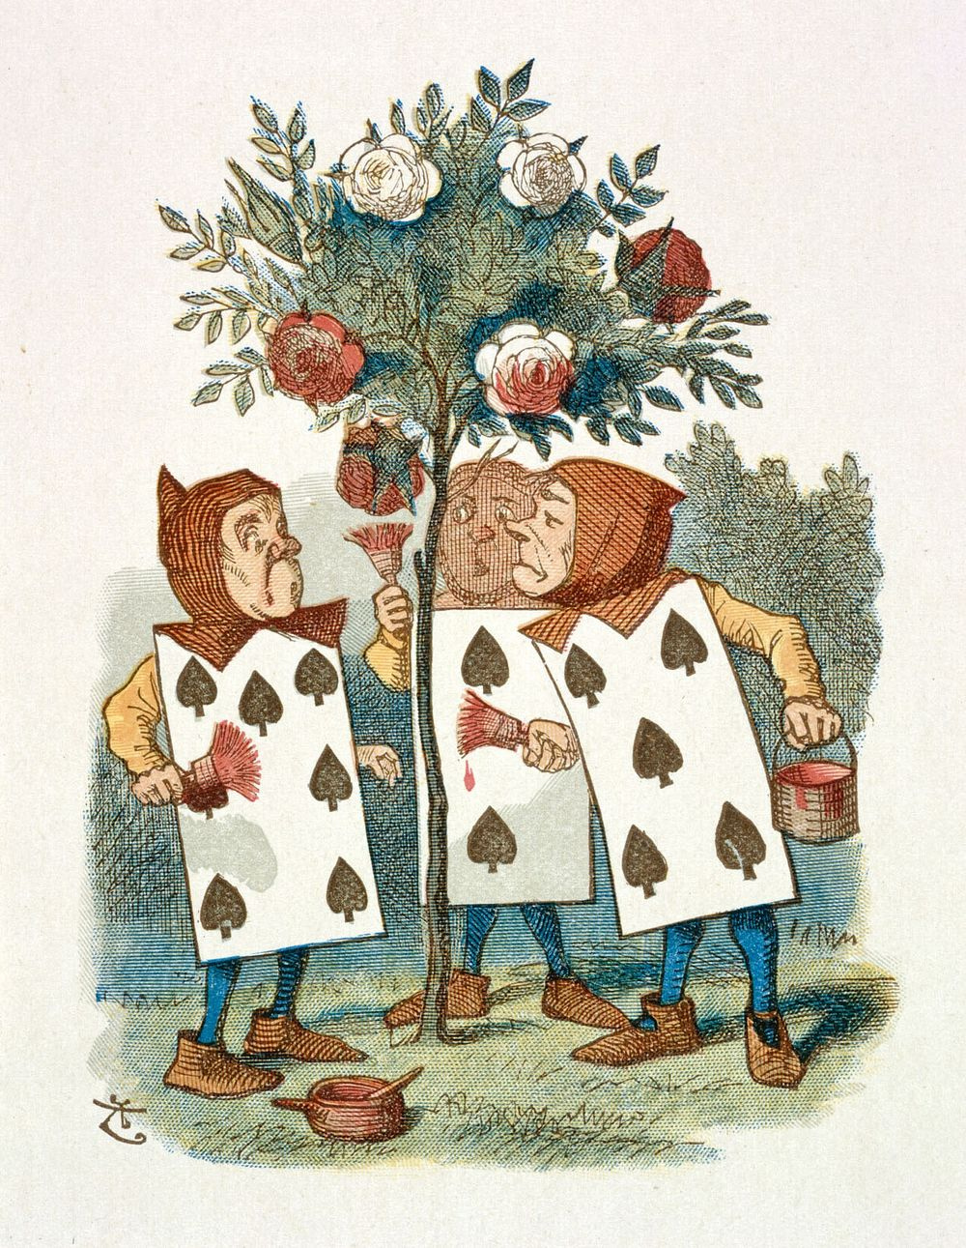
Why must the roses be red?
Notes:
Let’s imagine the Queen of Hearts as a professor… of Roses
- The queen tells her students tthat at the end of the semester, they must produce red roses
--- Is it cheating to paint the roses?
---- What learning is meant to be demonstrated?
----- What do students learn from this experience?

Slide 19
Ungrading for Equity

Slide 20
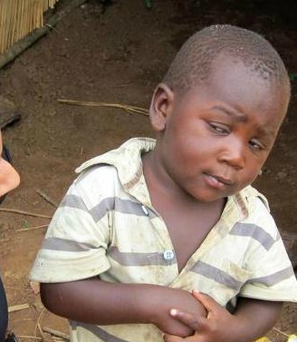
“Ungrading” means raising an eyebrow at grades as a systemic practice, distinct from simply “not grading.” The word is a present participle, an ongoing process, not a static set of practices.
(Stommel, 2021)

Slide 21
Ungrading pedagogy
Shifts focus away from metrics
Recenters attention on learning

Slide 22
Key tenets
Evaluation criteria must be transparent
Students must be actively involved in the evaluation process
Learning objectives must be clear and relevant
Notes:
It’s about more than just the assessments themselves, it’s about the learning design; then consider how to assess that learning

Slide 23
Ungrading Assessment Practices
Minimal Grading
Self-assessment
Student-generated rubrics
Authentic Assessment
Portfolios
Contract Grading
Notes:
Minimal grading
- minimal grading scales (no more tan 4 tiers)
- simplified rubrics (e.g., single-point or pointless rubrics)
Student-generated rubrics
Self-assessment
- goal setting
- reflections
- process letters
- peer assessment
Contract grading
Portfolios
Authentic Assessments

Slide 24
Minimal grading
Use a simplified grading scale to make grading “simpler, fairer, clearer” (Elbow, 1997).
Too many gradations can result in a challenging task for teachers and often fail to transmit clear information to students.
Potential Scales:
3-tier (e.g., strong/satisfactory/weak)
2-tier (e.g., Pass/Fail; complete/incomplete)
“Zero scale” (i.e., not collected)
Grade-free Zones (e.g., first ¼ of the term)
Notes:
Avoid 5-tier scales as (1) at this level, we lose the advantage of making “simpler, fairer, and clearer” and (2) because a 5-tier scale maps onto the A-F scale, thus losing the

Slide 25
Visual Markers
Options | Meaning
✔️ | Meets standards. Student work meets assignment expectations. (100%)
🟠 | Approaching standards. Most assignment expectations are met. (70%)
❌ | Below standards. Few assignment expectations are met. (40%)
Notes:
There is a lot of baggage that comes with percentages, points, and the A-F grading scale – this distracts from the learning, so visual markers

Slide 26
Pointless Rubrics
Holistic Evaluation | Meets Standards The assignment demonstrates evidence of A, B, and C | Approaching Standards The assignment demonstrates two of the evaluation criteria | Below Standards The assignment does not demonstrate two or more criteria
Criteria A | Outstanding | Acceptable | Insufficient
Criteria B | Outstanding | Acceptable | Insufficient
Criteria C | Outstanding | Acceptable | Insufficient

Slide 27
Formative Assessments
In the chat, respond to these questions:
In what ways do your students monitor their learning and get feedback for growth?
Does your course use online learning platforms (e.g., MindTap, MyLab, OERs)?
Do your students ever evaluate their own work?

Slide 28
Autograded Assignments
Notes:
Gradebook from an online learning platform; instead of giving students the exact points from the autograded assignments, I decide that an average over 70% is on-track and “meeting expectations” and students get full credit. An average between 40 and 70% is “approaching expectations” and below 40% does not meet expectations

Slide 29
What message do I want my evaluation system to send to students?
Their effort is valued.
Mistakes are part of learning.
Risk-taking is not penalized.
Their opinion of their own work matters.
Connection of course content to their goals is important.

Slide 30
Curiouser and curiouser

Slide 31
Critical thinking
Autonomy
Equity

Slide 32
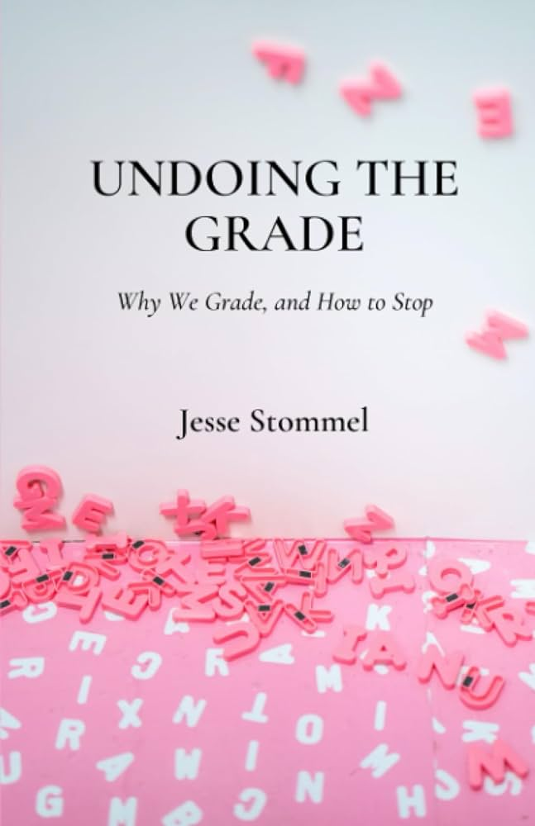
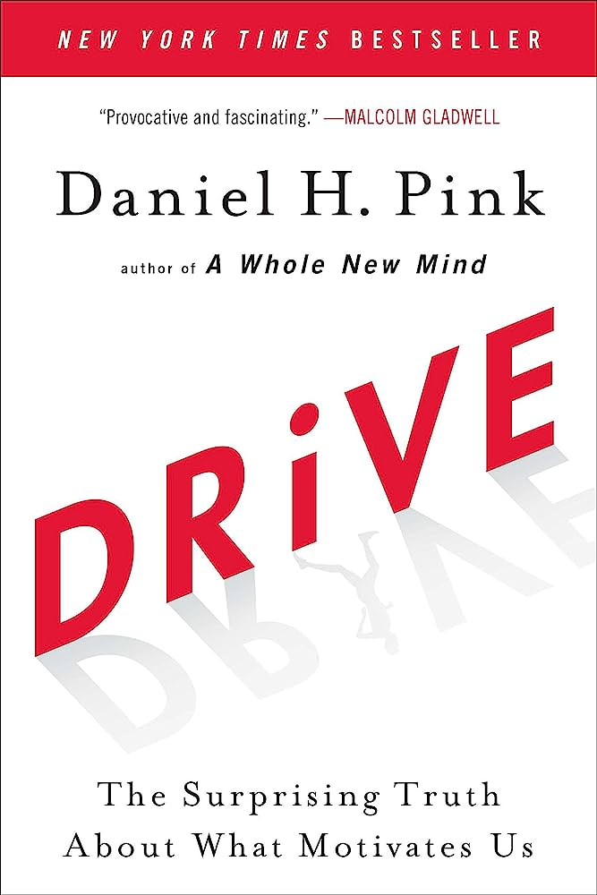
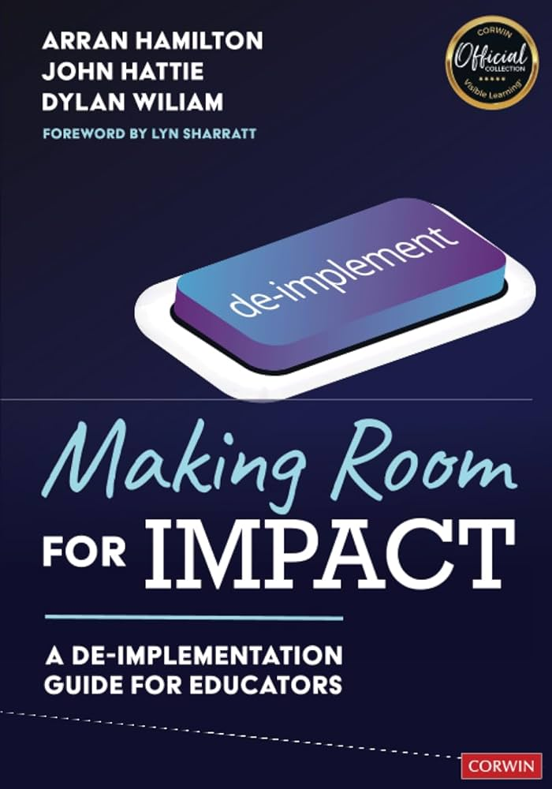
Suggested Reading

Slide 33
Questions & Discussion

