Slide 1
Tips & Tricks for Integrating DEIB Initiatives in Your Classroom
Trevor Bell

Slide 2
Before we begin, let’s chat…
What are you hoping to get out of this talk?
In your own opinion, why is this important to discuss?

Slide 3
Indigenous Land Grant Acknowledgement
As the first land-grant institution established under the 1862 Morrill Act, we acknowledge that the state of Kansas is historically home to many Native nations, including the Kaw, Osage, and Pawnee, among others. Furthermore, Kansas is the current home to four federally recognized Native nations: The Prairie Band Potawatomie, the Kickapoo Tribe of Kansas, the Iowa Tribe of Kansas and Nebraska, and Sac and Fox Nation of Missouri in Kansas and Nebraska.
Many Native nations utilized the western plains of Kansas as their hunting grounds, and others – such as the Delaware – were moved through this region during Indian removal efforts to make way for White settlers. It’s important to acknowledge this, since the land that serves as the foundation for this institution was, and still is, stolen land.
We remember these truths because K-State’s status as a land-grant institution is a story that exists within ongoing settler-colonialism, and rests on the dispossession of Indigenous peoples and nations from their lands. These truths are often invisible to many. The recognition that K-State’s history begins and continues through Indigenous contexts is essential.

Slide 4
What will we cover in today’s talk?

Slide 5
Outline for Today’s Chat
1) Rethinking your syllabus & assignments
2) Adjusting Classroom Assignments
3) Introducing Historical Controversies & Underrepresented Figures to Your Topics
4) Be the Advocate Your Students Need

Slide 6
Think back to a time you felt SEEN in a class you’ve taken

Slide 7
Rethinking Your Syllabus & Assignments
Add a multiculturalism statement to your learning objectives (if possible)

Slide 8
Student Learning Outcome Example

Slide 9
Rethinking Your Syllabus & Assignments
Add a multiculturalism statement to your learning objectives (if possible)
“In this course, you will discover how historically underrepresented and excluded groups were….”

Slide 10
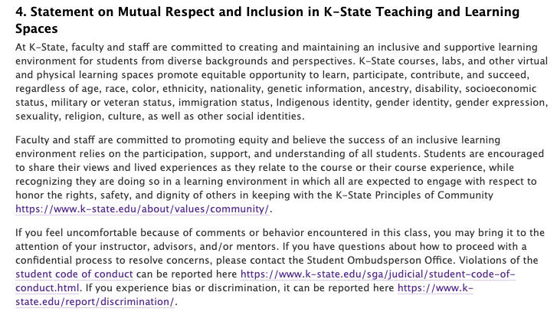
K-State Multiculturalism Syllabus Statement
https://www.k-state.edu/provost/resources/teaching/course.html

Slide 11
Rethinking Your Syllabus & Assignments
Add a multiculturalism statement to your learning objectives and syllabus
Avoid attendance policies or reliance on “no make up” rules
Yes the university has policies but it assumes…
Assumes people have equal access to doctors for notes
Assumes people SHOULD disclose all their medical and mental history

Slide 12
Rethinking Your Syllabus & Assignments
Diversity statements or prompts for relevant course proposals (graduate courses or research methods)
Rethink standardized testing
Allow your students a chance to connect the work to their own personal experience

Slide 13
Open-Ended Personal Question Assessment
Notes:
Averages went from 82.3% to 95.7% after I changed my assessments to a different type of assessment

Slide 14
Rethinking Your Syllabus & Assignments
Diversity statements or prompts for relevant course proposals (graduate courses or research methods)
Rethink standardized testing
Grade ANONYMOUSLY

Slide 15
Introducing Controversies & Figures

Slide 16
Introducing Controversies & Figures
ALL fields have contributed to societal problems
Our fields DO contribute to societal views and mainstream myths
So INTRODUCE these! Point these out! Call out the racist, sexist, ableist, homophobic views!

Slide 17
Student Reviews about Covering Historical Controversies

Slide 18
Introducing Controversies & Figures
ALL fields have contributed to societal problems
What we research can be used badly
We contribute to societal views and mainstream myths
Introduce hidden figures in your field! ALL fields have these

Slide 19
Notes:
Don’t be a company who changes their logo during pride month only to change it back later

Slide 21
Be the Advocate Your Students Need

Slide 22
Be the Advocate Your Students Need
We are ALL taught stereotypes about groups from the time we were born
It is up to us to undo what we were taught
Normalize your pronouns

Slide 23
Email Signature Example with Pronouns

Slide 24
Be the Advocate Your Students Need
We are ALL taught stereotypes about groups from the time we were born
Normalize your pronouns
Show that you care and see what is going on
Signs in your office
Recognizing other holidays in your classroom (out loud)
Provide your students with resources and events around campus (LGBT+ Resource Center, Diversity and Multicultural Student Affairs, Student Organizations)
Notes:
More than anything, BE OPEN ABOUT RESOURCES! Students don’t even know the resources they have
Lafene – can arrange HRT appointments and prescriptions
Speech Pathology – voice training for students on campus

Slide 25
Take Home Message

Slide 26
Take Home Message
DEIB is important to us as educators
It separates a tolerant environment vs. an accepting environment
You might think “I don’t have time to do this or reprep this course,” but that is an excuse

Slide 27
A Special Thanks to YOU!

