Slide 1
Using ChatGPT and other AI Tools

Slide 2
What is Artificial Intelligence?
"A machine's ability to perform the cognitive functions we associate with human minds, such as perceiving, reasoning, learning, interacting with an environment, problem solving, and even exercising creativity" (McKinsey & Company, 24 April 2023)

Slide 3
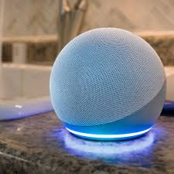
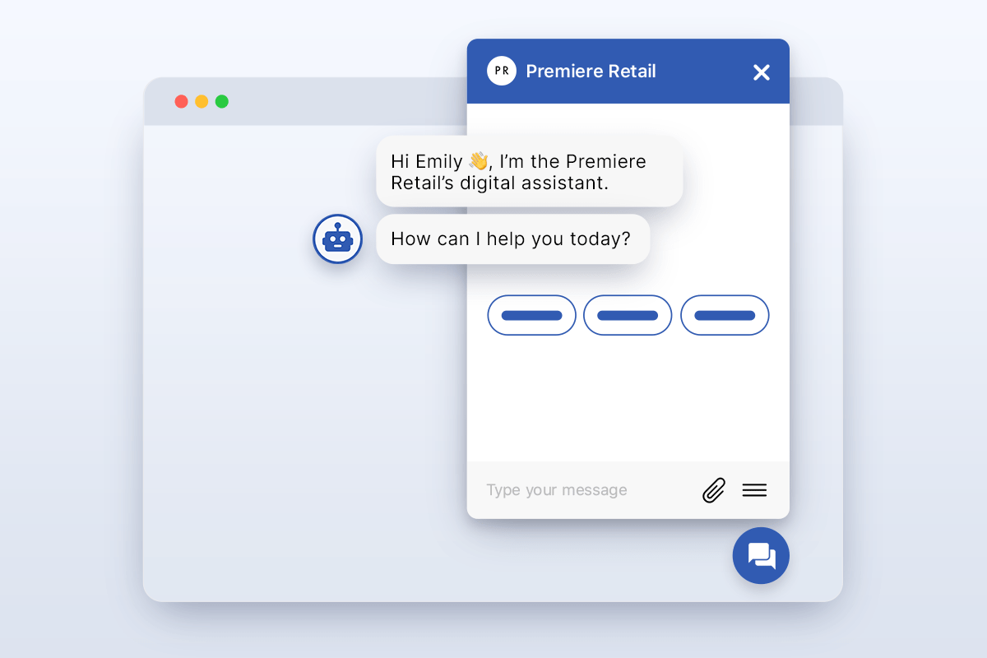
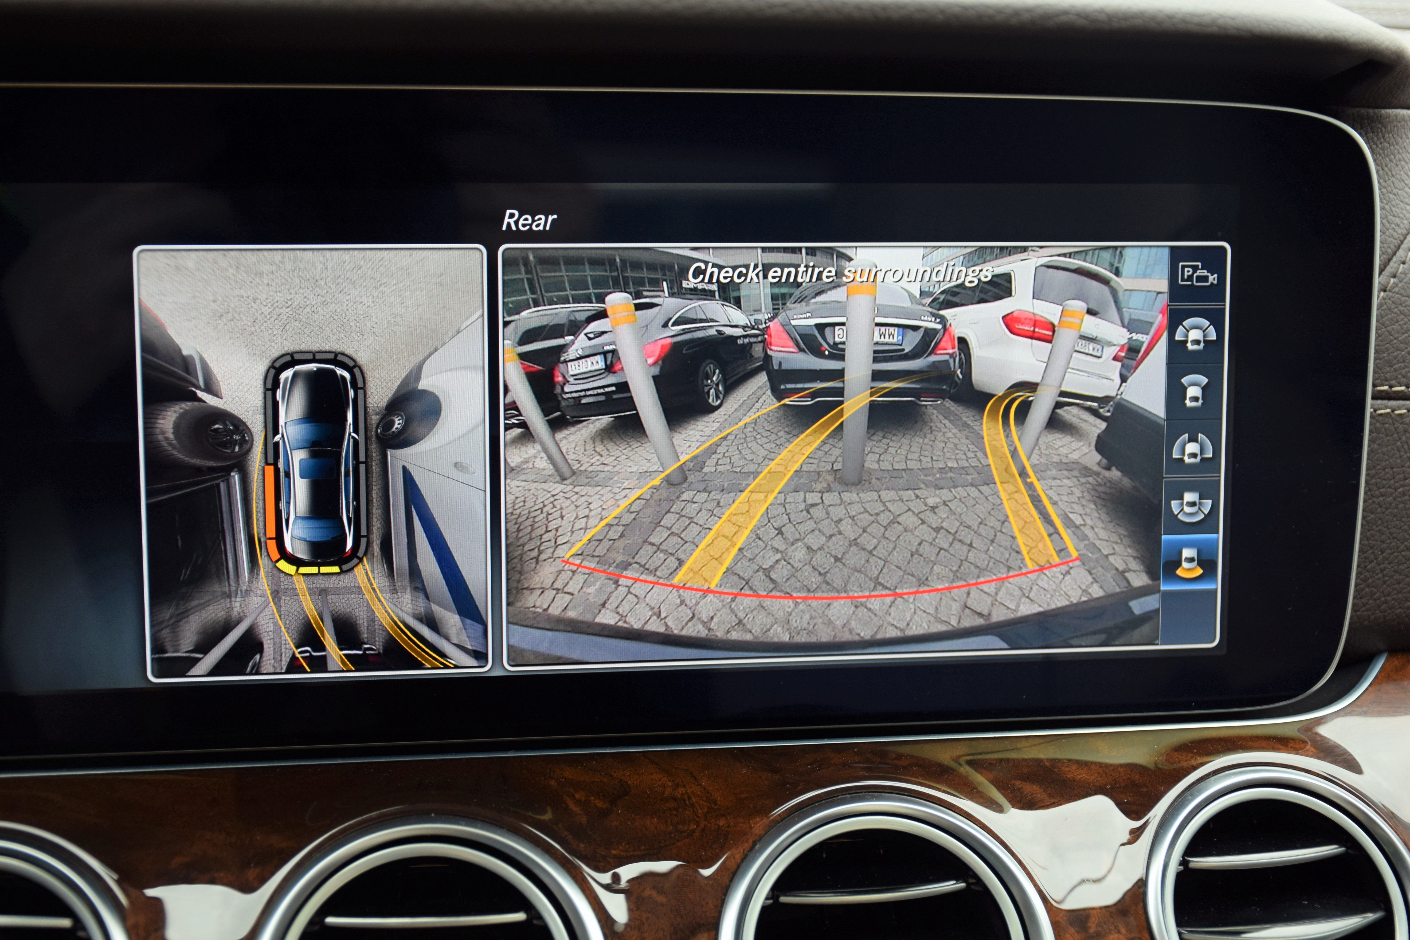
You Likely Already Use AI!

Slide 4
ChatGPT and Large Language Models
Large language models (LLM) are a specific kind of AI
Use machine learning by inputting text and documents to learn how people use language
Predicts what word goes next based on the patterns it finds in the text and documents it learned from
Just like your phone when you are texting!
How the AI learns is a black box – engineers are not completely sure what the AI is doing to learn and make predictions

Slide 5
Many Large Language Models Available
Text
ChatGPT (https://chat.openai.com/)
Microsoft Bing (https://www.bing.com/?/ai)
Google Bard (https://bard.google.com/)
Images
Microsoft Bing (https://www.bing.com/create)
Midjourney (https://www.midjourney.com/)

Slide 6
How to Use ChatGPT (or Bing, or Bard, or Other LLMs)
Go to the website
Many require an account
Once you have signed up, you are ready to go!

Slide 7
Prompt Engineering
"The art of crafting prompts that effectively instruct ChatGPT [or other AI tools] to generate the desired output" (DataCamp, May 2023)
Always assume when you begin a session that ChatGPT doesn't know anything
What exactly do you want ChatGPT to do?
What will that output look like?
Why do you need ChatGPT to do this task?
What roles does ChatGPT play in doing the task? (e.g., a student, a teacher)

Slide 8
More Effective Prompt Engineering (DataCamp, May 2023)
Clarity: define what you want model to do and kind of output you want (e.g., a summary, an analysis)
1
Context: provide clear context and instructions
2
Precision: specifically ask for what you want (e.g., a list, a paragraph)
3
Role-play: give ChatGPT a role to play
4

Slide 9
Be Careful!
Never believe output from AI without verifying it!
AI is known to hallucinate (i.e. make up facts and references)
Verify with knowledge you already know
Verify by using your textbook or other academic resources (e.g., the Library website)
Google information if you are unsure

Slide 10
How Do You Learn to Use ChatGPT?
You have to practice!
Let's try out a prompt in class:
We are learning about political behavior at work. You are not understanding the concept well and would like ChatGPT's help in:
Defining political behavior at work
Providing examples of what political behavior looks like at work
The consequences of political behavior in the workplace
How would you write this prompt?

Slide 11
Studying with ChatGPT
Let's see if we can get ChatGPT to create quiz questions to test our learning:
We learned about SQ3R last week.
How would you write a prompt to get ChatGPT to provide quiz questions for you to test your basic knowledge of SQ3R?

Slide 12
Writing a Cover Letter with ChatGPT
Let's pretend we are applying for an internship at Google
Search for "Google internships" for more information
Find an internship you might be interested in
Ask ChatGPT to write a cover letter for the internship

Slide 13
ChatGPT and Other LLM AI Have Limitations
Some, like ChatGPT, are not connected to the internet
ChatGPT's information is only current up to 2021
Use Microsoft Bing or Google Bard because they are connected to the internet and current
AI is not connected to Library resources such as articles and books
Another that is considered proprietary (i.e. owned by a company) and behind a paywall is inaccessible to AI
Always check output from AI
It can output garbage (e.g., made-up information, sentences that do not make sense, a writing tone that is not appropriate for professional writing)

Slide 14
What Can ChatGPT and AI Do for Us?
Save us time!
Improve our writing
Create an outline
Generating initial text
Correcting text we have already written
Learn difficult concepts
Study for quizzes and exams
Create flashcards or quizzes
Summarize a new topic
Create study plans and schedules

Slide 15
Cite Your Use of AI
When you use AI, you need to cite your use of AI in your paper or project.
Suggestions for citing AI: https://libguides.slcc.edu/ChatGPT/Citations
For your classes, be sure to look at the syllabus
Does your professor have an AI policy?
Does your professor want you to describe how you used AI in your paper or project?
Does the professor want details like specific prompts you used?
Do you need to describe how you checked and changed the AI output?

Slide 16
Other AI Resources
"One Useful Thing" blog by Ethan Mollick: https://www.oneusefulthing.org/
"What Is AI?" by McKinsey & Company: https://www.mckinsey.com/featured-insights/mckinsey-explainers/what-is-ai
"A Beginner's Guide to ChatGPT Prompt Engineering" by DataCamp: https://www.datacamp.com/tutorial/a-beginners-guide-to-chatgpt-prompt-engineering
"What Is Prompt Engineering?" by Educative: https://www.educative.io/blog/what-is-prompt-engineering

