Slide 1
Captioning Your Classroom Videos
Tom Hallaq Ed.D.
A.Q. Miller School of Media and Communication

Slide 2
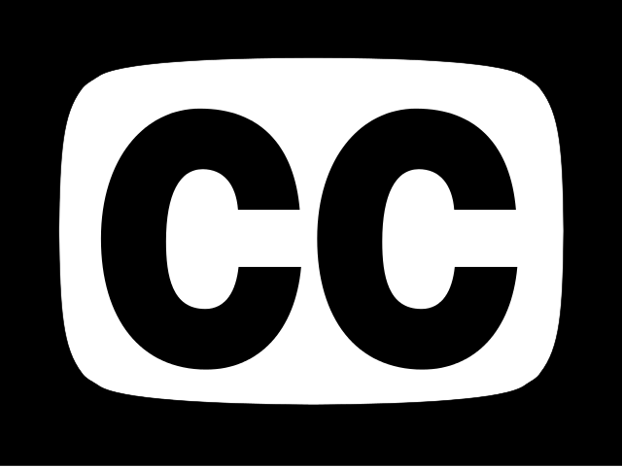
Legal Requirements for Captioning
Sections 504 and 508 of the 1973 Rehabilitation Act - content from government agencies and public education organizations required to be accessible.
The Americans with Disabilities Act (ADA) of 1990 requires public spaces to be accessible.
The 2010 21st Century Communication and Video Accessibility Act (CVAA), required broadcast stations caption online video that had been broadcast with captions.
In 2014, the FCC called for the captioning requirement to be extended from entire shows to individual video clips.
While the ADA originally focused on the physical world, it also required many public facilities to provide captions for videos they showed (Americans with Disabilities Act of 1990. 42 U.S.C. § 12101 et seq., 1990).
The ADA has been expanded and is now being applied to the virtual world as well as the physical world – supported by a recent court case (National Association of the Deaf, et al. v. Netflix, Inc., 896 F.Supp.2d 196 (D. Mass. 2012)., n.d.; United States Department of Justice, 2022).

Slide 3
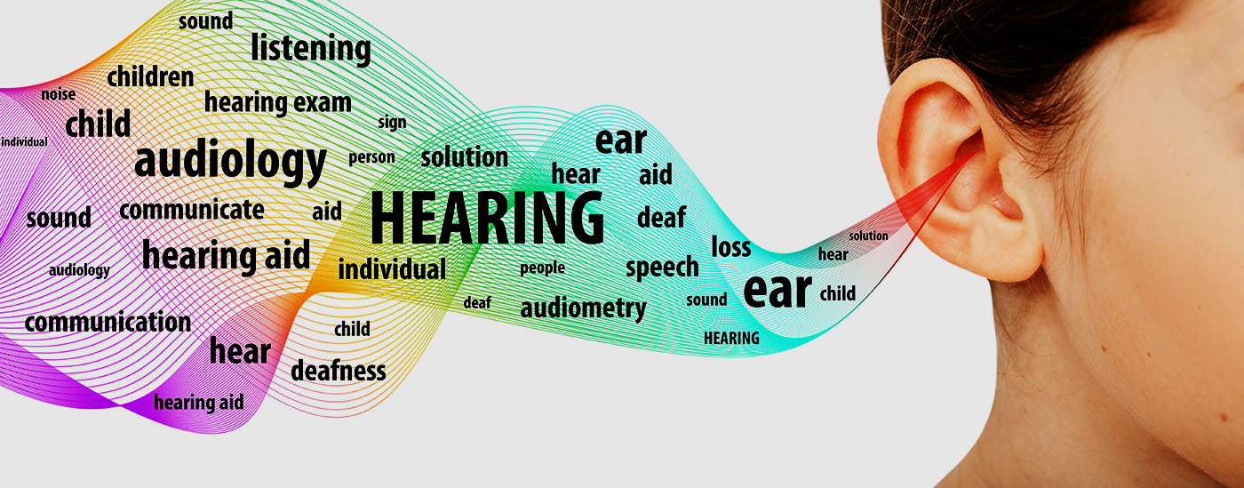
DHoH Statistics
The U.S. alone has over 8 million deaf or hard of hearing (DHoH) residents (Brault, 2012).
Although the majority of the videos are produced with sound (music, narration, etc.), they are designed so that the message remains clear even with the sound off (Patel, 2016).
From the perspective of higher education, videos produced require the ability of captions to accommodate students with disabilities.
Approximately 85 percent of social media users view videos with the sound muted, requiring the use of captions to understand many of the videos they encounter on their mobile devices.
Captioning social media content also promotes language acquisition and increased literacy (Tirumala and Youngblood, 2020).
Increasingly, social media creators create their own open captions, at times not even including speaking at all but relying solely on these open captions and visuals to communicate the message.

Slide 4
Captions in Higher Education
“Captions of classroom and video content enhance students' notetaking and are easy to repurpose into a searchable study guide to prepare for tests. The USFSP study also found that transcripts improved student test scores by 8%.” (Sorenson.com)
A 1994 report submitted to the Office of Special Education and Rehabilitative Services found that although disabled students retained more information through print media, regular academic students retained more information through the use of closed-captioned video rather than text.
The authors theorize that a combination of two learning modalities are most effective in the learning process but “that the addition of the third modality (i.e.,sound) may interfere with learning and retention” (Lee and Meyer 1994, pp. 10).

Slide 5
Accuracy of Captions
The FCC recommends evaluating captions in four areas,
- How well synchronized they are with the audio
- Whether or not they block important onscreen information
- Whether the captions run from the beginning to the end of a program
- How accurately they reflect the onscreen audio information (FCC, 2018)
To be accurate, captions must:
Match the spoken words, lyrics, and sounds to the fullest extent possible, without paraphrasing.
Must include correct spelling, grammar, punctuation, and capitalization.
Include captions for nonverbal sounds such as background music, audible reactions, background sounds, and sound effects.
Identify each speaker correctly if there is more than one speaker, so that viewers can understand who is speaking at any given time.
Be legible, with appropriate spacing between words to allow for readability.
Need to contain all words in the order spoken, without paraphrasing.
The industry standard = 99% accuracy.

Slide 6
Measuring Caption Accuracy
Word Error Rate (WER) and Number, Edition, and Recognition (NER).
NER is often used for evaluating the accuracy and effectiveness of broadcast captions, particularly live captions.
Error Scoring –
critical errors (false information)
major errors
minor errors
Paraphrasing (without changing the meaning)

Slide 7
Captioning Quality
YouTube auto-captions were notoriously problematic early on, earning them the moniker “craptions” (Green, 2021) and researchers have expressed concern that these accuracy problems can make the captions almost unusable, particularly in areas like education (Parton, 2016).
YouTube captions errors have been found to be frequent, in one study averaging around two errors per minute, with the majority of errors coming from the word substitution (Lee & Cha, 2020).
ASR tools, including YouTube’s, have also been found to have built in biases in terms of recognizing different American accents (Tatman & Kasten, 2017) including those of non-US nationalities (Hutiri & Ding, 2022).
Zdenek (2015) also addresses the concerns of auto-generated captions and offers a book-length in-depth discussion of how to write quality captions, including what information to caption.
Zdenek, S. (2015). Reading sounds: Closed-captioned media and popular media. University of Chicago Press.

Slide 8
Captioning Quality
The table below shows the various Flesch reading ease score ranges, their respective grade levels, and their interpretation.
Score | Grade | Interpretation
90-100 | Grade 5 and Below | Very easy to read
80-90 | Grade 6 | Easy to read
70-80 | Grade 7 | Fairly easy to read
60-70 | Grades 8 and 9 | Plain English
50-60 | Grades 10 to 12 | Fairly difficult to read
30-50 | Undergrad | Difficult to read
10-30 | Graduate | Very difficult to read
0-10 | Professional | Extremely difficult to read

Slide 9
Word Error Rate of TikTok’s auto-generated captions:
97% or higher for three of the four text samples at the 4th-grade reading level.
9th-grade reading level, only two had a word error rate below 5%.
Undergraduate reading level, three samples with a WER of 6% or higher.
Graduate-level reading samples, WER ranged from 3% to 3.6%.
Captioning Quality
Reading Level | 4th Grade | 9th Grade | Undergraduate | Graduate
Sample 1 | 1.90% | 16.90% | 2.30% | 3.00%
Sample 2 | 3.10% | 6.90% | 6.00% | 3.30%
Sample 3 | 1.50% | 4.30% | 7.10% | 3.50%
Sample 4 | 11% | 2.80% | 7.80% | 3.60%

Slide 10
Captioning Your YouTube Videos
1 00:00:00,599 --> 00:00:04,160 >> ALICE: Hi, my name is Alice Miller and this is John Brown 2 00:00:04,160 --> 00:00:06,770 >> JOHN: and we're the owners of Miller Bakery. 3 00:00:06,770 --> 00:00:10,880 >> ALICE: Today we'll be teaching you how to make our famous chocolate chip cookies! 4 00:00:10,880 --> 00:00:16,700 [intro music] 5 00:00:16,700 --> 00:00:21,480 Okay, so we have all the ingredients laid out here
YouTube uses speech recognition technology to automatically create captions for your videos.
YouTube encourages creators to add professional captions first. If automatic captions are available, they'll automatically be published on the video. Automatic captions may not be ready at the time that you upload a video. Processing time depends on the complexity of the video's audio.
If you’re new to creating caption files, you may want to use SubRip (.srt). It only requires basic timing info and can be edited using any plain text editing software.
Here’s how to format your text file for .srt captions:

Slide 11
SRT file structure
1 00:00:00,599 --> 00:00:04,160 >> ALICE: Hi, my name is Alice Miller and this is John Brown 2 00:00:04,160 --> 00:00:06,770 >> JOHN: and we're the owners of Miller Bakery. 3 00:00:06,770 --> 00:00:10,880 >> ALICE: Today we'll be teaching you how to make our famous chocolate chip cookies! 4 00:00:10,880 --> 00:00:16,700 [intro music] 5 00:00:16,700 --> 00:00:21,480 Okay, so we have all the ingredients laid out here
An SRT file contains subtitles in the following format:
A numeric counter identifying each sequential subtitle. Upon importing an SRT file, this counter is dismissed and then restored during the exporting.
A timecode specifying when the subtitle should appear on the screen, followed by an arrow -->, and the timecode saying when it should disappear. The timecode format used is hours:minutes:seconds,milliseconds with time units fixed to two zero-padded digits and fractions fixed to three zero-padded digits (00:00:00,000).
Subtitle text which can span one or multiple lines. The text is saved as a translation value on Lokalise.
A blank line containing no text, indicating the end of the current subtitle.

Slide 12
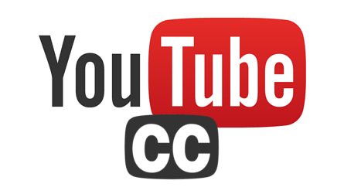
Captioning Your YouTube Videos
“YouTube is constantly improving its speech recognition technology. But automatic captions might misrepresent the spoken content due to mispronunciations, accents, dialects, or background noise. Always review automatic captions and edit any parts that haven't been properly transcribed” (from https://support.google.com/youtube/answer/6373554?hl=en#zippy=%2Cautomatic-captions-on-long-form-videos-and-shorts).
Here's how you can review automatic captions and make changes, if needed:
Sign into YouTube Studio.
From the left menu, select Subtitles.
Click the video you want to add captions or subtitles to.
Under “Subtitles”, click More next to the subtitles you want to edit.
Review automatic captions and edit or remove any parts that haven't been properly transcribed.

Slide 13
Some Core Guides for Successful Captioning
Auto captions only caption dialogue – not complete for closed captions.
Keep captions to two lines – 32-35 characters.
Indicate when a speaker changes (Chevrons or Speaker 1, Speaker 2, etc.)
Less formatting is better – users are able to adjust personal settings.
SRT captions are always dropped at bottom center – Captions should not cover essential content.
“If it’s a sound I’ve never heard before, that I’m not familiar with, it’s hard for me to understand. So, simply using ‘music’ with notes doesn’t tell me much.”

Slide 14
Helpful Resources
DCMP – best practices - https://dcmp.org/learn/5-captioning-guidelines-for-the-dcmp
AI Captioning software
Mac Whisper (free version + pro version for ~$15)
Whisper AI

Slide 15
References
Americans with Disabilities Act of 1990. 42 U.S.C. § 12101 et seq. (1990).
Brault, M. W. (2012). Americans with disabilities: 2010. United States Census Bureau. Retrieved from https://www2.census.gov/library/publications/2012/demo/p70-131.pdf
CRTC. Broadcasting Regulatory Policy CRTC 2019-308-1: English-language closed captioning mandatory quality standards relating to the accuracy rate for live television programming – Correction, Pub. L. No. Public record: 1011-NOC2019-0009 (2019). Retrieved from https://crtc.gc.ca/eng/archive/2019/2019-308-1.pdf
FCC. (2018). Closed captioning on television | Federal Communications Commission. Retrieved December 28, 2019, from https://www.fcc.gov/consumers/guides/closed-captioning-television
Hutiri, W. T., & Ding, A. Y. (2022, June). Bias in automated speaker recognition. In Proceedings of the 2022 ACM Conference on Fairness, Accountability, and Transparency(pp. 230-247).
Lee, Y. B. B., & Meyer, M. J. (1994). Closed-Captioned Educational Video: Implications for Post-Secondary Students.
National Association of the Deaf, et al. v. Netflix, Inc., 896 F.Supp.2d 196 (D. Mass. 2012).
Ofcom. (2006). Television access services. Retrieved from https://www.ofcom.org.uk/__data/assets/pdf_file/0016/42442/access.pdf
Parton, B. S. (2016). Video captions for online courses: Do YouTube’s auto-generated captions meet deaf students’ needs? Journal of Open Flexible and Distance Learning, 20(1), 8–18. Retrieved from http://www.jofdl.nz/index.php/JOFDL/article/view/255
Patel, S. (2016). 85 percent of Facebook video is watched without sound. Digiday. Retrieved November 16, 2018, from
https://digiday.com/media/silent-world- facebook-video/
Section 504 of the Rehabilitation Act of 1973. 29 U.S.C. § 701, sec. 794 (1973).
Section 508 of the Rehabilitation Act of 1973, 29 U.S.C. § 794d (1998).
Tatman, R., & Kasten, C. (2017, August). Effects of Talker Dialect, Gender & Race on Accuracy of Bing Speech and YouTube Automatic Captions. In Interspeech (pp. 934- 938).
Youngblood, N. E., & Tirumala, L. N. (2022). Local television news station compliance with online captioning rules. Universal Access in the Information Society, 21(1), 239-247 United States Department of Justice. (2022). Guidance on Web Accessibility and the ADA | ADA.gov. Retrieved March 22, 2023, from https://www.ada.gov/resources/web- guidance/
Zdenek, S. (2015). Reading sounds: Closed-captioned media and popular culture. University of Chicago Press.

