Slide 1
Bringing Integrity Back to Basics
Camilla J. Roberts
Director, Honor & Integrity System, Kansas State University

Slide 2
AGENDA
Introduction
Fundamental Values of Academic Integrity
Student Decision Making and Development
  Why Students Cheat
  Student Development
  Why Students Don’t Cheat and Community Building
Assessing Students
What you can do with this knowledge

Slide 3
Fundamental Values of Academic Integrity
Honesty
Trust
Fairness
Respect
Responsibility
Courage

Slide 4
Honesty
Be truthful
Give credit to the owner of the work (i.e., musician, author, artist, speaker etc.)
Keep promises
Provide factual evidence
Aspire to objectivity, consider all sides and one's own potential preconceptions

Slide 5
Trust
Clearly state expectations and follow through
Promote transparency in values, processes, and outcomes
Trust others
Give credence
Encourage mutual understanding
Act with genuineness

Slide 6
Fairness
Apply rules and policies consistently
Engage with others equitably
Keep an open-mind
Be objective
Take responsibility for your own actions

Slide 7
Respect
Practice active listening
Receive feedback willingly
Accept that others’ thoughts and ideas have validity
Show empathy
Seek open communication
Affirm others and accept differences
Recognize the consequences of our word and actions on others

Slide 8
Responsibility
Hold yourself accountable for your actions
Engage with others in difficult conversations, even when silence might be easier
Know and follow institutional rules and conduct codes
Create, understand, and respect personal boundaries
Follow through with tasks and expectations
Model good behavior

Slide 9
Courage
Be brave even when others might not
Take a stand to address a wrongdoing and support others doing the same
Endure discomfort for something you believe in
Be undaunted in defending integrity
Be willing to take risk and risk failure

Slide 10
Why Students Cheat
Opportunities to do so
Under pressure or stress
No connection to the course
Fairness (“Others do it.”)
Class Reinforces Extrinsic, not Intrinsic Goals
Not Sure what Constitutes Cheating or Do Not Think They Would Be Caught

Slide 11
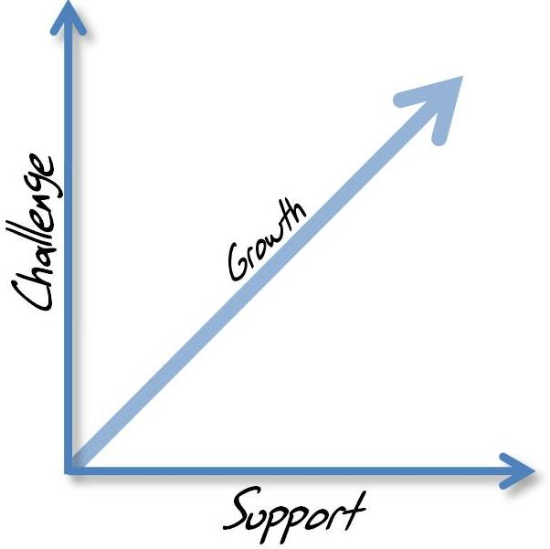
Astin’s Theory of Challenge and Support
Astin, A. W. (1984). Student involvement: A developmental theory for higher education. Journal
of College Student Personnel, 25(4), 297–308.

Slide 12
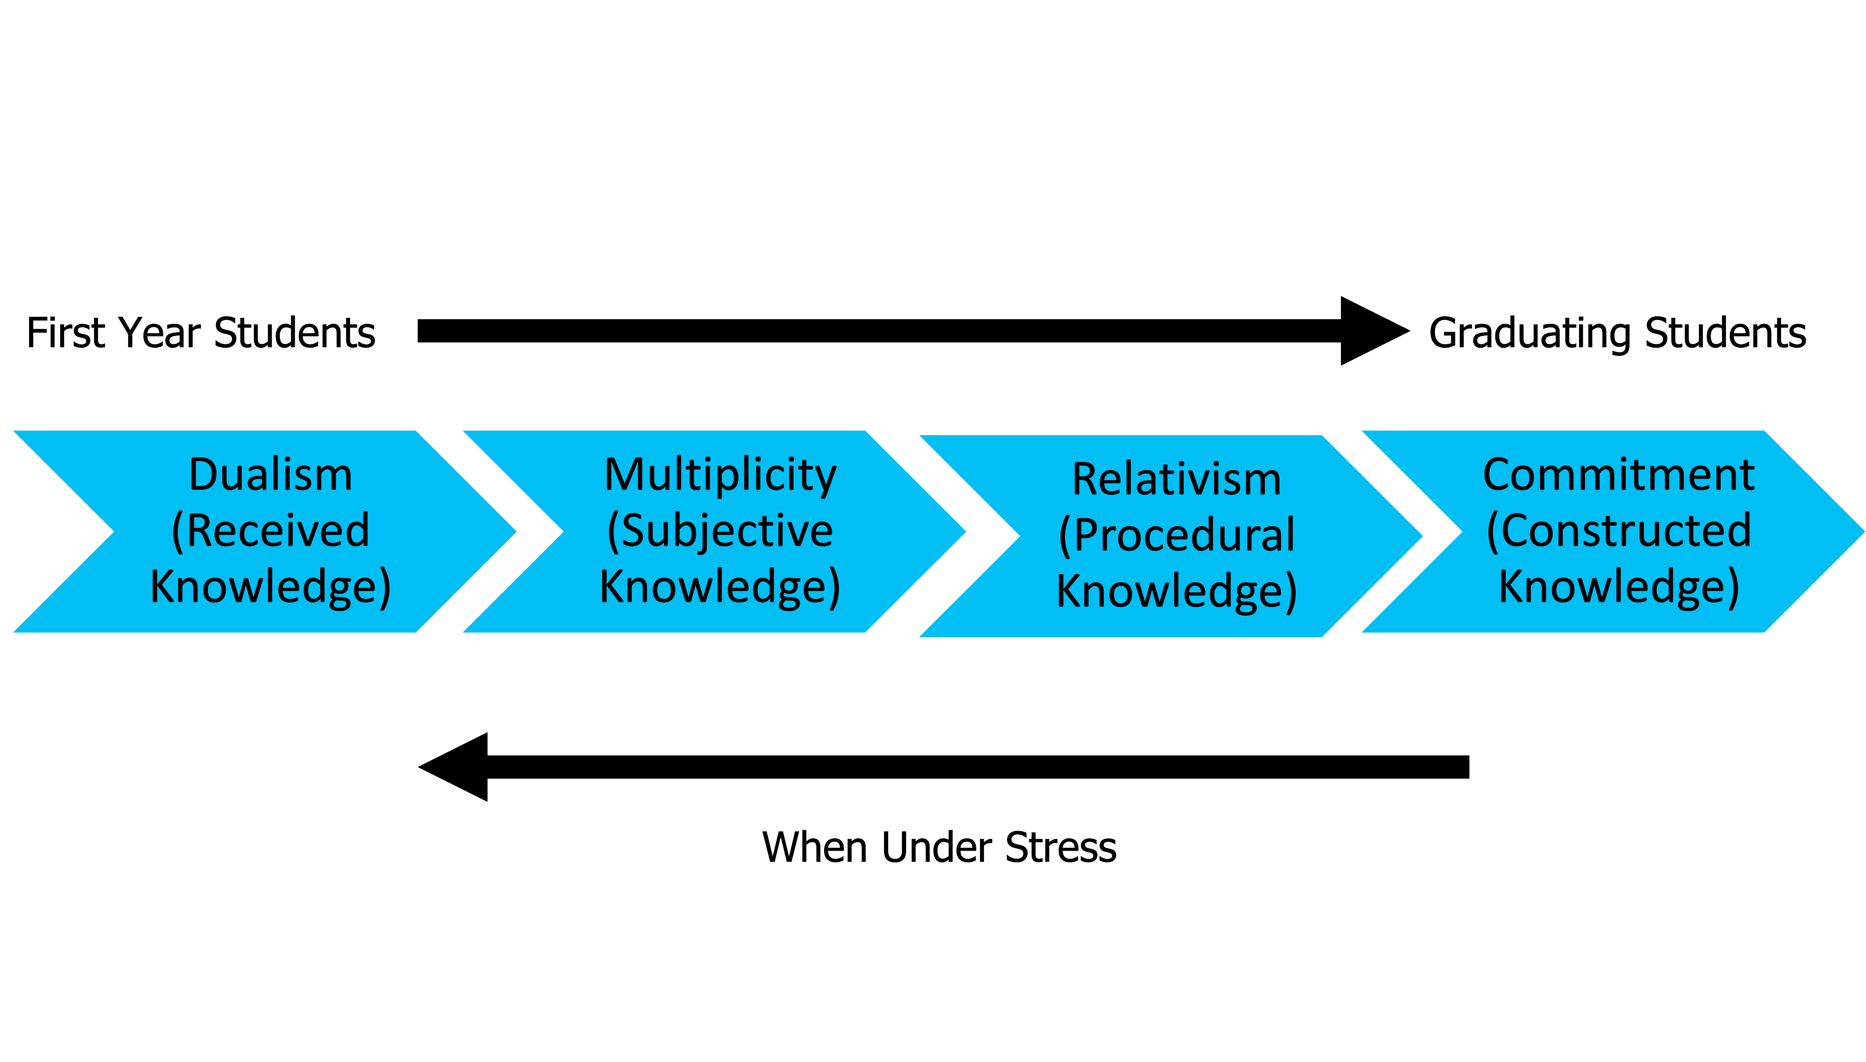
Perry’s Theory of Intellectual and Ethical Development
Perry, W. G. (1970). Forms of intellectual and ethical development in the college years: A scheme. Holt, Rinehart, and Winston.

Slide 13
Student Development
Chickering and Reisser’s Seven Vectors of Student Development (1993)
Developing Competence
Managing Emotions
Moving Through Autonomy to Interdependence
Developing Mature Interpersonal Relationships
Establishing Identity
Developing Purpose
Developing Integrity
Chickering A. W. & Reisser, L. (1993). Education and identity. San Francisco: Jossey-Bass.

Slide 14
Why Student’s Don’t Cheat and Building Community
The norm on campus is to not cheat.
There are consequences to being academically dishonest and there is a high probability of being caught.
Students are committed to learning.
Notes:
(Kohlberg and Hersh (1977) Moral Development theory Conventional Level shows students follow the expectations of a social situation.

Slide 15
How does knowing this help us?
Understanding the needs of students
Challenge and support student
Building the community of integrity
  Classroom expectations
  Institutional expectations

Slide 16
Assessing Students
Important to remember type of assessment related to student development.
Understanding group projects / collaboration
Need for all assessments (more low stake assessments)
Communication is important
Various Types of Assessments are important

Slide 17
What You Can Do…
Assessment Styles for first year students versus graduate students (FAIRNESS)
  Remember dualistic vs. multiplicity
Assessments in teams versus individual (HONESTY, RESPECT)
  How can they work together?
  Assessment from the teams as part of the “grade”
Rules, Policies, and Regulations in the Classroom (RESEPCT, HONESTY)
  Building community
Reiteration of everything (RESPECT, RESPONSIBILITY)
  Not hand holding, but working with students

Slide 18
What You Can Do…
Understanding authentic learning – what do you really need to assess? (RESPONSIBILTY)
  Lower Stakes Assessments possibly
Give them a voice (RESPECT, TRUST, COURAGE)
  Build the community
Find the source of motivation (RESPECT, TRUST, COURAGE)
  Allow them to decide topics (within reason)
  Talk about why your class and integrity is important

Slide 19
What You Can Do…
Adapt teaching / assessments to a variety of learning styles (FAIRNESS)
  Writing, presentations, projects, etc.
Let them see examples of good, mediocre, and poor work (HONESTY)
  Provide a rubric for quality rather than just for a grade
Holding them accountable (COURAGE, RESPONSIBILITY)
  Students who know you will hold them accountable are less likely to try to do something inappropriate.
  I can help, but students need to be held accountable and have due process

Slide 20
My Conclusions
Academic misconduct CANNOT be eliminated
  It CAN be minimized, lessoned, or reduced
  New challenges will continue to evolve
Education and awareness are key
It takes time to be vigilant and engaged
  Focus on prevention of misconduct
It can be frustrating (especially at the end of the term)
Have the Courage to do what is Right – and do it with compassion
  Address the issue with the student
  Document the issue with an Integrity Violation
  Follow-up with takedown notices

Slide 21
Questions?

