Slide 1
Welcome to the TLC Professional Development Series!
#ITeachAtKState
Every Wednesday from 12 noon to 1PM
Zoom link: https://ksu.zoom.us/s/93060130828
All events recorded and archived on Canvas
TLC Professional Development Certificates and Fellows
TLC Professional Development Series

Slide 2
Achieving (and Demonstrating) Excellence in Teaching
@don_saucier
#ITeachAtKState
Don Saucier
University Distinguished Teaching Scholar
Professor of Psychological Sciences
Faculty Associate Director of the Teaching & Learning Center
TLC Professional Development Series

Slide 3
My First Objective
@don_saucier
#ITeachAtKState
How to Achieve Excellence* in Teaching
How to develop your own excellent and unique teaching philosophy
Using my teaching philosophy as a model and foundation
*Strive for “excellence” (NOT “effectiveness”)

Slide 4
My Second Objective
@don_saucier
#ITeachAtKState
How to Demonstrate Excellence in Teaching
For teaching statements as part of job applications
For annual reviews and merit evaluations
For tenure and promotion materials
For teaching award applications

Slide 5
Disclaimers
@don_saucier
#ITeachAtKState
I will share my perspectives and experiences
I have many privileges
I am a straight, White, cisgender, middle-aged man, etc.
I may have succeeded despite (not because of) what I did
Disregard recommendations that do not work for you
Seek others’ perspectives to complement my talk

Slide 6
What Do You Hope to Take Away?
@don_saucier
#ITeachAtKState
What is one thing you want to learn in this session today?
Please type that take-away into the chat

Slide 7
Teaching Starts with Teachers
saucier@ksu.edu
#ITeachAtKState
Our teaching personas and philosophies…
… provide the foundations for teaching and learning
… dictate our teaching practices
… are intentional, purposeful, and dynamic

Slide 8
Achieving Teaching Excellence
@don_saucier
#ITeachAtKState
How to develop your own excellent and unique teaching persona and philosophy

Slide 9
Achieving Teaching Excellence
@don_saucier
#ITeachAtKState
Teaching Persona
How you decide to present yourself to your students
Teaching Philosophy
How you personally conceptualize the process of teaching and learning

Slide 10
What single word…
@don_saucier
#ITeachAtKState
… would you want your students to use to describe you “in class”?
Please type that word in the chat – but wait for the “waterfall”!

Slide 11
My Early Goal for My Teaching Persona
@don_saucier
#ITeachAtKState

Slide 12
Guiding Questions to Your Teaching Persona
@don_saucier
#ITeachAtKState
Who do you want to be “in class”?
Which characteristics will you highlight?
How will you behave to demonstrate these?
How will you behave to inspire that single word?

Slide 13
Starting Points for Your Teaching Philosophy
@don_saucier
#ITeachAtKState
Be the teacher you want to learn with
Promote student learning and success
Teach people (not just content)

Slide 14
Starting Points for Your Teaching Philosophy
@don_saucier
#ITeachAtKState
Teach whole people
Teach inclusively
Your practices must then be consistent with these goals

Slide 15
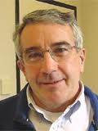
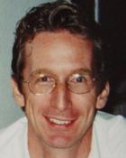
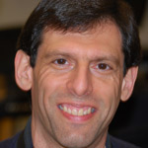
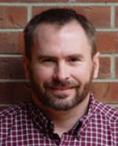
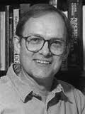
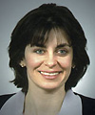
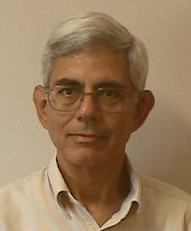
When I Engaged and Learned Best as a Student
@don_saucier
#ITeachAtKState
Notes:
Like it! Good transition to your ideas

Slide 16
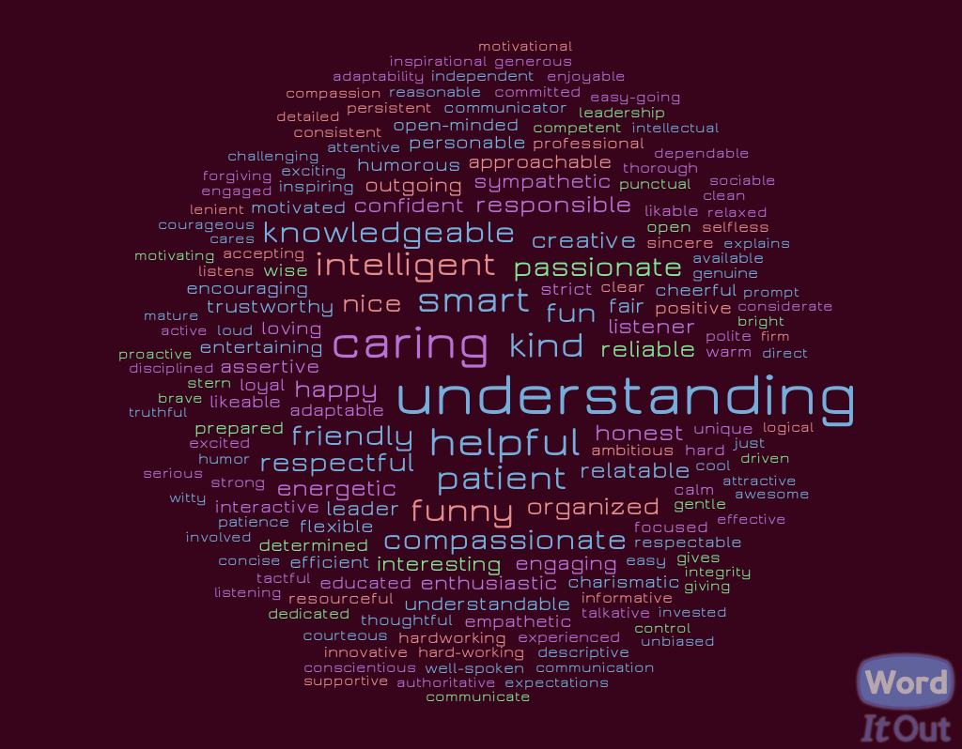
What do students want in their teachers?
@don_saucier
#ITeachAtKState
N = 355 General Psychology students
Notes:
Nice!

Slide 17
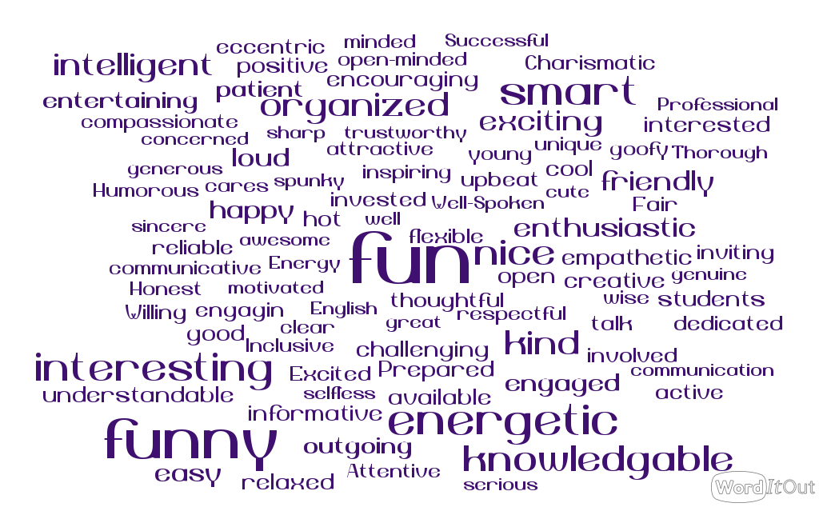
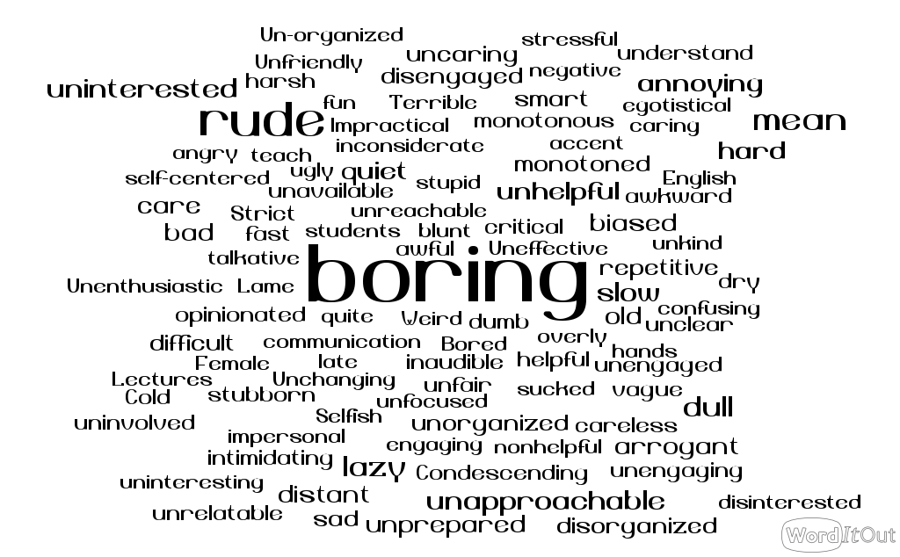
How Students Describe Their Favorite/Least Favorite College Teacher
@don_saucier
#ITeachAtKState
N = 215 K-State undergraduate students
Notes:
Engaging was referenced 90 times

Slide 18
A Starting Point
@don_saucier
#ITeachAtKState
My Teaching Philosophy
Trickle Down Engagement
Bring PEACE to the Classroom
Choice to Learn
Empathetic Course Design Perspective

Slide 19
My Teaching Philosophy
saucier@ksu.edu
#ITeachAtKState
Trickle Down Engagement
Engage the Sage
We should focus on our own experience first

Slide 20
The Trickle Down Engagement Model
@don_saucier
#ITeachAtKState
Teacher Engagement
Student Engagement
Student Learning
Notes:
Makes sense and is clear,

Slide 21
My Teaching Philosophy
@don_saucier
#ITeachAtKState
Bring PEACE to the Classroom
P = Preparation
E = Expertise
A = Authenticity
C = Caring
E = Engagement

Slide 22
My Teaching Philosophy
@don_saucier
#ITeachAtKState
Choice to Learn
Focused on fostering intrinsic motivation
Offer “opportunities” (not “requirements”)
Emphasize “earning” (not “losing”) points

Slide 23
My Teaching Philosophy
@don_saucier
#ITeachAtKState
Empathetic Course Design Perspective
I infuse empathy into all aspects of my courses:
Syllabus statements
Course scheduling, structure, and policies
Use of Zoom
Assignments and assessments

Slide 24
Ten Ways to Demonstrate Your Teaching Excellence
@don_saucier
#ITeachAtKState

Slide 25
Create an Excellent Statement of Your Teaching Philosophy
@don_saucier
#ITeachAtKState

Slide 26
Get (and Document Your) Teaching Experience
@don_saucier
#ITeachAtKState

Slide 27
Provide Your Teaching Evaluations
@don_saucier
#ITeachAtKState
Student perception data, peer observations, etc.

Slide 28
Share Your Teaching Practices
@don_saucier
#ITeachAtKState

Slide 29
Show What Your Students Have Learned with You
@don_saucier
#ITeachAtKState

Slide 30
Document Your Efforts to Improve Your Teaching
@don_saucier
#ITeachAtKState

Slide 31
Document Your Efforts to Improve Others’ Teaching
@don_saucier
#ITeachAtKState

Slide 32
Document Your Efforts in SoTL
@don_saucier
#ITeachAtKState
SoTL = Scholarship of teaching and learning

Slide 33
Document Your Efforts in Research Mentoring and Academic Advising
@don_saucier
#ITeachAtKState

Slide 34
Show What It Is Like to Learn with You
@don_saucier
#ITeachAtKState

Slide 35
The Truth About Getting the Thing
@don_saucier
#ITeachAtKState
You have to apply to get the thing
The people who get the things are the ones who do the best job (among the applicants) of demonstrating their excellence

Slide 36
Recommendations to Get the Thing
@don_saucier
#ITeachAtKState
Believe in Your Excellence
Take ownership of your practices
Believe you deserve the thing
Initiate the process of getting the thing

Slide 37
Recommendations to Get the Thing
@don_saucier
#ITeachAtKState
Be Generally and Uniquely Excellent
Do all the things excellent teachers do
Do things that other excellent teachers do not
And consider naming those things
Be motivated to impress the committee

Slide 38
Recommendations to Get the Thing
@don_saucier
#ITeachAtKState
Create Excellent Materials
Provide all materials in the specified format
Create moments for your evaluators
Consider using video resources
Get feedback on your materials
Use compiled letters of recommendation

Slide 39
Recommendations to Get the Thing
@don_saucier
#ITeachAtKState
Be Realistic and Persistent
Seek information and feedback about the thing
Understand you may deserve, but still not get the thing
It often takes more than one application
Seek post-rejection feedback (if possible)
Keep building the case for your teaching excellence

Slide 40
In Conclusion
saucier@ksu.edu
#ITeachAtKState
To get the things, you need to both:
Be excellent
Demonstrate that you are excellent
You got this!

Slide 41
Engage the Sage Video Resources
@don_saucier
#ITeachAtKState
Requesting a Letter of Recommendation
Writing Excellent Statements of Your Teaching Philosophy
Demonstrating Your Teaching Excellence: Part 1
Demonstrating Your Teaching Excellence: Part 2
The Four Cs of Writing

Slide 42
What Will You Take Away?
saucier@ksu.edu
#ITeachAtKState
What is one concrete take-away from our conversation today that you will use to achieve and/or demonstrate your teaching excellence?

Slide 43
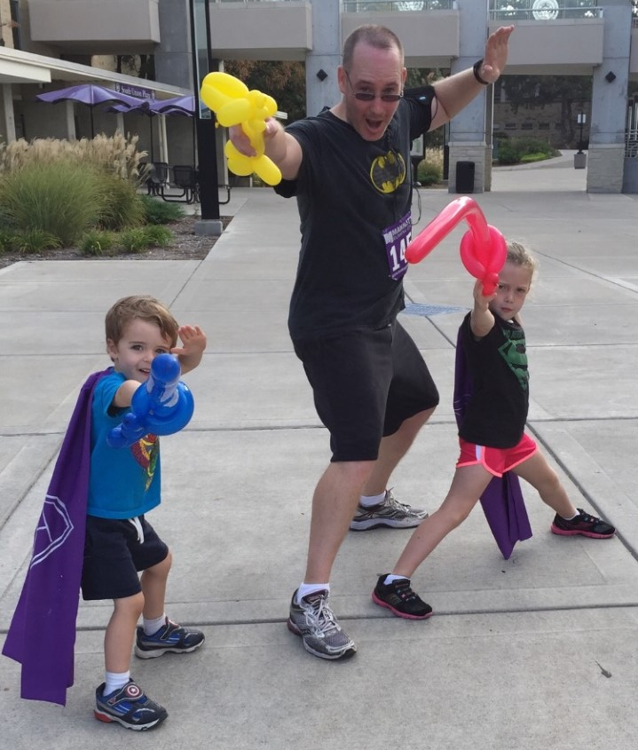
What Questions Do You Have?
@don_saucier
#ITeachAtKState
Further questions and/or a copy of this presentation:
Email Don Saucier at saucier@ksu.edu
Thank you!
Please submit a Post-Event Survey!

