Slide 1
Academic Integrity – The Bigger Picture
Camilla j Roberts
Director, Honor and Integrity System
Kansas state university
President, international center for Academic Integrity

Slide 2
Agenda
Overview of Academic Integrity
Fundamental Values of Academic Integrity
A Little Student Development Theory Connected to Academic Integrity
Contract Cheating and Concerning Websites
Making the Shift to Mold Students
Practical Examples

Slide 3
Academic Integrity: a commitment, even in the face of adversity, to six fundamental values: honesty, trust, fairness, respect, responsibility and courage.
From these values flow principles of behavior that enable academic communities to translate ideals into action.
Why it’s important:
Higher education and society benefit when colleges and universities have standards of integrity that provide the foundation for a vibrant academic life, promote scientific progress, and prepare students for responsible citizenship.
Source: https://www.academicintegrity.org/fundamental-values/

Slide 4
Honesty
Honesty forms the indispensable foundation of integrity and is prerequisite for full realization of trust, fairness, respect, and responsibility.
Ways to demonstrate honesty:
Be truthful
Give credit to the owner of the work (i.e., musician, author, artist, speaker etc.)
Keep promises
Provide factual evidence
Aspire to objectivity, consider all sides and one's own potential preconceptions

Slide 5
Trust
The ability to rely on the truth of someone or something is a fundamental pillar of academic pursuit and a necessary foundation of academic work.
Ways to demonstrate trust:
Clearly state expectations and follow through
Promote transparency in values, processes, and outcomes
Trust others
Give credence
Encourage mutual understanding
Act with genuineness

Slide 6
fairness
Impartial treatment is an essential factor in the establishment of ethical communities because it reinforces the importance of truth, ideas, logic, and rationality.
Ways to demonstrate fairness:
Apply rules and policies consistently
Engage with others equitably
Keep an open-mind
Be objective
Take responsibility for your own actions

Slide 7
Respect
Respect in academic communities is reciprocal and requires showing respect for oneself as well.
Ways to demonstrate respect:
Practice active listening
Receive feedback willingly
Accept that others’ thoughts and ideas have validity
Show empathy
Seek open communication
Affirm others and accept differences
Recognize the consequences of our word and actions on others

Slide 8
Responsibility
Upholding the values of integrity is simultaneously an individual duty and a shared concern.
Ways to demonstrate responsibility:
Hold yourself accountable for your actions
Engage with others in difficult conversations, even when silence might be easier
Know and follow institutional rules and conduct codes
Create, understand, and respect personal boundaries
Follow through with tasks and expectations
Model good behavior

Slide 9
Courage
Courage differs from the preceding fundamental values by being more a quality or capacity of character. However, as with each of the values, courage can be practiced and developed. Courage often is interpreted as a lack of fear. In reality, courage is the capacity to act in accordance with one’s values despite fear.
Ways to demonstrate courage:
Be brave even when others might not
Take a stand to address a wrongdoing and support others doing the same
Endure discomfort for something you believe in
Be undaunted in defending integrity
Be willing to take risk and risk failure

Slide 10
Development of student integrity
Chickering and Reisser’s Seven Vectors of Student Development (1993)
Developing Competence
Managing Emotions
Moving Through Autonomy to Interdependence
Developing Mature Interpersonal Relationships
Establishing Identity
Developing Purpose
Developing Integrity
Chickering A. W. & Reisser, L. (1993). Education and identity. San Francisco: Jossey-Bass.

Slide 11
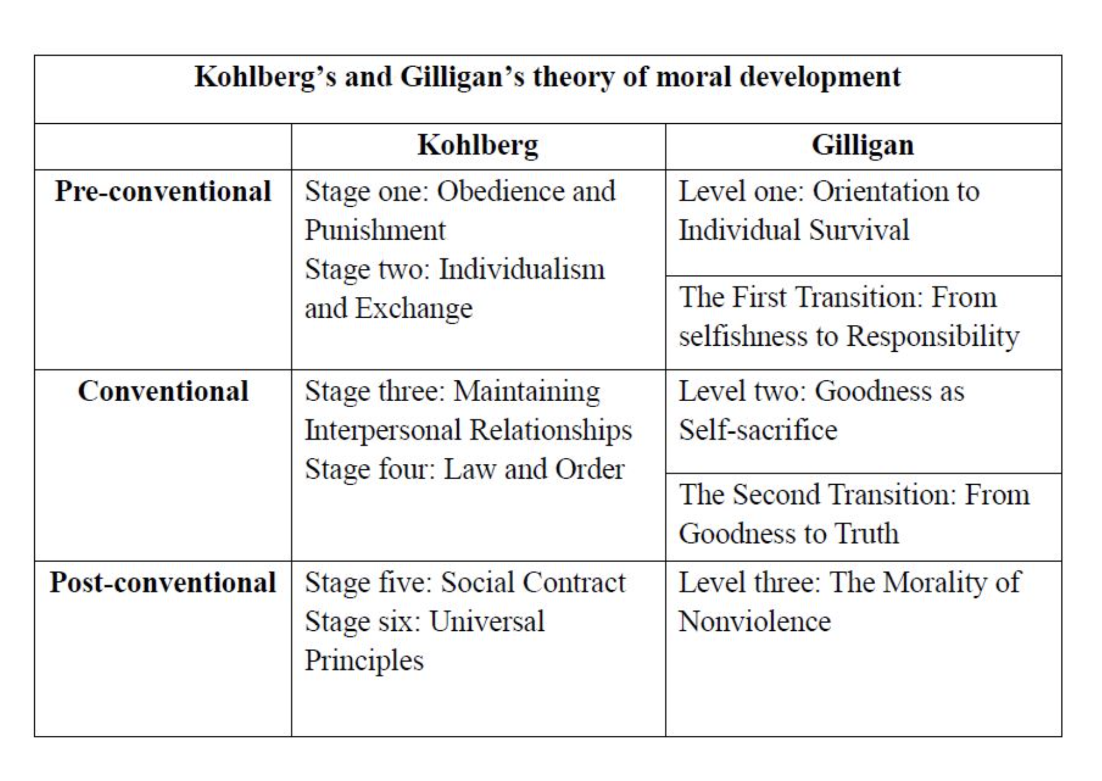
Development of student integrity
Kohlberg (1958) and Gilligan (1977) Theories of Moral Development
Image from: Yxiong (2018). Cognitive development & moral reasoning.
https://edu.glogster.com/glog/kohlberg-and- gilligan/2t1kigfa3b7
Gilligan, C. (1977). In a different voice: Women’s conceptions of self
and of morality. Harvard Educational Review, 47, 481–517.
Kohlberg, L. (1958). The development of modes of thinking and choices
in years 10 to 16. PhD dissertation, University of Chicago.

Slide 12
Pedagogical choices connected to student development
Dualism (Received Knowledge)
Multiplicity (Subjective Knowledge)
Relativism (Procedural Knowledge)
Commitment (Constructed Knowledge)
Perry’s Theory of Intellectual and Ethical Development
First Year Students
Graduating Students
When Under Stress
Perry, W. G. (1970). Forms of intellectual and ethical development in the college years: A scheme. Holt, Rinehart, and Winston.

Slide 13
Why Students Cheat
Pressure to Succeed
Fairness (“Others do it.”)
Material is Trivial / Irrelevant
Course is Too Hard / Faculty Expectations are Unreasonable
Poor Time Management
Not Sure what Constitutes Cheating

Slide 14
Why Students Don’t Cheat
Peer Environment (cheating not the norm)
Self Respect (values)
Consequences for Academic Dishonesty
Chances of being Caught are High
Commitment to Learning

Slide 15
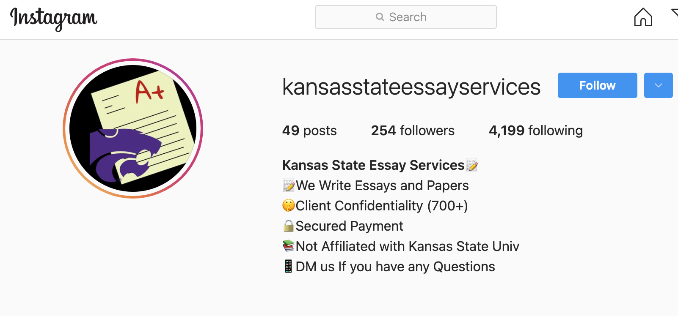
Contract Cheating - Day of Action
Chegg
Bartleby
CourseHero
Study.com
Slader / Quizlet
StudySoup
A variety of Essay Mills
Domyhomework123.com
The Honor and Integrity System does have a Chegg account and is looking into getting an account for other sites so we can provide a pdf of the “answers” posted at any time for you.

Slide 16
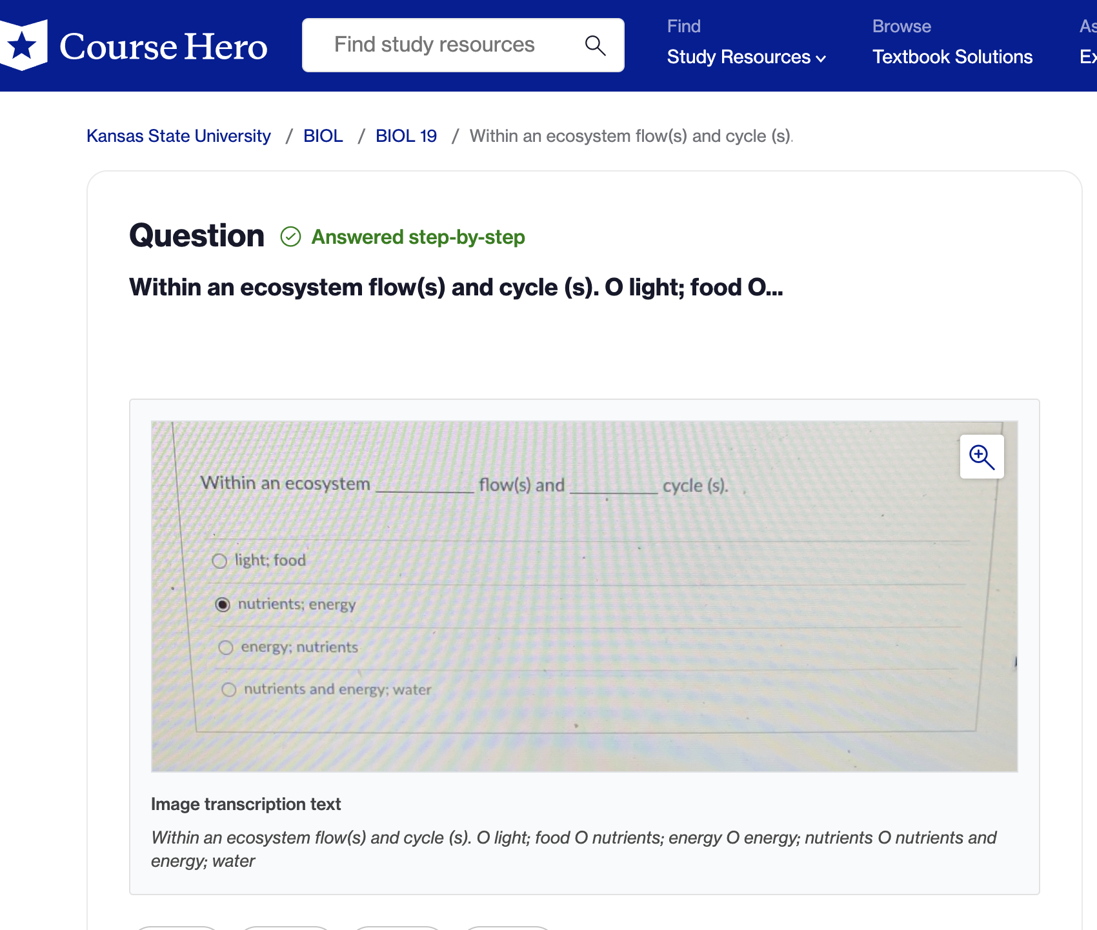

Slide 17
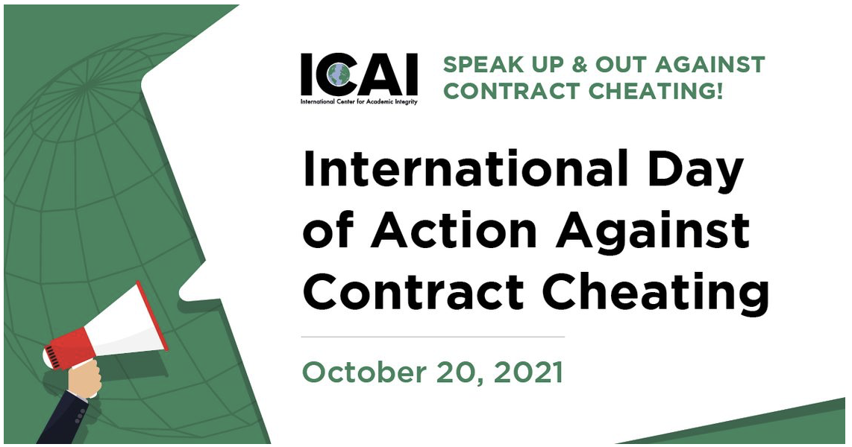
Movement Against Contract Cheating
Pearson Publisher – Suit Against Chegg (copyright)
Wiley Publisher and OpenStax Publishing had previously had relations with Chegg and have dropped all relations.
Chegg stock prices dropping (-31.67% in past 6 months)
Australia – national movement to remove all ads about these contract cheating sites as well as banning two different essay mill sites from the internet nationwide based on a national law that bans advertising and selling of cheating services.
Jeopardy-type Game About Contract Cheating: https://hoaonline.org/UTL/UT3_JrAgeCalc2.C.php

Slide 18
Making the shift to mold students
Understand where students are – they are still developing
Understand challenge and support of student
Be the teacher

Slide 19
What you can do…other than just putting the honor pledge in your syllabus
Assessment Styles for first year students versus graduate students
Remember dualistic vs. multiplicity
Assessments in teams versus individual
How can they work together?
Assessment from the teams as part of the “grade”
Rules, Policies, and Regulations in the Classroom
Building community
Reiteration of everything
Not hand holding, but working with students

Slide 20
What you can do…other than just putting the honor pledge in your syllabus
Understanding authentic learning – what do you really need to assess?
Lower Stakes Assessments possibly
Give them a voice
Build the community
Find the source of motivation
Allow them to decide topics (within reason)
Talk about why your class and integrity is important

Slide 21
What you can do…other than just putting the honor pledge in your syllabus
Adapt teaching / assessments to a variety of learning styles
Writing, presentations, projects, etc.
Let them see examples of good, mediocre, and poor work
Provide a rubric for quality rather than just for a grade
Holding them accountable
Students who know you will hold them accountable are less likely to try to do something inappropriate.
I can help, but students need to be held accountable and have due process

Slide 22
Contact: Camilla Roberts cjroberts@ksu.edu Honor and Integrity System honor@ksu.edu

