Slide 1

Troy Brockway
Introduced by Levi Unruh

Slide 2
Failure is Not an Option

Slide 3
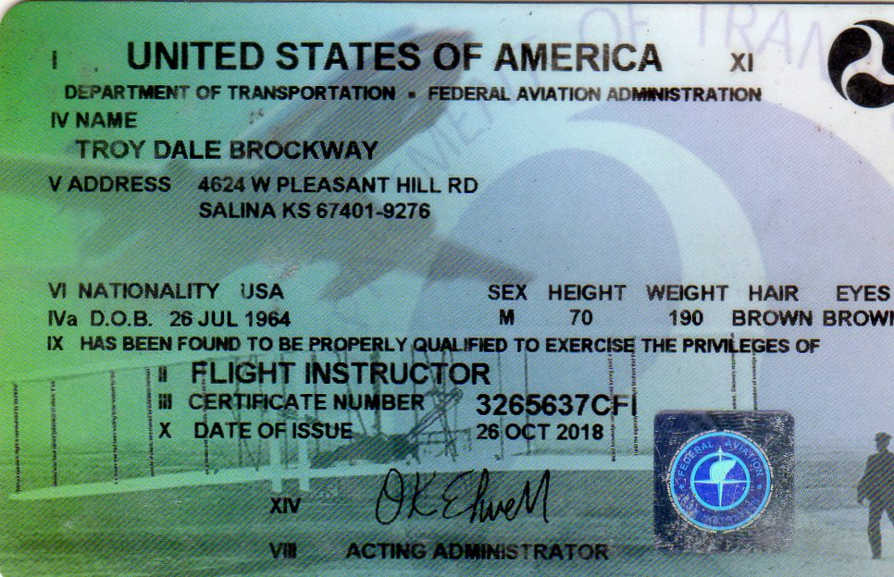
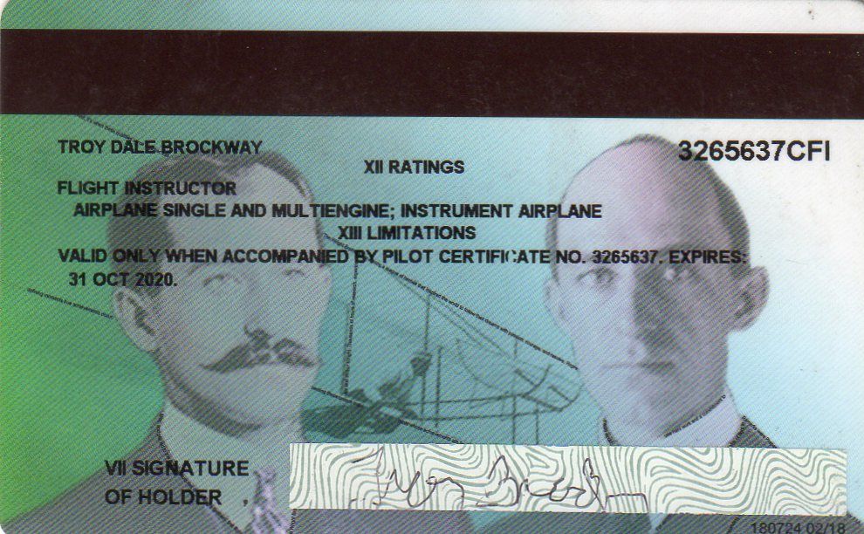

Slide 4


Slide 5


Slide 6
What skills do I want my students to have?
Good Judgement

Slide 7
Two Teachers

Slide 8
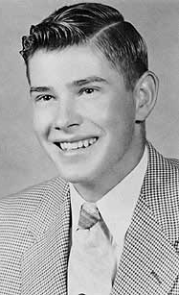
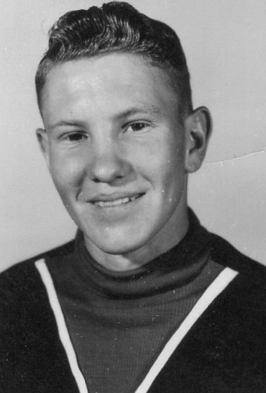

Slide 9
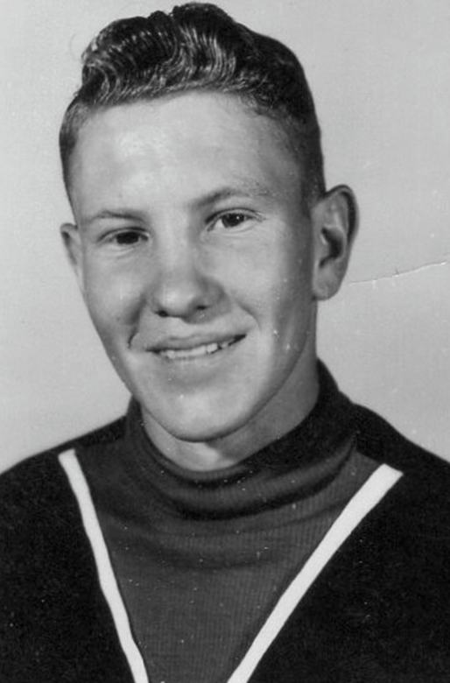
Charles Brockway

Slide 10
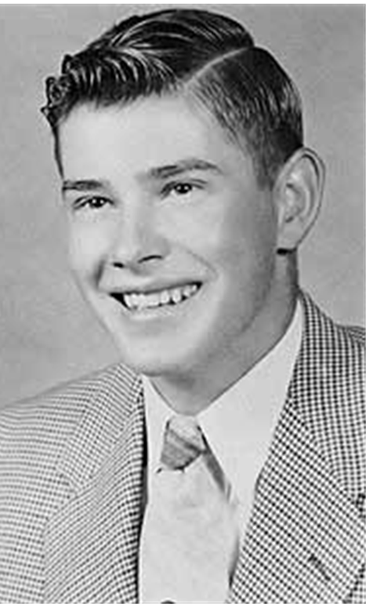
Roger Peterson

Slide 11
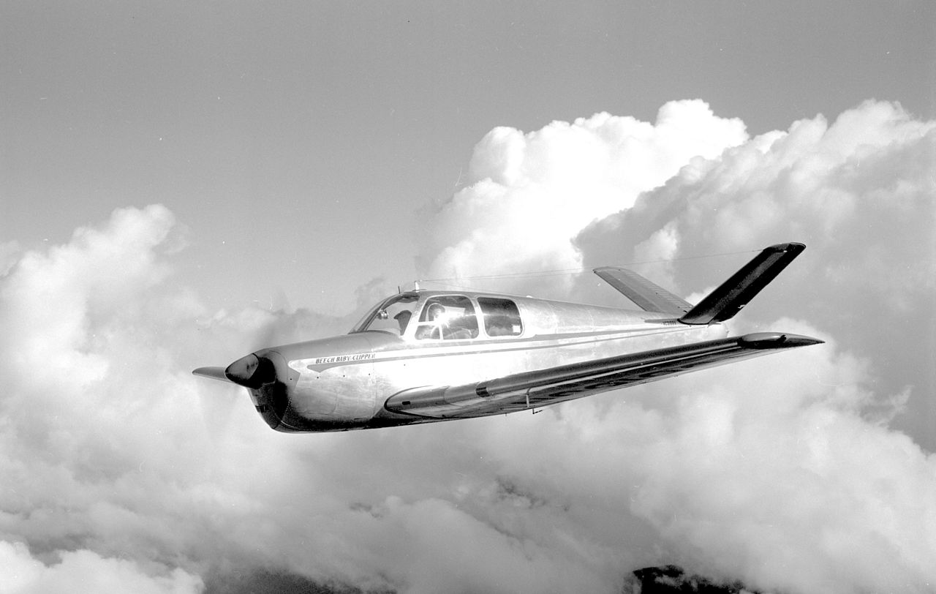

Slide 12
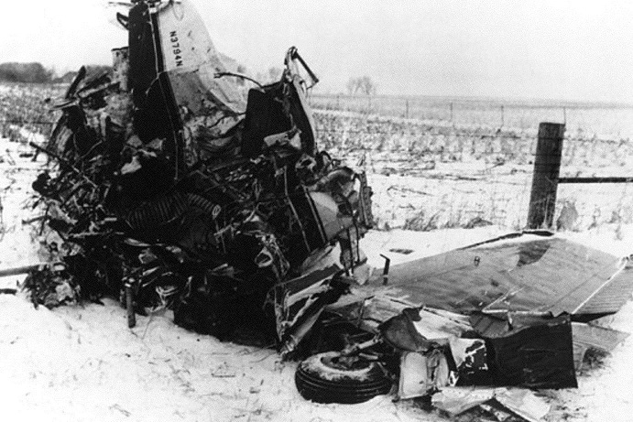

Slide 13
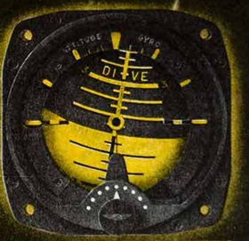



Slide 14
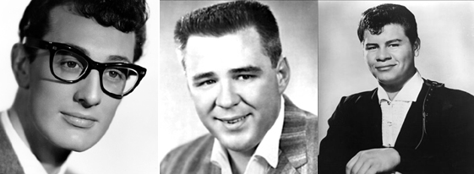
February 3, 1959

Slide 15


