Slide 1
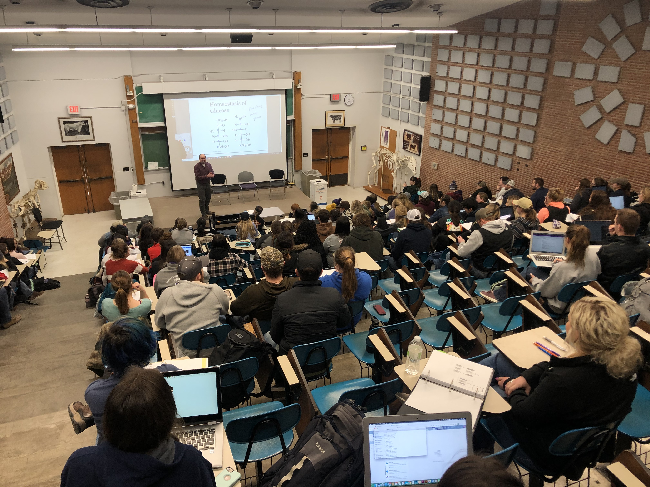
ASI 533, Anatomy and Physiology

Slide 2
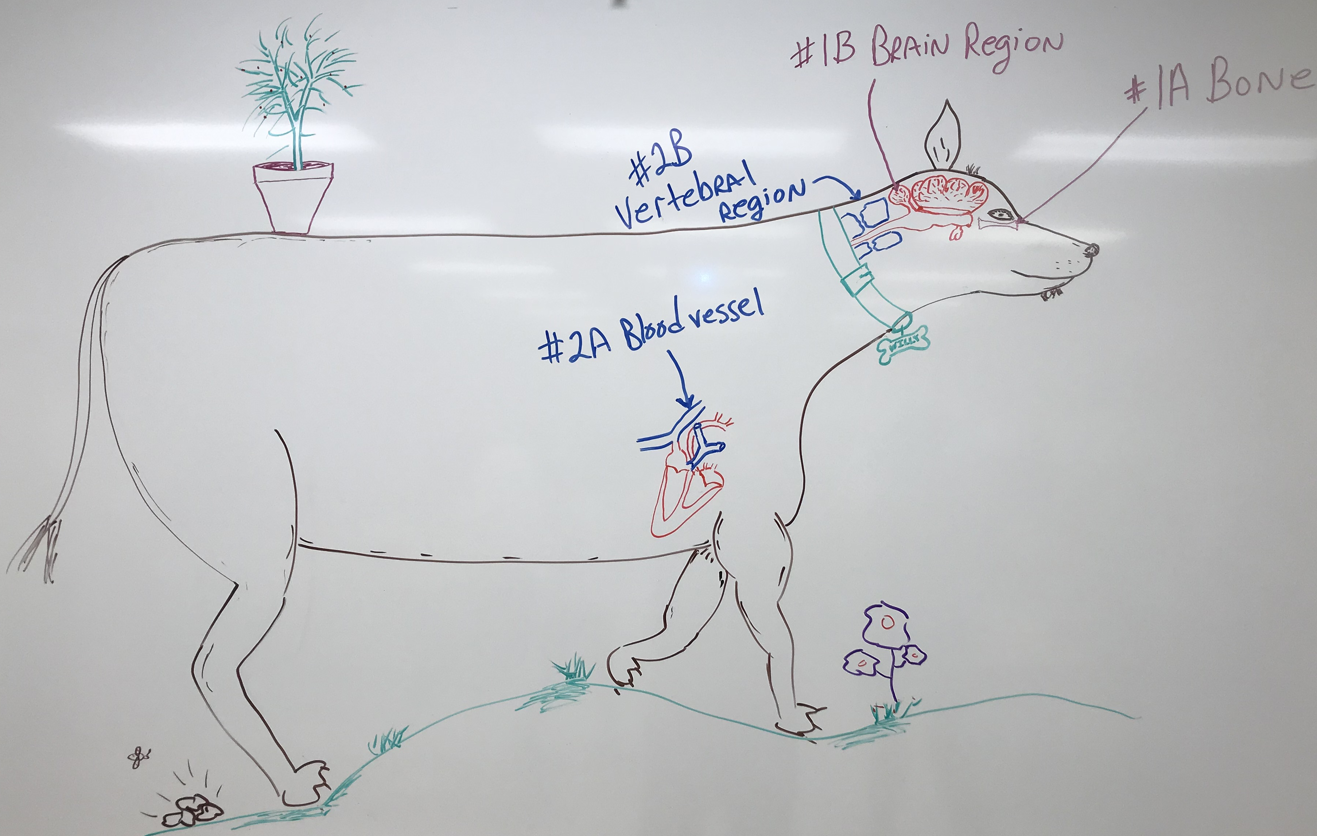
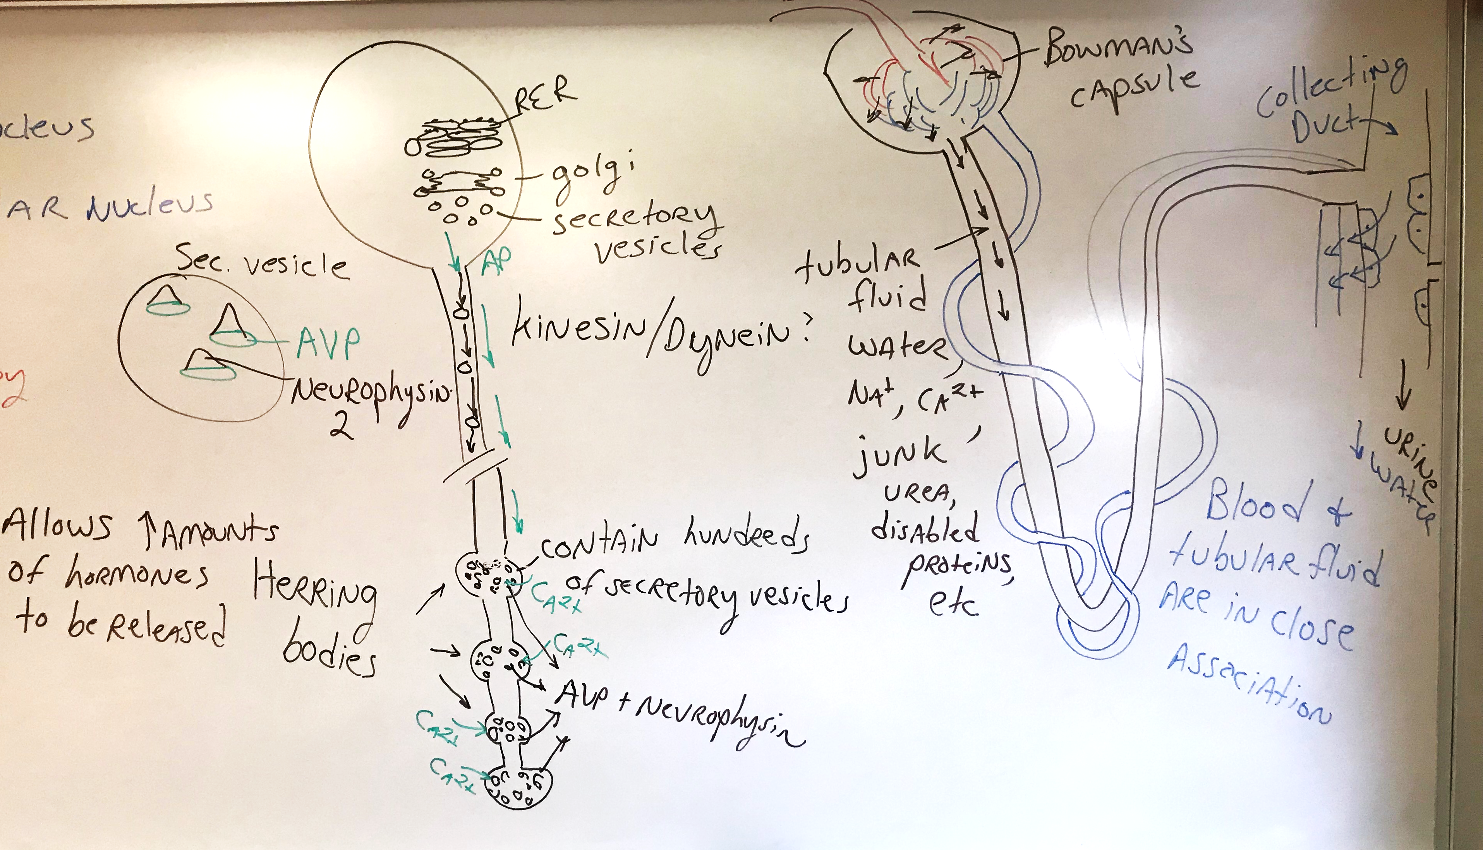
Lecture

Slide 3
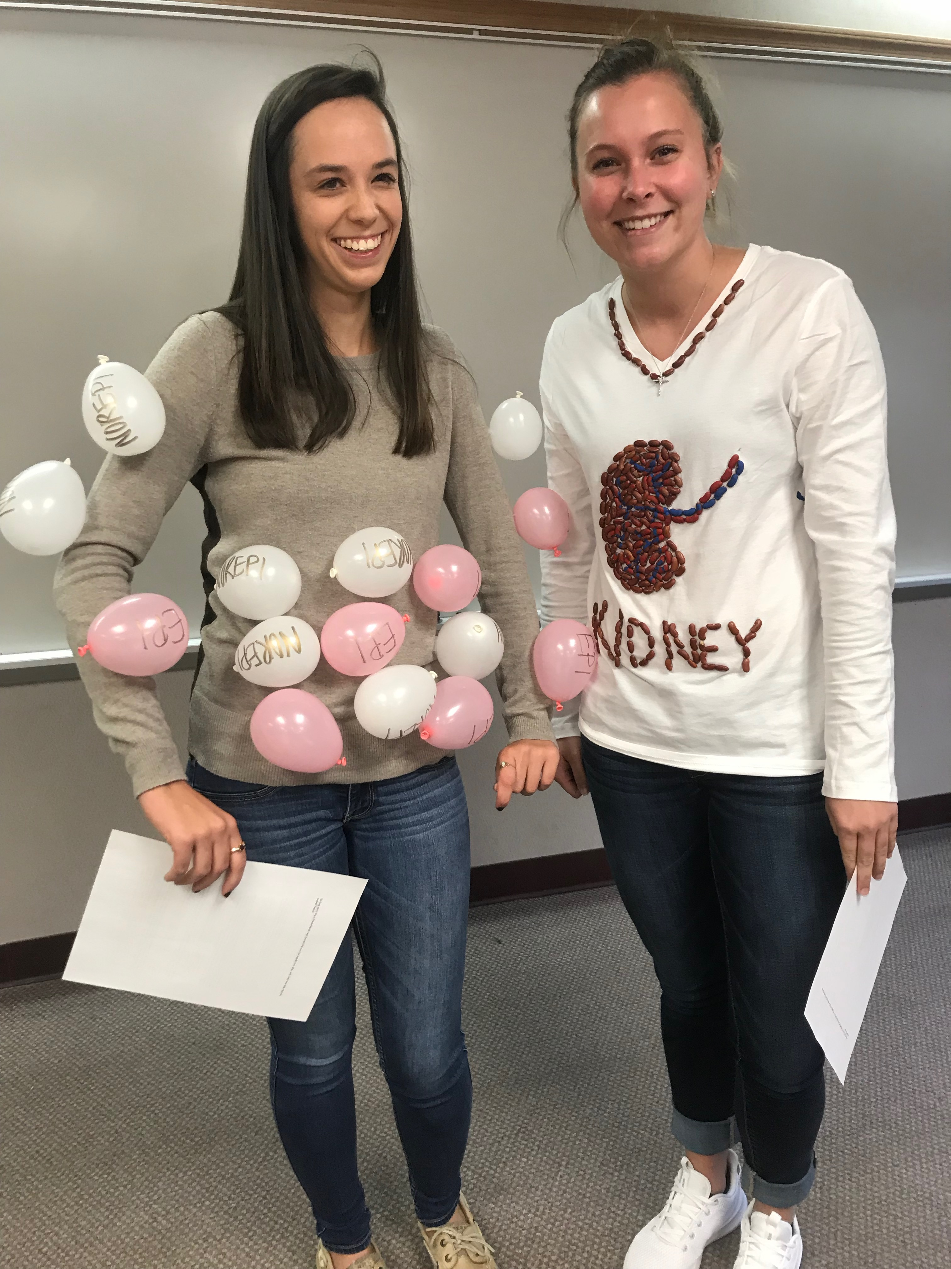
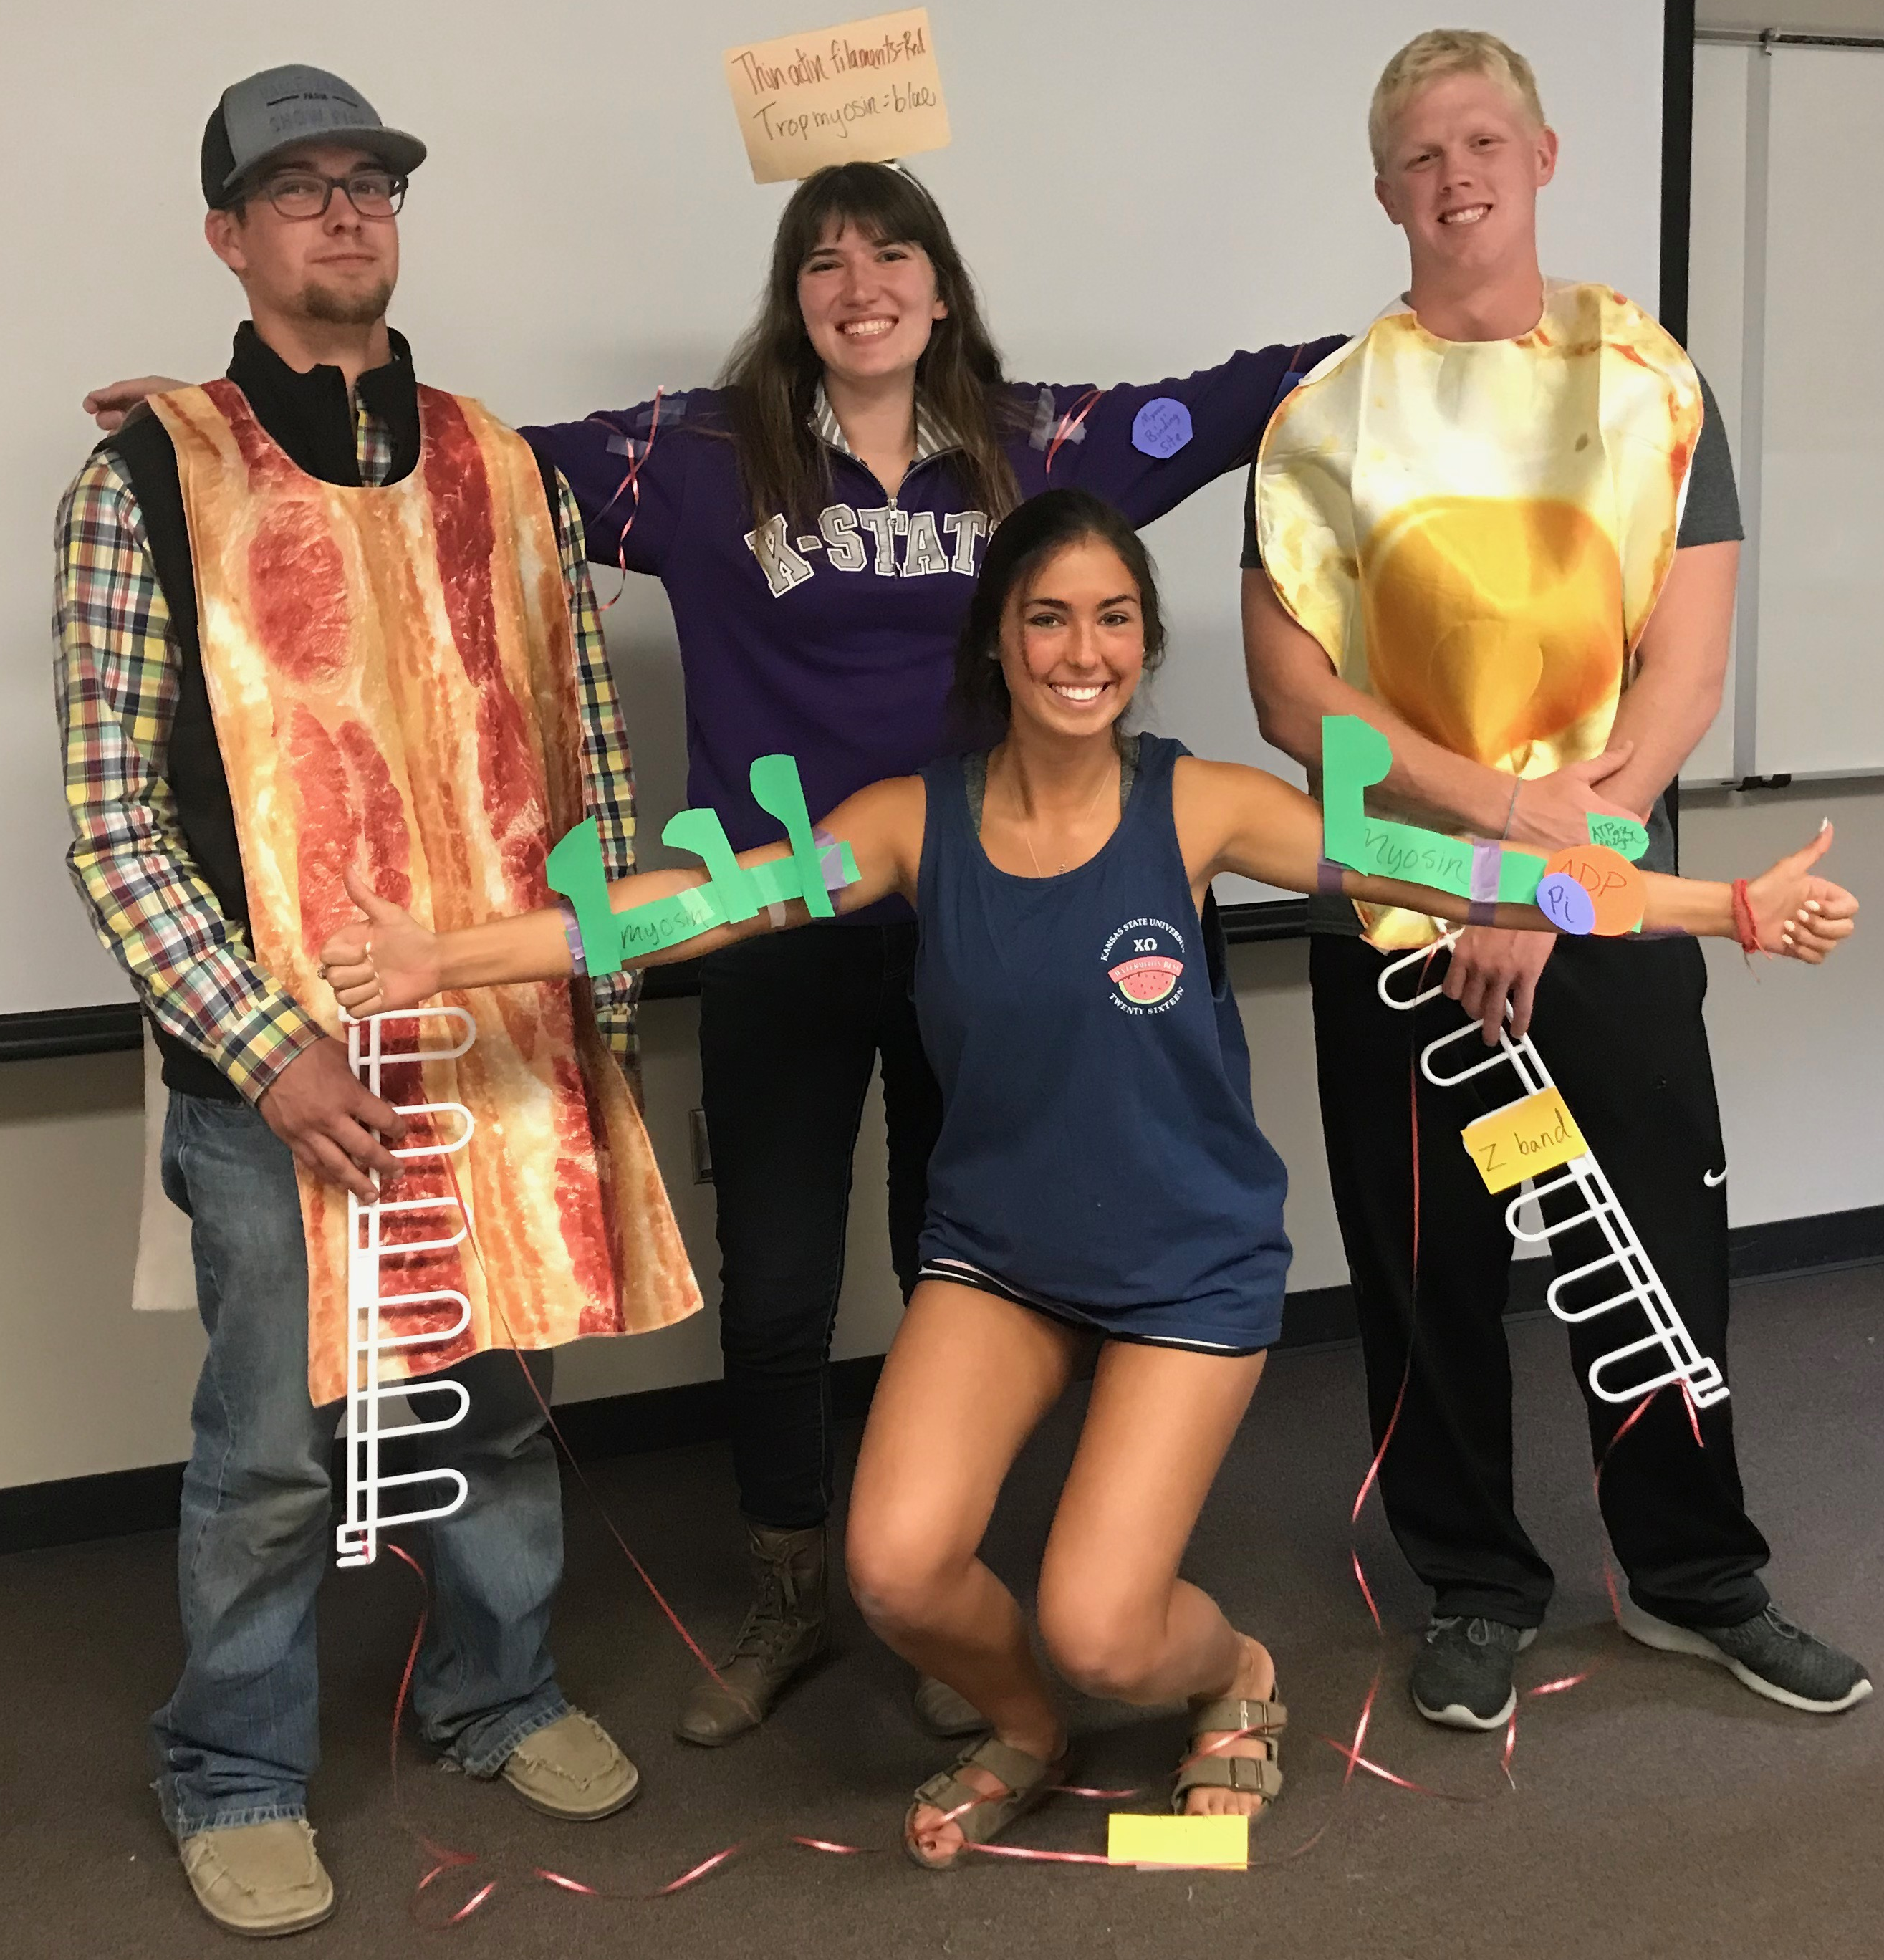
Activities

Slide 4
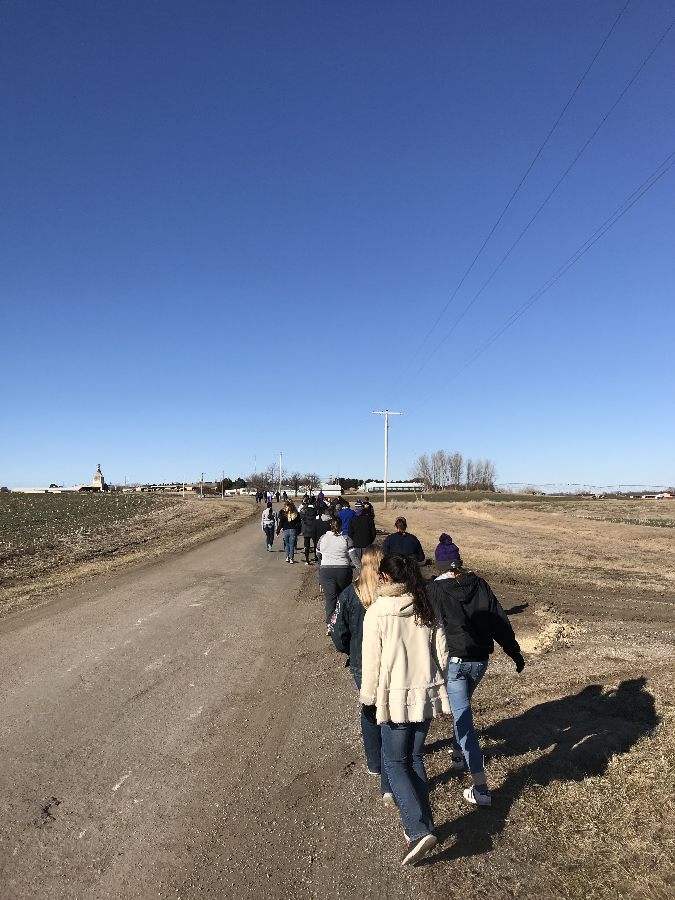
Activities

Slide 5
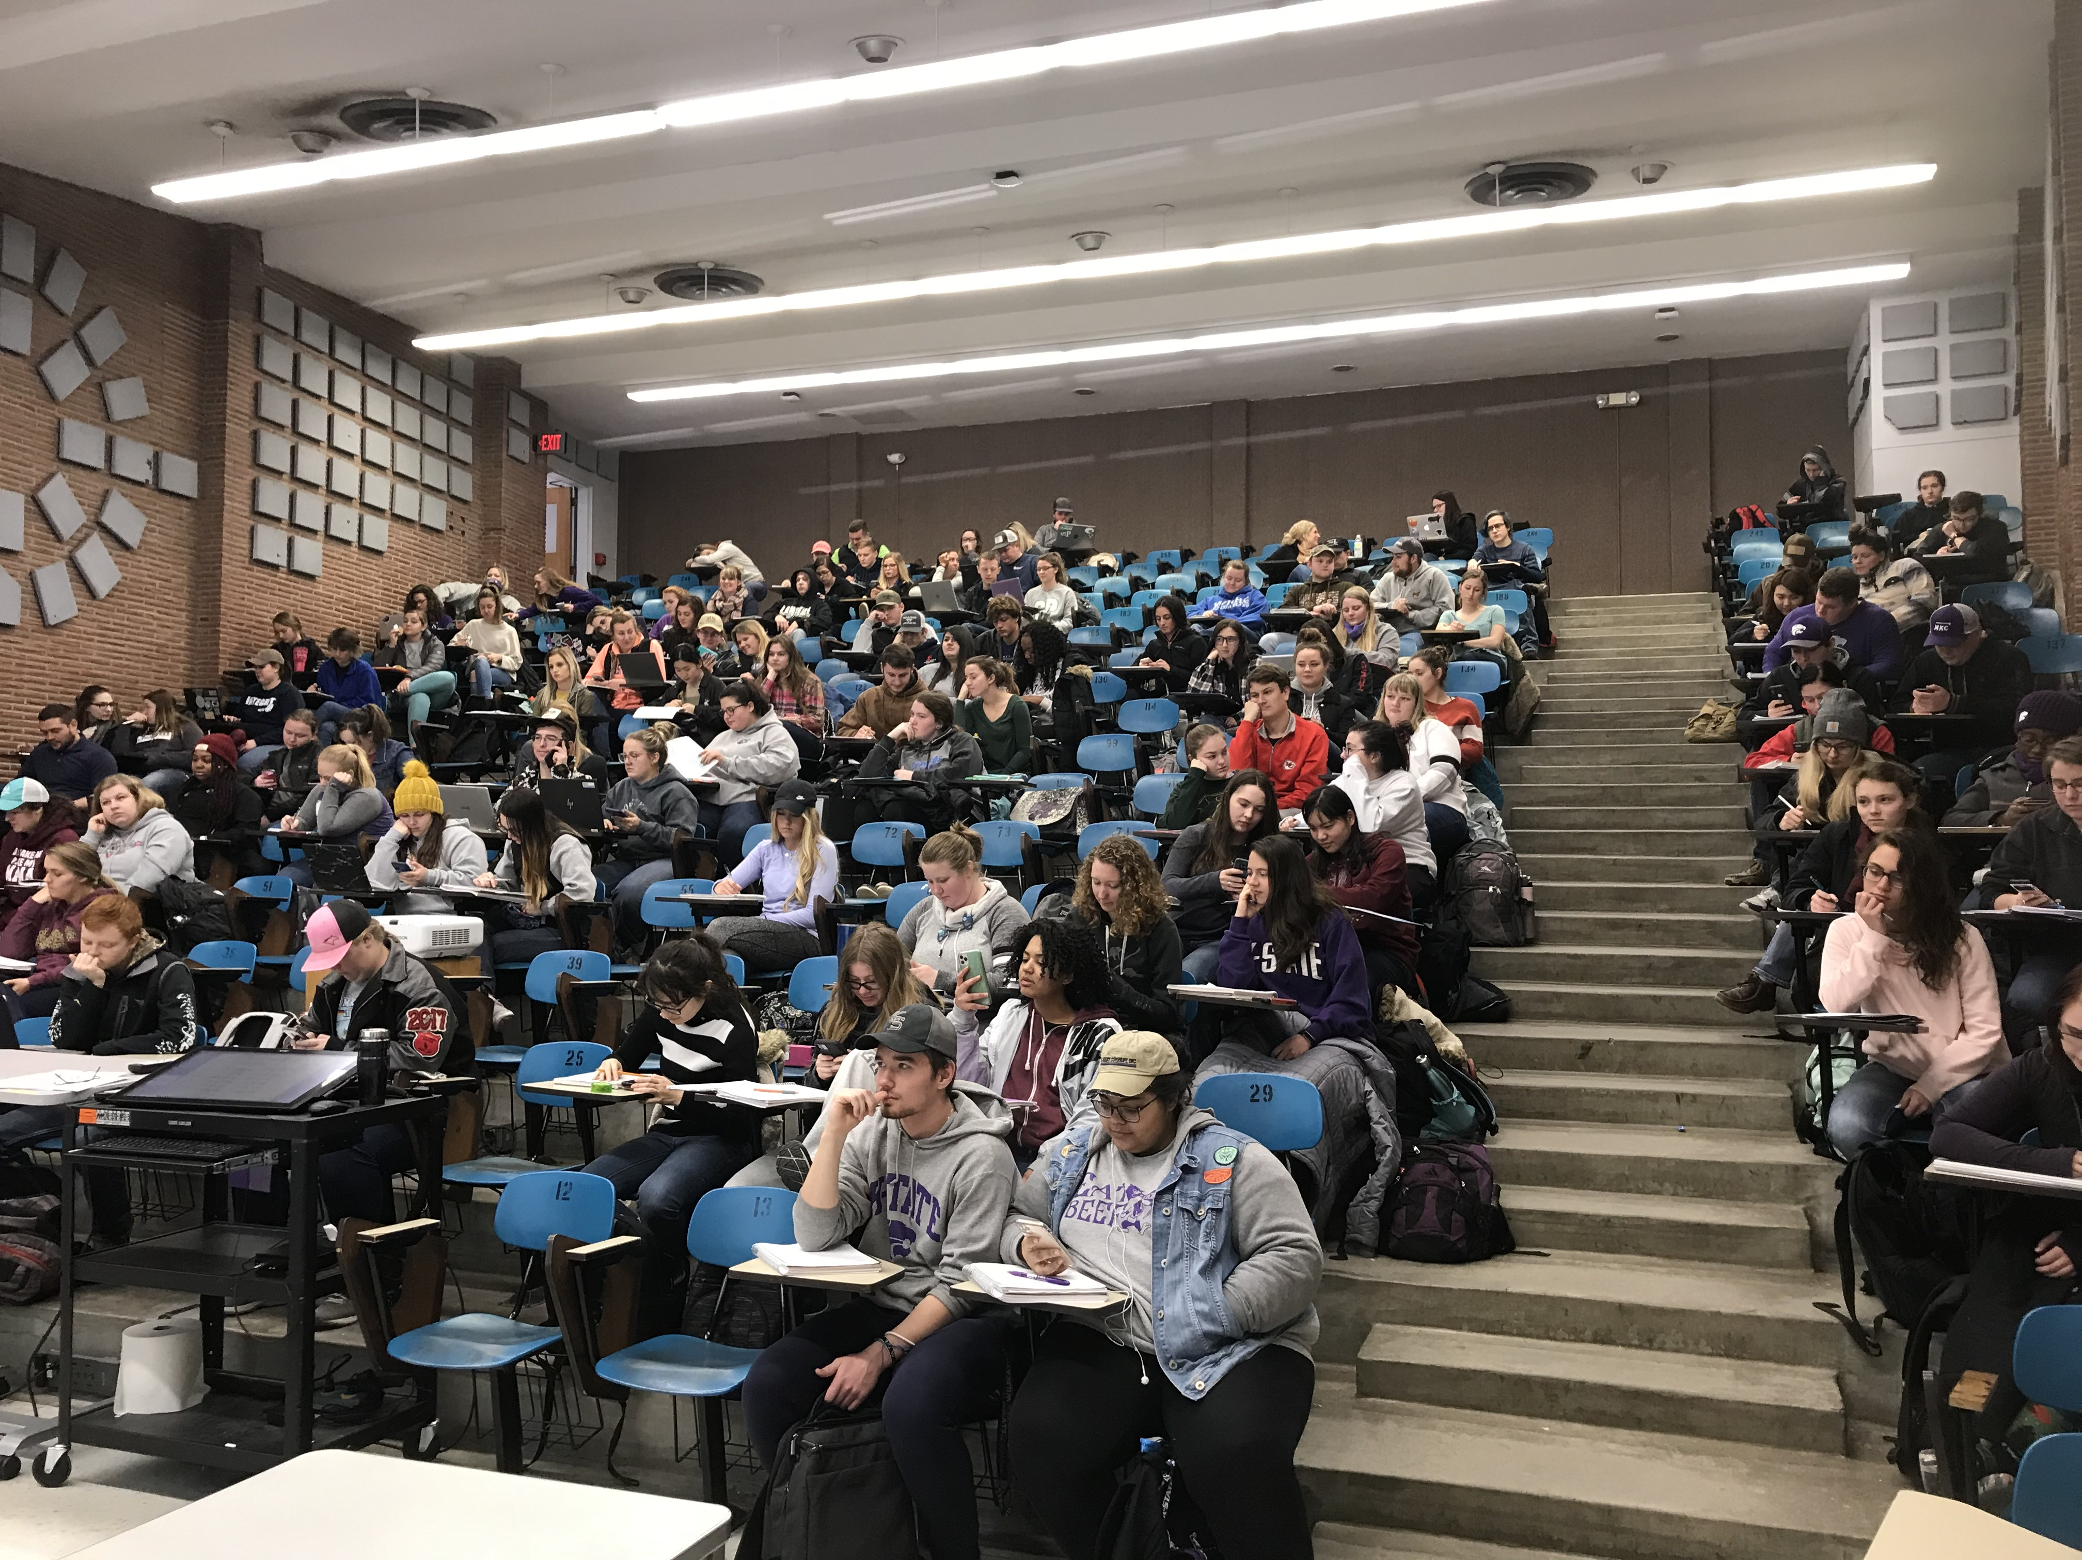
Eventually…

Slide 6
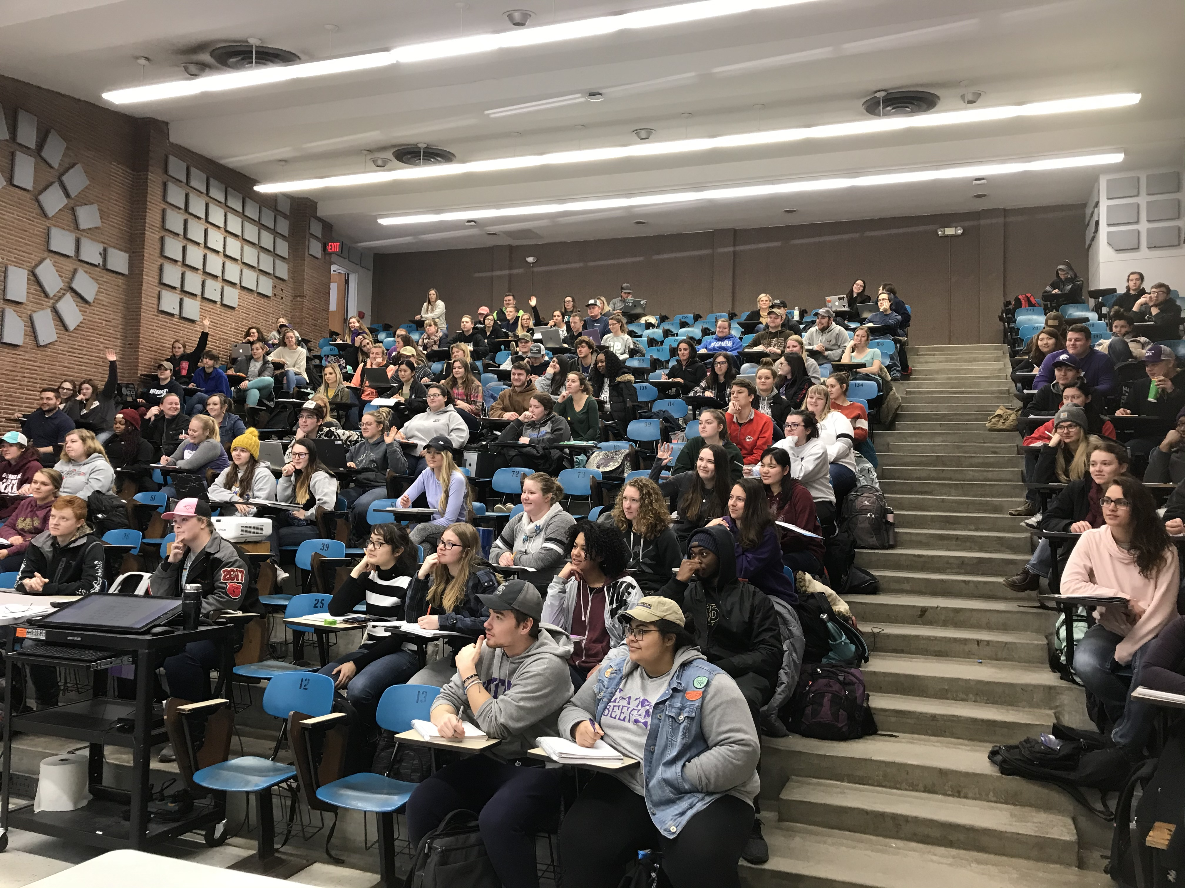
Using Stories
Story time…
https://en.wikipedia.org/wiki/File:Dickens_Gurney_head.jpg

Slide 7
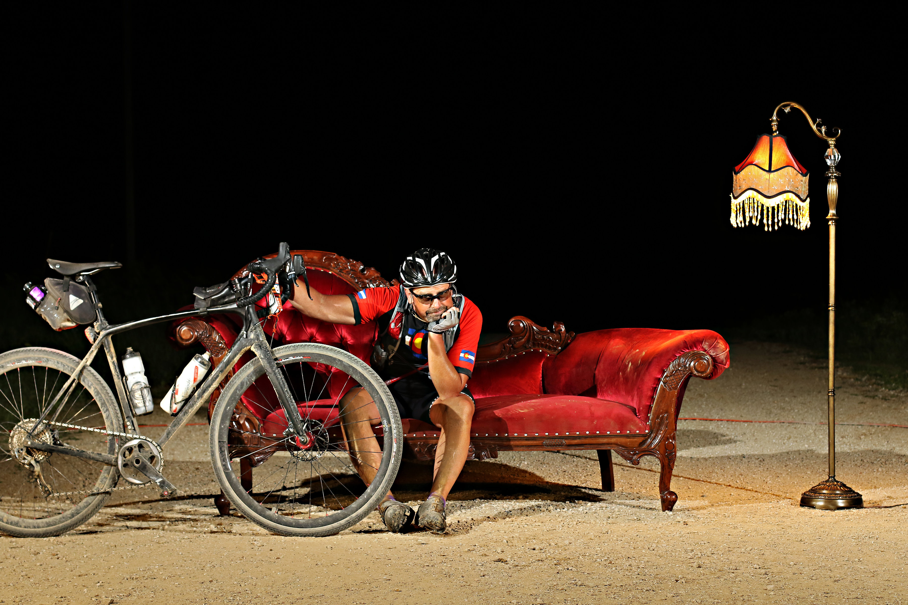
Personal Stories

Slide 8
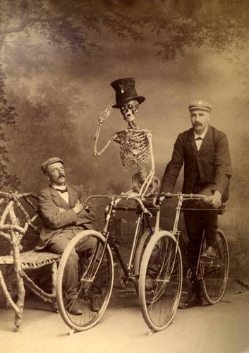
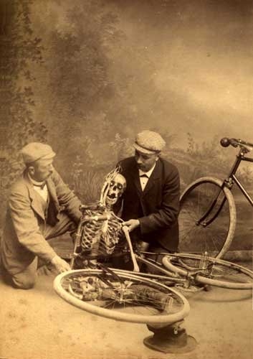
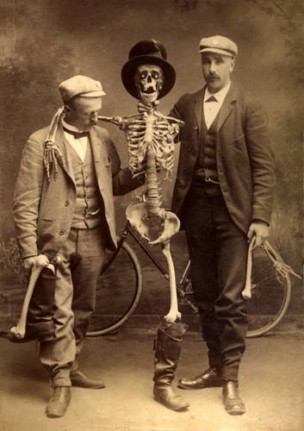
Personal Stories

Slide 9
https://farmia.com/offers/details/0c0c766e-0bb8-4079-ae0e-901634495187/brahman-cattle

Slide 10
Value of Stories?
Teaching with stories is BRAND NEW!
  Oh wait…
Aesop
Aristotle
Jesus
Chiselogram.com?

Slide 11

Value of Stories?
Schank and Abelson, 1995
Memory
Knowledge and Understanding
Social Communication
http://cogprints.org/636/1/KnowledgeMemory_SchankAbelson_d.html

Slide 12
What in the Dickens is he talking about?
I understand __________% of your stories, Dr. Rozell
38%

Slide 13

What in the Dickens is he talking about?
“I feel like class time could have been used more effectively”
“You are the most annoying professor I’ve ever had in my life”
“‘Waisted” a lot of lecture time”
“I want to fill your office with live squirrels. Mad ones.”
“Ugh…Just teach us the d$#! Concepts”
“Your ‘snippets of wisdom’ take up a lot of class time”
“Stories were entertaining but off topic”
“You promised us full value for our K-State dollar, but…”
“Dr. Rozell has the voice of an angry clown”
“I usually spaced out during the stories”
“Some things get really old after a while”
“I really enjoyed the stories”

Slide 14
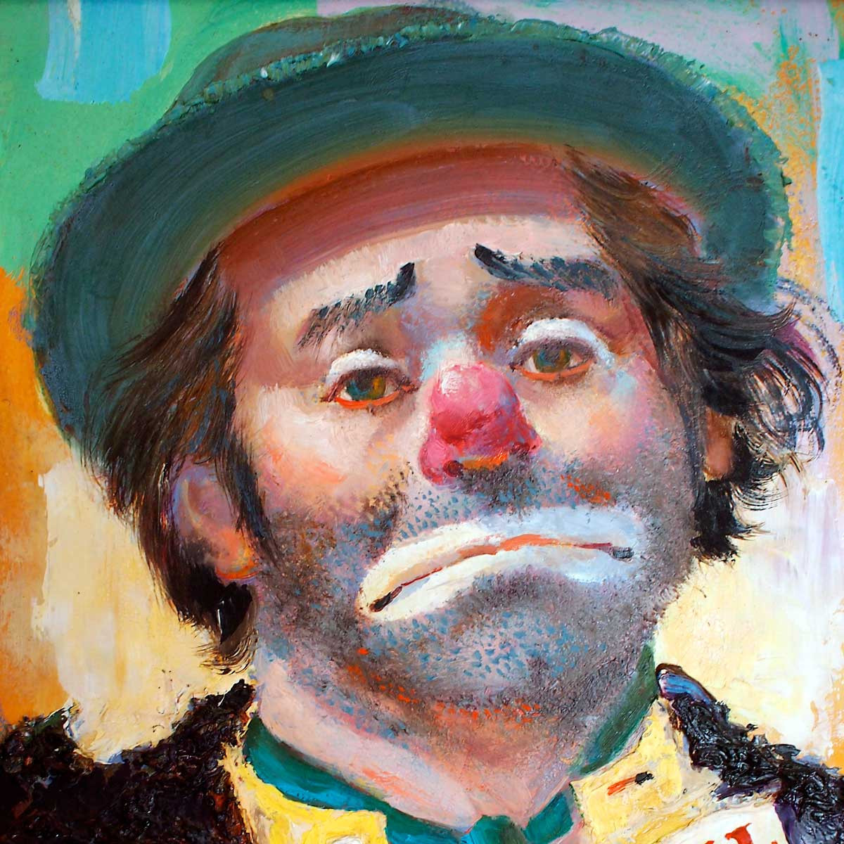

Slide 15
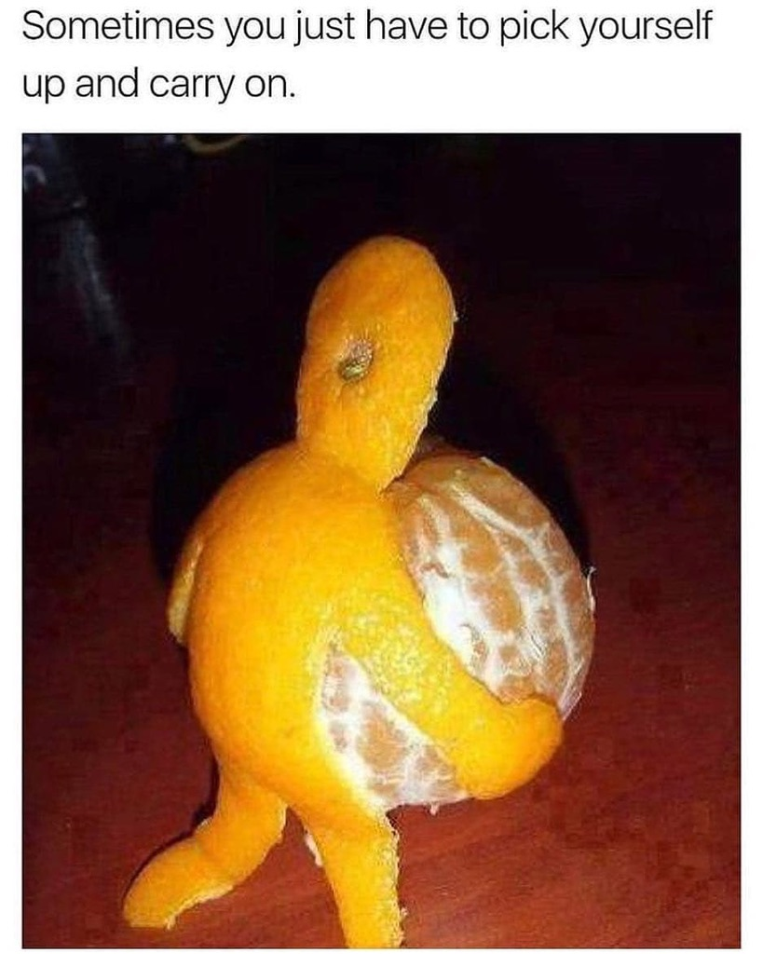

Slide 16
Faster Horses?
1. The sympathetic nervous system:
  Enhances pain sensations
  Suppresses pain sensations
  Reduces activity of memory-recording brain regions
  Reduces visual acuity

Slide 17
Next Question
(application and transfer)
1. If a drug was used that reduced sympathetic nervous system activity:
  An animal would be unable to experience pain
  A squirrel falling out of a tree and being attacked by a Border Collie would experience more pain in that moment than normal
  A cow would have no way to know the extent of her injuries
  A squirrel falling out of a tree and being attacked by a Border Collie would experience less pain in that moment than normal

Slide 19
Conclusion
I can be:
Happy and Effective
Awkward and Sad
OR

Slide 20

