Slide 1
SPOTLIGHT 2020

Slide 2

Luke = You want the impossible
Yoda (moves x-wing out of swamp with the force)
Luke = I don’t believe it
Yoda = That is why you fail
Notes:
Good evening, and I am truly honored to have this opportunity to share with you this evening. In preparing for this, this scene from the Empire Strikes Back came to mind. Luke had just crashed his X-wing in the swamp. Yoda encouraged him to lift it out of the swamp. Luke said he would “give it a try” – he did, and he failed. Yoda then proceeded to coach him and help him understand that effort, desire, motivation, etc. were needed to succeed and the following events transpired…

Slide 3
TRYING TO TEACHING

Slide 4
Notes:
I contest that we learn from trying.
Luke tried, he was not successful at ‘doing’ but he learned from it. He learned that if he was to achieve his goal, he needed to approach the situation differently next time. He eventually became motivated, practiced more, and achieved the desired outcome.
For me, I would not be before you tonight without similar attempts at trying to succeed at public speaking. When I decided I wanted to be a faculty member, very similar skillsets as a Jedi, I knew public speaking was something I must ”do” and do well.
However… I was like this guy. In fact, I had read (yes word for word) my first scientific presentation as a graduate student. Before lectures as a GTA, I would take many deep breaths and pray for the class to go well. After many many attempts, I improved immensely in this area. I still have issues to improve, but by making attempts and trying, I have learned ways to improve. I believed it could happen, and I did not give up on my goal of being a faculty member.

Slide 5
Trying Research and Scholarship

Slide 6
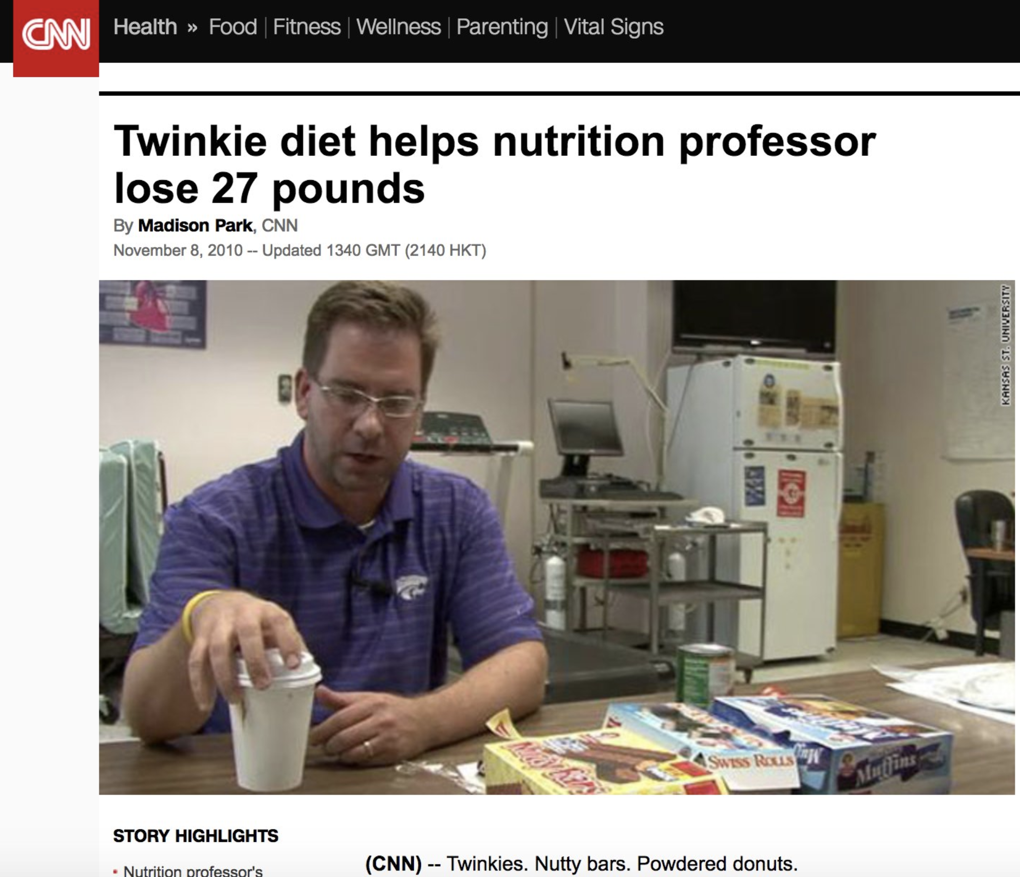
What I tried:
  A ‘simple’ Class Project
  …K-State Collegian ran a story about it…
What failed:
  - Gave others fodder
  - Created public confusion

Slide 7


Slide 8
TRYING TO LEAD

Slide 9
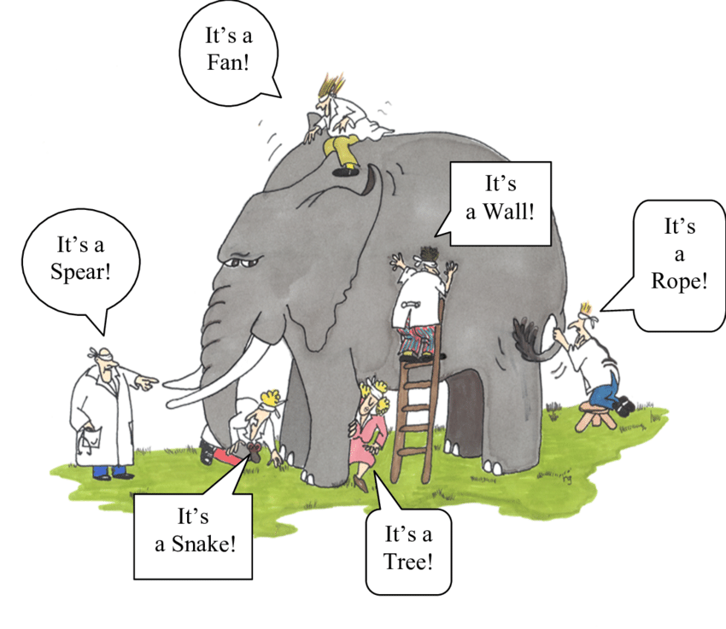
We struggled initially
Learned from mistakes
Grew into a very successful department
  Largest in College of HHS
  30% Increase in enrollment

Slide 10
Summary --> Be Courageous
  Fear and doubt lead to less trying and doing
    Failures are great learning opportunities
  Let students/others see you experience life and learning
  Get out of your comfort zone
    This will help others do the same
  Explore new ways to teach, study, learn, etc.

Slide 11
