Slide 1
Failure & Opportunity

Slide 2

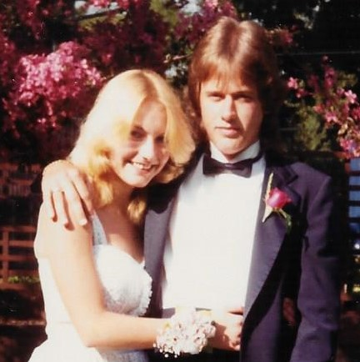
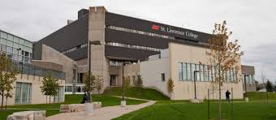
Notes:
The path that brought me here , started with a failure – a big failure.
On March 7th, 1983, Brian, my high school sweetheart, committed suicide. As a result, I failed to complete my last year of high school and did not go off to University with my friends the following fall. Instead, I ran off with the carnival, for 10 whole years, . Really, I did.
The next fork in my path started with another failure. I decided to go back to school. I submitted a mediocre application to the veterinary technology program at a Community College in Canada. I was not accepted. This Failure was a wake-up call. I needed to get to work if I wanted to make anything of my life.

Slide 3

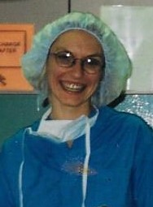

Notes:
Shortly thereafter I applied to the University of Guelph as a mature student, I worked my butt of, and then 3 years later I was accepted to the Ontario Veterinary College on my first attempt.
After graduating from vet school, I practiced for a few years and then decided to further my education again.

Slide 4

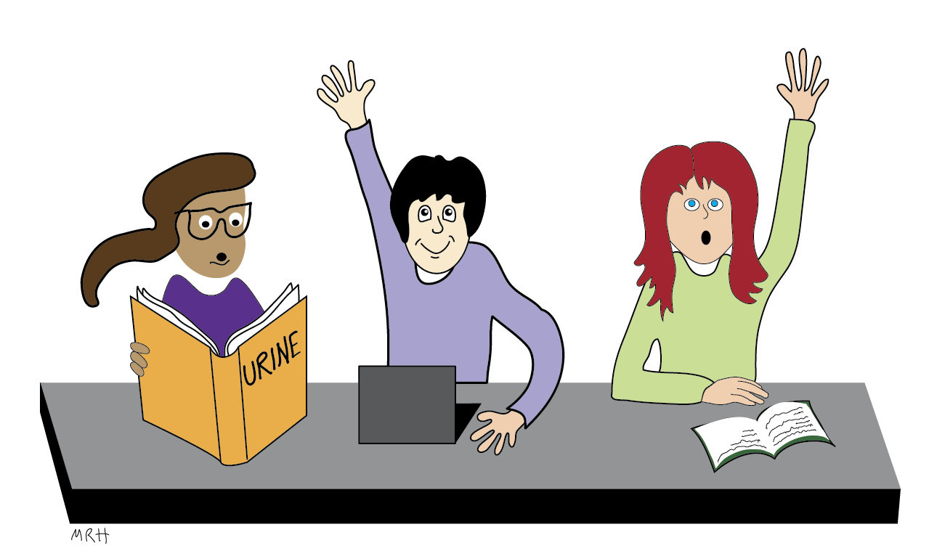

First Ever Lecture
How I imagined it would be
How it really was
Notes:
I landed at Auburn University to do a Clinical Pathology residency and graduate degree. In the second year of my residency I got my first chance to lecture. Urinalysis – AWESOME! I was going to teach the students EVERYTHING they would ever have to know about urinalysis in my 50 min lecture.
This is how I imagined it would be -- look at those excited and engaged students.
But as I turned up the lights, at the end of the lecture and actually looked at the students, rather than at the powerpoint slides, this is what I saw. In fact, as I was leaving I even heard a student say – “WOW, that was painful”.
Another failure – another wake-up call!
And so, the journey of learning to teach began.
Very quickly I discovered that teaching is a great deal more than simply imparting information.

Slide 5
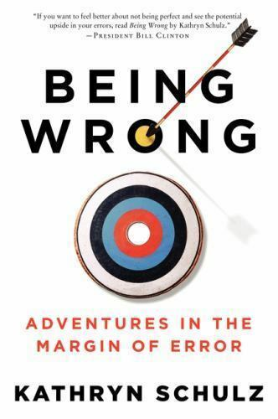
“The one book that Harvard University president Drew Gilpin Faust wishes all incoming freshmen would read. “
“… the moment when the feeling of being right seroconverts to the feeling of being wrong … this moment is crucial to our moral and intellectual development”
Notes:
Along the way, I came across Kathryn Schultz’s book -- Being Wrong. On the back there is an excerpt from a New Your Times book review “The one book that Harvard University president Drew Gilpin Faust wishes all incoming freshmen would read.” In it the author discusses what happens psychologically during “wrongness”. Or as she puts it “when the moment of thinking we are right, seroconverts to an awareness of being wrong … this moment is crucial to our moral and intellectual development.”
This moment is an OPPORTUNITY! We need to harness the opportunity that lies within each defeat.
I have been telling you about big lifechanging personal failures and how my path was redirected as a result. But, the concept of redirection/opportunity from failure works on a small scale too. Let me give you an example.

Slide 6
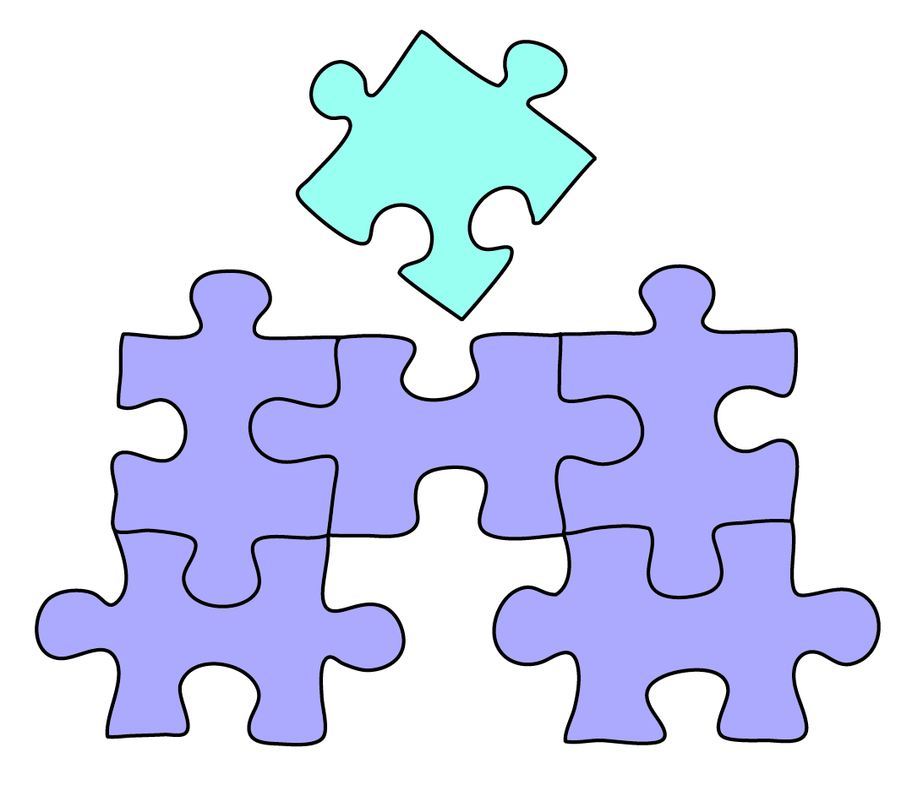
CBC
Biopsy
Urinalysis
Serum Chemistry
Patient History
Physical Exam
Findings
Blood Gas
Other
Notes:
In my clinical pathology classes I teach the students how to evaluate and interpret laboratory data to come up with a diagnosis – putting the puzzle pieces of patient history, physical examination, bloodwork, urinalysis, coagulation data and blood gas panels etc. together into a coherent picture. Everything needs to make sense. Everything needs to fit. It can be tempting to consider the puzzle solved even though you have a piece left that doesn’t quite fit.

Slide 7
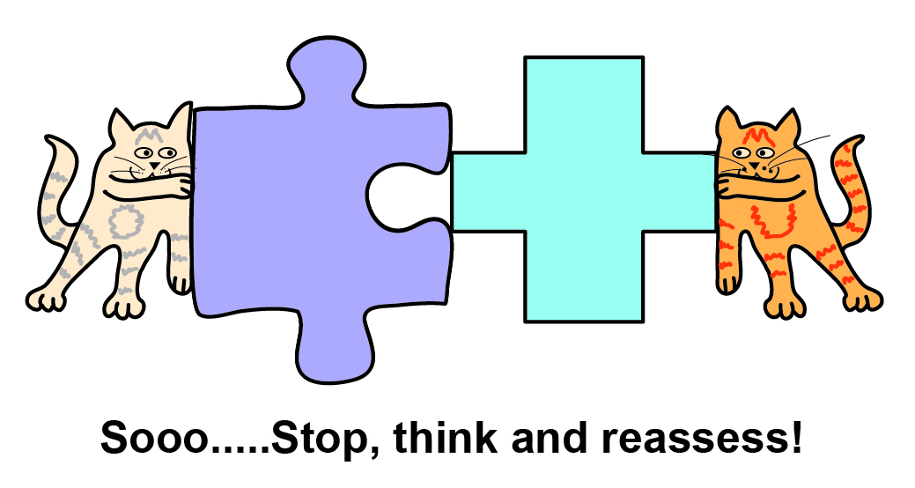
Notes:
But that can lead us down the wrong path. So, what if a piece doesn’t fit? When that happens, we need to stop, think and reassess. In teaching the art of diagnosing we have a tendency to go in one direction, meaning, here are the puzzle pieces, put them together to make a diagnosis. And it is a good way to do it, because that is real life. But I wanted to get the students to really look, to make sure all the data fits. So I developed an exercise that goes backwards. This exercise is called, Identify the error.

Slide 8
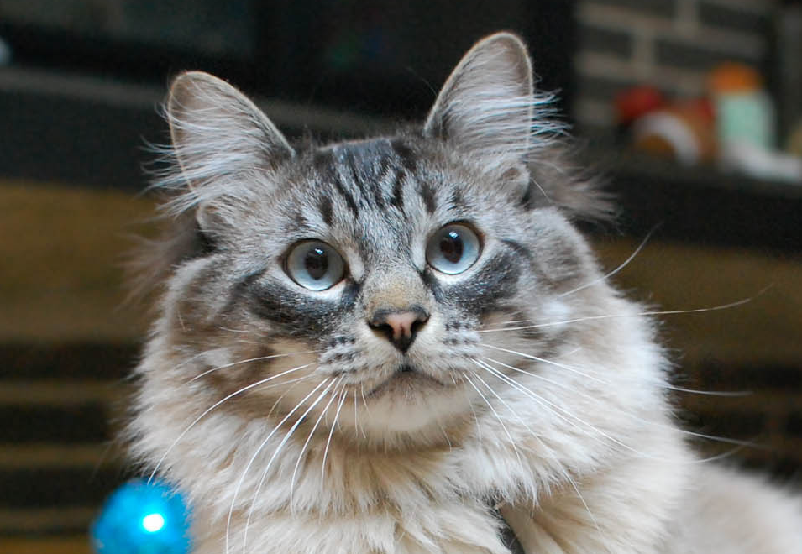
Given the provided Diagnosis Identify the data Error
Fang
Diagnosis: urethral obstruction
He can’t pee!
Notes:
I provide the history and diagnosis and then they will need to look at some altered data to identify what doesn’t fit with that diagnosis. This is Fang. He has a urethral obstruction – otherwise known as a “blocked cat”. He can’t pee!

Slide 9
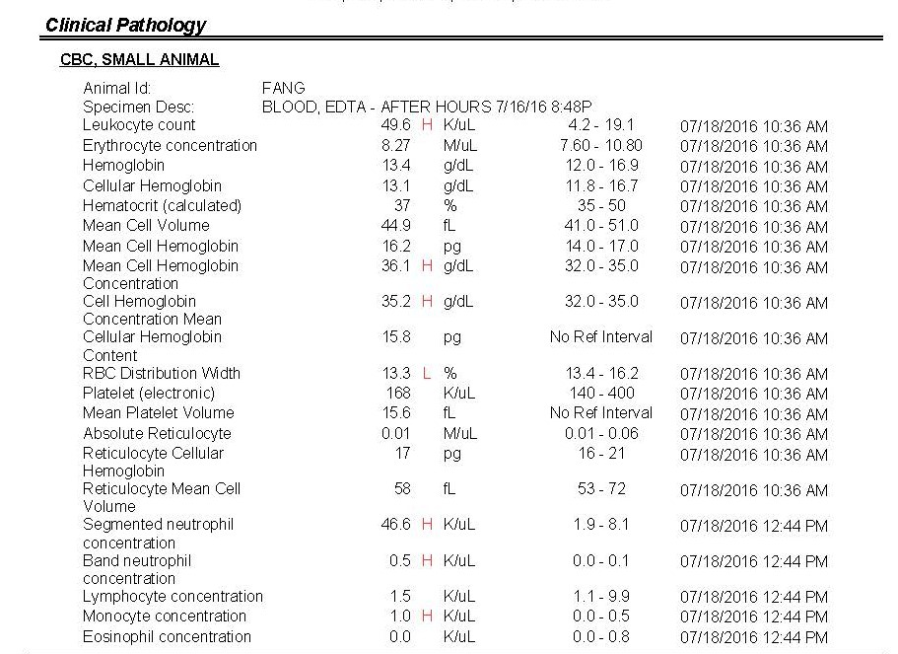
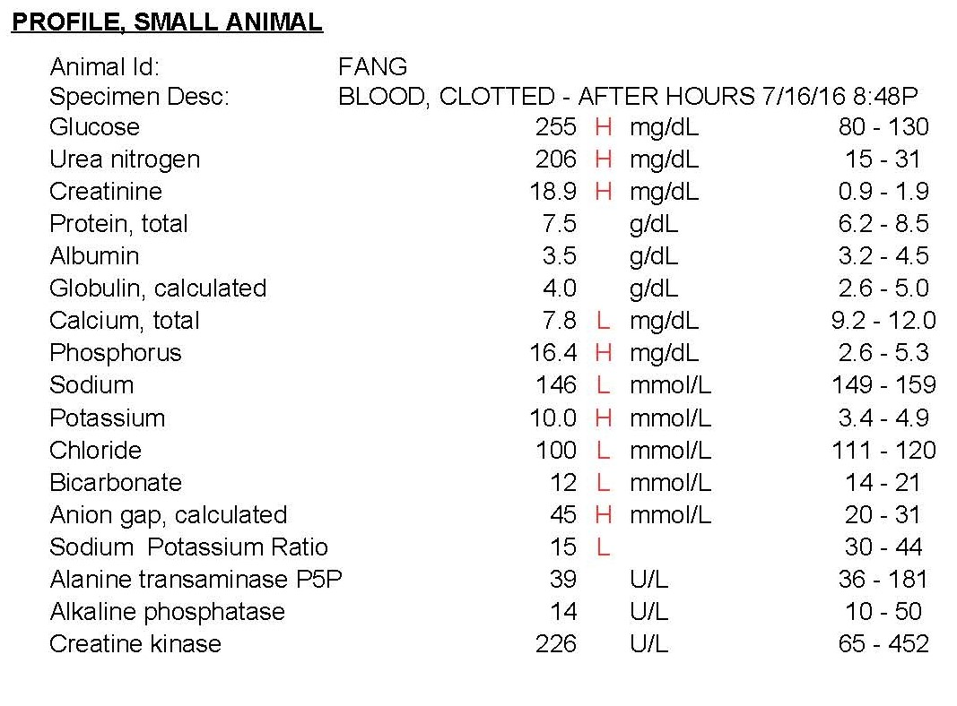
Notes:
So I give them a bunch of data. I know you can’t read this – I’m just showing it to you so you can get a sense of what is provided. In this example I am providing a complete blood count (CBC) and serum chemistry. But before I give it to the students I alter some KEY values. For example I could alter the potassium value.

Slide 10
2 L
Notes:
Let’s look closer at potassium. This is the true, unaltered value and it is an important value in his diagnosis. In animals that can’t urinate, potassium can’t be excreted. That is really important to recognize because it is the high potassium that kills these patients. High potassium can stop the heart – that is why KCl is used for lethal injection in people. So, for this example, I will alter the potassium value from being very high to low. Now the altered potassium value doesn’t fit with the given diagnosis and the students need to recognize that. Usually, in these assignments I alter multiple things so they don’t stop looking after finding 1 error.

Slide 11
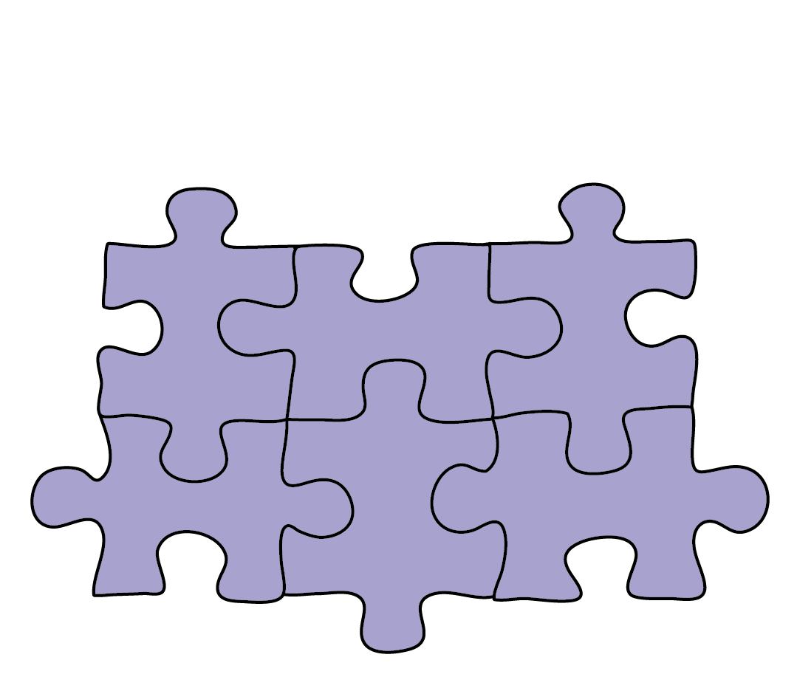
Stage 1
Identify errors & Explain
Stage 2:
Reflect, Understand & Learn
Notes:
So in stage 1 of this ID the Error exercise, the students need to identify any pieces of the puzzle that don’t fit with the given diagnosis. If they fail to identify the specified errors, all is not lost; they get another chance to earn the points. In Stage 2 of the exercise, after being given the answers, they need to write an explanation of why the specified errors fit more precisely than the ones they chose. This requires them to reflect, and to recognize and utilize their mistakes as learning opportunities .
I believe that my role as a teacher and mentor is much more than imparting the subject matter. I want to help guide my students become critical thinkers and problem solvers who are able to harness their failures to grow and flourish, not to let their failures discourage or destroy them.

Slide 12
Our failures provide the opportunity to become
better students
better mentors
better people
Notes:
Our failures provide the opportunity to become better students, better mentors and overall, better people.

