Slide 1

Don Saucier
Introduced by Tucker Jones

Slide 2
Reflecting on and Sharing Our Failures

Slide 3
We should share our failures
We can normalize and learn from our and others’ failure

Slide 4
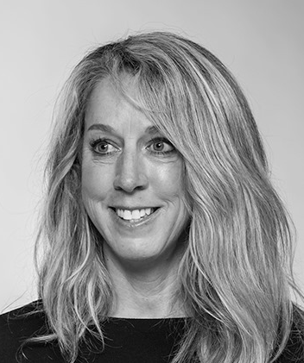
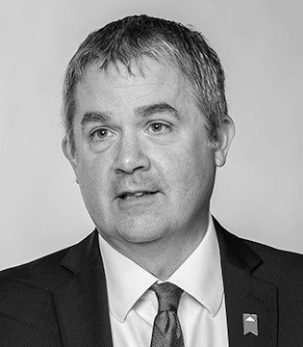
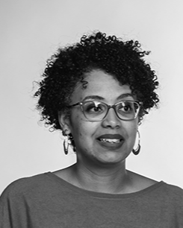
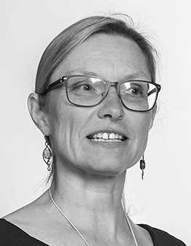
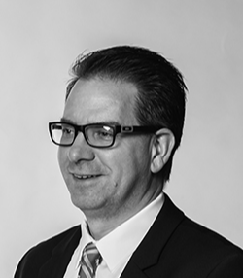
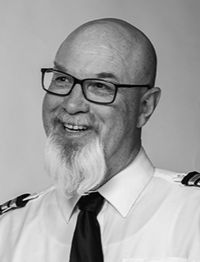
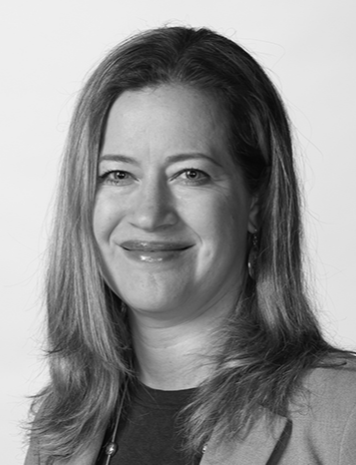
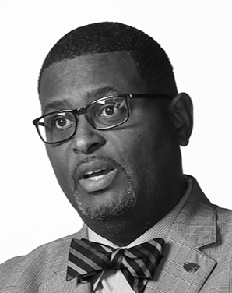
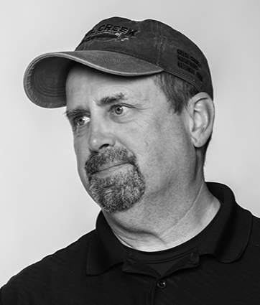
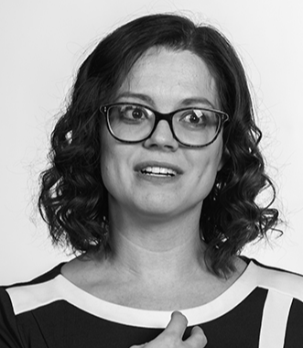
What I Learned
We All Fail

Slide 5
What I Learned
Failures Have Consequences

Slide 6
What I Learned
Excellent Teachers Learn from Failure

Slide 7
I Fail A Lot

Slide 8
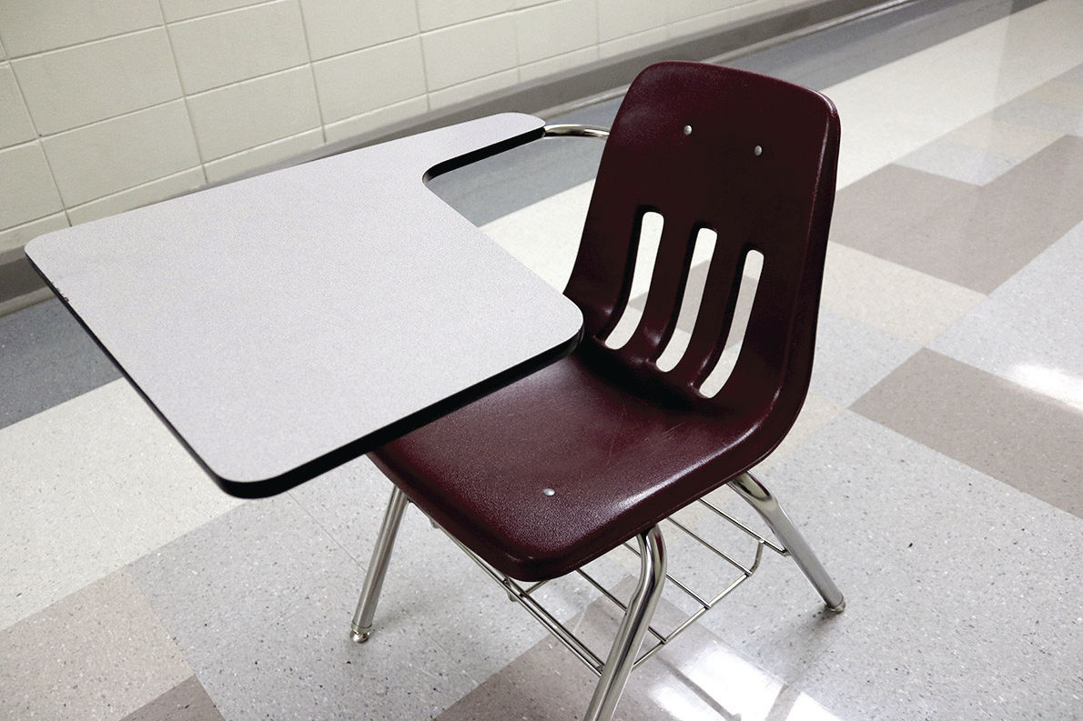

Slide 9

Miller Library, Colby College

Slide 10
Publication Ordeals

Slide 11
Failed Job Searches

Slide 12
Failure → Social Psychology

Slide 13
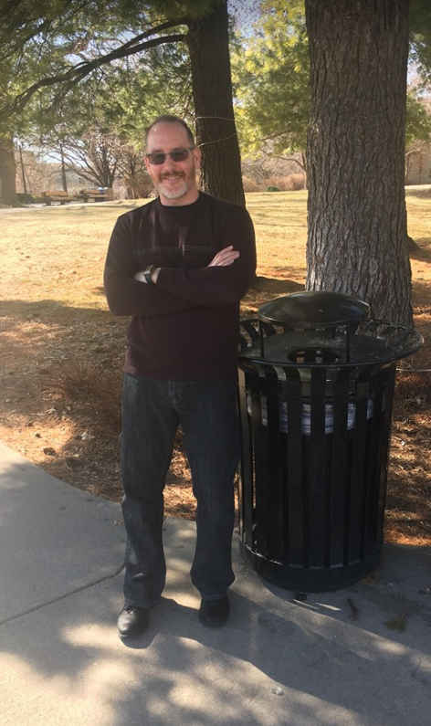

Slide 14
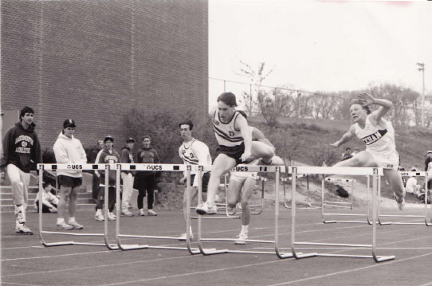

Slide 15
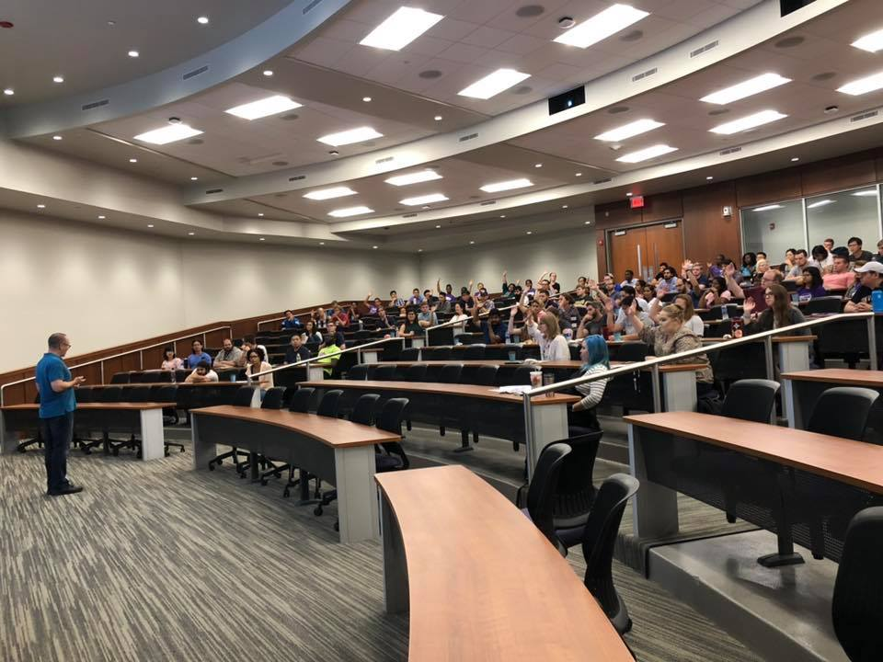
Teaching is the best thing we do
Let’s keep talking about failure.

Slide 16
Thank you for attending SPOTLIGHT K-State!
#ITeachAtKState

