Slide 1
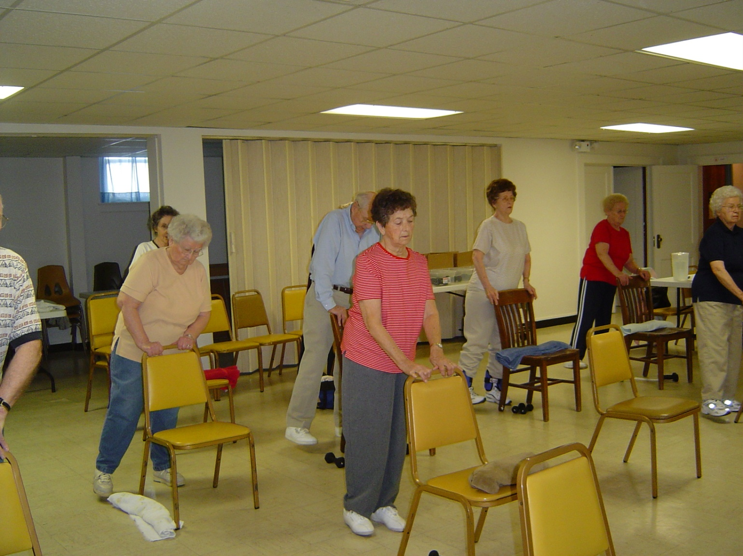
Stay Strong, Stay Healthy
Steve Ball
Susan Mills-Gray
August 26th, 2015

Slide 2
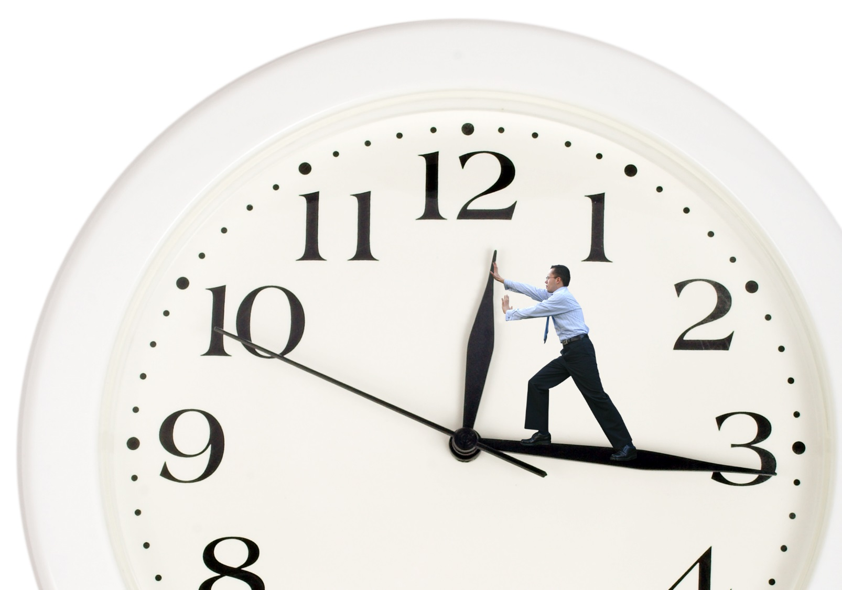
Not enough time
Inconvenient
Intimidated
Never exercised
Poor health/fatigue
Lack of facilities
Bad weather

Slide 3
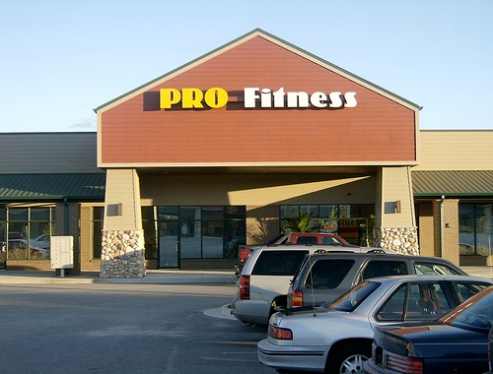
Pro Fitness
Columbia, MO

Slide 4
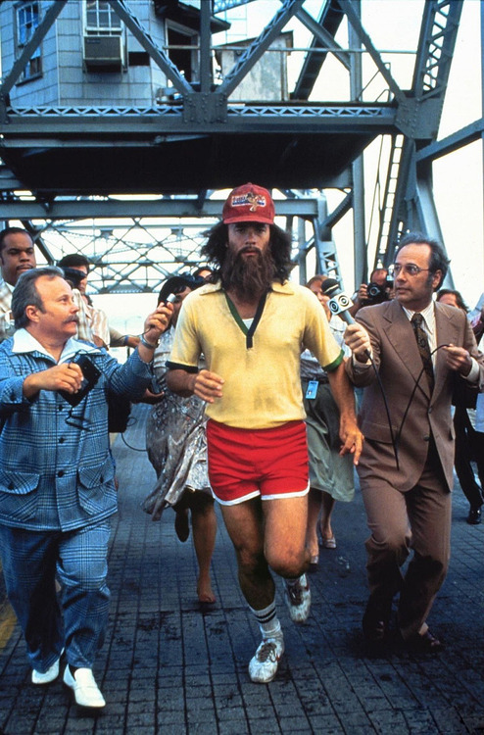
Reasons for
Exercising (Pros)
Health and fitness
Enjoyment
Relaxation
Challenge
Social
Appearance
Competition
Feel good about self
Chance to be outdoors

Slide 5
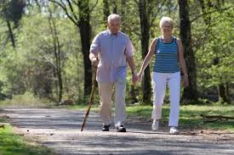
Heath Benefits
All-cause mortality (live longer)
Coronary heart disease
Hypertension
Lipid disorders
Type 2 diabetes
Cancer (breast and colon)
Depression, anxiety disorders
Osteoporosis
Obesity
Frailty
Falls
Sleep problems
Cognitive impairment, Alzheimer’s Disease?

Slide 6
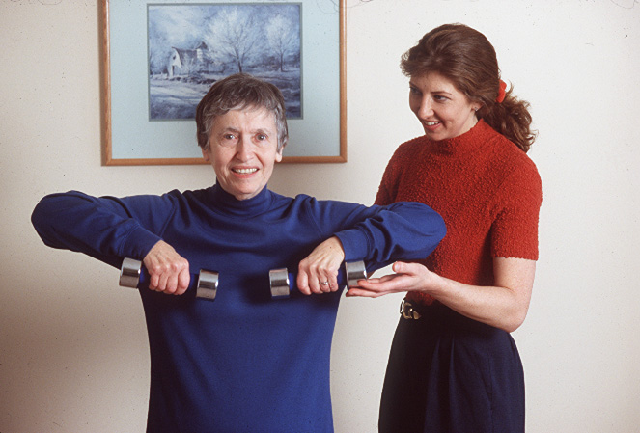

Slide 7
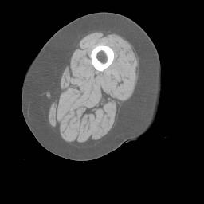
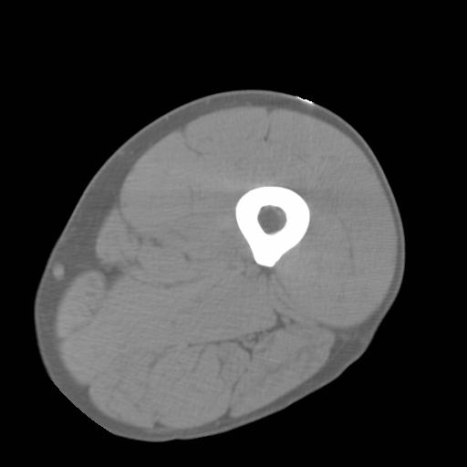
Sarcopenia
Young, active
Older, sedentary
Notes:
On the left is a picture of an active 23-year-old female. The view shown is a cross-section of the thigh. The dark grey is fat, the light grey is muscle, and the white ring is bone. As you can see, her muscle makes up approx. 90% of the thigh.
On the right we have a picture of a sedentary 68-year-old woman. Again the view is of the thigh, but in this picture her muscle makes up only takes up 50-60% of her thigh. This is called sarcopenia, which is defined as the age-related loss of muscle.
Strength training is a powerful antidote to combat this loss. It will allow one to build back or at least maintain muscle mass, in turn reducing sarcopenia and help people stay strong and fit as they age.

Slide 8
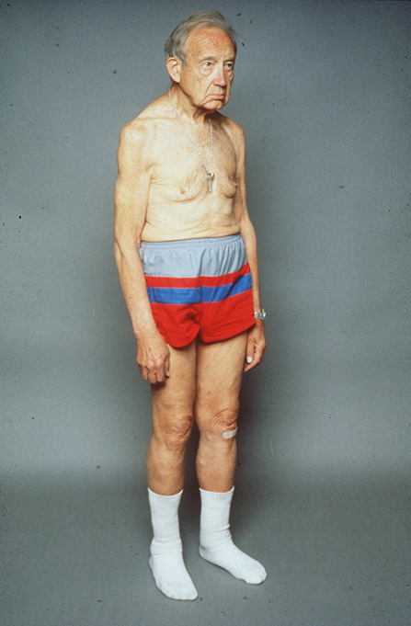
Notes:
This man in his 70’s is a healthy runner.
He has great cardiovascular fitness but you can see he has lost much of his muscle mass. This scenario is particularly troublesome, because although his heart will remain strong and healthy, he will likely have difficulty carrying out basic activities of daily living that require minimal muscular strength.

Slide 9
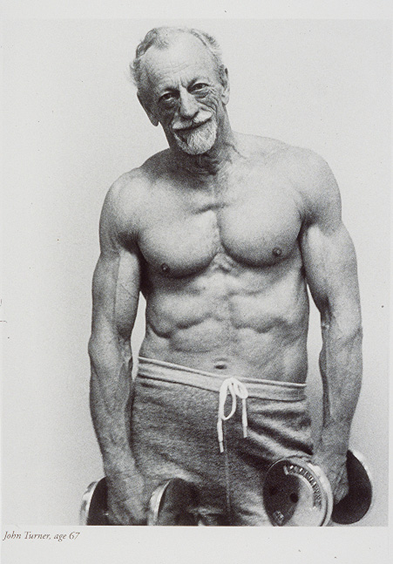
Notes:
This is Mr. Turner, age 67. He is an avid strength trainer – with an amazing body!

Slide 10
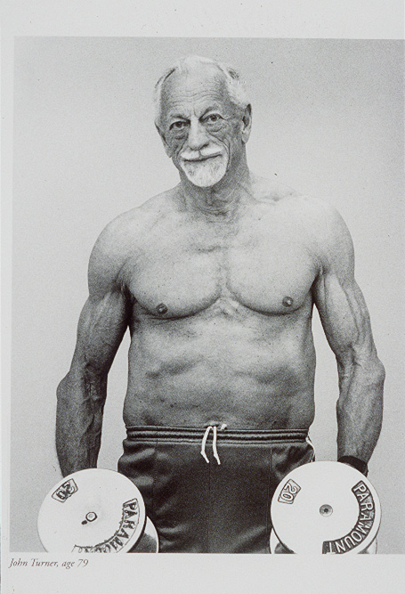
Notes:
Here is Mr. Turner 12 years later, at age 79.
He has kept much of his muscle mass through strength training and healthful eating habits.

Slide 11
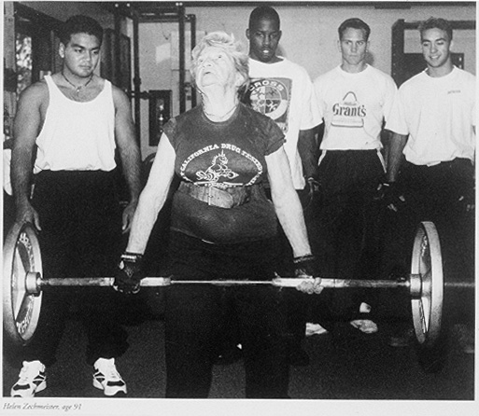
Notes:
Helen is a an avid weight lifter - She is 93 in this photo – dead lifting 85 pounds! Look at the guy’s faces in the back!

Slide 12
Why Strength Train?
Preserve or gain back muscle
Preserve or gain back bone
Improve strength and balance (reduce falls)
Maintain or boost metabolic rate
Improve glucose control and lipid profile
Reduce arthritis symptoms
Improve mood: self-esteem, self-confidence
Decrease depression
Improve sleep
Notes:
These are some of the benefits of strength training that have been demonstrated through research.
Comments from the evaluations received from SW classes include “I feel I have” :
More muscle—vacuuming story
Better body so I look better –perhaps through increased metabolic rate
Better strength and balance—house painting story
Reduced arthritis pain
Better mental outlook, more self confidence
More energy –perhaps from sleeping better; house painting story

Slide 13
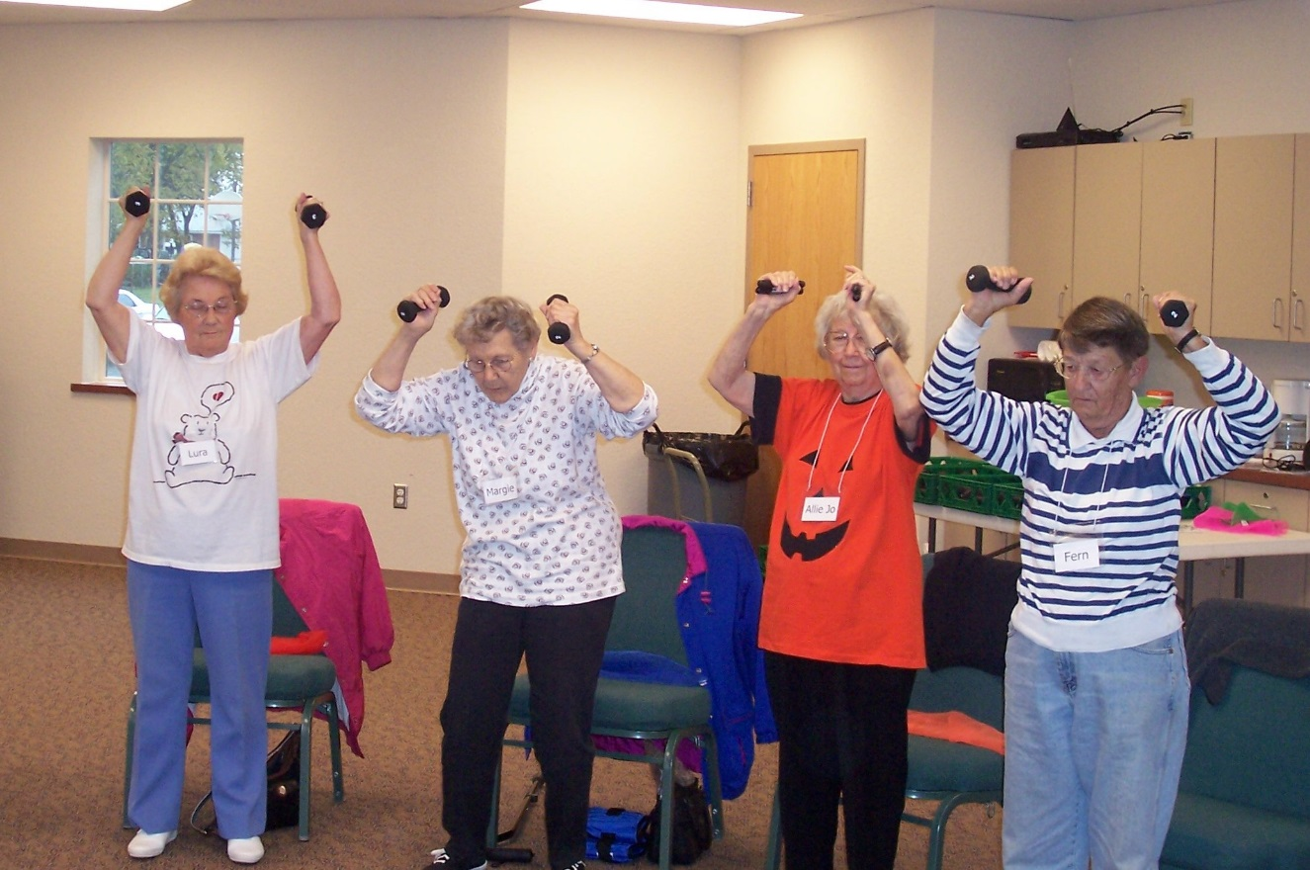

Slide 14
Bone
44 million American men and women
have low bone density or osteoporosis
Notes:
Throughout childhood and early adulthood, our bones are growing – in length and density. Around our late 30’s and into our 40’s, we begin to slowly lose bone, which is accelerated at menopause.
Since our population is living longer (life expectancy of 77.6 years, 80.1 for women), bone loss continues to occur as age increases.
Currently, osteoporosis is a major health issue for 55% of people over age 50.
This is about 1 in 2 women and 1 in 5 men.
One is two women will have an osteoporosis fracture in their lifetime.

Slide 15
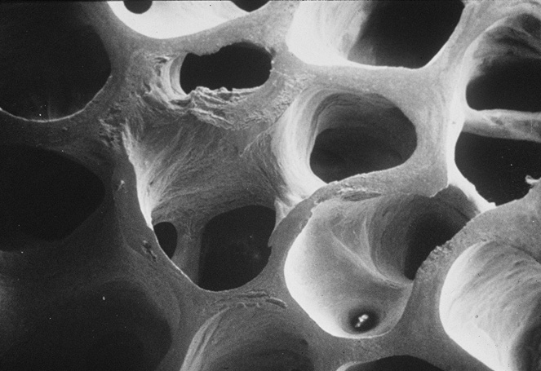
Notes:
This slide represents what a strong dense bone looks like.
This is the healthy bone tissue of a 73-year old woman. Note the well formed trabeculi—the spongy structure of the bone.

Slide 16
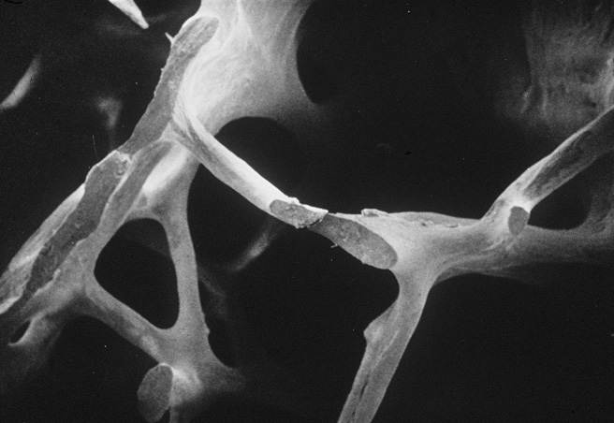
Notes:
This is the bone of a 42 year old woman with osteoporosis – you can see she has weak brittle bone. You can see the open spaces where the trabeculi aren’t formed.
To combat this loss of bone women can and should perform weight bearing exercise such as walking and strength training. These activities have been shown to maintain and even increase bone density.
Reduced bone density makes people very vulnerable to fracture. One out of 6 women in the US will have a hip fracture. The risk of dying from complications of a hip fracture are equal to a woman’s risk of dying from breast cancer.

Slide 17
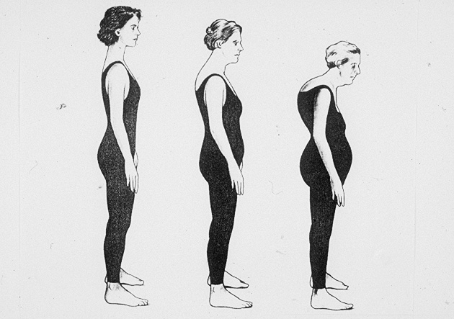
Notes:
Many people think of these pictures as “typical” aging ---- but it’s not. Osteoporosis is a clinically diagnosable condition– and it is largely preventable.
Osteoporosis is a silent disease, and is shown in these pictures. Notice the pronounced changes in posture. Bone loss results in small fractures in the spine causing the hump, or kyphosis.
Living with osteoporosis is devastating. It changes your:
functional capabilities
self-image
social role ( look and feel older)
role as a family member (now a person with a problem)

Slide 18
SSSH Program is based on solid research
Adapted from Dr. Miriam Nelson’s Strong Women Program
Notes:
I will briefly summarize three studies conducted at Tufts in which Dr. Nelson and others were involved and upon which the StrongWomen Program is based. You have copies of these and other studies in your Tool Kit. I, personally, found these studies initially daunting to read. However, in preparation for today’s presentation I felt it was necessary to make the effort. I’m sharing that with you to encourage you to skim through these papers at the very least.
Read the abstract, methods and results to get the big picture. I think you’ll be amazed at how much more sense it makes for the rationale of the selection of exercises in your Tool Kit that you’ll use in your classes.
For example, the exercises are selected because they trained the major muscle groups attached to the bones of interest.

Slide 19
Strength Training and Bone
Strength Training
(n=20)
Sedentary Control
(n=19)
Postmenopausal
Women
(50-70 yrs old)
RCT, 1 year duration
Nelson, et al., JAMA 1994
Notes:
This is the first study I’ll review on strength training and bone. In the early 90’s, Dr. nelson conducted a one-year randomized controlled trial to examine the effects of strength training on bone density in postmenopausal women. 40 postmenopausal women were divided into two groups. One group strength trained using a select set of exercises 2 days a week for a year. The control group was asked to maintain their current level of physical activity which included no strength training and less than 20 minutes of aerobic exercise 2x/week.

Slide 20
Results After One Year
Muscle strength increased 76%
Muscle mass increased 1.4 kg
Fat decreased 1.4 kg
Balance improved 14%
Physical activity increased 25%
Notes:
Read the slide.
It is interesting to note here that low muscle strength and muscle mass and poor balance are all risk factors for falls in the elderly, but have the potential to be modified by a single intervention.
Essentially, these women in the strength training group were stronger, fitter, and healthier through this very simple regimen.

Slide 21
Bone Mineral Density (BMD)
*
**
†
Change (%)
*p=0.02
**p=0.04
†p=0.12
Control
Exercise
Notes:
The changes for the Exercise group were significantly greater (see the P values) for all 3 measurements.
In addition, the strength training group increased their bone mineral density by about 1%, while the control group decreased their BMD to the “expected” loss of about 2%.
Just a simple twice weekly program has these powerful effects.
BMC = Bone Mineral Content

Slide 22
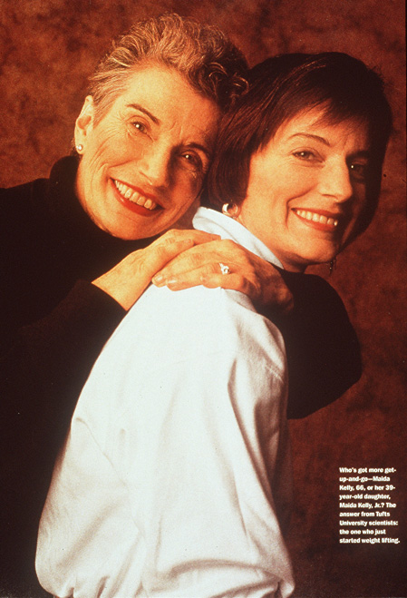
Notes:
If you are strength training, you are more likely to look vibrant like the woman in this picture. Maida, on the left, was a participant in one of the original strength training studies. Afterwards, the women’s daughters were brought in, and without exception, the mothers were all stronger than their daughters.

Slide 23
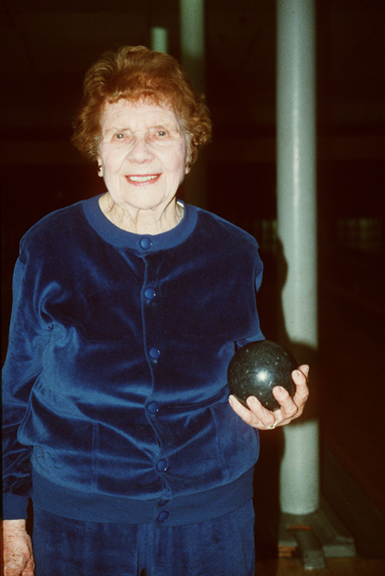
Notes:
This is Bernice. She is 93 years old, still strength training, living independently, bowling, etc. She was part of the 1994 study.

Slide 24
Arthritis
≈40 million American men
and women have arthritis
Notes:
Arthritis is a disease which causes inflammation of the joints resulting in pain and swelling.
It is a chronic condition that affects more than 40 million American men and women, and is the leading cause of disability.

Slide 25
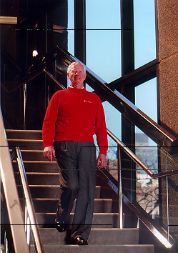
Notes:
Strength training research has also showed benefits for people with arthritis.
This is Al. as you may know, walking down a flight of stairs can be very painful for people with knee osteoarthritis.
When he joined the study, he couldn’t walk down the stairs, as you see him doing here.

Slide 26
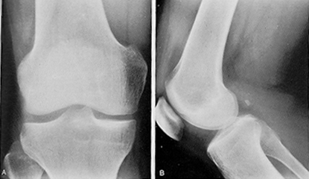
Normal Knee Radiograph
Notes:
As some of you may know, arthritis occurs when the cartilage between bones starts to wear away and crack.
This is a normal, healthy knee.

Slide 27
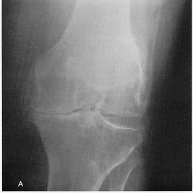
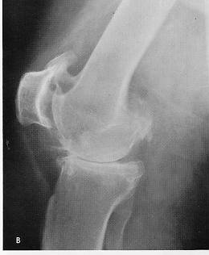
Osteoarthrosis Knee Radiograph
Notes:
This is an osteoarthritis knee x-ray. Bony surfaces are exposed to one another, resulting in pain and stiffness within that particular joint. There is little cartilage. Bone is on bone.
Through strength training and stretching not only can some of this discomfort be eliminated but muscular strength and joint mobility can also be improved. You can build up the quadriceps muscle and provide more support for the bones.

Slide 28
Home-Based, 4-Month Study
Randomized
Control-trial
Attention Control
n=22
Strength Training
n=22
Baker, et al., Journal of Rheumatology, 2001
Notes:
Here is another randomized controlled trial from Tufts. Volunteers with knee osteoarthritis – Al, who we saw earlier, was one of them – were randomized to the control group or the strength training group.
Strength trainers lifted weights for 4 months in a home based program – a program that uses the same equipment as the StrongWomen program. (2 sets of 12 reps 3x/wk)
Attention control group received nutrition education to change eating behavior.

Slide 29
Study Findings
  Muscle strength + 71% Chair stands and stair climbing + 15%
  Pain – 43%
  Physical function + 44%
  Depression reduced
  Self-confidence improved
Notes:
The results were impressive. After only 4 months, strength training subjects experienced the following benefits: Read slide

Slide 30
SSSH Mission
To improve the health and well-being of older adults by increasing access to a
structured, safe, and effective strength training program

Slide 31
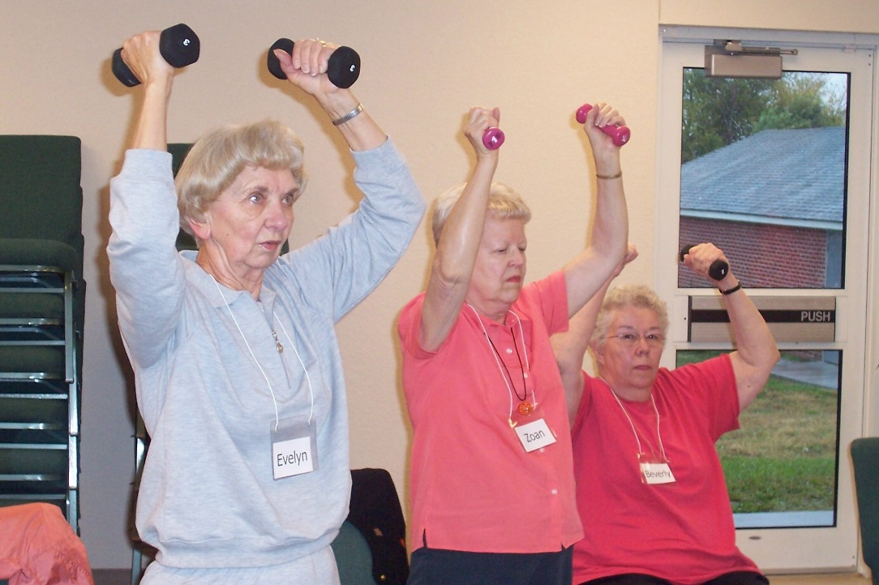
SSSH In Missouri
4048 participants reached
75% completing program
85% of participants are female
61% of the state is reached (80 counties).

Slide 32
Missouri Results
95% feel better because of the program
94% feel physically stronger
90% feel more flexible
87% feel they have more energy
61% improved in four to five of the assessments
84% improved three to five of the assessments
82% improved in at least one pre/post assessment

Slide 33
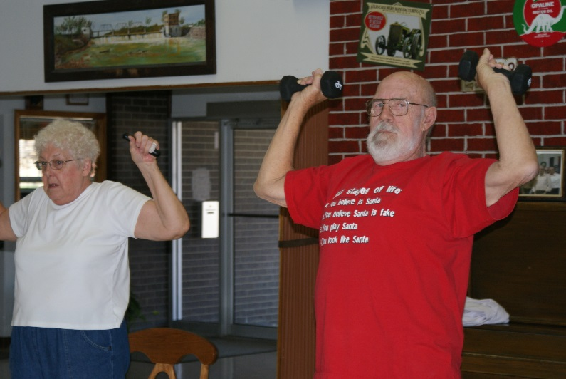
Intermediate outcomes
89 percent continued to lift weights
92 percent report ability to do everyday tasks improved
72 percent described activity level as “somewhat more” or “a lot more”
73 percent report health as “somewhat improved” or “a lot more improved”

Slide 34
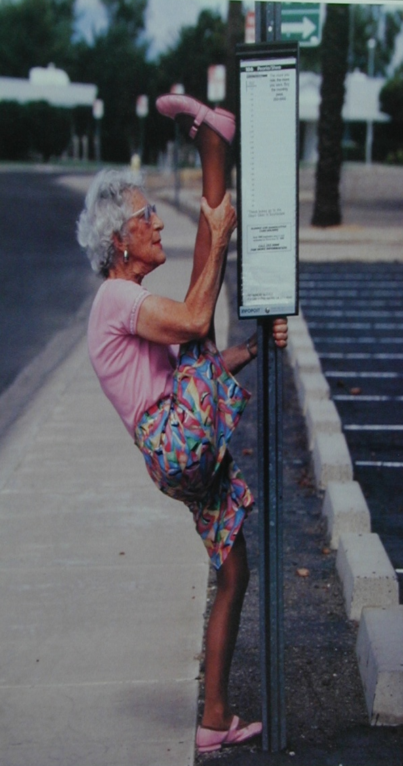
Big improvements in Flexibility!

Slide 35
Documenting Fitness Assessments
Chair Stand
  Record in number of stands fully completed in :30 seconds
Sit/Reach
  Record number of inches to the ½ inch
Back Scratch
  Record number of inches to the ½ inch
8-Foot Up-and-Go
  Record score in number of seconds to the 1/10th of a second
Balance Tests
  Record score in number of seconds to the 1/10th of a second

Slide 36
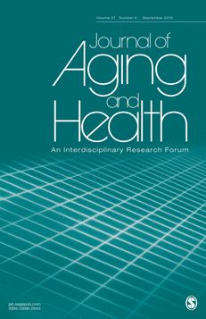
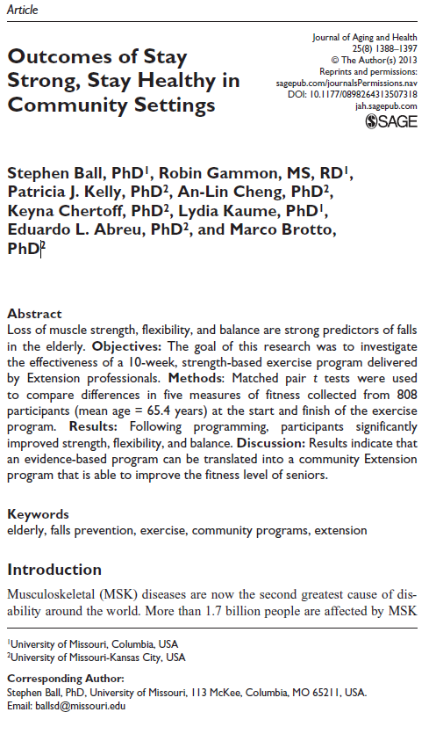

Slide 37
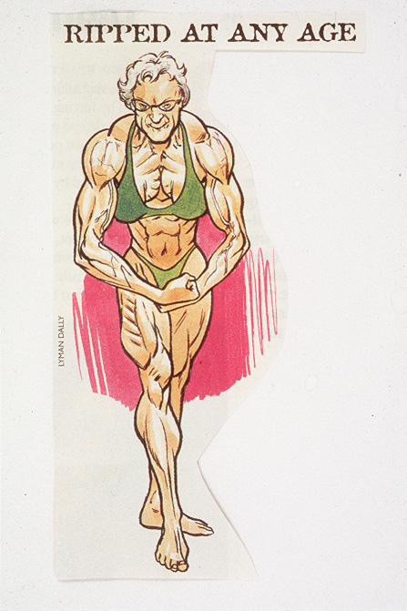
Notes:
This is NOT an ‘after’ picture of a participant who has completed the StrongWomen Program!
Women often think they’ll bulk up if they strength train, but you can assure your participants that
they will not look like this!

Slide 38
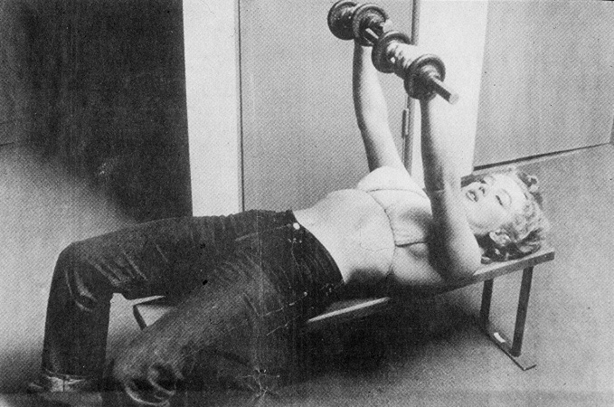
Notes:
Strength training, and the muscles it enhances, give us our beautiful female shape, as we saw with Marilyn Monroe.
It is important to remind yourself and the women in your classes that you won’t bulk up from this program.

Slide 39
https://www.youtube.com/watch?v=k5CJUB4zRU4
https://www.youtube.com/watch?v=rlsmLUs3ZM8

