Slide 1
Nutrition policy:
How new data on the cost & affordability of healthy diets
can help improve food access in Malawi and worldwide
William A. Masters
Friedman School of Nutrition Science and Policy
Tufts University
william.masters@tufts.edu
https://sites.tufts.edu/foodpricesfornutrition
USAID Bureau for Resilience and Food Security -- 16 June 2022

Slide 2
Our findings in one slide
Measuring the cost & affordability of healthy diets can guide nutrition policy
Standardized data & methods (SOFI 2020-2022, from FAO, IFAD, UNICEF, WFP and WHO)
retail prices for food items: from Malawi NSO & other countries’ stats agencies, World Bank ICP etc.
global standards for diet quality: nutrients, plus food-group adequacy to meet dietary guidelines
matched to food composition: new Malawi , then select least-cost items at each place to meet global standards
We find that:
real costs per day are similar around the world (averaging c. US$3.31 for an average person in 2017)
in Malawi, cost per day is slightly below world average (US$2.72)
In Malawi, cost per day exceeds available income for >90% of people, and is 2x actual food expenditure
In Malawi (and the global total of 3 billion who cannot afford a healthy diet), key barrier is lack of access
=> policy remedies start with increased supply of healthy foods, and safety nets for those in greatest need
also need to ease preparation of healthy meals, and avoid displacement by unhealthy foods
Elsewhere (for the global total of 4.9 billion who could buy a healthy diet), other barriers apply
=> policy remedies start with avoiding displacement by unhealthy foods, and easing preparation of healthy meals
also need to increase supply of healthy foods, and safety nets for those in greatest need

Slide 3
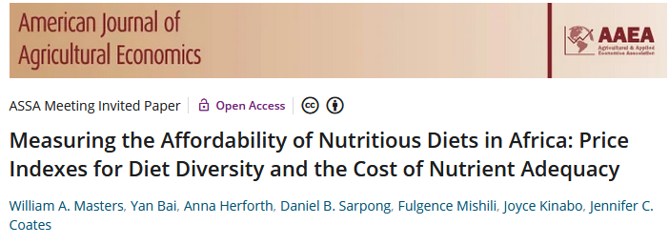
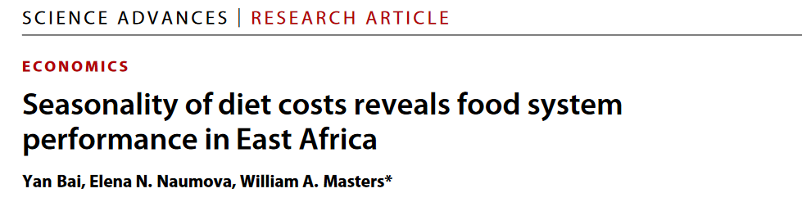
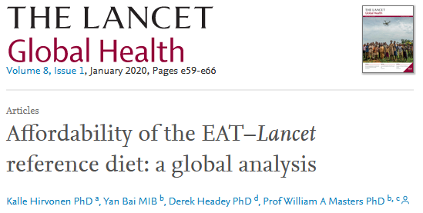
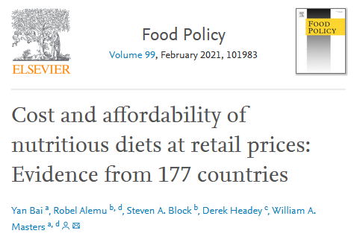
Policies and programs pursue
what they measure
The Food Prices for Nutrition project equips decisionmakers
with new metrics for the cost and affordability of healthy diets
Results help guide policies and programs by
-- distinguishing unaffordability from other barriers to healthy eating
-- guiding intervention towards universal access via lower costs and safety nets
-- revealing where other interventions are needed, beyond price and income
 |  |  | Food preferences, convenience and other goals (including food security, diet diversity, sustainability, equity and inclusion)
 | Caloric adequacy (short-term subsistence)
Health effects are invisible and delayed, so food choice among affordable options remains dominated by these objectives ->
 |  |  | Healthy diets (meet food group recommendations)
 |  | Nutrient adequacy (avoid deficiencies and excesses of essential nutrients )
 | Daily energy (short-term subsistence)
Source: Food Prices for Nutrition (2022). https://sites.tufts.edu/foodpricesfornutrition

Slide 4
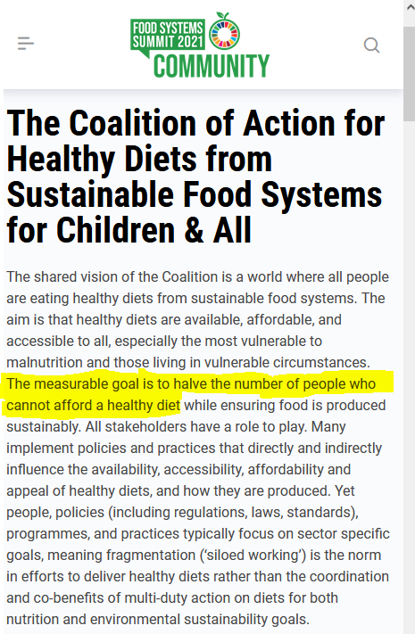
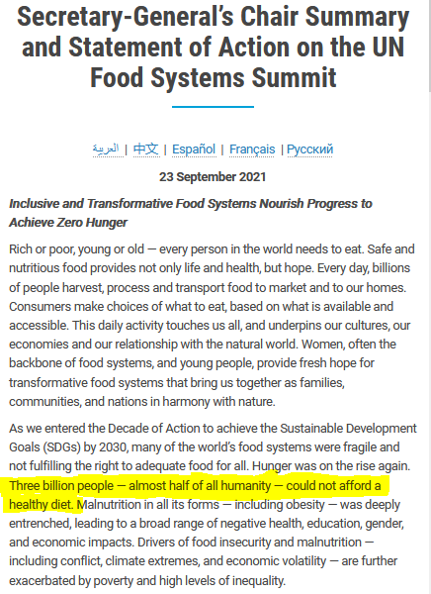
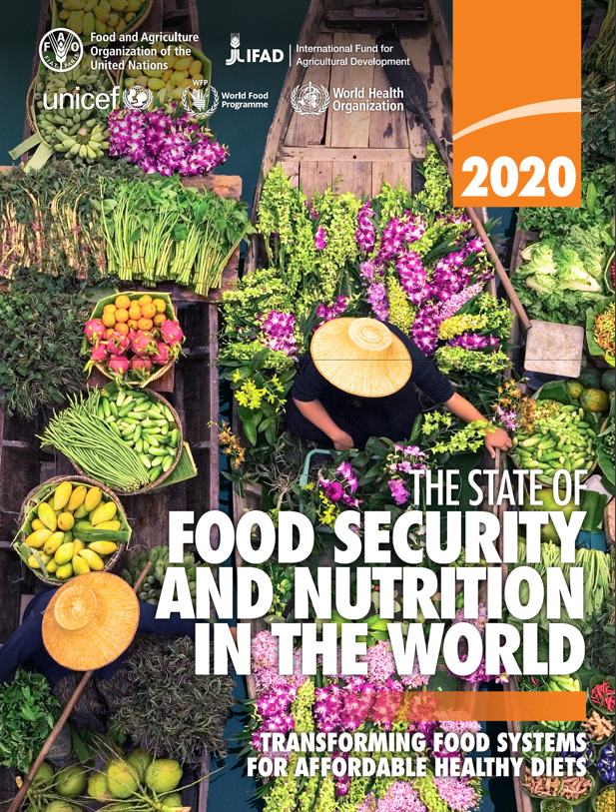
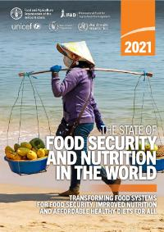
Coordinated global actions are needed
The FAO provides worldwide leadership
through the UN system to national governments
Technical background papers behind SOFI 2020 and 2021, published by FAO, IFAD, UNICEF, WFP and WHO
These data provide actionable new targets
New results for SOFI 2022, and our World Bank data hub on Food Prices for Nutrition, will be launched in July 2022
Source: UN Food System Summit (New York: United Nations): https://www.un.org/en/food-systems-summit/news/making-food-systems-work-people-planet-and-prosperity; https://foodsystems.community/coalitions/the-coalition-of-action-for-healthy-diets-from-sustainable-food-systems-for-children-all

Slide 5
Affordability of healthy diets is necessary but far from sufficient for healthy outcomes
Many foods are available at each time & place
For access and affordability, focus on least-cost items that meet dietary needs
Our innovation is to measure access with the most affordable locally-available items
that would meet international standards for a healthy diet
Previous work focuses on the cost of all foods for CPI to measure inflation
or the prices of a few farm commodities rather than hundreds of retail items
For policy relevance, we define a healthy diet using dietary guidelines
 |  |  |  | Cost of other objectives e.g. for health and sustainability
 |  |  | Cost of a Healthy Diet Meets most governments’ dietary guidelines, through target quantities of each food group | Healthy diets (meet food group recommendations)
 |  | Cost of Nutrient Adequacy Meets DRI targets for macro- and micro-nutrients as first formulated by Stigler (1945), still widely used for specific interventions such as WFP’s Fill the Nutrient Gap programs
 | Cost of Daily Energy Meets only calorie needs, for short-term survival and physical work
The diet quality standard here is a “Healthy Diet Basket”
of 11 items
in 6 food groups

Slide 6
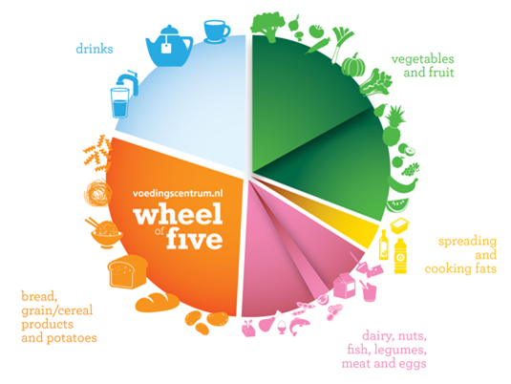
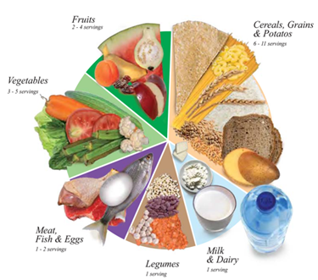
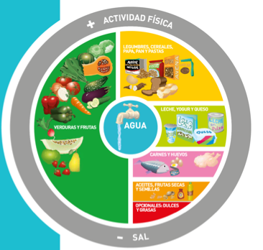
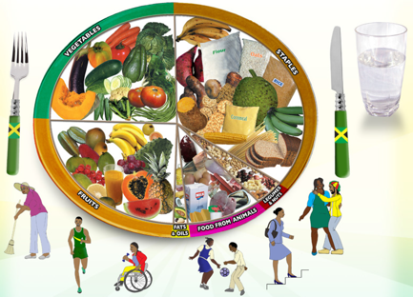
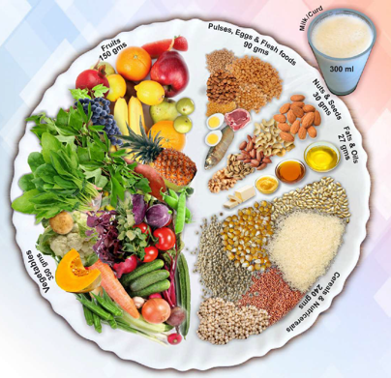
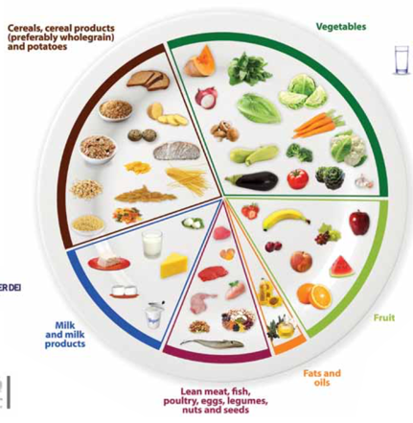
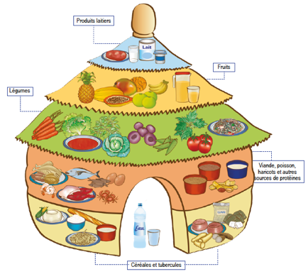
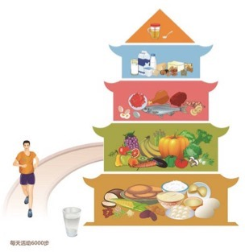
How do we define healthy diets to measure their cost
and affordability?
Use least-cost items needed to meet dietary guidelines
Meet target quantities of each food group
Maintain energy balance by converting volume and weight targets to calories
Food group targets differ, but within a narrow range
For SOFI 2020, used median cost of meeting 10 quantified guidelines from all UN regions
Now we use a single Healthy Diet Basket derived from 31 guidelines with food guides
Meeting targets for 6 food groups leads to nutrient-adequate diets within most guidelines
Quantities of food in the healthy diet
Typical weight (grams) | Typical volume (plate share)
322g dry rice | 25%
270-400g veg. | 25%
230-300g fruits | 25%
210g egg | 25%
85g dry bean
34g oil
Definition of the Healthy Diet Basket
Food group | Number of items | Total energy (kcal)
Starchy staples | 2 | 1160
Vegetables | 3 | 110
Fruits | 2 | 160
Animal-source foods | 2 | 300
Legumes, nuts & seeds | 1 | 300
Oils and fats | 1 | 300

Slide 7
How does the healthy diet basket work in practice?
Examples of actual least-cost Healthy Diet Baskets in selected countries, using items and prices from 2017 ICP data
Malawi |  |  |  | Senegal |  |  |  | Pakistan
Item name | Qty (g/day) | Cost (USD/day) |  | Item name | Qty (g/day) | Cost (USD/day) |  | Item name | Qty (g/day) | Cost (USD/day)
Maize flour, yellow | 161 | 0.07 |  | Maize grains, white | 161 | 0.19 |  | Wheat flour | 161 | 0.19
Rice, 25% broken | 161 | 0.26 |  | Rice, 25% broken | 164 | 0.22 |  | Maize | 161 | 0.22
Cabbage, fresh | 147 | 0.12 |  | Onions, fresh | 108 | 0.23 |  | Onions, fresh | 108 | 0.19
Aubergine, fresh | 147 | 0.22 |  | Carrots, fresh | 106 | 0.24 |  | Carrots, fresh | 106 | 0.21
Carrots, fresh | 89 | 0.26 |  | Aubergine, fresh | 173 | 0.33 |  | Water spinach | 103 | 0.23
Mango, large | 133 | 0.17 |  | Dates, dried | 29 | 0.17 |  | Bananas | 89 | 0.39
Bananas | 90 | 0.22 |  | Mangoes, fresh | 132 | 0.25 |  | Coconut, green | 49 | 0.52
Sardines, dried | 37 | 0.54 |  | Sardines, dried | 36 | 0.12 |  | Buffalo milk, raw | 149 | 0.41
Milk, fresh | 234 | 0.55 |  | Small fish, dried | 36 | 0.25 |  | Chicken, live | 68 | 0.58
Groundnuts, whole | 52 | 0.13 |  | Groundnuts, whole | 52 | 0.12 |  | Dhal, musur | 82 | 0.33
Soybean oil | 34 | 0.18 |  | Palm oil | 34 | 0.19 |  | Vegetable oil | 34 | 0.19
Total cost (USD/day) |  | 2.72 |  | Total cost (USD/day) |  | 2.29 |  | Total cost (USD/day) |  | 3.44

Slide 8
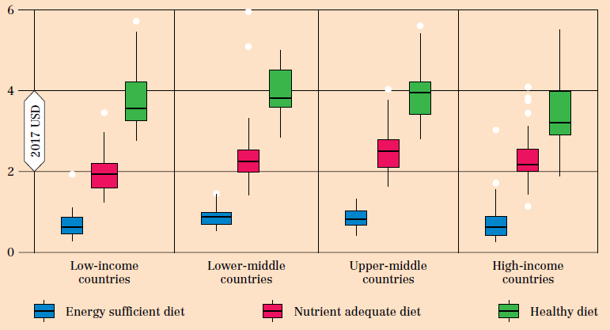
What did the SOFI 2020 work reveal about diet costs
around the world?
The cost of energy sufficient, nutrient adequate and healthy diets by country income group in 2017
Least-cost items in each place generally have similar prices for lower- and higher-income people
Smaller step up,
due primarily to
lower prices for dairy
c. $3.50/day
Cost of a Healthy Diet
c. $2.00/day
Cost of Nutrient Adequacy
c. $0.75/day
Cost of Caloric Adequacy
Source: Figure 2 of Herforth et al. (2020). Cost and affordability of healthy diets across and within countries. Background paper for
The State of Food Security and Nutrition in the World 2020. FAO Agricultural Development Economics Technical Study No. 9. Rome, FAO.

Slide 9
What did the SOFI work reveal about affordability?
Cannot afford sufficient daily energy
(global total ≈ 185 million,
ave. cost = PPP$0.79)
Percent of population, by country in 2017
About 3 billion people (38% of world) could not afford a healthy diet in 2017
Monitoring diet cost and affordability complements other ways of measuring poverty and food insecurity:
≈ 690 m. below $1.90/day
≈ 653 m. undernourished (“PoU”, from 1960s)
≈ 1.9 b. experience food insecurity (“FIES”)
Cannot afford a nutrient-adequate diet
(global total ≈ 1.5 billion, ave. cost=PPP$2.33)
Africa: 596 million
latest updates (through 2019) here:
S Asia: 1.3 billion
Cannot afford a healthy diet
(global total ≈ 3.0 billion, ave. cost=PPP$3.75)
SE Asia: 326 million
Africa: 829 million
Source: FAO, IFAD, UNICEF, WFP and WHO (2020). The State of Food Security and Nutrition in the World 2020, FAO, Rome.

Slide 10
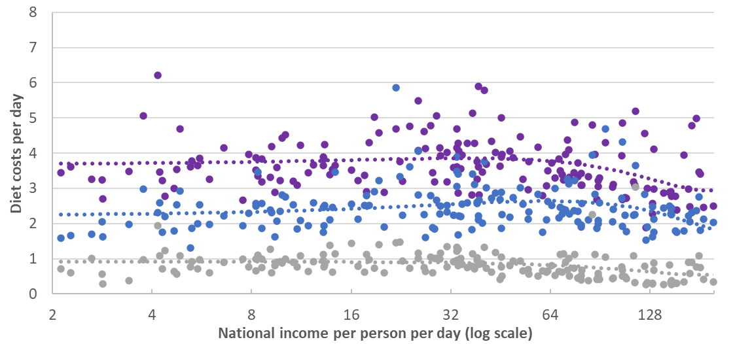
Does adding sustainability
criteria raise diet costs?
Diet costs at each level of national income (2017, in US dollars at PPP prices)
● Healthy diet (meets national dietary guidelines)
● Nutrient adequate
(within bounds for 23 essential nutrients)
● Calorie adequate
(energy balance)
Source: Food Prices for Nutrition (2021). Data shown are national averages for 166 countries in 2017, in US dollars at 2017 PPP price levels. Chart omits two small countries with outlier national income levels, Singapore (240/day) and Qatar (260/day). Regression line is cubic function of income, and methods for diet cost are as defined in the technical background paper accompanying SOFI 2020 (Herforth et al. 2020).

Slide 11
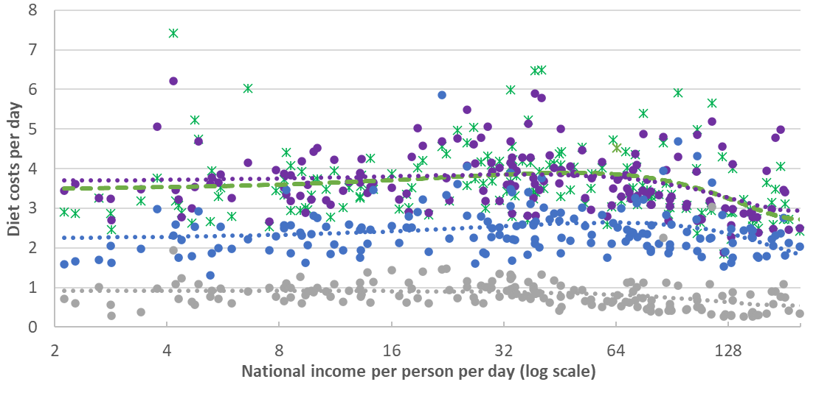
Does adding sustainability
criteria raise diet costs?
No, because least-cost healthy diets already use very few animal foods
Diet costs at each level of national income (2017, in US dollars at PPP prices)
* EAT-Lancet reference diet
(flexitarian version)
● Healthy diet (meets national dietary guidelines)
● Nutrient adequate
(within bounds for 23 essential nutrients)
● Calorie adequate
(energy balance)
Source: Food Prices for Nutrition (2021). Data shown are national averages for 166 countries in 2017, in US dollars at 2017 PPP price levels. Chart omits two small countries with outlier national income levels, Singapore (240/day) and Qatar (260/day). Regression line is cubic function of income, and methods for diet cost are as defined in the technical background paper accompanying SOFI 2020 (Herforth et al. 2020).

Slide 12
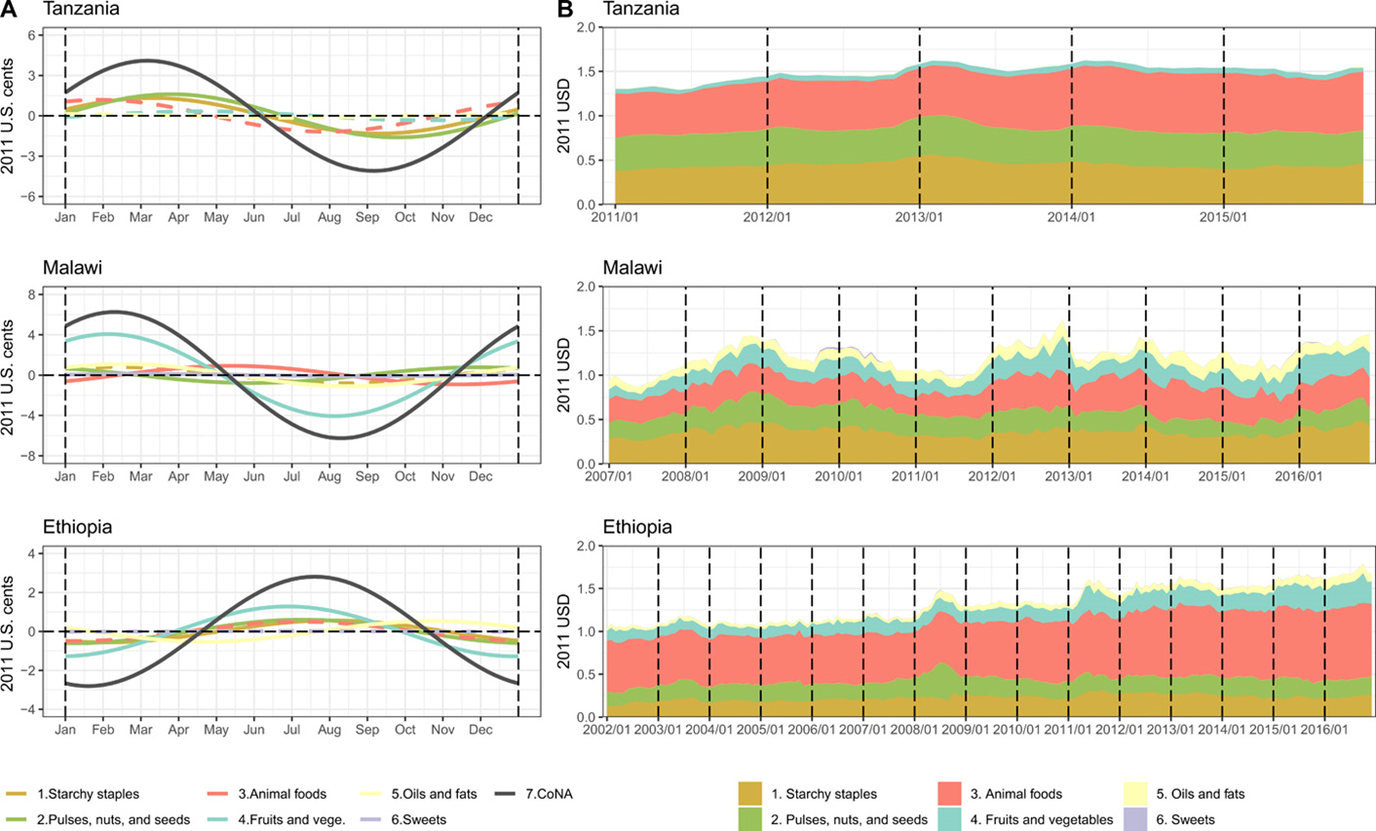
Diet cost data can guide national policy towards resilient food markets
Energy shares of least-cost diets
Seasonality of diet costs and cost by food group in Tanzania, Malawi and Ethiopia
Source: Bai, Y., E. Naumova and W.A. Masters (2020). Seasonality in diet costs reveals food system performance in East Africa. Science Advances, eabc2162.

Slide 13
Seasonality in vegetal food prices remains an important obstacle
to year-round healthy diets
Seasonality of rural food prices in Malawi, by category
Perishable vegetal foods
Non-perishable vegetal foods
Animal sourced foods
Source: Schneider, K.R., L. Christiaensen, P. Webb and W.A. Masters (2022). Assessing the Affordability of Nutrient-Adequate Diets. American Journal of Agricultural Economics, forthcoming.

Slide 14
The cost of nutrient adequacy varies by demographic group, due to different requirements
Variation in least-cost diets by age, sex and reproductive status across 172 countries in 2017
Cost per day is highest for adolescents or during lactation, due to high needs for total energy and nutrients
Cost per calorie is highest for girls and women, due to high nutrient needs per unit of dietary energy
Source: Bai, Herforth and Masters, 2022. Global variation in the cost of a nutrient-adequate diet by population group. Lancet Planetary Health 6(1): 19-28.

Slide 15
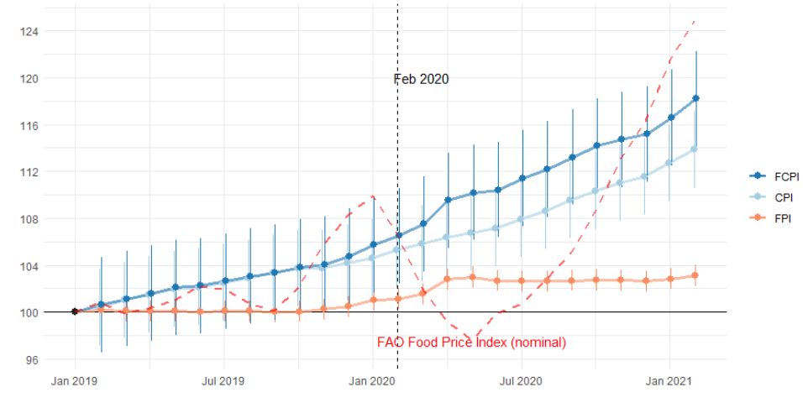
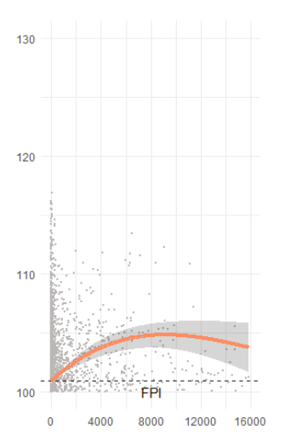
COVID impacts are mostly on income, but may include higher food prices
Monthly change in global consumer price indexes for food versus other items
(180 countries, Jan. 2019 – Feb. 2021)
Association with
cumulative COVID case counts
Larger (5%)
rise in countries
with higher case counts
3% rise in real food CPI since March 2020
(and does not follow commodity prices)
Source: Bai, Y. et al. (2022), Retail prices of nutritious food rose more in countries with higher COVID-19 case counts. Nature Food, 3: 325–330. (May 19, 2022)

Slide 16
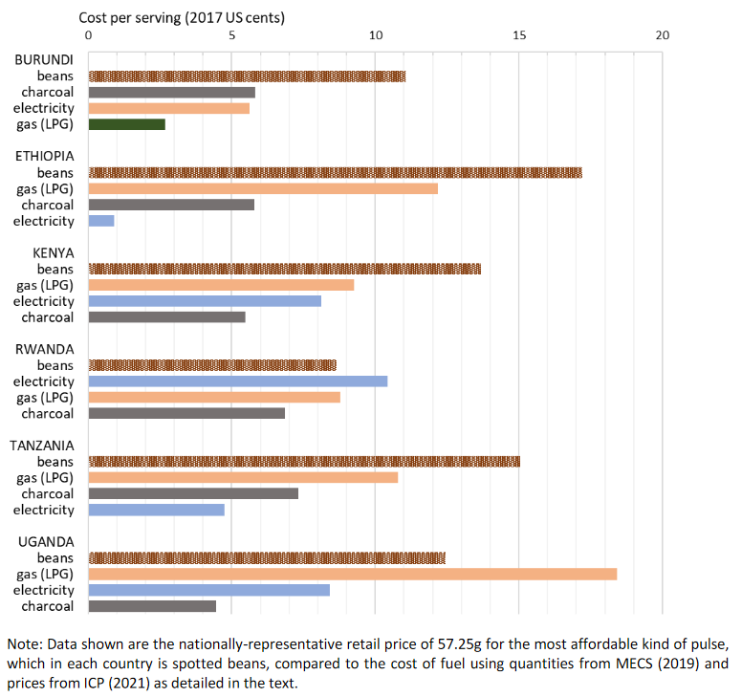
New frontiers include cost of meal preparation and cooking
Cost per serving of cooking fuel, relative to the cost of dried beans in E. Africa
Cooking fuel costs are large and variable
relative to ingredient costs
Source: Masters WA, Martinez EM, Greb F, Herforth A, Hendriks SL (2021). Cost and Affordability of Preparing a Basic Meal around the World. UN Food System Summit Scientific Group Partners’ Brief (23 pages), available online at https://sc-fss2021.org/materials/fss-briefs-by-partners-of-scientific-group

Slide 17
Fuel costs are a large fraction of meal preparation cost in Malawi
Cost of fuel as a percent of food expenditure in Malawi, 2010-2020
Note: Author’s calculation, from Malawi Integrated Household Panel Survey data for the years shown. Data exclude the 6 respondents who report using LPG as their main cooking fuel. Source: Rachel Gilbert (2022), Fueling diet quality in Malawi. Preliminary draft working paper, Food Prices for Nutrition project, Tufts University.

Slide 18
What can we say about
true cost accounting?
A more complete accounting framework for non-market costs and benefits
Examples of externalities and tax/subsidy transfers in the food system
Domains of external costs and benefits
 | External Costs | External Benefits | Transfers
Farm production of crops and livestock | GHG emissions, water depletion, antimicrobial resistance | Rural development, ecosystem services | Government payments to farmers, purchase of crops for biofuels
 | Wage theft and mistreatment, animal welfare | Farm animal well-being, presence of traditional farms
 | Illness and accidents from occupational hazards
Food processing, storage and distribution, packaging and marketing | Landfill and pollution from food loss, packaging etc. |  | Taxes, market power due to monopoly, monopsony, and cartel behavior associated with vertical and horizontal integration
 | Underpayment and mistreatment of workers | Community development
 | Illness from food contamination, harmful advertising | Food safety, nutrient enrichment/fortification
Meal preparation and consumption at home and away from home | Landfill and pollution from food waste, cooking etc. |  | Taxes paid and nutrition assistance received
 | Time burden on caregivers | Enjoyment of food culture / traditions
 | Higher disease risk due to intake of unhealthy foods | Lower disease risk due to intake of healthy foods
Environmental
Social
Health

Slide 19
Conclusion: from retail prices
to the cost of a healthy diet
and true cost accounting
For many people (3 billion, 40% of world) healthy diets remain beyond reach
Perishable or bulky foods more costly to grow and distribute than starchy staples, vegetable oil & sugar
Seasonality and other price volatility is an important constraint on year-round access
Affordability requires income growth and safety nets, plus food system change to lower prices
Adding sustainability criteria does not raise diet costs, because least-cost items are not resource-intensive
For most people (4.9 billion, 60% of world) healthy diets are affordable but often not chosen
Factors beyond price and income often drive choice
preferences (food culture, taste and satiation)
meal preparation (time, fuel, water, equipment)
marketing of packaged foods (availability and advertising)
Adding externalities for the true price of food should be based on a complete accounting framework
Include external benefits of healthy and sustainable foods, not just environmental costs of harmful foods
Include transfers and compute net cost/benefit ratio of expanding each category of food
Accounting frameworks permit large-scale data collection and analysis

Slide 20
What’s next?
Food Prices for Nutrition data at the World Bank and FAO
Our work so far (publications, outreach, data and code) is at:
https://sites.tufts.edu/foodpricesfornutrition
or https://ourworldindata.org/food-prices
Main policy documents so far are the UN system’s SOFI 2020 and 2021 reports:
https://www.fao.org/publications/sofi
SOFI 2022 with new results launched July 6th, then World Bank data hub here:
https://data.worldbank.org
USAID played key role via the Feed the Future Policy Impact Consortium (2015-21), as well as the Innovation Lab for Nutrition (2010-2021) and now the Feed the Future Food Systems for Nutrition Innovation Lab (2022-2027), many opportunities ahead!

Slide 21
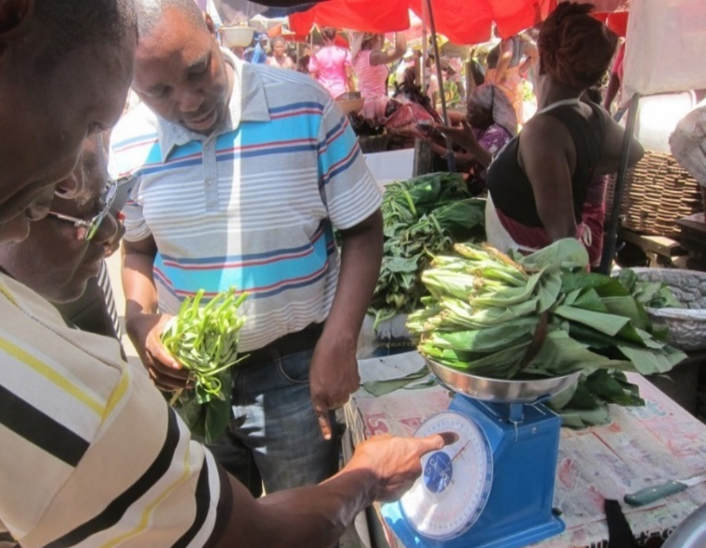
https://sites.tufts.edu/foodpricesfornutrition
Thank you!
The Food Prices for Nutrition project (https://sites.tufts.edu/foodpricesfornutrition) is conducted at Tufts University jointly with Anna Herforth, and with IFPRI (led by Derek Headey) and the World Bank (led by Nada Hamadeh, with Yan Bai and Marko Rissanen), with numerous Tufts students and staff including Robel Alemu, Leah Costlow, Rachel Gilbert, Elena Martinez, Julia Matteson, Kate Schneider, Kristina Sokourenko, Aishwarya Venkat, Jessica Wallingford, and faculty collaborators Steve Block, Shibani Ghosh, Elena Naumova and Patrick Webb. In-country studies have been led by Stevier Kaiyatsa (Ministry of Finance, Malawi), Fulgence Mishili (Sokoine University, Tanzania), Daniel Sarpong (University of Ghana), Fantu Bachewe (IFPRI-Addis) and Kalyani Ragunathan (IFPRI-Delhi) among others.
All of our work relies on the countless data collectors, survey respondents and analysts behind the food prices, nutrient composition and nutritional requirements we use.
Our primary funding source is the Bill & Melinda Gates Foundation and the FCDO, with complementary funding from the U.S. Feed the Future initiative.
Photo by Anna Herforth
at Agbogbloshi market, Ghana

Slide 22
Omitted slides

Slide 23
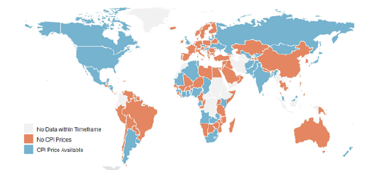
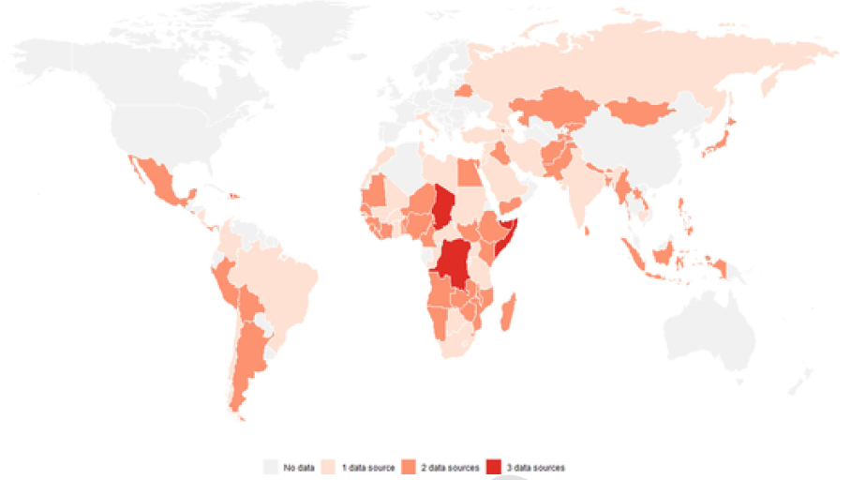
The innovation is linking retail price data to nutritional needs
Availability of food item prices from national governments’ Consumer Price Index (CPI) data in 2019-2020
Availability of food item prices from international agencies’
Early Warning System (EWS) data in 2019-2020

Slide 24
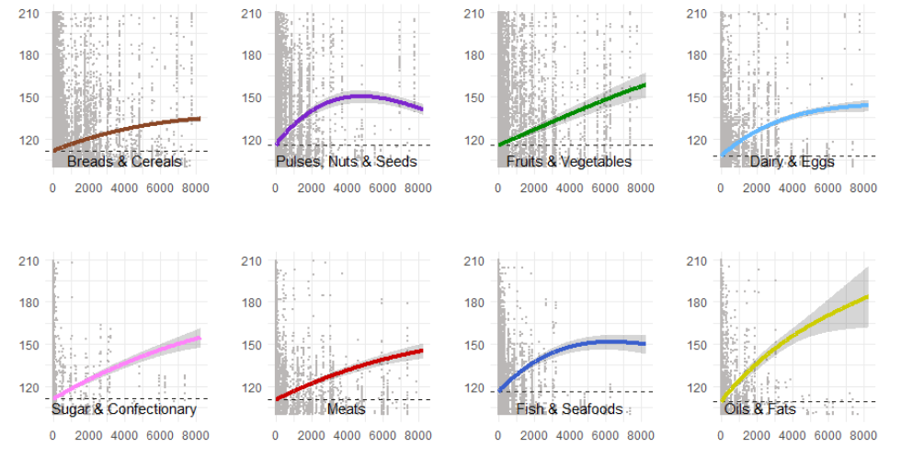
COVID impacts include
higher food prices,
especially for certain foods
Average nominal prices by food group vs. cumulative COVID case counts
(n=1,309 items from 86 countries, Jan. 2019 – Feb. 2021)
Source: Bai, Y. et al. (2022), Retail prices of nutritious food rose more in countries with higher COVID-19 case counts. Nature Food, forthcoming.

Slide 25
What can we say about
true cost accounting?
A more complete accounting framework for non-market costs and benefits
Product or service | Impacts per unit of food | Valuation per unit of impact | Valuation per unit of impact |  | Total cost or benefit per unit of food
Market price of activity of item i |  |  |  |  | P_{i}
External costs from nonmarket burden j
Environmental, e.g., GHG emissions | a_{ij} | c_{j} | c_{j} |  | a_{ij *} c_{j}
Social, e.g., underpayment of workers | a_{ij} | c_{j} | c_{j} |  | a_{ij *} c_{j}
Health, e.g., higher cardiovascular disease risk | a_{ij} | c_{j} | c_{j} |  | a_{ij *} c_{j}
 |  |  |  |  | C_{i} = Σ_{j} (a_{ij *} c_{j})
External gains from nonmarket benefits k
Environmental, e.g., ecosystem services | a_{ik} | b_{k} | b_{k} |  | a_{ik *} b_{k}
Social, e.g., local job creation | a_{ik} | b_{k} | b_{k} |  | a_{ik *} b_{k}
Health, e.g., lower micronutrient deficiency risk | a_{ik} | b_{k} | b_{k} |  | a_{ik *} b_{k}
 |  |  |  |  | B_{i} = Σ_{k} (a_{ik *} b_{k})
Transfers between people caused by activity or item i
Taxes paid on sales of products, e.g., VAT |  |  |  |  | t_{i}
Subsidies received for production, e.g., crop insurance |  |  |  |  | s_{i}
Markup due to market power, e.g., monopolies |  |  |  |  | m_{i}
 |  |  |  |  | T_{i} = t_{i} - s_{i} + m_{i}
True value of item i (market price, plus or minus externalities and transfers) |  |  |  |  | V_{i} = P_{i} - C_{i} + B_{i} - T_{i}
True cost/benefit ratio from expansion of item I (market price, plus or minus nonmarket costs and benefits |  |  |  | TCB_{i} = (P_{i} +C_{i}+s_{i})/(P_{i}+B_{i}+t_{i}+m_{i})

