Slide 1


Integrating Youth in USAID Programs
Objectives
Strategic Imperative of Youth
Positive Youth Development (PYD)
Features of PYD
Youth engagement
Resources to support your work
Notes:
Landing page on the screen when participants enter the room.

Slide 2
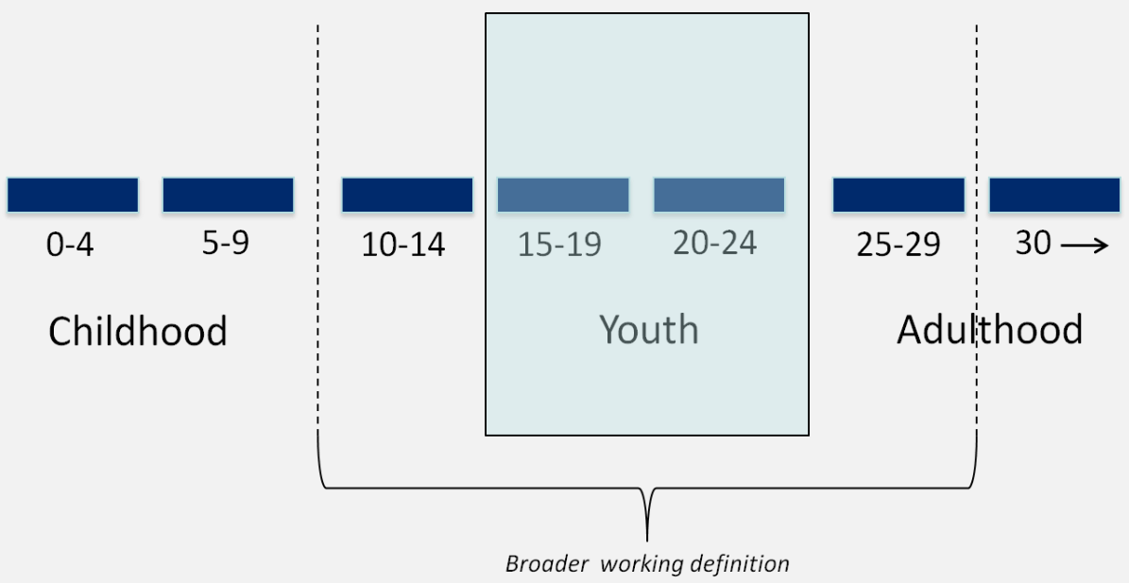
Defining Youth
Early Adolescence: 10-14
Adolescence: 15-19
Emerging Adulthood: 20-24
Transition into Adulthood: 25-29
USAID
Notes:
LAUREN
Defining Youth
ASK:
-What age ranges would you say are best defined as “youth”?
There is often confusion about the definition of youth depending on the audience. Several countries have their own definition of youth. In Uganda, a person is a youth until the age of 35. And within those countries there are socio-cultural experiences which also separate a youth from adults that can be influenced by gender, cultural rites, marriage, parentage and more.
However, the USAID Youth in Development Policy defines young people as aged 10-29. What is important about how USAID defines youth is our recognition of distinct phases of adolescence.
“We recognize that there are unique aspects of the different stages and facets of adolescent development, which you will learn about later, that impact how successful our youth programming can be.
Thus we use the World Bank research on specific stages of youth development: Early Adolescence: 10-14; Adolescence: 15-19; Emerging Adulthood: 20-24; Transition into Adulthood: 25-29
“For example, a parent would not present the same information or have the same discussion on sex, norms, substance abuse, or jobs with a 12 year old that they would with a 20 year old. That is because it is important to take into account the ages and stages of development. That is, the four defined periods of physical, cognitive, emotional, and psychological development: Early, Mid adolescence, emerging and transition into adulthood. We will dive deeper into this in the coming days.”

Slide 3
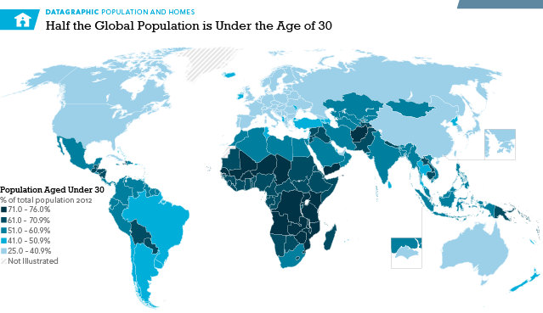
Problem or
Opportunity?
Notes:
You mentioned the large number of young people around the world. Let’s take a look at where these large populations are concentrated. Note that this graph is from 2012. The dark areas across the arc of fragility are countries where we have more than 70% of the population under age 30
One telling stat: We need to create 5 Million new jobs / month every month for the next 10 years just to keep the youth unemployment rte at the current level which is 3 times the adult unemployment level. For Uganda that translates into approximately 25,000 new jobs need to be generated each month.
Ask participants if they find these percentages surprising.
It is easy to see these large populations as a challenge…

Slide 4
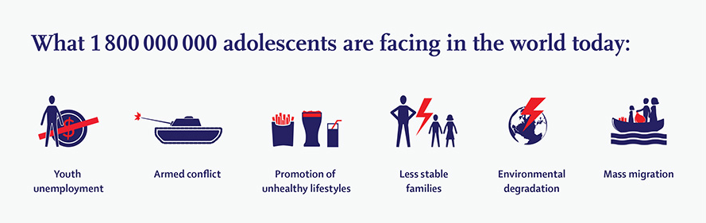
Challenges for Youth
EDUCATION: 225 million youth, or 20% of youth are not in education, employment or training
EMPLOYMENT: 5 million new employees every month
SECURITY/VIOLENCE: 43% of the homicides are youth 15 to 29
REPRESENTATION: 6% of the representatives are under 35
Notes:
Here are just a few of the problems youth face… Which issues are of highest importance to youth? The afrobarometer poll for this year had them put safety/security number one, then youth unemployment, then environmental issues.

Slide 5





Approximately 800,000 youth in Guatemala do not work or study
Guatemala has one of the world’s highest rates of violent crime and a 97% rate of impunity, the main scapegoat is youth delinquency (gang activity, petty crime) leading to severe crime
Only 46 percent of school-age children make it into high school and a scant 24 percent graduate
Only 39% of sexually active (never-married) women aged 15–19 use a contraceptive method
90% of Guatemalan migrants of all ages migrate in order to find jobs and to increase income
What Challenges Do Youth Face?
Notes:
LAUREN
Challenges for Youth
These are some of the statistics that I found particularly compelling for making the case for youth. Being able to articulate some of the most important challenges in terms of statistics is important for how we mobilize broad support.
The mental health statistics are also quite shocking. You can see on your hand-out that suicide is the 3rd cause of death for young people globally, and the number 1 cause for adolescent girls. Also note that half of mental health disorders begin by age 14.

Slide 6
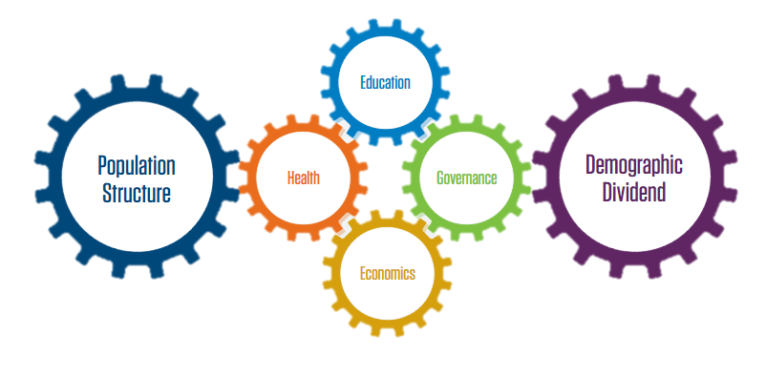
Reaping the Benefits…
Reduced death rate + reduced fertility = Demographic Transition
Working Age Population > Dependents (Children and Elderly) = Economic Opportunity
Demographic transition + Health, Education and Socio-Economic Investment=
Demographic Dividend
**Democratic Dividend?
Source: USAID, iDEA, PRB
Notes:
However, large youth populations can be an opportunity for a demographic dividend.
"Let’s put it all together…
Fewer births and reduced mortality rates can create a demographic transition when the labor force grows more rapidly than dependents of those workers. When countries invest in education, health and training and follow good economic policies, more productive populations with fewer dependents offer an opportunity for economic growth"
"If you meet the opportunity in a timely fashion and support the health, education, and economic power of the working population, you can realize the demographic dividend.”
"Let’s take a look at some regional experiences."
"East Asia is well known for its success with its demographic dividend.
By supporting family planning and investing in the education and economic potential of the growing working class, countries such as Korea and Singapore benefited from unprecedented economic growth."
Several countries invested heavily in youth, expanded access to voluntary family planning, enabling people to start families later and have fewer children
With a larger working age population, countries then invested in education, health, economic policy and social support
The result was dramatic economic growth. Between 25-40% of growth in East Asia between 1965-1990 has been attributed to this demographic dividend.

Slide 7

Why Adolescent Development?
Needs and characteristics of adolescents and youth change at different points of their lives
Design development strategies that can meet adolescent and youth needs
Know when within the life cycle and how to target adolescents and youth
Notes:
Before we look at approaches and strategies for youth we need to understand the developmental factors and stages during this time period so that we design our strategies to meet their needs. This will also help us understand when and how to support youth. We use the term adolescent development in this presentation. Different cultures may have different interpretations of the age ranges of adolescence but psychologists usually refer to adolescence as the second decade of life.
We will be reviewing some general stages and characteristics of adolescent development. Most of the literature comes from the field of psychology from the US and other developed countries and although some of what will be discussed is biological, different cultural norms can impact how youth develop so we always need to think about the impact of the local cultural context. While we will be talking about broad age categories, remember that not everyone goes through these stages at the same time.

Slide 8
Quick Summary of Adolescent Brain
When is the brain fully developed?
Brain is fully developed in mid-20s.
Last part of the brain to develop is pre-frontal cortex
  Planning
  Making decisions based on rational thinking
  Controlling impulses
  Organizing
  Setting goals
What is the last part of the brain to be developed? Why is it important?
Which part of the brain is most active during adolescence? What impact does that have?
The limbic system, the part of the brain related to sensory processing, emotions, and instincts is more dominant in adolescence.
Notes:
Brain Development – Quick Review
“Let’s do a quick overview on the adolescent brain development
When is the brain fully developed?
Until several decades ago, we thought the brain was fully developed by the age of 6. Now we have a much deeper understanding of brain development. We now know that the brain is not fully developed until the mid 20s with the female brain completing development a bit earlier and males a bit later.
Place the brain fully developed cards - females early 20s and males mid-20s.
What is the last part of the brain to be developed and why does that matter?
The last part of the brain to develop is called the pre-frontal cortex which is often called the Executive Function part of the brain. The prefrontal cortex is responsible for things like planning, controlling impulses, using rational thinking to make decisions, problem solving and other functions relating to planning and organizing. This does not mean that adolescents and young adults are not capable of decision making but that these skills are less developed than in later years.
Place the weak planning, organizing and goal setting skills card between ages 10-14.
Which part of the brain is most active during adolescence? What impact does that have?
The limbic system. This part of the brain related to sensory processing, emotions, and instincts is more dominant in adolescence. And, because the limbic system or the part of the brain or the emotional part of the brain is more developed, adolescents often act out of impulse or emotion.

Slide 9
The Big Picture
Self-harm
Substance abuse
Emotional intensity
Depression
Impulse control
5
10
15
20
25
30
Age
Source: George Patton, University of Melbourne
Notes:
This graph gives a quick view of some of the major issues in adolescence, particularly relating to psychological development: depression, self-harm, emotional intensity, risky behaviours and impulse control. As you can see, the teen years are the most important period for when mental health issues impact a person, and these habits (positive or negative) tend to last across adult years when not addressed early on.
We should note that Adolescent Mental Health issues are the leading cause of disability for youth worldwide and the second leading cause of death for teens.
Source: George Patton, University of Melbourne

Slide 10
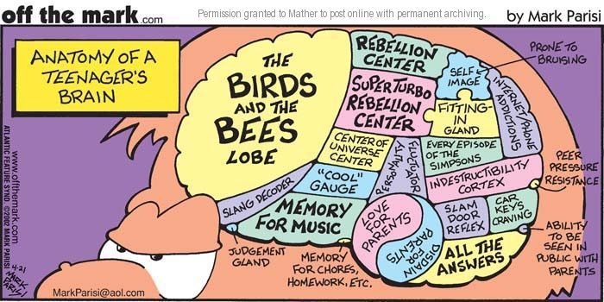
Adolescent Brain
Notes:
This cartoon captures a bit of the stereotypes many of us have about teenagers. While there is some good humor here, there are also some pieces of truth about this period of life.
What jumps out at you most about the elements in this cartoon of the brain?
( If there is time show video - but typically there isnt)
video: https://www.youtube.com/watch?v=5Fa8U6BkhNo

Slide 11

Getting faster and better
Notes:
The video talked about another difference in adolescent and teen brains relating to their efficiency. Can anyone explain myelination? A process called mylenation enables the brain to become more efficient and specialized. The result of these changes in the brain, the kinds of activities and exposure a young person has during adolescence can have a long term impact. That is why exposure to new experiences and continued learning is so important be it academic learning, sports, music or learning a new language.
Another relatively recent discovery is that the brain is malleable and can reorganize itself over time. This concept is particularly important for youth who may have experienced trauma and whose cognitive development was interrupted due to the stress in their life. Adolescence can be a particularly important time of life to develop non-cognitive or social/emotional skills that were not developed earlier in childhood.

Slide 12

USAID’s Response. Youth in Development Policy, Realizing the Demographic Opportunity
Objectives:
Strengthening programming, participation, partnership
Integrating and engaging youth across USAID initiatives.
Support, Protect, Prepare!! then Engage…
Notes:
LAUREN
Youth in Development Policy
“So how is USAID responding to the challenges and opportunities facing youth and our knowledge of adolescent development? One way is through the Youth in Development Policy.
“In 2012 USAID released its policy on youth in development. USAID was the first donor agency to release a youth policy, setting up USAID to be a leader in youth development. This month is the five-year anniversary of the policy and an evaluation of the policy has just been completed (include relevant information from evaluation when complete).
Can someone read the goal of the policy? Which words stick out to you? I always notice the words “benefit” and “contribute”. It’s important to think of youth not just as beneficiaries of programs but also partners in development.
“The policy aimed to strengthen youth capacity and aspirations thereby enabling them to better contribute to and benefit from their local and national environments.”
“The objectives included strengthening programming, participation and partnership and integrating and engaging youth across USAID initiatives.”
“The youth in development policy aims to: Support, Protect, Prepare and Engage youth. These four intertwined elements are across the areas of economics, education, health and participation and safety/security. As such, the policy promotes cross sectoral collaboration.”

Slide 13
YouthPower: Definition of PYD
Positive Youth Development (PYD) engages youth along with their families, communities and/or governments so that youth are empowered to reach their full potential. PYD approaches build skills, assets and competencies; foster healthy relationships; strengthen the environment; and transform systems.
Notes:
LAUREN
“With support from YouthPower, USAID, has developed its own definition of PYD. Take a moment to read this definition.
This definition can be broadly applied across youth age groups (10 to 29) though it should be noted that youth have different developmental stages and rapidly changing social, emotional and cognitive skills across these age ranges. This definition is also relevant to various settings. As this definition is intended to be visionary, terms like “skills,” “relationships,” “environment” and “systems” should be interpreted broadly. The terms “families, communities and governments” are also broad and encompass systems such as peer networks and educational and workplace settings”
Ask participants to take a few minutes to review the definition.
Ask them what jumps out at them/what catches their attention
Highlight the key terms in the definition (highlighted)
USAID, with support from YouthPower Learning, has developed this definition of PYD. Take a moment to read this definition. What stands out to you?
This definition can be broadly applied across youth age groups (10 to 29) though it should be noted that youth have different developmental stages and rapidly changing social, emotional and cognitive skills across these age ranges. This definition is also relevant to various settings. As this definition is intended to be visionary, terms like “skills,” “relationships,” “environment” and “systems” should be interpreted broadly. The terms “families, communities and governments” are also broad and encompass systems such as peer networks and educational and workplace settings

Slide 14
Key Features
Build skills, assets, competencies
Healthy relationships and role models
Belonging/membership
Clear norms, expectations and perceptions
Youth engagement and contribution
Safe spaces
Access to integrated youth friendly services
Adapted from National Resource Council of the National Academies of Science
Notes:
"We have highlighted some of the key features of PYD that may be more common in USAID programs. We will go into more detail of each of these features but I wanted to stop and highlight the words in red. If we just look at the words in red, think about why some youth find gangs attractive. Do gangs or extremist groups provide some of these opportunities for youth? Gangs provide youth with a sense of belonging and friendships, access to older youth who serve as role models, and provide youth with the opportunity to develop skills. Although they may not be a safe space, many youth may feel safer being in a gang. And, in a very informal sense gangs and extremists group may also provide youth with key services such as loans, housing and protection. The fact that these features can have both negative and positive impacts highlight their attraction to youth. Let’s look back at the flipchart of the positive influences in our own lives and see how they fit into this list of features (Highlight teachers, coaches or scout leaders for healthy relationships, sports, music or theatre for skill building or belonging, student government or community service for youth participation)"
NOTE: Have another trainer put the PYD Feature poster on the wall so people can reference the features.

Slide 15
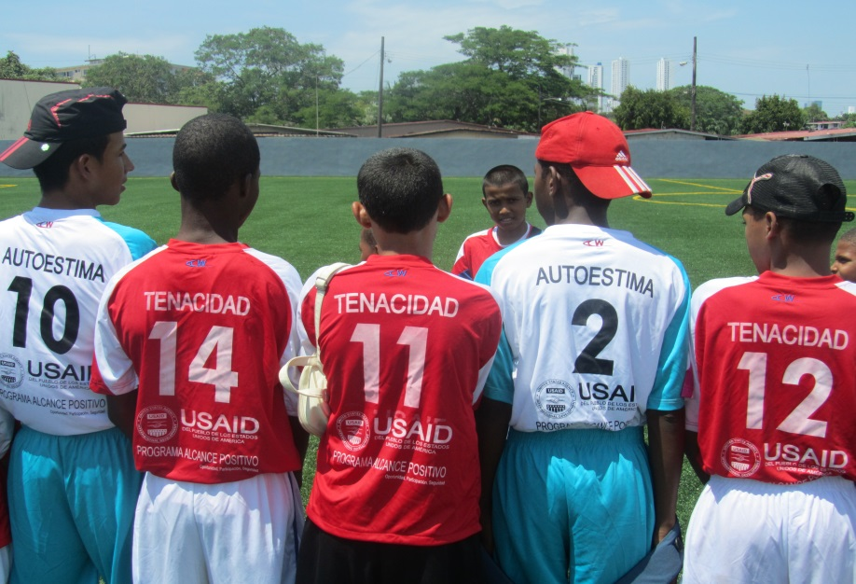
Evidence on life/soft skills
“… rival IQ in predicting educational attainment, labor market success, health, and criminality
… more malleable in adolescence than cognitive skills… universally valued across culture, religion and society”
(James Heckman, Nobel Laureate economist)
Notes:
There has been a lot of attention recently on life skills and soft skills. Why is that?
Recent research highlights the importance of soft or social/emotional skills. James Heckman, a nobel leaureate economist, who helped coin the term “non-cognitive skills” for these types of skills, found that these skills are as predictive as IQ in educational attainment, success in work, health and in whether a person might be involved in crime”
In addition to being important to future success, these skills are actually more malleable in adolescence than cognitive skills
Other research has linked these kinds of skills to other outcomes. These findings come from the education sector and highlight why social and emotional skills are important to educational outcomes.
Improved attitudes
Positive social behaviors
Less emotional distress
Fewer conduct problems
Better academic performance/grades

