Slide 1
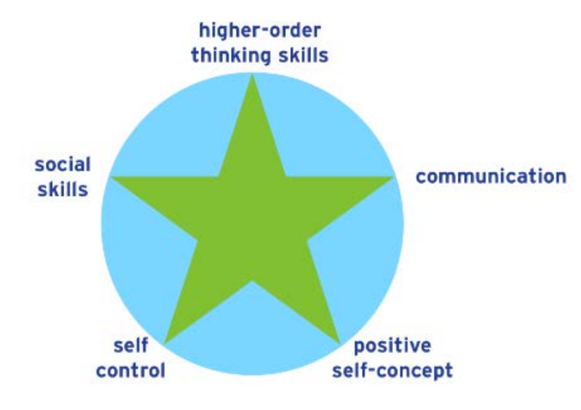
Key Soft Skills for Youth Workforce Success
Source: USAID Workforce Connections Publication Implemented by ChildTrends
Notes:
“In this diagram we are talking about soft skills. Soft skills is the terminology used in the field of workforce development to refer to those non-technical skills that impact how well a person succeeds in the workplace. For a long time there was not a consensus on which soft skills are most important for workforce success.”
USAID, under the Workforce Connections project, carried out research to identify the most important soft skills for youth age 15-24 to succeed in work. Within this research initiative, “Soft Skills” were defined to include behaviors, attitudes, personal qualities, “and competencies. The research identified one cognitive skill which some call higher order thinking skills which includes decision making skills, critical thinking and problem solving, two interpersonal skills—those you need to interact with others—and two intrapersonal skills, those skills that have to done with how a person feels or thinks.”
The two interpersonal skills that are particularly important developmentally for the 15-29 age group were ranked the highest. These include:
Social skills is really a cluster of skills that encompass getting along with others, respecting others, resolving conflicts, using appropriate behaviors
Communication skills include expression, transmission, understanding and interpreting knowledge and ideas
Two intrapersonal skill that are supportive and linked to the top three include:
Positive self-concept, including self-confidence, self-efficacy, self-awareness and beliefs, as well as a sense of well-being and pride, a healthy identity and awareness and of one’s strengths in the workforce
Self-control refers to one’s ability to delay gratification, control impulses, direct and focus attention, manage emotions, and regulate behaviors. Self-control is foundational to social skills, communication, being hardworking and dependable, teamwork, leadership, problem solving, critical thinking, and decision-making.”
These skills are inter-related as the intrapersonal skills can impact one’s interpersonal skills as well as the higher order thinking skills.
These priority soft skills for workforce outcomes fit into the broad categories in the life skills definitions. YouthPower Action is doing research on the priority soft and life skills for other outcomes including the prevention of violent behaviors and positive sexual and reproductive health behaviors to help the youth field identify the most important skills across outcomes. Following the completion of this research YouthPower Action will be developing a tool to measure these skills and doing research to provide guidance around how to develop these important skills.
While that research is not yet complete, we know that good PYD programs should facilitate the development of these soft and life skills and that many aspects of PYD such as positive role models, safe space and participation in many youth programs can help develop these skills.

Slide 2
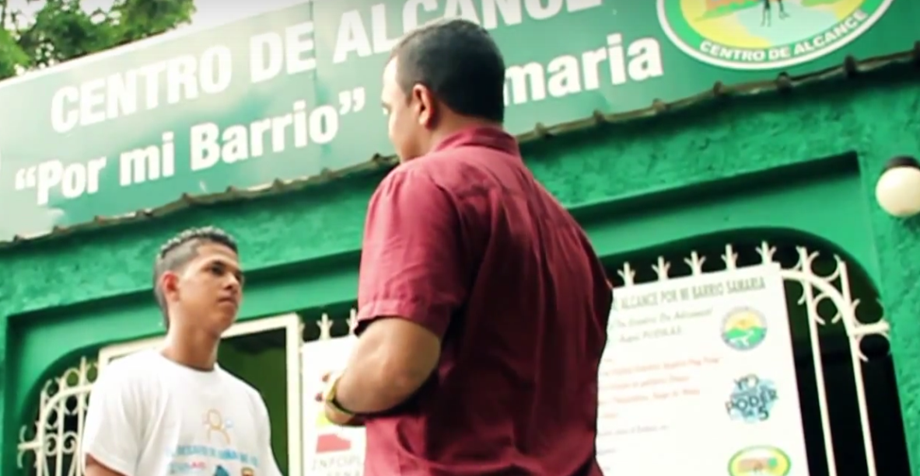
Healthy Relationships
Developmental relationships
  Express care
  Challenge growth
  Provide support
  Share power (respect, give voice, listen)
  Expand possibilities
Notes:
Youth development researchers have coined the term “developmental relationships” to highlight the aspects of relationships that can have a positive impact. These include providing the opportunity to try out roles and behaviors, receive feedback and reflect. They have highlighted five elements for adults working with youth.
We will talking more about youth engagement in the next session

Slide 3


Safe Spaces
Physical safety
Emotional safety
Youth mapping to identify safe and unsafe spaces
Physical and virtual safe spaces
Promoting safe peer group interaction (anti-bullying)
Parent and youth worker education on creating emotionally safe environment
Policies and laws protect youth; support structure for youth exposed to violence
Adapted from National Resource Council of the National Academies of Science
Notes:
Safe spaces relates to physical infrastructure as well as emotional safety. Both types of safety are essential for youth to feel comfortable and ready to absorb the other features (skills building, youth engagement). Many neighborhoods lack any space for youth to convene. Thus communities must be committed to providing youth with space spaces to practice, engage, and learn creatively and collaboratively. And an emotionally safe space is critical to learning. Given youth activity online, virtual safe space is increasingly important.

Slide 4
Belonging
Belief one is recognized and valued in community
Social inclusion
Support for cross-cultural competencies
Creating sense of community within youth programs, vocational programs, youth activities
Opportunities to reach and include marginalized and vulnerable youth
Anti-bullying programs; building tolerance and respect
Adapted from National Resource Council of the National Academies of Science
Notes:
Belonging is extremely important, particularly in early and mid-adolescence. By breaking large schools into smaller groupings, schools can help create a sense of belonging, and sports, scouts, music or theatre groups can all create a sense of belonging. Research into how young people decide to join ISIS highlights the importance of peer relationship and the impact of social networks making it important to help youth find positive ways of finding that belonging and meaning. OVCs and minority groups are often in need of ways to belong.
Reflect again on participant responses from the positive influences activity.

Slide 5
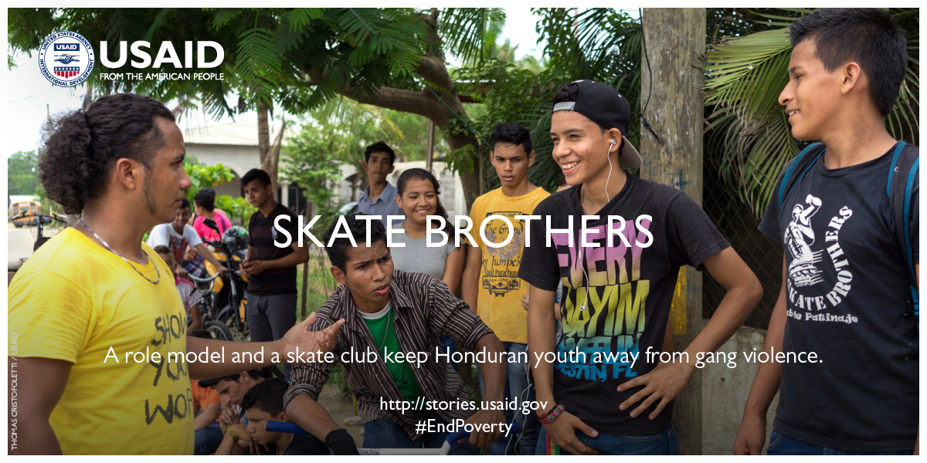
Notes:
In Honduras—one of the most violent countries in the world—nearly 50 centers across the country provide a range of youth activities. They can come to learn how to use a computer or take English classes, receive job training, play instruments and games, get after-school tutoring, and socialize with other children in a safe, supervised environment. These centers are one way that USAID seeks to address the factors causing young people to attempt a costly and dangerous migration to the United States—including insecurity, crime and a lack of economic and educational options.
After the 24-year-old was wrongly accused of stealing the cell phone of a dangerous criminal, a hit was placed on his life. He was just 16. The man’s 9-millimeter pistol put a bullet through Jessel’s back, narrowly missing his lungs, ribs and heart. “It was a case of death,” Jessel explains. Jessel grew up in Cofradía, a town outside of San Pedro Sula, Honduras, a city that has been called “the murder capital of the world.” He watched people become numb to senseless violence like the gunshot that nearly killed him. He knew he had to do something about it. “I didn’t want to seek revenge,” Jessel said, “because the bullet not only pierced my flesh, my skin—it pierced that life that I was living. It ended this mentality that I had and changed it into something positive."
Skate Brothers is a club where at-risk youth learn rollerblading, skateboarding, BMX and breakdancing. Since it was formed in 2011, the group has grown to about 50 members who perform in street fairs and parades and volunteer to support their community. Skate Brothers is about more than just sports. It’s about instilling values in the kids and counseling them on how to best live their lives.
“Youth who don’t have anything to do, they look for a group that gives them love or gives them affection,” Jessel said. “And what a shame how some of them choose criminal groups that commit illegal acts.” “My guys, my sheep” Jessel created Skate Brothers so these kids could find a sense of belonging without turning to gangs. “I call them, my children, my guys, my sheep,” he says.
In the town park, where Skate Brothers practices, Jessel greets the kids with fist bumps and hugs. They follow him gleefully. Jessel asks them about their day, how things are going in school. He acts like an involved parent, sometimes meeting with their teachers and school principals. He invites them to his home to eat guacamole, carne asada and baleadas—a traditional Honduran dish consisting of a flour tortilla filled with mashed fried beans.
Jessel convinced one boy in his club to leave a gang by sharing his own near-death story as a cautionary tale. “I told him the story with tears in my eyes because I was seeing the same life I had lived in him. I told him, ‘I love you a lot, and I want to help you if you let me. But I respect that the decision is yours.’” Everything Jessel does is for the youth who look up to him. “I don’t want my kids to live a difficult life like I did,” he says. To some, Skate Brothers might just seem like sports and fun, but Jessel understands that it’s a lifeline—a way to stay out of crime and violence.
The outreach center in Cofradía, Honduras, is one of nearly 200 that USAID has built in crime-ridden neighborhoods around Central America to give at-risk youth a safe space to have fun, learn valuable life and job skills, and stay away from drugs and gangs. It is run by Creative’s Alianza Joven Honduras program.

Slide 6
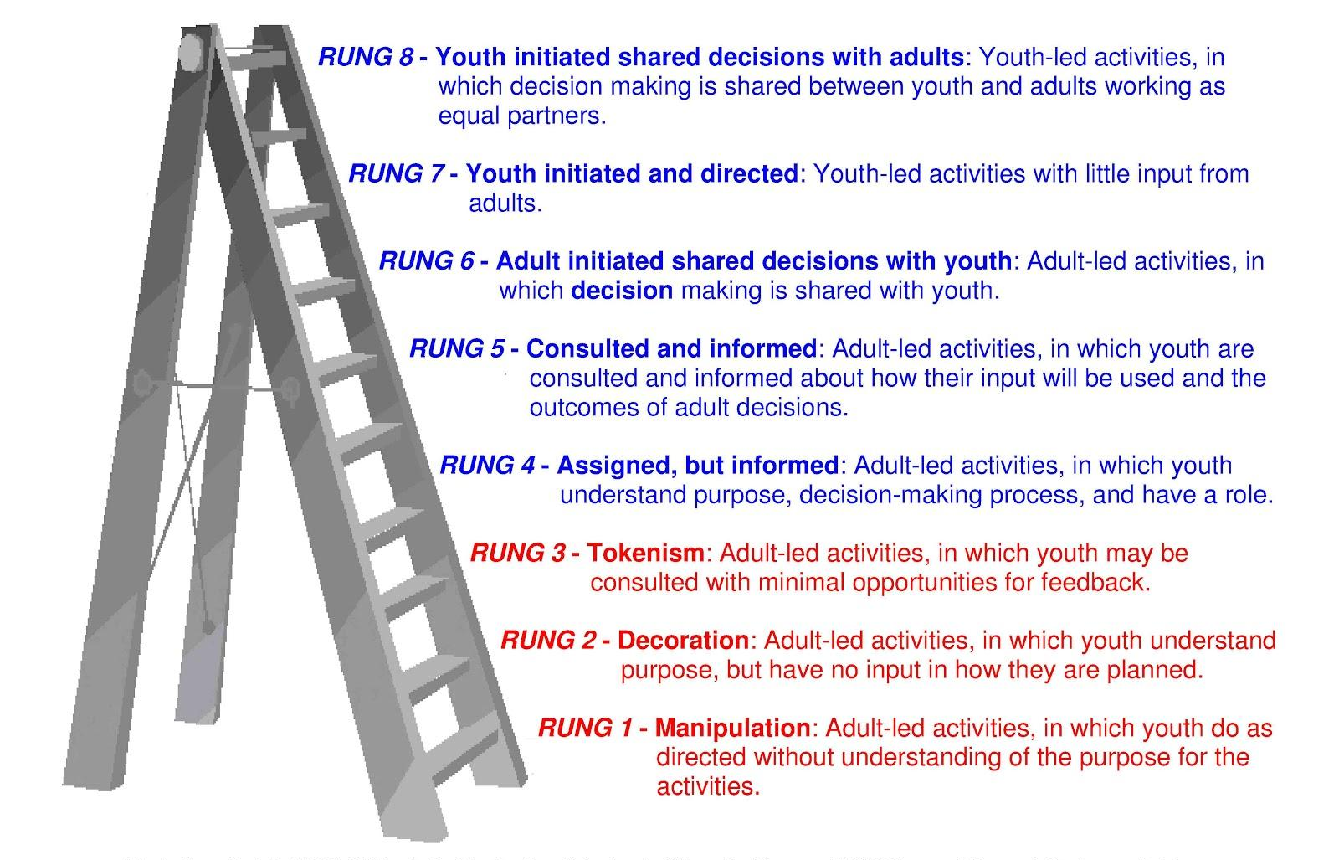
Hart’s Ladder
Notes:
LAUREN
Facilitator should highlight: Hart’s Ladder is one of the foundational frameworks in the youth engagement literature. It illustrates the various levels of youth participation. The bottom three rungs are NOT participation, but levels of tokenism. These can be detrimental to youth, as their decisions may be heard, but not acknowledged.
The higher rungs of the ladder where participation really occurs – when youth are informed, consulted, provide leadership, and participate in decision-making. Reiterate that we can’t always reach level 8, and level 8 isn’t always relevant for each situation, but we should be striving for the greatest level of youth engagement as possible in each situation.
Facilitator should go through each rung asking for an example.
Rung 1: Youth asked to carry political signs for an election
Rung 2: Youth posing for a photo, song or dance
Rung 3: Inviting one young person to speak on a panel to represent all youth and telling them what to say
Rung 4: Inviting one young person to speak on a panel, telling them the purpose and goal and allowing them to shape their own remarks
Rung 5: Survey for a project where youth are asked for their opinions and told what it is being used for
Rung 6: Agency of mission youth advisory group, youth invited to shape the content of a program or policy
Rung 7: Youth led organization deciding their own priorities
Rung 8: Youth led organization where youth and adults together determine funding and programs.

Slide 7
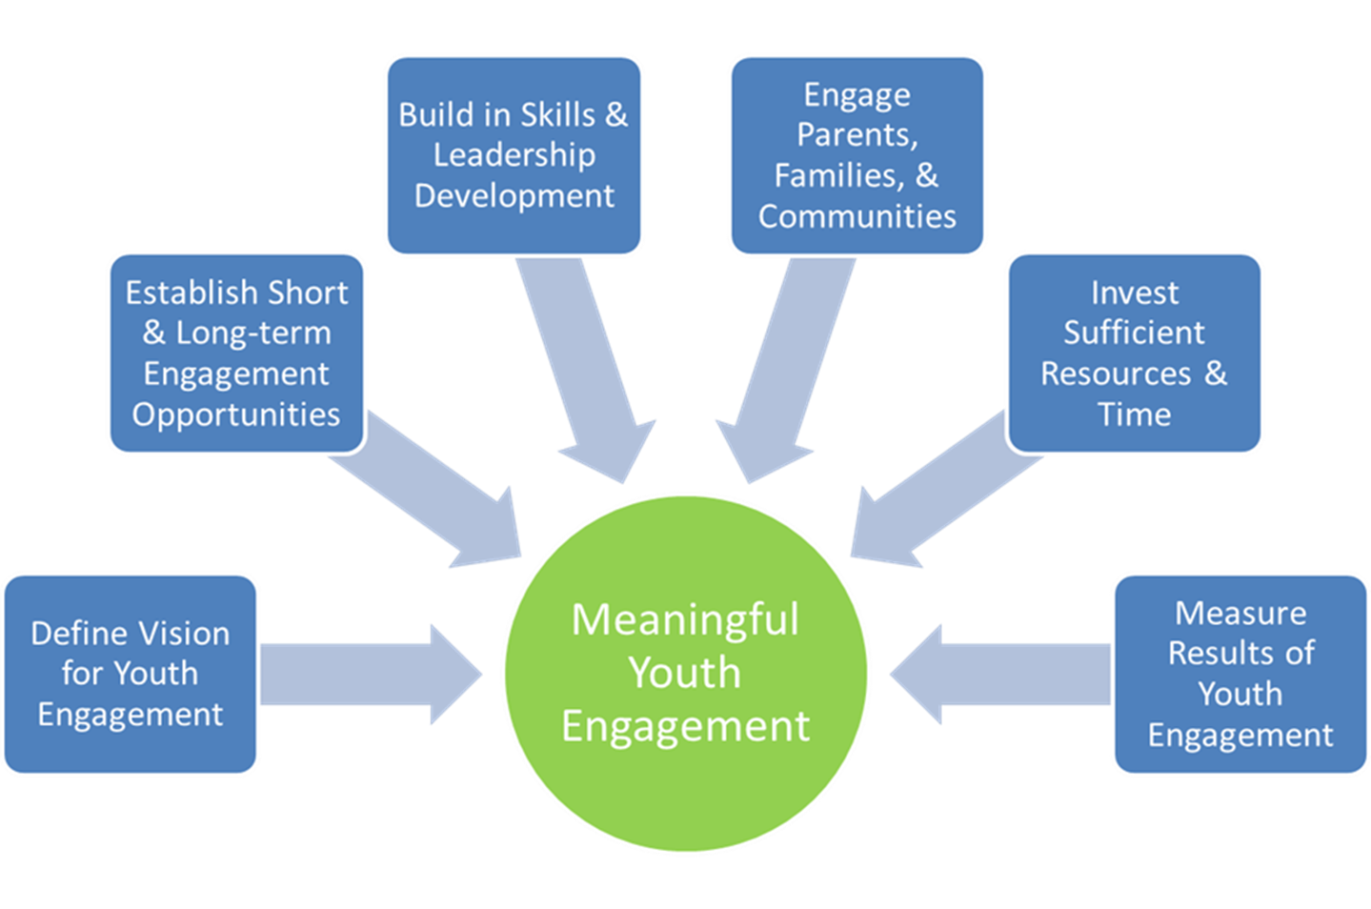
Tips for Meaningful Youth Engagement from Beginning to End
Notes:
These tips come from a YouthPower brief
Link to Six Tips to Meaningful Youth Engagement Brief: http://www.youthpower.org/resources/six-tips-increasing-meaningful-youth-engagement-programs

Slide 8
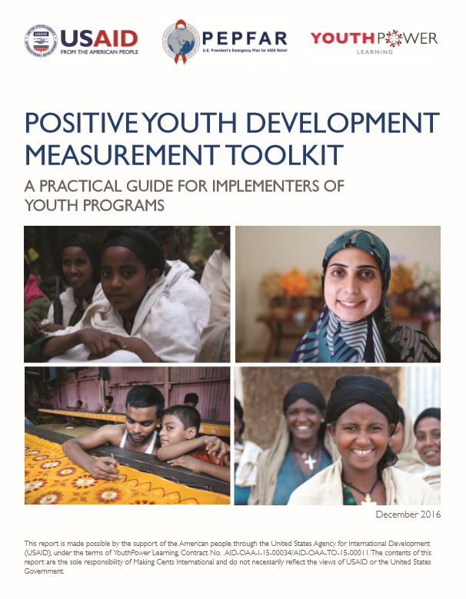
Key Phases of Program Design and Evaluation
1. Refine desired outcomes / research questions
2. Select PYD features and beneficiaries
3. Finalize logic model
4. Decide what to measure, and how (study design and indicators)
5. Analyze, disseminate and learn from data
Notes:
Mike
The Toolkit focuses on 5 key phases in which PYD measurement is relevant. These phases are introduced on page 27 of the toolkit. Generally talk about phases 1, 2 and 3.
In this session, we will focus specifically on Phase 4, ending with a brief overview of phase 5.
Emphasize that the full measurement training is one day long. TODAY we are just touching on key measurement concepts, giving participants the chance to become familiar with the toolkit and indicators, and providing an opportunity for practical application. This is a rich resource that you will often refer to throughout the program cycle when you return to your missions.
Talk generally about cross-sectoral youth assessments, that would occur in phases 2 and 3 (examples from EQUIP3 and YouthMap)
(Elizabeth to include EQUIP CSYA link in annotated bibliography, to be distributed at end of training)

Slide 9
NEXT STEPS for FTF

Slide 10
Move toward a FTF strategy that applies PYD best practices
Integrate youth explicitly into Feed the Future projects
Build staff understanding of the Youth Development Policy and PYD

Slide 11
resources to SUPPORT youth mainstreaming
USAID/Washington Support
Agency Youth Coordinator: Mike McCabe mimcabe@usaid.gov
Bureau for Food Security Senior Youth Advisor: (TO BE ANNOUNCED)
Agency Youth Corps (cross-sectoral youth working group) – field and virtual support.
YOUTH POWER LEARNING Globsal Task Order (Making Cents Int’l, ICRW)

Slide 12
resources to SUPPORT youth mainstreaming
Intranet site on Youth in Development with samples and tools
PYD Agency Training available on request
Indicators for PYD programming developed by Youthpower
Youthpower website: www.youthpower.org contains a growing document base and will soon add agriculture and food security, incorporating Feed the Future’s annotated bibliography on youth and food security.

Slide 13
resources to SUPPORT youth mainstreaming
See the new Leveraging Economic Opportunities (LEO) Report #46: “Youth Engagement in Agricultural Value Chains across Feed the Future: A Synthesis Report (on Microlinks)
Review the Feed the Future Annotated Bibliography that recommends 20 documents as references on youth and agriculture. This will be updated regularly.

Slide 14
Sample bfs youth efforts
Soybean Lab – Youth Mapping program (Ghana buy-in); Youth-run SMART farm (Ghana); Pan-African variety trials; Mechanization effort, jobs
Horticulture Lab – Youth Training Center (USAID/Guinea)
World Veg Center – Youth Agribusiness Hub (Tanzania)
SIIL – Cambodia (CeSAIN, high school techno parks), Senegal, Peace Corps
Peanut Lab, Legume Lab – recently awarded, committed

Slide 15
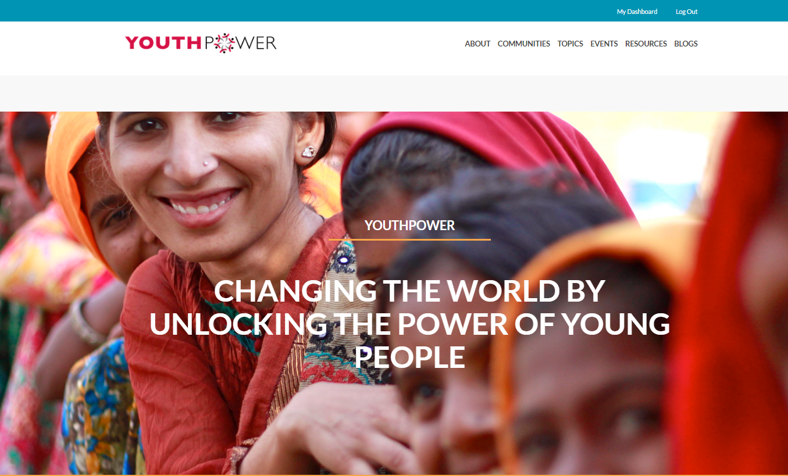
YouthPower.org
www.youthpower.org
Notes:
5 minutes (go on the website)
YouthPower Learning was the first task order awarded under the YouthPower Evaluation and Evidence IDIQ
Making Cents is the prime contractor and we have several partners – International center for research on women, young americas business trust, results for development and khulisa management
Designed to build the evidence on the use of positive youth development strategies in low and middle income countries
We are the knowledge management backbone for youthpower – website and communities of practice

