Slide 1


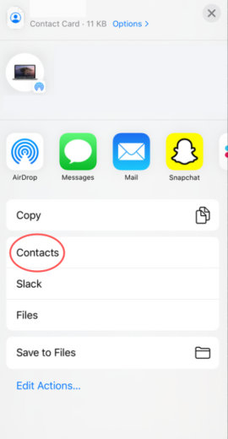
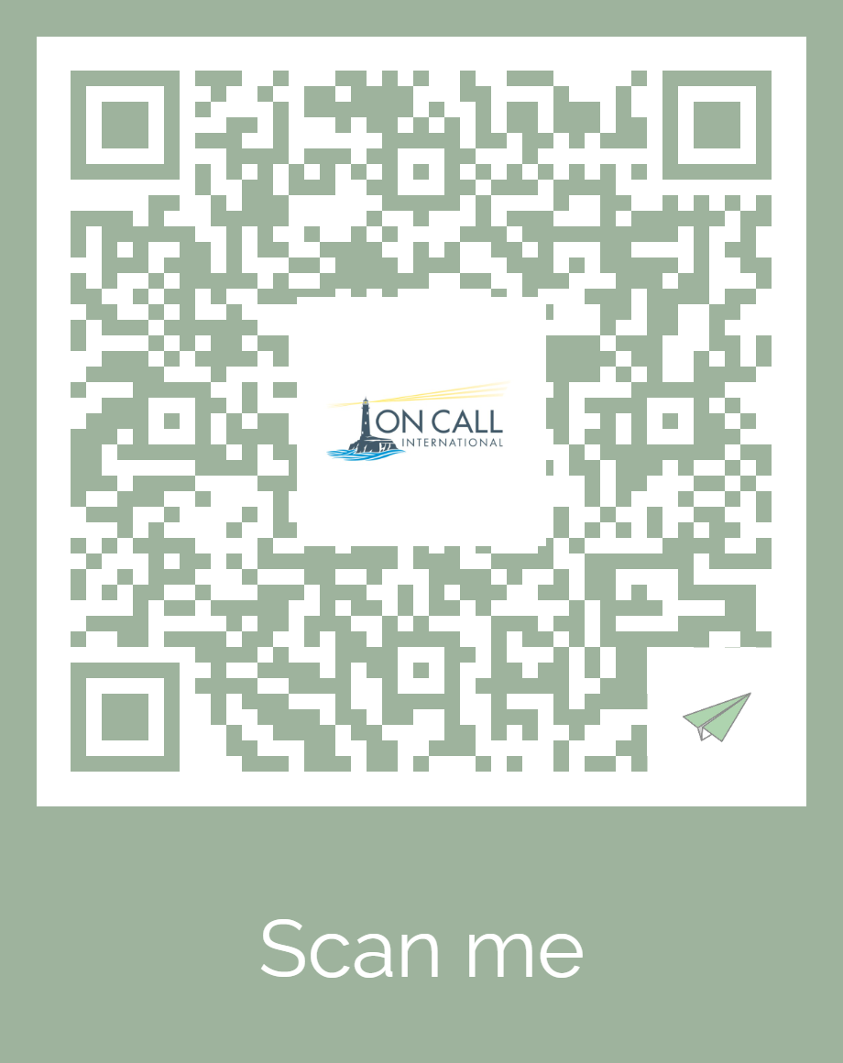

Save On Call’s 24/7 contact information to the phone you’ll carry with you abroad:
Start downloading the contact card by scanning the QR code with your smartphone’s camera, any QR scanning app, or by visiting the link provided.
Tap the link that pops up. Once in the web browser, fill out your info; then, click the “download card” button
On iPhones: once you see a preview of the card, click the export button in the top right corner. Then, click “contacts,” then “Save”
On Androids: open the file by tapping “Open” or by sliding down on the screen. Save the cards to the “Phone” option
OR
https://www.aerogami.us/user/OCIKANSAS
Notes:
Saving the On Call 24/7 contact information is easy, simply pull out your phone right now, open your camera application, scan the QR code on the screen and then follow the prompts. This is not an app to download, in a few taps you will have a new contact in your phone with important information you can use while traveling such as the dedicated phone number for Indiana Wesleyan University travelers to contact On Call, an email address or a LiveChat link if you prefer an alternatives to making a phone call. The contact is also pre-loaded with links to your On Call plan documents and myoncallportal.com.
We hope you have a very safe and healthy trip!
This concludes your On Call plan overview.

