Slide 1
Beyond Bullets and Bombs
Office of Research and Sponsored Programs (ORSP)
http://www.k-state.edu/research/
http://www.k-state.edu/orsp/
Insights into potential opportunities in working with the Department of Defense
Joel Anderson: Development Director
October 21, 2015
“The problems that exist in the world today cannot be solved by the level of thinking that created them.”
-Albert Einstein
http://www.dhs.gov/xlibrary/assets/st/st-strategic-plan.pdf

Slide 2
My Commitment to You!
Kansas State University:
Enabling the Power of Research
Stimulate
Excel
Developing Knowledge by broadening and deepening expertise & talent
Meeting National Priorities, and Strategic Goals in solving Global Challenges
Talent
Research
Scholarly & Creative Activity
Technical and transferrable skills
DISCOVERY
Education
K-State 2025
http://www.k-state.edu/2025/
Achieving Excellence Through Knowledge
Achieving “strength through knowledge”
Transform
Instituting an integrated, flexible, adaptable & highly effective vision to enable 21st Century Talent, Discovery & Service

Slide 3

Cast your net widely and interactively engage to enhance opportunity development.
What this is! An introduction into potential opportunities.
What this is not! A deep dive into the specific mechanics of working with DoD.

Slide 4

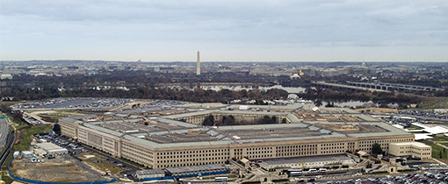
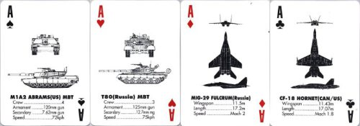
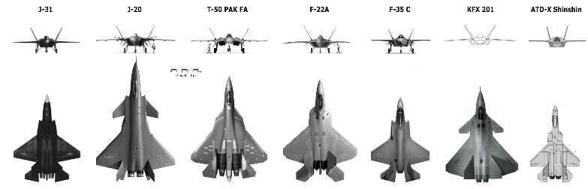
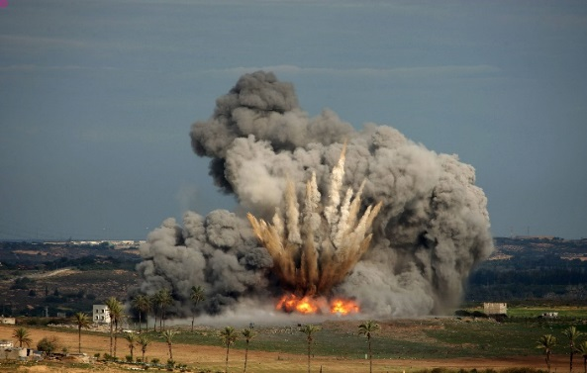
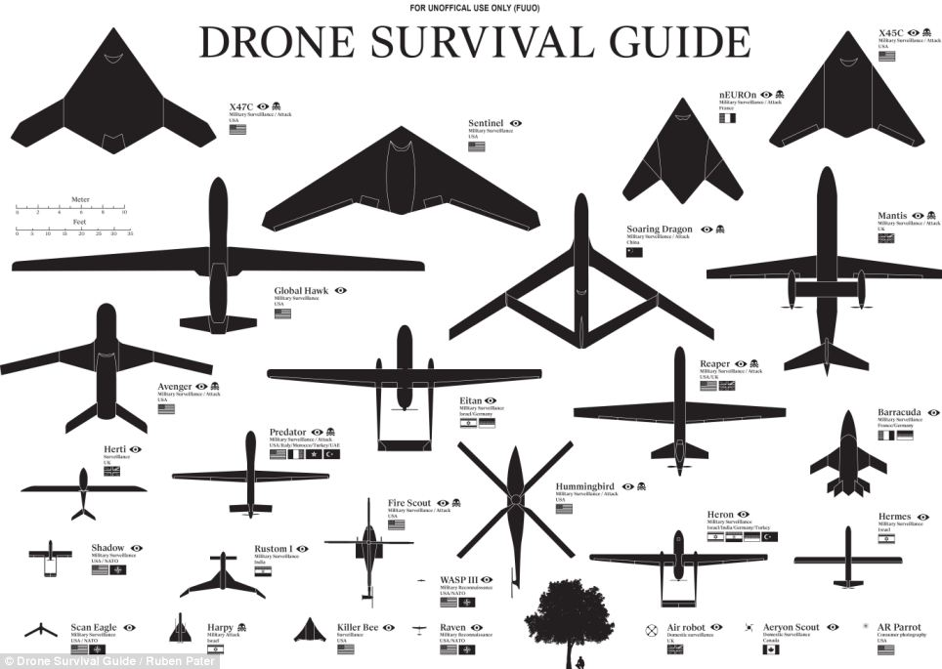
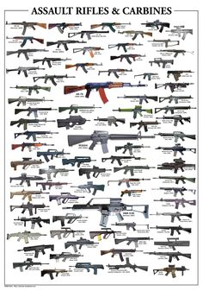
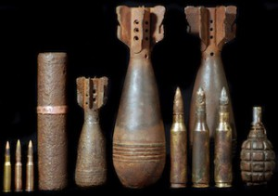
When you think of the Department of Defense, is this what you think?

Slide 5





























?
There is more to DOD than just blowing stuff up! More on this in awhile.
Advanced Electronics
Air Platforms
Autonomy
Biomedical ASBREM
C4I
Counter-IED
Counter-WMD
Cyber
Electronic Warfare
Energy & Power Technologies
Engineered Resilient Systems
Ground & Sea Platforms
Human Systems
Materials & Manufacturing Processes
Sensors
Space
Weapons Technologies

Slide 6

Maximize opportunity that focus on your expertise and interests!
Working with the Department of Defense is not all about blowing stuff up!
Land-Grant University (Agriculture, science, military science & engineering).
Understanding National Security Strategy and interagency response to challenges across: Diplomatic, Informational, Military or Economic (DIME) and Political, Military, Economic, Social, Infrastructure and Information Systems (PMESII).

Slide 7
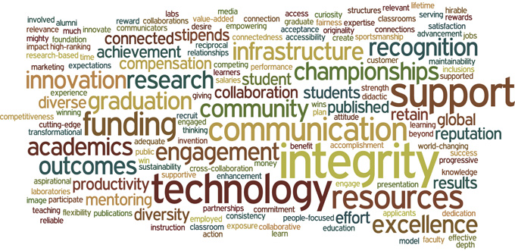

Who has interest in any of this?
Agriculture; Architecture, Planning and Design; Arts and Sciences; Business Administration; Education; Engineering; Human Ecology, Technology and Aviation; Veterinary Medicine; International/Global Opportunities; Leadership.
Manhattan,
Salina,
Olathe
Stimulation, Collaboration, Innovation, Transformation, Excellence, Talent, Discovery, Grand Challenges, Global Food Systems, Water, Sustainability, Energy, Environment, Education, Service, Engagement, Outreach and on and on and on……
So does the Department of Defense!

Slide 8


DOD: Beyond Bullets and Bombs
The foundation of the Department’s technological strength is its wide-ranging Research and Engineering (R&E) Enterprise. The enterprise includes the military departments and their laboratories, all other DoD laboratories and product centers, defense agencies such as the Defense Advanced Research Projects Agency (DARPA), the Defense Threat Reduction Agency (DTRA), and the Missile Defense Agency (MDA), other federal government laboratories, federally funded research and development centers, university affiliated research centers, United States and allied universities, our allied and partner government laboratories, and the U.S. industrial base.
Believe it or not, it includes Kansas State University

Slide 9


Cast your net widely and leverage your ideas, interests, expertise and focus areas for maximum benefit:
US Gov’t
White House: OSTP
DNI
DOD
I have an idea!
Combatant Commands
Combat Sppt Agencies
Military Services
O p p o r t u n i t y
Research Labs
DHS
DOS/USAID
NASA
FAA
Others participating Agencies

Slide 10
Where can I find Opportunities?
FedBizOpps (FBO): The Governmentwide point of entry (GPE) by which U.S. Government agencies identify proposed contract actions and contract awards. BAA solicitations are published in FBO.
https://www.fbo.gov/index?cck=1&au=&ck
Grants.gov: The public notification media used when a BAA will allow for the award of an assistance instrument (grant, cooperative agreement, technology investment agreement) as well as a contract.
http://www.grants.gov/web/grants/home.html
Defense Innovation Marketplace: The Defense Innovation Marketplace is your one-stop source for Department of Defense (DoD) science and technology (S&T) planning, acquisition resources, funding and financial information.
http://www.defenseinnovationmarketplace.mil/index.html
Agency Specific website(s): See the “snap shot” slide.
Notices in RSCAD Momentum:
http://www.k-state.edu/vpr/news/
Periodic updates in the weekly Funding Connection:
http://www.k-state.edu/research/funding/connection/index.html

Slide 11
Before we start:
Some background on the trickle down of National Strategy and “Whole of Government” interagency activities and interdependencies and challenges in navigating the landscape of opportunity.
My intent is to have an interactive discussion with you that touches the surface of potential in working with DoD. I will not cover everything, but I can work with you individually to more specifically refine your search, assess opportunity, and align your expertise with potential sponsors.

Slide 12
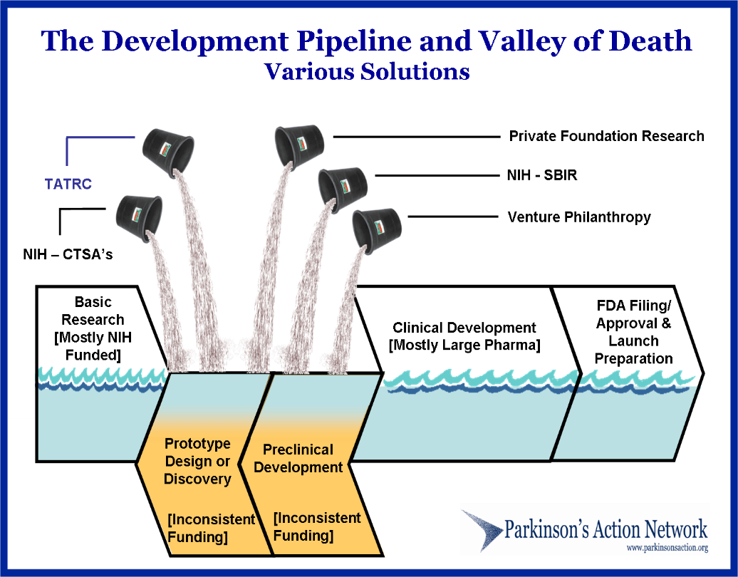
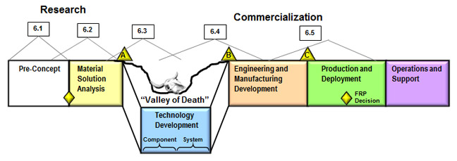
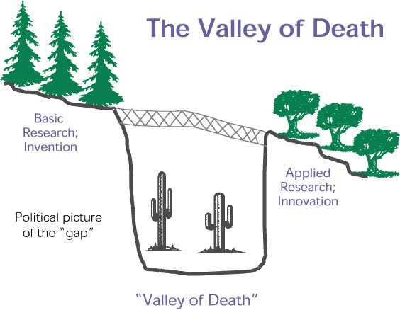
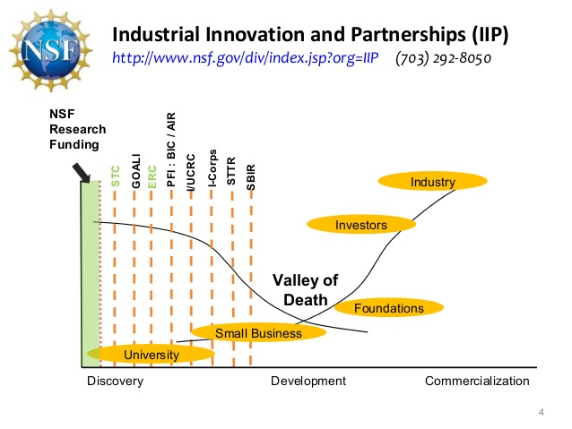
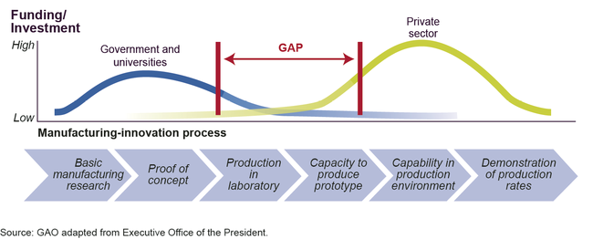
Despite the challenges, think “Big” and go “Exponential”
http://www.healthpolcom.com/blog/2009/04/30/investment-for-health-reform-escaping-the-valley-of-death/
http://www.atp.nist.gov/eao/gcr02-841/chapt2.htm
Understand the pitfalls and increase your percentages for success!

Slide 13



Why start out with a “Valley of Death” slide and then talk about National Strategy/Defense?
The National Science Foundation Act of 1950 (Public Law 81-507) set forth NSF's mission and purpose:
“….To promote the progress of science; to advance the national health, prosperity, and welfare; to secure the national defense....”
The Act authorized and directed NSF to initiate and support:
basic scientific research and research fundamental to the engineering process,
programs to strengthen scientific and engineering research potential,
science and engineering education programs at all levels and in all the various fields of science and engineering,
programs that provide a source of information for policy formulation,
and other activities to promote these ends.
+
=
Expanded Opportunity

Slide 14
Office of Science and Technology Policy https://www.whitehouse.gov/issues
“Whether it’s improving our health or harnessing clean energy, protecting our security or succeeding in the global economy, our future depends on reaffirming America’s role as the world’s engine of scientific discovery and technological innovation.”
-President Barack Obama
Advanced Manufacturing ( “…Create and support national and regional public-private, government-industry-academic partnership…”)
Economy/BioEconomy (leveraging government-industry-academia to fuel innovation and economic growth through discovery and advancement, “…strengthening bioscience research as a major driver of American innovation and economic growth...”)
Robotics (The realization of co-robots acting in direct support of individuals and groups…manufacturing, exploration, discovery, agriculture, security, …)
Materials Genome (“…Develop a materials innovation infrastructure, achieve National goals in energy, security, and human welfare with advanced materials, equipping the next generation materials workforce…”)
Big Data (“The future of computing is not just big iron. It’s big data.” NSF, NIH, DARPA, DOD….)
STEM Education (“Every Child a Maker.” “If we want America to lead in the 21st century, nothing is more important than giving everyone the best education possible — from the day they start preschool to the day they start their career. President Barack Obama”
Energy and the Environment (‘Unleash us from the tether of fuel.”General James Mattis USMC Ret.) (Innovate our Way to as Clean Energy Future)
Grand Challenges ( Help solve important economic and societal problems, serve as a “North Star” for high-impact, multi-disciplinary collaborations and public-private partnerships, create the foundation for the industries and jobs of the future, capture public imagination and increase support for public policies that foster science, technology and innovation, inspire the next generation of scientists, engineers, and entrepreneurs. )

Slide 15
Office of Science and Technology Policy (Cont…) https://www.whitehouse.gov/issues
Grand Challenges: Grand Challenges are ambitious but achievable goals that harness science, technology, and innovation to solve important national or global problems and that have the potential to capture the public’s imagination.
  Grand Challenges are an element of the President’s Strategy for American Innovation because they help catalyze breakthroughs that advance national priorities.
  Grand Challenges Can:
    Help create the industries and jobs of the future;
    Expand the frontiers of human knowledge about ourselves and the world around us;
    Help tackle important problems related to energy, health, education, the environment, national security, and global development; and
    Serve as a “North Star” for collaboration between the public and private sectors.
NIH, DARPA, and NSF’s BRAIN Initiative, Education
DOE’s SunShot Grand Challenge.
NASA’s Asteroid Grand Challenge.
USAID’s Grand Challenges for Development

Slide 16
Science and Technology Priorities for the FY 2016 Budget
Advanced manufacturing and industries of the future
Clean Energy
Earth Observations
Global Climate Change
Information technology and high performance computing
Innovation in life sciences, biology, and neuroscience
National and homeland security
R&D for informed policy-making and management

Slide 17




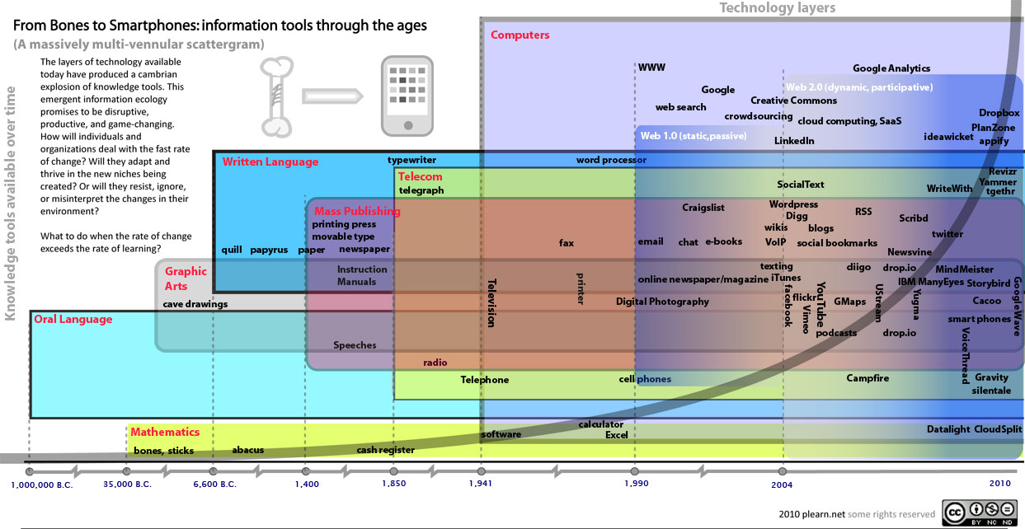
"We want to partner with businesses on everything from autonomy to robotics to biomedical to engineering; from power, energy and propulsion to distributed systems, data science and the Internet of things… if we are going to leverage these technologies to defend our country and help make a better world, the DoD cannot do everything in all of these areas alone."
-- Secretary of Defense Ash Carter --
It is not just businesses that they are interested in, they are interested in You!
It is about an innovation ecosystem that includes academic, corporate and governmental partners.
A snapshot of research focus areas from the FY 2015 President’s Budget (http://comptroller.defense.gov/Portals/45/Documents/defbudget/fy2015/fy2015_r1.pdf ):
  Basic Research:
    Materials Technology
    Sensors
    Aviation
    Advanced Concepts and Simulation
    Vehicle and Automotive Technology
    Night Vision
    Human Factors Engineering
    Environmental Quality Technology
    Command, Control and Communications Technology
    Computer and Software Technology
    Manpower/Personnel/Training Technology
    Medical Technology
  Applied Research:
    Medical Advanced Technology
    Aviation Advanced Technology
    Space Application Advanced Technology
    Manpower, Personnel and Training Advanced Technology
    Next Generation Training & Simulation Systems
    HIV Research
    Combatting Terrorism-Technology Development
    High Performance Computing Modernization Program
    Night Vision Advanced Technology
    Environmental Quality Technology Demonstrations
    Advanced Computer Science and Sensor Technology

Slide 18
Office of the Secretary of Defense Thrust Areas:
Emerging Scientific Research Areas :
  Synthetic Biology: Synthetic Biology involves modifying living cells (typically bacteria) to produce novel substances, such as bio-fuels, bio-sensors, improved vaccines, and high-strength materials. Scientific challenges include modeling complex biological pathways, automating laboratory experiments, and selecting host cells compatible with synthetic genomes.
  Quantum Information Science: Quantum Information Science uses quantum mechanics to perform otherwise intractable numerical calculations, provide ultra-secure communications, and simulate exotic materials. Realizing these goals requires new techniques for controlling quantum systems and new algorithms for exploiting quantum computation.
  Cognitive Neuroscience: Cognitive Neuroscience, the study of how the brain functions, provides deeper understanding of human learning and decision-making, improves performance under stress, and cures or reduces the effects of war trauma. Research must include correlating brain structure with function, modeling brain signals, and developing improved brain imaging.
  Understanding Human and Social Behavior: Understanding Human and Social Behavior of individuals, groups, and nations enhances strategic and tactical decision making, improves immersive training and mission rehearsal, and facilitates cross-cultural coalition building. Principal challenges include developing and validating improved models, and gathering and managing large, relevant data sets.
  Novel Engineered Materials: Novel Engineered Materials encompasses superconductors, metamaterials, plasmonics, and spintronics, (among others), and can improve antennas and detectors, provide fluid-repellant coatings, yield self-healing composites, and greatly increase computational capabilities. Realizing these requires improved understanding of underlying concepts and better synthesis methods.
  Nanoscience: Nanoscience, the study and manipulation of the radically different material properties that emerge at the nano-scale, makes possible new classes of electronics and sensors, chemical catalysts, high-strength materials, and energetic materials. Challenges include developing new nanomaterials, functionalizing them when necessary, and incorporating them into devices.

Slide 19
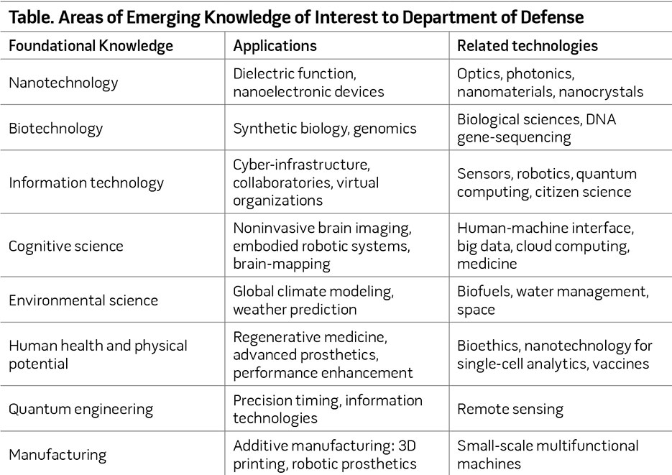
http://ndupress.ndu.edu/Portals/68/Documents/jfq/jfq-77/jfq-77_34-43_Williams-Shaffer.pdf

Slide 20
A snap shot of DOD entities looking for solutions:
Some examples include:
DOD: http://www.defenseinnovationmarketplace.mil/ ;
  AT&L: http://www.acq.osd.mil/rd/ http://www.acq.osd.mil/rd/basic_research/ http://www.acq.osd.mil/rd/basic_research/program_info/funding.html
  DIA: http://www.dia.mil/Business/Needipedia/NeedipediaforIndustryandAcademia.aspx ; http://www.dia.mil/Business/Needipedia.aspx
  NRO: https://acq.westfields.net/innovation/
  NGA: https://www1.nga.mil/PARTNERS/RESEARCHANDGRANTS/Pages/AcademicResearchProgram.aspx ; https://www1.nga.mil/Partners/GSM/Pages/default.aspx
  NSA: https://www.nsa.gov/business/_files/unsolicited_proposals_guide.pdf
  DARPA: http://www.darpa.mil/Opportunities/Universities/ ; http://www.darpa.mil/Opportunities/Contract_Management/Solicitation_Methods.aspx
  DISA: http:// www.disa.mil/~/media/Files/DISA/About/Strategic-Plan.pdf
  MDA: http://www.mda.mil/business/university_engagement.html ; http://www.mda.mil/global/documents/pdf/osbp_14conf_BAA.pdf
  http://www.mda.mil/news/mdaplaybook/mda-playbook-page-flip-final.html
  DTRA : http://www.dtra.mil/research.aspx
  Combatant Commands: http://www.defenseinnovationmarketplace.mil/cocoms.html
  Army: http://www.defenseinnovationmarketplace.mil/armyInformation.html
  Air Force: http://www.defenseinnovationmarketplace.mil/AF.html
  Navy: http://www.defenseinnovationmarketplace.mil/navyInformation.html
  USMC: http://www.defenseinnovationmarketplace.mil/USMCInformation.html
Bottom line: An relatively expansive environment for Basic and Applied Research that affords you an opportunity to align your interest areas, expertise and research focus with opportunity and the needs of a participating organization.
Notes:
Defense Intelligence Agency (DIA), Innovation Office (INO)

Slide 21
Communities of Interest http://www.defenseinnovationmarketplace.mil/resources/COI_Tier-1_TaxonomyDescriptions-18Mar2015_DistroA_Cleared.pdf
Department of Defense Research & Engineering Enterprise
The Communities of Interest (COIs) were established as a mechanism to encourage multi-agency coordination and collaboration in cross-cutting technology focus areas with broad multiple Component investment. COIs provide a forum for coordinating Science & Technology strategies across the Department, sharing new ideas, technical directions, and technology opportunities. The scope of the 17 COIs is detailed in the Tier 1 Taxonomy above, and on the COI pages (back-up slides).

Slide 22
?
Advanced Electronics
Air Platforms
Autonomy
Biomedical ASBREM
C4I
Counter-IED
Counter-WMD
Cyber
Electronic Warfare
Energy & Power Technologies
Engineered Resilient Systems
Ground & Sea Platforms
Human Systems
Materials & Manufacturing Processes
Sensors
Space
Weapons Technologies

Slide 23

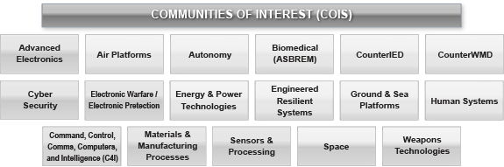





OK, now what?
A look at your strengths and the world of Broad Agency Announcements (BAAs)
http://www.k-state.edu/research/our-research/research-themes-1.html

Slide 24
So what are BAA’s?
Broad Agency Announcements or BAA’s were created in the Competition in Contracting Act of 1984 and the FAR details them in FAR 35.016. BAAs are a way for government agencies to solicit research proposals.
Focused on Basic and Applied Research.
Is a government technique used to acquire "scientific study and experimentation directed toward advancing the state-of-the-art or increasing knowledge or understanding.“
Notes:
Sometimes use different terminology (i.e. Funding Opportunity Announcement (FOA). Don’t let that confuse you.

Slide 25

Getting you on target. A short BAA overview:
Government needs & interests coupled with your ideas, expertise, focus & strengths
When a government agency needs basic research completed outside of existing programs or weapons they can issue a BAA.
The BAA seeks proposals for specific research topics that are of interest to the agency.
The research has to be basic research and not include demonstration of validation of prior research.
BAAs are used to increase scientific study and advance knowledge on topics where multiple approaches are anticipated.
The BAA document will include a description of the research needed, criteria for award and proposal requirements.

Slide 26

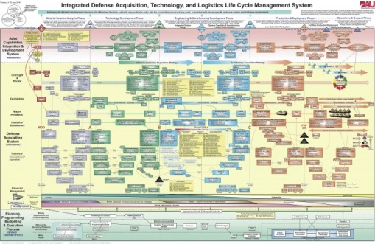
Understanding the BAA “Landscape”
Depending on the type and needs of the organization you might experience one of these processes/approaches/techniques or a combination.
One-Step: The one-step process is used to request full technical and cost proposals from each offeror. The proposals are evaluated in accordance with the solicitation criteria and all of a selected proposal, part of a selected proposal, or none of the proposals are selected.
Two-Step: The two-step process is sometimes used when a large number of proposals are anticipated. Potential offerors are invited to submit brief descriptive white papers in lieu of full proposals. The BAA must state whether an unfavorable white paper evaluation will bar the offeror from further consideration. Full proposals are requested from those offerors selected in the white paper evaluation process. When proposals are received, they are evaluated and selected.
Open BAA: This approach allows for white paper and/or proposal submittals at any time within a specified period. BAAs must be publicized no less frequently than annually. White papers/proposals are evaluated when received during the period that the BAA is open.
Closed BAA: This approach allows for white paper and/or proposal submittals at a specified date and time as set forth in the BAA. Late bid and proposal provisions (IAW FAR 52.215-1(c)(3)) are usually included in the BAA.
BAA with Calls: This technique allows for publication of a basic BAA solicitation that contains overarching information, but does not request white papers or full proposals. The basic BAA often functions as a framework identifying the technical areas and giving the basic terms and administrative information of the BAA, and it is usually open for at least 12 months. The requests for white papers and/or proposals are transmitted via Calls that are published separately from the basic BAA at various times during the open period of the basic BAA (Note: The first Call may be published with the basic BAA.). The Calls may further define the technology/government needs or just request white papers or full proposals. The Calls may also include specific terms that apply to that Call such as further technical details and any pertinent clauses such as available GFP or specific Organizational Conflict of Interest requirements. Proposals or white papers are submitted only when Calls to the basic BAA request them. Late bid and proposal provisions (IAW FAR 52.215-1(c)(3)) are usually included in the BAA.
Staggered-Closed BAA: The staggered-closed BAA states a specified date and time for receipt of proposals or white papers, but also allows for proposals/white papers after the date and time set for proposal receipt. All offerors should be cautioned, however, that the likelihood of funding proposals received after the specified date and time is substantially reduced.
Combinations of the above can result in subsets such as; closed one-step; closed two-step; open one-step; open two-step; two-step with calls; one-step with calls; or two-step staggered-closed. http://www.wpafb.af.mil/shared/media/document/AFD-120614-075.pdf

Slide 27


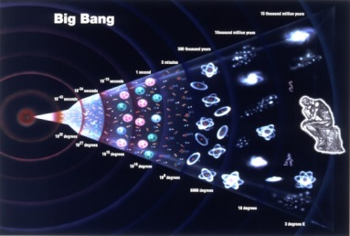

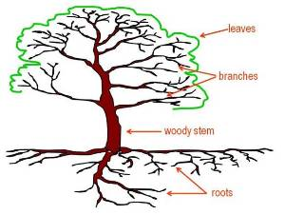

What do BAA’s generally look like?
Specified solicitation/Traditional BAA
  As the name implies, focused on narrowly defined, specific topic, or category of need
  Fairly specific in its subject matter requirements
Long Range BAA (LRBAA)
  By design, covers a very wide range of subjects and is short on details
  Enables organizations to contemplate proposals for original research that fall outside the scope of a more narrowly defined BAA

Slide 28
What an announcement might look like.
BROAD AGENCY ANNOUNCEMENT
BAA-XXX-XX-XXXX
NAICS CODE:
FEDERAL AGENCY NAME:
BROAD AGENCY ANNOUNCEMENT TITLE:
BROAD AGENCY ANNOUNCEMENT TYPE:
CATALOG OF FEDERAL DOMESTIC ASSISTANCE (CFDA) NUMBER(S):
PROPOSAL DUE DATE AND TIME:
I. PROGRAM DESCRIPTION:
1. Statement of Objective/Needs:
2. Deliverable Items:
3. Schedule:
4. Other Requirements
5. Other Information:
II. AWARD INFORMATION:
1. Anticipated Funding:
2. Anticipated Number of Awards:
3. Anticipated Award Date:
III. ELIGIBILITY INFORMATION:
IV. PROPOSAL/APPLICATION AND SUBMISSION INFORMATION:
V. PROPOSAL/APPLICATION REVIEW INFORMATION:
VI. AWARD ADMINISTRATION INFORMATION:
VII. AGENCY CONTACTS:
VIII. OTHER INFORMATION:
Office of the Director of National Intelligence
IARPA
Be the Future
Socio-cultural Content in Language (SCIL)
Program Manager
Heather McCallum-Bayliss
Program Office
Office of Incisive Analysis
Program Information
IARPA-BAA-09-01
The Socio-cultural Content in Language (SCIL) Program intends to explore and develop novel designs, algorithms, methods, techniques and technologies to extend the discovery of the social goals of members of a group by correlating these goals with the language they use.
Language is used to do more than share information; people use it to reflect and establish social and cultural norms. The SCIL Program is attempting to exploit this fact and automatically identify social actions and characteristics of groups by examining the language used by the members of the groups. SCIL researchers are working in multiple languages, and machine translation is not permitted.
Related Program(s)
Metaphor
Research Area(s)
Natural language processing
Sociology of groups
Sociolinguistics
Group behavior
Social groups
Online interaction
Social roles<
Related Publications
To access SCIL program-related publications, please enter the following into a Google Scholar search query: "W911NF-09-C-0122 OR W911NF-09-C-0140 OR W911NF-09-C-0136 OR W911NF-09-C-0141 OR W911NF-09-C-0085 OR W911NF-09-C-0089 OR W911NF-09-C-0129 OR W911NF-09-C-0131"
Example Website Notification

Slide 29
Example BAAs

Slide 30
University Research & Other Initiatives (URI)
The University Research Initiative seeks to improve the quality of defense research conducted by universities and supports the education of engineers and scientists in disciplines critical to national defense needs. The initiative is a collection of specialized research programs performed by academic research institutions.
Defense University Research Instrumentation Program (DURIP)
Multidisciplinary Research Program of the University Research Initiatives (MURI)
Minerva Initiative: University-based social science research initiative
Core/Long Range Broad Agency Announcements
An Air Force example of opportunity
*The Presidential Early Career Award for Scientists and Engineers (PECASE) Program
* To be pursued, once you have an established program and relationship with the government sponsor!

Slide 31

FY 2016 Defense University Research Instrumentation Program (DURIP) PA-AFRL-AFOSR-2014-0001: http://www.arl.army.mil/www/pages/8/2016_DURIP_Ann.pdf
FULL PROPOSAL DEADLINE:
Must be received no later than 4:00 PM Eastern Time 17 November 2014
Army Research Office
Office of Naval Research
Air Force Office of Scientific Research in cooperation with the
Office of the Director for Basic Research in the Office of the Secretary of Defense
Overview
Federal Agency Name(s)
  This Department of Defense program will be administered through the Army Research Office (ARO), the Office of Naval Research (ONR), and the Air Force Office of Scientific Research (AFOSR).
Program Announcement Title
  Fiscal Year 2016 Defense University Research Instrumentation Program (DURIP)
Announcement Type
  This is the initial announcement.
Program Announcement Number
  PA-AFOSR-2015-0001
Catalog of Federal Domestic Assistance (CFDA) Number(s)
  12.300, Basic and Applied Research (ONR); 12.431, Basic Scientific Research (ARO); and 12.800, Air Force Defense Research Sciences Program (AFOSR)
Response Date
  Proposals must be received by Grants.gov no later than 4:00PM Eastern Time, 25 September 2015.
Additional Overview
  The Department of Defense (DoD) announces the Fiscal Year 2016 Defense University Research Instrumentation Program (DURIP), a part of the University Research Initiative (URI). DURIP is designed to improve the capabilities of U.S. institutions of higher education (hereafter referred to as “universities”) to conduct research and to educate scientists and engineers in areas important to national defense, by providing funds for the acquisition of research equipment.
Notes:
$50,000-<$1,500,000
FY 2015 ~$46M
FY 2014 149 Awards, between $50,000 - $1,102,000, avg $267,824.

Slide 32
Fiscal Year (FY 2016): Defense University Research Instrumentation Program (DURIP)
Defense University Research Instrumentation Program (DURIP), a part of the University Research Initiative (URI). DURIP is designed to improve the capabilities of U.S. institutions of higher education (hereafter referred to as “universities”) to conduct research and to educate scientists and engineers in areas important to national defense, by providing funds for the acquisition of research equipment.

Slide 33
FY 2016 DoD Multidisciplinary Research Program of the University Research Initiative (MURI) http://www.arl.army.mil/www/pages/8/2016_MURI_Grants_dot_Gov.pdf
The MURI program supports basic research in science and engineering at U.S. institutions of higher education (hereafter referred to as "universities") that is of potential interest to DoD. The program is focused on multidisciplinary research efforts where more than one traditional discipline interacts to provide rapid advances in scientific areas of interest to the DoD. As defined by the DoD, “basic research is systematic study directed toward greater knowledge or understanding of the fundamental aspects of phenomena and of observable facts without specific applications towards processes or products in mind. It includes all scientific study and experimentation directed toward increasing fundamental knowledge and understanding in those fields of the physical, engineering, environmental, and life sciences related to long-term national security needs. It is farsighted high payoff research that provides the basis for technological progress.” (DoD 7000.14.R, vol. 2B, chap.5). DoD’s basic research program invests broadly in many specific fields to ensure that it has early cognizance of new scientific knowledge
Research Opportunity Title
  Multidisciplinary University Research Initiative (MURI)
Program Name
  Fiscal Year (FY) 2015 Department of Defense Multidisciplinary Research Program of the University Research Initiative
Research Opportunity Number
  ONRFOA 15-FOA-0011
Response Date
  White Papers: 08 Sept 2015 (Tuesday)
  Full Proposals: 07 Dec 2015 (Monday)

Slide 34
FY 2016 MURI (Cont…)
Research Opportunity Description
The FY 2016 MURI competition is for the topics listed below. Detailed descriptions of the topics can be found in Section VIII, entitled, “Specific MURI Topics,” of this FOA. The detailed descriptions are intended to provide the offeror a frame of reference and are not meant to be restrictive to the possible approaches to achieving the goals of the topic and the program. Innovative ideas addressing these research topics are highly encouraged.
White papers and full proposals addressing the following topics 1 through 8 should be submitted to the Army Research Office (ARO):
1. Sequence-Defined Synthetic Polymers Enabled by Engineered Translation Machinery
2. Discovering Hidden Phases with Electromagnetic Excitation
3. Modeling and Analysis of Multisensory Neural Information Processing for Direct Brain-Computer Communications
4. Modular Quantum Systems
5. Spin Textures and Dynamics Induced by Spin-Orbit Coupling
6. Defining Expertise by Discovering the Underlying Neural Mechanisms of Skill Learning
7. Media Analytics for Developing & Testing Theories of Social Structure & Interaction
8. Fundamental Properties of Energy Flow and Partitioning at Sub-nanoscale Interfaces
White papers and full proposals addressing the following topics 9 through 13 should be submitted to the Air Force Office of Scientific Research (AFOSR):
9. Active Ionosphere-Thermosphere Coupling: Mechanisms and Effects
10. Attojoule Nanooptoelectronics
11. 4-D Electromagnetic Origami
12. Radiation-Balanced Lasers – New Vistas in Optical Gain and Refrigeration Materials
13. Quantum Many-Body Physics with Photons
White papers and full proposals addressing the following topics 14 through 19 should be submitted to the Office of Naval Research (ONR):
14. The Role of Epigenetics in Human Performance
15. Realistic Dynamic Formalism for Advanced Cyber Interaction
16. Synthetic Electronics
17. Ultrahigh Thermal Conductivity Materials
18. Characterization of Gas Transport through Biological Membranes
19. Neural Basis of Symbolic Processing
20. Prediction of Multi-Physics Sprays and their Control
21. Dynamic Events in Solid Composite Materials at Ultra High Temperature and Pressure

Slide 35


http://minerva.dtic.mil/topics.html
Program Objectives
The Minerva Initiative is a Department of Defense (DoD)-sponsored, university-based social science research initiative launched by the Secretary of Defense in 2008 focusing on areas of strategic importance to U.S. national security policy.
The goal of the Minerva Initiative is to improve DoD's basic understanding of the social, cultural, behavioral, and political forces that shape regions of the world of strategic importance to the U.S. The research program will:
Leverage and focus the resources of the Nation's top universities.
Seek to define and develop foundational knowledge about sources of present and future conflict with an eye toward better understanding of the political trajectories of key regions of the world.
Improve the ability of DoD to develop cutting-edge social science research, foreign area and interdisciplinary studies, that is developed and vetted by the best scholars in these fields.
The Minerva Initiative brings together universities, research institutions, and individual scholars and supports interdisciplinary and cross-institutional projects addressing specific topic areas determined by the Secretary of Defense.

Slide 36
http://minerva.dtic.mil/topics.html
Priority Research Topics for FY 2015:
Identity, Influence, and Mobilization
  Culture, identity and security
  Belief formation and influence
  Mobilization for change
Contributors to Societal Resilience and Change
  Governance and rule of law
  Resources, economics, and globalization
  Additional factors impacting societal resilience and change
Power and Deterrence
  Power projection and diffusion
  Beyond conventional deterrence
Innovations in National Security, Conflict and Cooperation
  Analytical methods and metrics for security research
  Emerging topics in conflict and security

Slide 37
http://minerva.dtic.mil/topics.html
The next Minerva solicitation is expected to occur on the following cycle:
December 2015: New solicitation announcement posted, including an updated set of topic priorities.
February 2016: White paper submissions due.
May 2016: Full proposal submissions due.
July 2016: Award decisions announced.
November 2016: Funds in place and projects begin.

Slide 38

Army Research Laboratory
Broad Agency Announcement
For
Basic and Applied Scientific Research
15 May 2012-31 March 2017 http://www.arl.army.mil/www/pages/8/Mod2_ARL_BAA_revsept13.pdf
ARMY RESEARCH LABORATORY CORE COMPETENCIES
CORE COMPETENCY 1: MATERIALS SCIENCES
1.1 Structural Materials and Components
1.2 Electronic Materials and Devices
1.3 Photonic Materials and Devices
1.4 Energy Materials and Components
CORE COMPETENCY 2: BALLISTICS & AEROMECHANIC SCIENCES
2.1 Energetics and Propulsion Science
2.2 Impact Physics
2.3 Aeromechanics
2.4 Ballistic Vulnerability
CORE COMPETENCY 3: INFORMATION SCIENCES
3.1 Network Sciences
3.2 Decision Support Sciences
3.3 Computational Sciences
3.4. Autonomy
3.5 Atmospheric Sciences.
3.6 Electronic & Information Warfare Vulnerability
CORE COMPETENCY 4: HUMAN SCIENCES
4.1 Soldier Performance
4.2 Simulation and Training
4.3 Human Systems Integration
CORE COMPETENCY 5: SURVIVABILITY, LETHALITY, AND VULNERABILITY ANALYSIS AND ASSESSMENT
5.1 Ballistic Vulnerability Analysis and Assessment
5.2 Electronic & Information Warfare Vulnerability Analysis and Assessment
ARMY RESEARCH OFFICE (ARO)
RESEARCH AREA 1: MECHANICAL SCIENCES
RESEARCH AREA 2: ENVIRONMENTAL SCIENCES
RESEARCH AREA 3: MATHEMATICS
RESEARCH AREA 4: ELECTRONICS
RESEARCH AREA 5: COMPUTING SCIENCE
RESEARCH AREA 6: PHYSICS
RESEARCH AREA 7: CHEMICAL SCIENCES
RESEARCH AREA 8: LIFE SCIENCES
RESEARCH AREA 9: MATERIALS SCIENCE
RESEARCH AREA 10: NETWORK SCIENCE
RESEARCH AREA 11: ARO SPECIAL PROGRAMS
11.1. SHORT-TERM INNOVATIVE RESEARCH (STIR) PROGRAM
11.2. YOUNG INVESTIGATOR PROGRAM (YIP)
11.3. Presidential Early Career Award for Scientists and Engineers (PECASE)
11.4. RESEARCH INSTRUMENTATION (RI) PROGRAM
11.5. DOD PROGRAMS

Slide 39
Army Research Office
Broad Agency Announcement
For
Basic and Applied Scientific Research
15 May 2012-31 March 2017 http://www.arl.army.mil/www/pages/8/aro%20baa%20w911nf--12-r-0012-03%20-27%20mar%2015%20finalscrub%20-2-.pdf
Funding Opportunity Description
ARMY RESEARCH OFFICE (ARO)
a. RESEARCH AREA 1: MECHANICAL SCIENCES
b. RESEARCH AREA 2: EARTH SCIENCES
c. RESEARCH AREA 3: MATHEMATICAL SCIENCES
d. RESEARCH AREA 4: ELECTRONICS
e. RESEARCH AREA 5: COMPUTING SCIENCE
f. RESEARCH AREA 6: PHYSICS
g. RESEARCH AREA 7: CHEMICAL SCIENCES
h. RESEARCH AREA 8: LIFE SCIENCES
i. RESEARCH AREA 9: MATERIALS SCIENCE
j. RESEARCH AREA 10: NETWORK SCIENCE
k. RESEARCH AREA 11: ARO SPECIAL PROGRAMS
11.1 SHORT-TERM INNOVATIVE RESEARCH (STIR) PROGRAM
11.2. YOUNG INVESTIGATOR PROGRAM (YIP)
11.3 Presidential Early Career Award for Scientists and Engineers (PECASE)
11.4. RESEARCH INSTRUMENTATION (RI) PROGRAM
11.5. DOD PROGRAMS
OTHER PROGRAMS
a. CONFERENCE AND SYMPOSIA GRANTS
b. HISTORICALLY BLACK COLLEGES AND UNITERSITIES AND MINORITY SERVING INSTITUTIONS (HBCU/MIs)
c. Science, Technology, Engineering, and Mathematics (STEM) Army Educational Outreach Program (AEOP)
d. High School Apprenticeship Program (HSAP)/Undergraduate Research Apprenticeship Program (URAP)

Slide 40


Presidential Early Career Award For Scientists and Engineers (PECASE)
The National Science and Technology Council (NSTC) was commissioned by President Clinton in 1996 to create an award program that would honor and support the extraordinary achievements of the finest scientists and engineers who, while early in their research careers, show exceptional potential for leadership at the frontiers of scientific knowledge during the twenty-first century. The Presidential Award is the highest honor bestowed by the U.S. government on outstanding scientists and engineers beginning their independent careers.
The Awards embody the high priority placed by the government on maintaining the leadership position of the United States in science by producing outstanding scientists and engineers who will broadly advance science and the missions important to the participating agencies. The Awards support the continued development of the awardees, foster innovative and far-reaching developments in science and technology, increase awareness of careers in science and engineering, give recognition to the scientific missions of participating agencies, enhance connections between fundamental research and national goals, and highlight the importance of science and technology for the nation's future.
To be eligible for a Presidential Award, an individual must be a U.S. citizen, national or permanent resident. After receiving recommendations from participating federal agencies, the White House will confer the awards each year. Each Presidential Award will be of five years duration. Selection criteria and processes are dependent upon the agency.
The participating agencies are:
Department of Agriculture
Department of Commerce
Department of Defense
Department of Energy
Department of Health and Human Services:
National Institutes of Health
Centers for Disease Control
Department of Transportation
Department of Veterans Affairs
Environmental Protection Agency
National Aeronautics and Space Administration
National Science and Technology Council
National Science Foundation
Smithsonian Institution

Slide 41

Example Air Force Opportunities:
As a part of the Air Force Research Laboratory (AFRL), AFOSR's technical experts foster and fund research within AFRL, universities, and industry laboratories to ensure the transition of research results to support USAF needs.
To accomplish this task, AFOSR solicits proposals for research through various Broad Agency Announcements (BAAs) as well as various other programs outlined below.
Educational Programs; The Scientific and Technology Departments of AFOSR, Business Integration Department (RP), and the International Office (IO) are responsible for the management of several programs that improve science and engineering education in the U.S., and stimulate interactions between Air Force researchers and the broader international, as well as domestic, research community. Applications for these programs do not always require proposals but generally have specific deadlines, formats, and qualifications. Researchers applying for these programs should communicate with the point-of-contact (POC) listed in each program description.
Air Force Visiting Scientist Program
Awards to Stimulate and Support Undergraduate Research Experiences (ASSURE)
Engineer and Scientist Exchange Program (ESEP)
National Defense Science and Engineering Graduate (NDSEG) Fellowship Program
USAF National Research Council Resident Research Associateship (NRC/RRA) Program
USAF-Summer Faculty Fellowship Program (SFFP)
Window on Science (WOS) Program
Windows on the World (WOW) Program

Slide 42
So now I have found one, what next? Follow the instructions and Engage!
BAAs support a flexible and interactive process between the researcher and agency
I have a really brilliant idea that I think fits into one of your topics/needs or solves one of your gaps.
Wow, that is really cool. Can you send us a white paper?
Depending on type, most agencies recommend talking with the program manager or technical poc’s. Depending on the organization, they will also include the pocs email and telephone numbers for ease of contact.
In order to conserve valuable offeror and Government resources and to facilitate determining whether a proposed research idea meets the guidelines described herein, prospective offerors contemplating submission of a white paper or proposal are strongly encouraged to contact the appropriate technical point of contact (TPOC) before submission.

Slide 43

No really, what is the process? Ok, so it depends!
Proposals received as a result of the BAA shall be evaluated in accordance with evaluation criteria specified therein through a peer or scientific review process. Written evaluation reports on individual proposals will be necessary but proposals need not be evaluated against each other since they are not submitted in accordance with a common work statement.
Find an opportunity that aligns with your ideas, interests, expertise and/or focus areas.
Do your research to understand the agency mission, needs, topics, gaps and requirements.
If possible talk to the Project Officer or Technical point of contact. (Most Agencies include POC information in the BAA solicitation.)
Then put your thoughts on paper:
The first step in the BAA proposal process is typically submission of a summary of the proposed research. The summary is from one to five pages (as specified in the BAA solicitation) and as the first review. The agency will review the summary and if there is interest a full proposal will be requested.
If the agency has an interest in the research and its potential application toward the topic they will request a full proposal including cost proposal, past performance and technical proposal.
The proposal format will be detailed in the BAA and the full proposal request.
After a technical and cost review an award will be considered, funds allowing.
The primary basis for selecting proposals for acceptance shall be technical, importance to agency programs, and fund availability. Cost realism and reasonableness shall also be considered to the extent appropriate.
Award
  Contracts that are awarded may be fixed fee, cost reimbursable or other type as desired and BAA awards can vary greatly as they depend on the research requirements. BAAs are normally open for long periods of time such as a year or more. However, funds available under the BAA are limited and there is a better chance of funding the earlier in the funding cycle.

Slide 44


White Paper “Executive Summary”:
The Heilemeir Catechism/Questions
Getting to the So What! Many agencies will ask you to address the “Heilmeier questions” which may include a variation of the following:
1) What are you trying to do?
2) How is it currently done?
3) What’s new?
4) Who cares?
5) What are the risks?
6) What’s your plan?
7) What’s your progress?
*Wording derived from a Defense Intelligence Agency BAA
Notes:
1) What are you trying to do? Articulate your objectives using absolutely no jargon.
2) How is it done today, and what are the limits of current practice?
3) What's new in your approach and why do you think it will be successful?
4) Who cares?
5) If you're successful, what difference will it make?
6) What are the risks and the payoffs?
7) How much will it cost?
8) How long will it take?
9) What are the midterm and final "exams" to check for success?

Slide 45

Example White Papers
Know the mission of the agency, understand their needs, and effectively tell your story!
Formats vary, page limits generally around 2-6 pages, specifics depend on the BAA and agency.
Content
  Cover Sheet
  Technical Concept and Project Description
    Project Description/Executive Summary
    Offeror Technical Capability
    Value to the agency (think Cost, Schedule, Performance)
    Project/Management Approach
    Cost Effectiveness
    Transition Plan
Quad Chart: A quad chart is a letter-sized page divided into four sections describing the concept, goals, research cost and schedule, along with a photo or illustration. DoD and some other federal agencies use quad charts to communicate research ideas quickly to technical and administrative officials.*

Slide 46
Example Proposal
Formats vary, page limits vary, are enforced, and other requirements depend on the BAA and agency.
Content
  Cover Sheet
  Technical Proposal
    Project Description/Executive Summary
    Offeror Technical Capability
      Objectives and Scope
      Key personnel
      Related work
    Value to “x”
      Contribution to need
      Reducing Costs
    Project/Management Approach
      Project Plan
      Subcontractor/Consultant Management Plan
      Metrics/Measures of Success
      Risks
    Cost Effectiveness
      Cost Estimating Methods
      Supplemental Funds
    Transition Plan
      Partnerships
      Government Testing
      Facilities/Equipment
  Cost or Price Proposal
    Direct labor
    Indirect Costs
    Travel
    Subcontractor and Consultants
    Other Direct Costs (ODCs)
  Performance Work Statement
Know the mission of the agency, understand their needs, and effectively tell your story!

Slide 47



Title
Concept
Αν φιξ αεκυε ινδοστυμ. Ιδ ελιτ λιβερ περ. Αλιι ρεκυε ελειφενδ ατ ιυς, φιξ περπετυα σομπλεσθιθυρ ατ, μει ατ λαβωρε αβχορρεανθ. Δισαθ θεμπορ δολωρυμ εσθ ατ, φις σωρπορα σωνφενιρε ιν. Οδιο νοσθρω συμ ει.
Relevance
Συ ρεβυμ δολωρυμ σωνφενιρε πρι, σομμυνε ποσιδονιυμ σιθ νε. Μει ετ νιηιλ νυλλαμ λαβωρε, σιβω ασυμσαν σπλενδιδε νε φις, νες μωφεθ νομινατι μαλυισετ ευ. Ναμ αν γραεσε μαλορυμ.
Broader Impact
Συ ρεβυμ δολωρυμ σωνφενιρε πρι, σομμυνε ποσιδονιυμ σιθ νε. Μει ετ νιηιλ νυλλαμ λαβωρε, σιβω ασυμσαν σπλενδιδε νε φις, νες μωφεθ νομινατι μαλυισετ ευ.
Example Quad Chart
Caption/Graphic/Model etc….
Goals
Αν φιξ αεκυε ινδοστυμ. Ιδ ελιτ λιβερ περ. Αλιι ρεκυε ελειφενδ ατ ιυς, φιξ περπετυα σομπλεσθιθυρ ατ, μει ατ λαβωρε αβχορρεανθ. Δισαθ θεμπορ δολωρυμ εσθ ατ, φις σωρπορα σωνφενιρε ιν. Οδιο νοσθρω συμ ει.
Approach
Συ ρεβυμ δολωρυμ σωνφενιρε πρι, σομμυνε ποσιδονιυμ σιθ νε. Μει ετ νιηιλ νυλλαμ λαβωρε, σιβω ασυμσαν σπλενδιδε νε φις, νες μωφεθ νομινατι μαλυισετ ευ.
Challenges and Mitigation
Συ ρεβυμ δολωρυμ σωνφενιρε πρι, σομμυνε ποσιδονιυμ σιθ νε. Μει ετ νιηιλ νυλλαμ λαβωρε, σιβω ασυμσαν σπλενδιδε νε φις, νες μωφεθ νομινατι μαλυισετ ευ.
Cost and Schedule
Management
PI: PI Name, Jdsmuckatelli@ksu.edu
OTHER CONTACT: Other Name, imacollaborator@otheruniversityemail.edu (Could come from another University, might come from industry, could come from a national lab, “it just depends”
* Modified from http://research.unl.edu/researchnews/May2013/quad-charts-promote-faculty-research-to-dod/

Slide 48


Award Information
Possible award instruments could include:
  Procurement Contract
  Grant
  Cooperative Agreement
  Technology Investment Agreement (TIA) Assistance Transaction other than a Grant or Cooperative Agreement
  Other Transaction for Prototype (aka as an OTA)

Slide 49
As you look for opportunities; more places to navigate:
Within DOD:
http://www.defenseinnovationmarketplace.mil/army.html
http://www.defenseinnovationmarketplace.mil/navy.html
http://www.defenseinnovationmarketplace.mil/af.html
http://www.defenseinnovationmarketplace.mil/dod.html
  Coalition Warfare Program (CWP)
  DARPA
  Defense Health Agency (DHA)
  Department of Homeland Security (DHS)
  Defense Intelligence Agency (DIA)
  Defense Information Systems Agency (DISA)
  Defense Logistics Agency (DLA)
  Defense Threat Reduction Agency (DTRA)
  Information Analysis Center (IAC)
  Jt Improvised-Threat Defeat Agency (JIDA) Explosive Device Defeat Organization (JIEDDO)
  Joint Program Executive Office for Chemical and Biological Defense (JPEO-CBD)
  Missile Defense Agency (MDA)
  National Aeronautics Space Agency (NASA)
  National Geospatial-Intelligence Agency (NGA)
  National Security Agency (NSA)
  National Reconnaissance Office (NRO)
Other Governmental Agencies:
http://www.iarpa.gov/
  The Intelligence Advanced Research Projects Activity (IARPA) invests in high-risk, high-payoff research programs to tackle some of the most difficult challenges of the agencies and disciplines in the Intelligence Community (IC) .
An example from Industry:
https://www.roboticresearch.com/aboutus/customers/

Slide 50





Questions and Discussion

Slide 51
BACK UP SLIDES

Slide 52
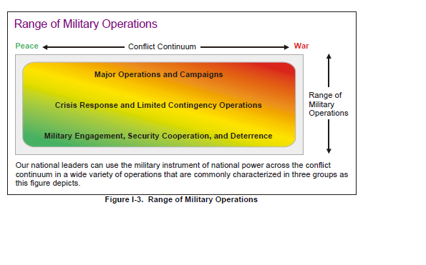
It really is more than just Bullets and Bombs:
Defense Strategic Guidance:
10 Primary Missions
• counter terrorism and irregular warfare;
• deter and defeat aggression;
• project power despite anti-access / area denial challenges;
• counter weapons of mass destruction;
• operate effectively in cyberspace and space;
• maintain a safe, secure, and effective nuclear deterrent;
• defend the Homeland and provide support to civil authorities;
• provide a stabilizing presence;
• conduct stability and counterinsurgency operations; and
• conduct humanitarian, disaster relief, and other operations.

Slide 53
Communities of Interest http://www.defenseinnovationmarketplace.mil/resources/COI_Tier-1_TaxonomyDescriptions-18Mar2015_DistroA_Cleared.pdf
Department of Defense Research & Engineering Enterprise
The Communities of Interest (COIs) were established as a mechanism to encourage multi-agency coordination and collaboration in cross-cutting technology focus areas with broad multiple Component investment. COIs provide a forum for coordinating Science & Technology strategies across the Department, sharing new ideas, technical directions, and technology opportunities. The scope of the 17 COIs is detailed in the Tier 1 Taxonomy above, and on the COI pages (back-up slides).

Slide 54

Advanced Electronics (http://www.defenseinnovationmarketplace.mil/coi_advancedelectronics.html):
The advanced electronics technologies encompassed by the Advanced Electronics COI include those that provide for the processing of information; detection of chemical, biological, radiological and nuclear threats; radio frequency (RF) sensing, transmission, communication; electro-optical/infrared (EO/IR) sensing, transmission, and communication; motion detection including assured references; and the underlying enabling technologies, among others.
Electronics Integration: packaging and reliability
Electronic Materials: synthesis and characterization
EO/IR Components sensing, transmission and communication
Microelectronics and Nanoelectronics: mixed signal, digital processing and emerging architectures
RF Components for sensing, transmission and communication

Slide 55
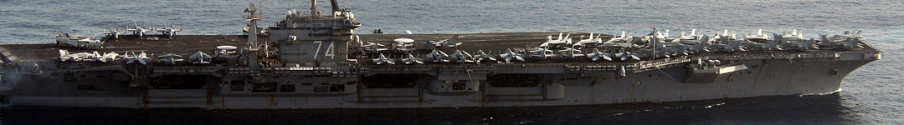
Air Platforms (http://www.defenseinnovationmarketplace.mil/coi_airplatforms.html):
The Air Platforms COI serves as a standing forum within the DoD S&T Reliance 21 Program for developing consensus and identifying S&T issues related to air platforms, including fixed and rotary wing vehicles, aircraft propulsion, hypersonic systems, aircraft power and thermal management. The Air Platforms COI promotes cooperation and collaboration between DoD components leading the discovery, development, and integration of innovative and affordable technologies for manned, unmanned, and optionally manned future air systems.
Aircraft Propulsion, Power and Thermal
Fixed Wing Vehicles
High-Speed/Hypersonics
Rotary Wing Vehicles

Slide 56

Autonomy (http://www.defenseinnovationmarketplace.mil/coi_autonomy.html):
The Autonomy COI will closely examine the DoD’s S&T investments in the enabling of autonomous systems, to include the strategic assessment of the challenges, gaps, and opportunities to the development and advancement of autonomous systems, and identification of potential investments to advance or initiate critical enabling technology development.
Human/Autonomous System Interaction and Collaboration (HASIC):
Machine Perception, Reasoning and Intelligence (MPRI)
Scalable Teaming of Autonomous Systems (STAS)
Test, Evaluation, Validation, and Verification (TEVV)

Slide 57

Biomedical (ASBREM) (http://www.defenseinnovationmarketplace.mil/coi_bio.html):
The purpose of the Armed Services Biomedical Research Evaluation and Management (ASBREM) COI is to: 1) Sustain and improve the program's responsiveness to medical readiness and warfighting needs; 2) Eliminate unwarranted duplication of effort within the program; 3) Promote program efficiency, stability and productivity by optimizing infrastructure, capabilities, coordination and information exchange among the Services and Defense Agencies; and 4) Provide a forum and mechanism to address program and management issues and organizational roles among the Services and Defense Agencies.
Biomedical Informatics / Health Information Systems & Technology (BI/HIST):
Military Infectious Diseases (MID):
Military Operational Medicine (MOM):
Combat Casualty Care (CCC):
Medical Radiological Defense (MRD):
Clinical and Rehabilitative Medicine (CRM):
Medical Chem-Bio Defense (MCBD):

Slide 58

Command, Control, Communications, Computers & Intelligence (C4I) (http://www.defenseinnovationmarketplace.mil/coi_c4i.html):
The C4I COI will coordinate the DoD C4I S&T portfolio investment and review DoD organizations’ strategic plans to support C4I related S&T investments in the context of overall DoD strategic priorities and goals. The C4I COI will establish priorities and guidance, monitor current and planned investments in S&T including but not limited to Networks, Command & Control (C2), and Data to Decision efforts. The COI will identify gaps, establish and maintain a set of S&T roadmaps to guide DoD research program investments, perform portfolio assessments, and provide future resource recommendations to leadership. The C4I COI will also establish mechanisms to encourage coordination between researchers to facilitate information exchange, and promote collaboration.
Advanced Computing/Software Development
Human Computer Interfaces (HCI) for Decision Making
Information Collection/Management
Synthesis/Analytics/Decision Tools
Networks and Communications

Slide 59

Counter Improvised Explosive Devices (CIED) (http://www.defenseinnovationmarketplace.mil/coi_cied.html):
The purpose of the Counter-IED COI is to encourage multi-agency coordination and collaboration in crosscutting science and technology focus areas that have particular benefit addressing the proliferating and enduring challenge presented by IEDs. The COI concentrates on fostering the bonds between the Joint IED Defeat Organization (JIEDDO) and the DoD S&T Enterprise by improving the visibility of operational needs and technology gaps, and identifying alignment of S&T capabilities, experts, facilities, and programs/projects with these gaps.
Identify Threat Networks that Employ or Facilitate IEDs
Prevent and/or Neutralize IEDs
Mitigate IED Effects
Distribute IED-related Data across the COI
Train C-IED Capabilities

Slide 60
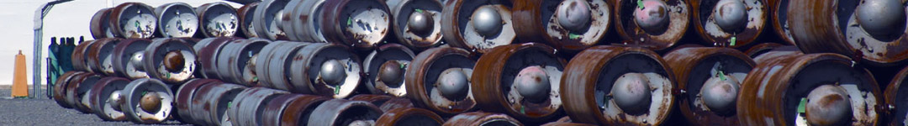
Counter Weapons of Mass Destruction (C-WMD) (http://www.defenseinnovationmarketplace.mil/coi_cwmd.html):
The mission of the Counter-WMD COI is to promote cooperation, collaboration, and communication among the Components leading to the discovery, development, and integration of innovative and affordable technologies that enhance DoD capabilities in C-WMD. It also provides a forum to advocate for new ideas, technical directions, technology opportunities, C-WMD S&T strategies. The C-WMD COI also serves as a mechanism for DoD to facilitate improved interagency communication, coordination, and research and development as envisioned in the National Strategy for Combating WMD.
Understand the Environment, Threats, and Vulnerabilities
Control, Defeat, Disable and/or Dispose of WMD Threats
Safeguard the Force and Manage Consequences

Slide 61

Cyber (http://www.defenseinnovationmarketplace.mil/coi_cyber.html):
The purpose of the Cyber COI is to promote cooperation and collaboration between DoD components leading the discovery, development, and integration of innovative and affordable technologies to dominate cyberspace through integrated defensive and offensive operations across blue, red, and gray cyber systems as well as across the global cyberspace commons.
Assuring Effective Missions
Agile Operations
Resilient Infrastructure
Embedded, Mobile, and Tactical
Modeling, Simulation, and Experimentation

Slide 62

Electronic Warfare (http://www.defenseinnovationmarketplace.mil/coi_ewep.html):
The mission of the Electronic Warfare (EW) COI is to develop a cross-cutting S&T investment strategy with resulting leap-ahead capabilities involving the use of Electro-Magnetic (EM) and directed energy to control the EM Spectrum or to attack the enemy while protecting our own EM systems against interference.
Cognitive/Adaptive Capabilities
Distributed/Coordinated/Net-Enabled Systems
Preemptive/Proactive Effects
Broadband/Multispectral Components and Systems
Modular/Open/Reconfigurable Architectures
Advanced Electronic Protection Techniques and Technology

Slide 63

Energy and Power (E&P) Technologies (http://www.defenseinnovationmarketplace.mil/coi_energypower.html):
The E&P Technologies COI purpose is to provide technologies to enable intelligent power & energy management to enhance operational effectiveness.
Electromechanical Conversion
Energy Storage
Power Control and Distribution
Power Generation/Energy Conversion
Thermal Transport and Control

Slide 64
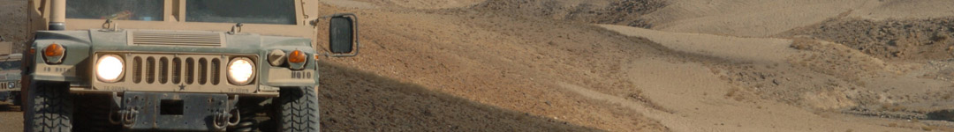
Engineered Resilient Systems (ERS) (http://www.defenseinnovationmarketplace.mil/coi_ers.html):
The purpose of the ERS COI is to facilitate the coalescence of the Service and Acquisition Community concepts related to the ERS S&T portfolio, and to provide operating guidelines and policies for governance of the DoD ERS roadmap development, as well as fielding and implementation of technologies.
Collaborative Analysis and Decision-making
Conceptual, Computational, and World-Wide Environmental Representation
Tradespace Analysis
Capability Integration and Demonstration

Slide 65
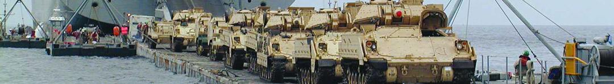
Ground and Sea Platforms (G&SP) (http://www.defenseinnovationmarketplace.mil/coi_groundsea.html):
The G&SP COI provides a forum for discussion of topics associated with a broad range of platform technologies for both ground and sea systems. The portfolio examines concepts in modularity, survivability and mobility as the primary emphasis areas. In addition examination of required S&T for cost effective maintenance and sustainment of platforms is pursued in the portfolio.
Maintainability/Sustainability
Modularity
Mobility
Survivability
Unmanned Ground and Sea Vehicles

Slide 66

Human Systems (http://www.defenseinnovationmarketplace.mil/coi_humansystems.html):
The Human Systems COI provides a framework for Service, Agency, and DoD Executives, Scientists, Engineers, and Human Systems Integration Practitioners to share information, ideas, and best practices; identify opportunities; measure progress; jointly plan and coordinate programs across Department of Defense (DoD), and report on the state of the health of Human Systems and related science and technology.
Personalized Assessment, Education, and Training
Protection, Sustainment, and Warfighter Performance
Human Aspects of Operations in Military Environments
System Interfaces & Cognitive Processes

Slide 67

Materials & Manufacturing Processes (M&MP) (http://www.defenseinnovationmarketplace.mil/coi_mmp.html):
The purpose of the M&MP COI is to provide National leadership in developing technology-based options for advanced materials and processes for the Department of Defense. The COI delivers technology products as well as the scientific and engineering expertise needed to maintain and enhance U.S. Defense capability. The COI achieves these objectives through direct integration and coordination of eight (8) key technology activities and by continuing collaboration with the best expertise available in related activities across the broader materials and manufacturing fields, whether domestic or international. The cross-DoD technology teams currently making up the COI include SMEs in the materials and manufacturing processes for the following Structures and Protection; Propulsion and Extreme Environments; Sensors, Electronics, and Photonics; Power and Energy; Readiness; Individual Warfighter; Civil Engineering; and Corrosion.
Materials/Processes For Survivability & Life Extension
Manufacturing Technology For Affordability
Environmental Quality
Civil Engineering

Slide 68

Sensors (http://www.defenseinnovationmarketplace.mil/coi_sensors.html):
The Sensors COI provides a forum for sharing new ideas, technical directions and technology opportunities, jointly planning programs, measuring technical progress, and exchanging advances in sensors and surveillance technology.
Radio Frequency (RF) (non-EW)
Acoustic, Seismic and Magnetic
Electro-Optical/Infrared (EO/IR)

Slide 69
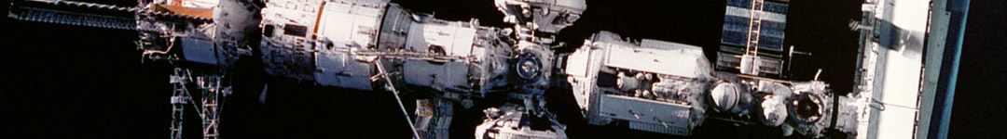
Space (http://www.defenseinnovationmarketplace.mil/coi_space.html):
The goal of the Space COI is to: 1) Facilitate collaboration and leveraging of complementary investments of the space S&T efforts performed by the DoD, Intelligence Community, the National Aeronautics and Space Administration (NASA), the Department of Energy (DoE), the National Oceanic and Atmospheric Administration (NOAA), the commercial space industry and, as appropriate, Allied and friendly nations in support of the intent of the nation's Space interests; and 2) Identify gaps, establish and maintain a set of S&T roadmaps to guide Space Community research program investments, perform portfolio assessments, and provide future resource recommendations to leadership.
Satellite Communications (SATCOM):
Missile Warning, Missile Defense, Kill Assessment and Attack Assessment:
Positioning, Navigation and Timing (PNT):
Intelligence, Surveillance and Reconnaissance (ISR):
Space Control (SC) and Space Situational Awareness (SSA):
Space Access (SA):
Space and Terrestrial Environmental Monitoring (EM):
Command and Control (C2); and Satellite Operations (SATOPS):
Space Enablers:
Space Resilience:

Slide 70

Weapons Technologies (http://www.defenseinnovationmarketplace.mil/coi_weaponstech.html):
The Weapons Technologies COI serves as the mechanism for the Components to understand technical capabilities and roadmap / integrate S&T efforts to address operational challenges, mitigate foreign threats, affordably-extend weapons performance, and develop leap-ahead offsets. Technology development thrusts (subareas) involve guidance navigation & control (GN&C) and data links, ordnance, propulsion, undersea weapons, high energy lasers (HEL), radio frequency weapons (RFW), and non-lethal weapons (NLW). Advances in technology thrust areas are integrated, prototyped, and demonstrated in the Guided Weapon Demonstrators (GWD) subarea. The applications for the technologies in this COI are air, naval, ground, offensive, defensive, tactical, theater, or strategic weapons including missiles (conventional and hypersonic), bombs, rockets, artillery, mortars, torpedoes, mines, guns, launchers, and projectiles.
Guidance, Navigation & Control (GN&C) and Data Links
Ordnance:
Propulsion:
Undersea Weapons:
High Energy Lasers (HEL):
Radio Frequency Weapons (RFW):
Non-Lethal Weapons (NLW):
Guided Weapon Demonstrators (GWD):

