Slide 1
Measuring Global Engagement at the University:
The Global Engagement Directory
KIE 2025 at KCKCC
Grant Chapman, Associate Provost for International
Programs at Kansas State University
Stefan Yates, International Program/Project Manager,
Kansas State University

Slide 2



Introduction – A little about Grant
Born in Oklahoma attended Oklahoma State University
Formative years in London; returned later to live and work in London
Graduate Degree and Doctorate in Law at St. Louis University
Thirty years in international higher education at Ottawa University, Webster University, and Kansas State University
Notes:
All about context, implicit bias, getting to know the speaker

Slide 3

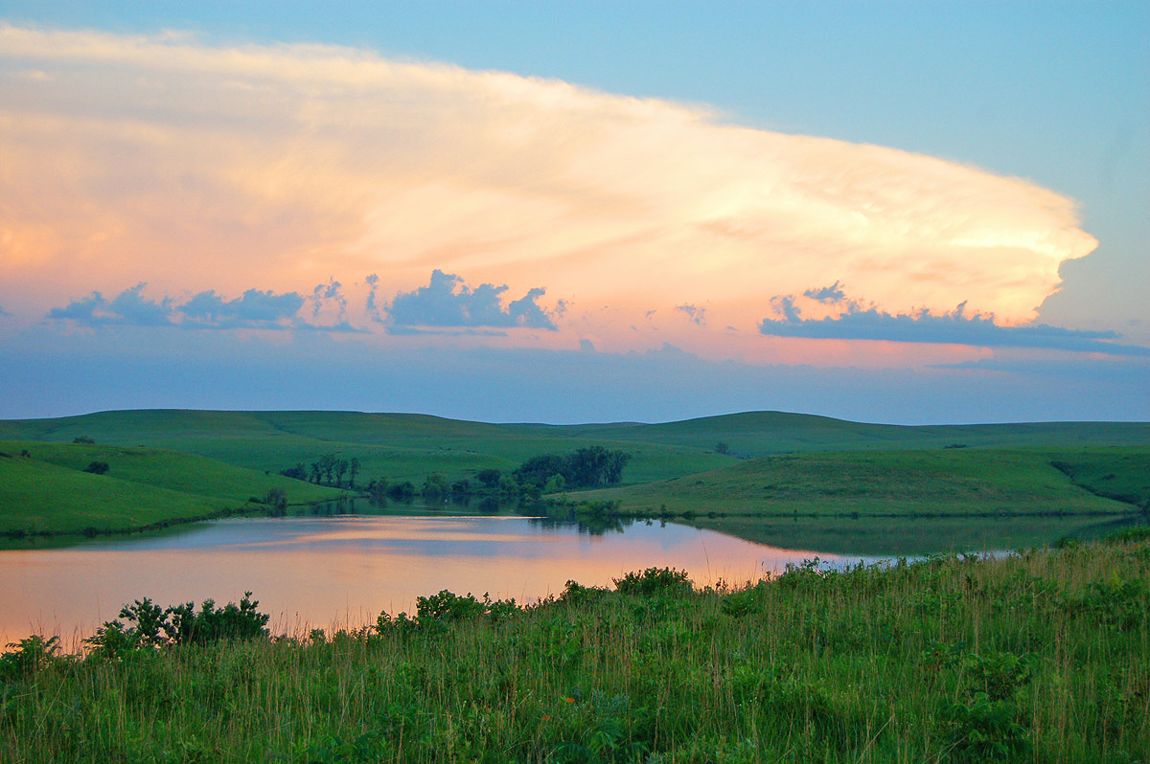

Introduction – A little about Stefan
Born in Kansas City, MO attended Kansas State University
Formative years split between urban Kansas City and rural central Kansas
Master’s Degree in Counseling and Student Services at Kansas State University (Doctorate in-progress)
Twenty years in higher education in student services, academic advising, DEIB, the Office of the President, and the Office of International Programs
Notes:
All about context, implicit bias, getting to know the speaker

Slide 4

Plan for this Presentation
Introduction
International Inventory Context
Global Engagement Directory Purpose
Global Engagement Directory Measures
Designing a Global Engagement Directory – process
Getting from inputs to impact and research output
Q & A
Notes:
Grant - Plan for Today
There are many types of database and software tools just focused for international programs
QS, Terra Dotta, Synapsis
CRM – slate, salesforce

Slide 5

Context
“Do you know all of the international activities, programs and agreements at the University?” asked the President of the University.
I answered…
“I only know about the activities that the Office of International Programs sponsor or staff and a few others as individuals or departments tell me”
Result…
The new Next Gen K-State Strategic Plan includes funding to develop an international inventory of all things international at Kansas State University.
Notes:
Grant -The Office of International Programs is place for centralized internationalization at a very de-centralized University – Education Abroad, English Language Program, Faculty International Collaboration and research, Global Partnerships, International Student and Scholar Services. The University went through a strategic planning process and is renewing commitment as a land-grant University. We were the first land-grant University – first one started after the Morrill Act (1863). Relatively new President and new Executive Vice President for External Engagement and President’s Chief of Staff are both life long land-grant people – from students and throughout their careers. Our strategic plan K-State Next Gen guides our thoughts on the international inventory.

Slide 6

Why an international inventory?
A central place to showcase all international activities, partnerships and programs at the University.
Compliance
Accreditation
Rankings
Security/Safety/Insurance
Networking
Background information for international enrollment decisions
Background information for education abroad decisions
Background information for grant proposals
Benchmarking
Understanding and analyzing trends
Promotion of the internationalization of K-State
Background for impact (value proposition) stories
Branding
Notes:
Grant - Our project started out to make sure I could answer the President’s question or at least send the President or Senior Leadership somewhere to find the answer. “Started out” – through our Working Group and first year of the project – the tool is more than an inventory so the working group decided on the term “Global Engagement Directory.” The first year of the working group – we discussed the question why do we need a global engagement directory and how will it be used. We ended up relying on our institutional research and effectiveness office and their ability to bridge many databases and software. We will use Power BI as the prototype tool

Slide 7
K-State Design and Process
Funding for the project (time, organization and research)
Setting a timeline – 3 years
Setting up a University Working Group
Finding the Project Manager (Me)
Year one – working group deciding purpose, measures, what is already available at the University, and where are the gaps?
Year two – prototype development, share to groups for feedback and continued development
Year three – share to community, feedback, more development and final product, implement a system to use the quantitative to tell K-State’s global engagement stories (the qualitative – the real impact)
Notes:
Stefan - Our design and process
Year One – define purpose, measures and finding where the information exists at the University (if it does exist), identify gaps where it does not exist – during this process it was determined that many people were unsure what an international inventory actually was so we renamed it as the Global Engagement Directory to better identify what we are trying to measure.

Slide 8
University Working Group
Kansas State University Working Group
Project Manager
Associate Director Global Partnerships
Associate Provost and Chief Data Officer - Data, Assessment and Institutional Research
Associate Dean for International – College of Agriculture
Faculty Member – Distinguished professor / Nobel Peace Prize co-winner /highly involved in international research
Vice Provost and Dean of the Graduate School
Associate Director for Research and Sponsored Programs- Vice President for Research Office
Assistant Vice President and University Risk and Compliance Officer – Vice President for Finance and Operations Office
Assistant Vice President and Director of Engagement & Outreach – President’s Office
Associate Director for International Planning and Analysis
Associate Provost for International Programs
Notes:
Stefan - Important to have a good WG – not too large. Probably, another one or two faculty members and someone from the library would be my preference. You can see that reps from President’s office VP for Research, VP for Finance and Operations, Provost Office, and the only associate dean of international from any of our colleges. Chief Data Officer is probably one the most important members of the WG.

Slide 9
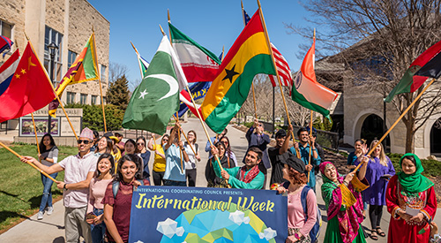
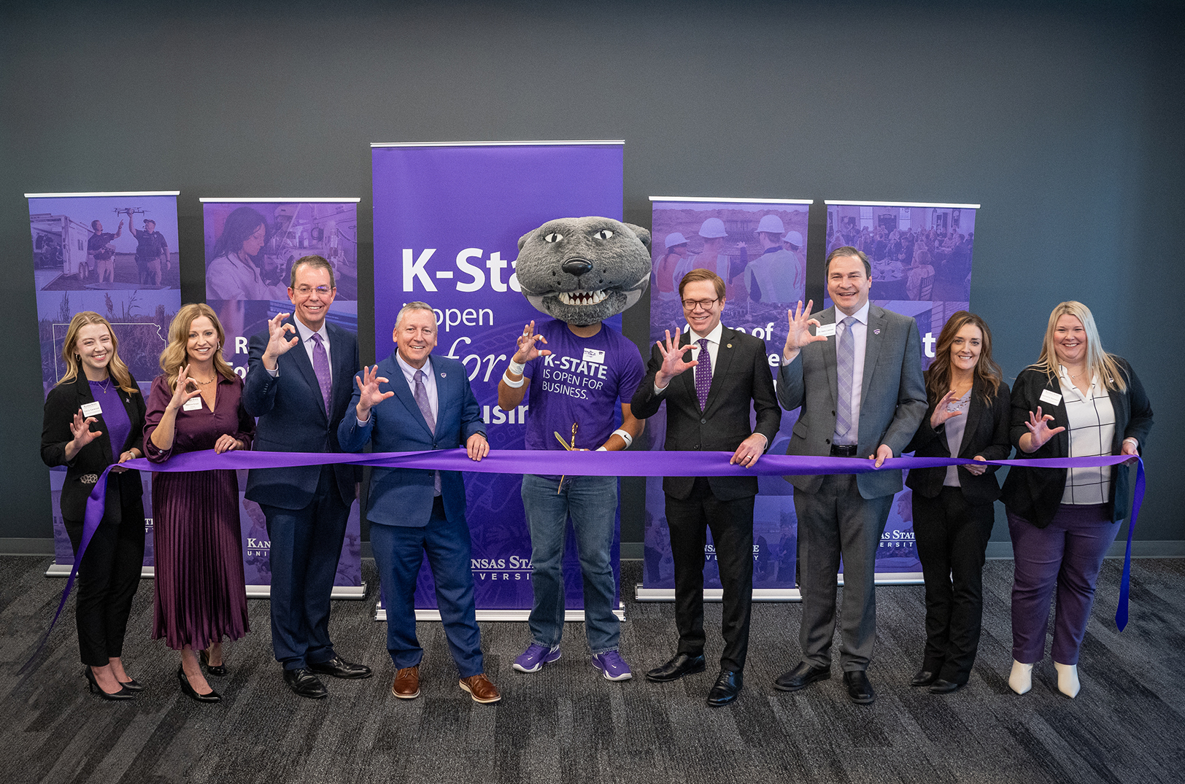

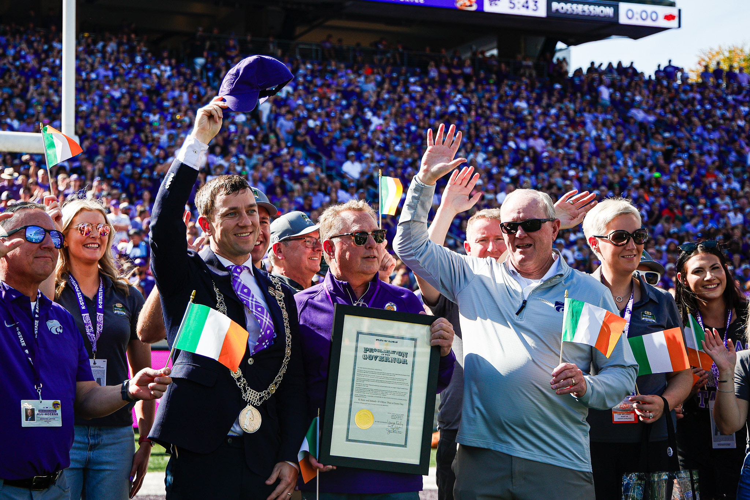
Audience
A global engagement directory is a tool for a multi-audience environment
President and Senior Leadership
International Programs
Faculty
Compliance and Risk Staff
Enrollment Management
Research
Procurement
Marketing
Student Services
External
Notes:
Stefan Working Group – asked WG how they might use tool – thought about the constituents or the audience for such a directory – each area may use the global engagement directory for different purposes. Faculty member – grant proposals, do we already have an agreement with an institution? President and Leadership – complete picture about relations with a particular country, organization, or institution. What do you think international programs will use such a tool? – Holistic data, connecting people, looking at trends, providing impact statements, preparations for visiting delegations or leading delegations abroad - The big picture items like the President – Funding, Research, Mobility, Engagement

Slide 10


Actual Request
Request from Leadership and Athletics –
"Our (American) football team is traveling to Ireland in August of 2025 to play in the College Football Classic football game against Iowa State, what, if anything, is the university doing with Ireland?"
Notes:
Stefan - example that we get in the international programs office all the time – these happen to be requests from August 2024 into my office

Slide 11


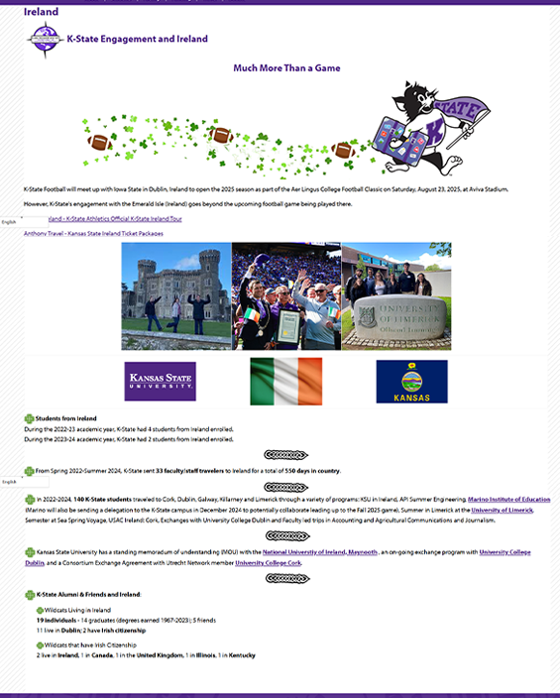
Actual Case Study
Personalized OIP Willie
Created a logo
Images of K-staters in Ireland and the Irish delegation visiting K-State
Flags!
Relevant data about K-State and K-stater activities involving Ireland including travel, Study abroud, nationality of students/faculty/staff, Alumi from Ireland or that live in Ireland, Partnerships, Projects, Funds
Stats!
Notes:
Stefan - One Case Study – Football team playing Iowa State in Ireland next August – August 2025. The It’s more than a game idea as a prototype of what a one page overview of a country could look like with data and photos generated by the Global Engagement Directory = so one page - students from Ireland, Travel to Ireland (employees), students to Ireland, Agreements, Alumni, we don’t have a current research project, however, in the future we could identify Irish collaborators with K-State, cited K-State publications by Irish authors, both by faculty/authors and by institution. As far as engagement, we will have the Football game as an engagement highlight. As far as students and travel – we can go in depth, demographics, purpose, academic college, department, program. We will utilize photos of K-State in Ireland or Irish at K-State in Kansas. Agreements (by type, purpose – will have contacts at K-State and the Irish entity, when established, when it will expire, and some outcomes – students and faculty to/from institution. Information is current and real time. Faculty and staff from Ireland, Irish citizenships and those who had a post secondary academic credential from an Irish institution. Cumulative information versus down to the individual.

Slide 12
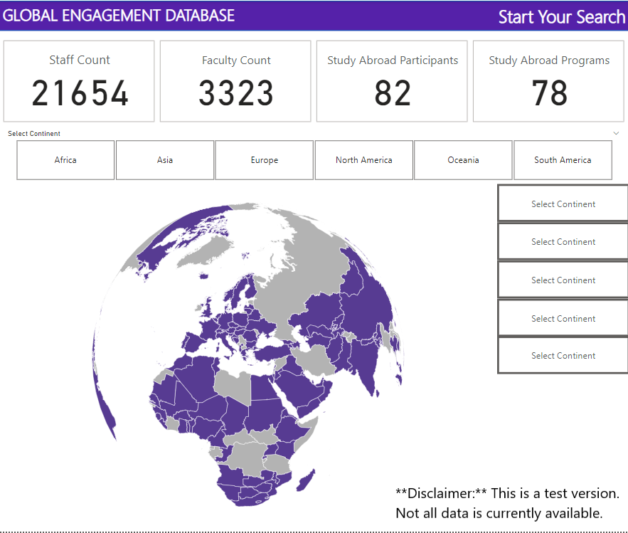
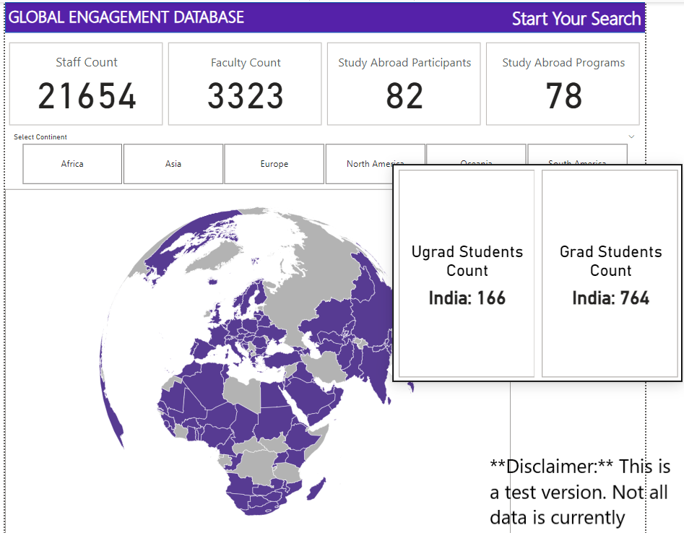
First Prototype combining international data – student, employee, and agreements
Notes:
Stefan - Sample – wish I could show you the dynamic global engagement directory, the spinning globe, zoom in and out, cursor over features, downloaded page, and looking into the detail of each measure (demographics, and by college, department and program, types and purposes of items. Real time and then archived per census date for trend and comparison analysis,
# of staff or faculty that have travelled, established an agreement/relationship, hosted visitors, conducted special workshops/training, led a faculty-led trip, researched, This is Power
BI based on a rotating globe as well as curser over functions, zoom in and zoom out functions, (finite detail on a particular area versus more general detail on a larger area). click throughs, ctrl click, downloading one pagers, and other visuals – Purple is where we have connections. Any idea - It might be light to bold purple depending upon some set of connection factors (just an idea). This is a work in process and will be a continual work in progress throughout the three years as problem continual.

Slide 13
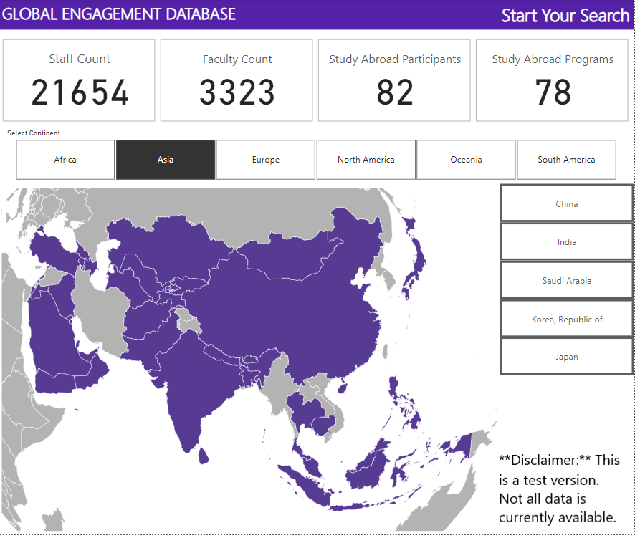
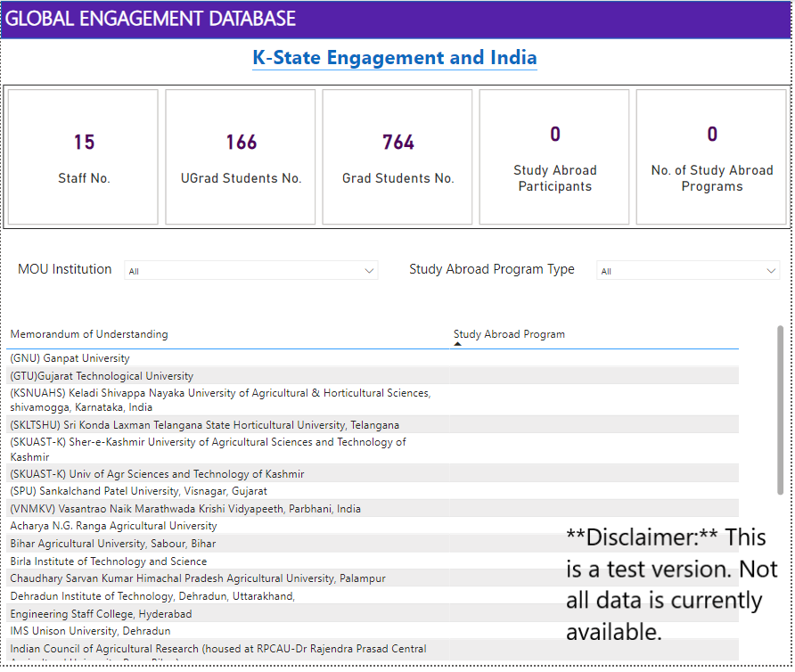
First Prototype combining international data – student, employee, research, travel, agreements
Notes:
Stefan - We have graphic views, but we will also have text and text search – we will have general summaries and data public, one pagers public, then more detailed data under the K-State eID protection so only K-State employees could see the data.

Slide 14

What to measure?
It is important to measure what you want, not what others measure.
It is important to think about how to sustain the Global Engagement Directory.
It is important to think about the measures’ data integrity and validity.
For Kansas State University, we wanted to follow our land-grant mission/vision and we wanted to use measures or data already collected or available at the University.
Throughout the first-year process, we added a third principle – to showcase or highlight the connection between global engagement and impact for Kansas
Notes:
Grant -diffrence between a global engagement directory and an international inventory is the global engagement directory is more than a list of agreements or numbers of students – the directory can measure both breadth of items and depth of items. So, the WG development some guidelines for useful measures and definitions. We did not want to ask faculty, staff, students or administrators for items if the items were already collected in some form around campus. We would develop what we would like to measure, see if any of the measures are already collected, collated those collections into a useful data base, identify gaps and see how best to find or collect the appropriate data.

Slide 15
Measures
International Agreements
International Research (RSCAD) - inputs and outputs
Student Mobility - both ways, includes student demographics, impact data
Faculty/Scholar/Professional Mobility -both ways
Faculty and Staff/Demographics
International Academic Programs (credit and/or credential partnerships)
International engagement/outreach learning (i.e. non-credit bearing programs, hosted workshops, conferences, training)
International Visitors (visiting delegations, short term visits)
International Alumni
Special attention – global engagement impact on Kansas, with Kansans, within the world. Data based impact stories – the value proposition of K-State global engagement, the qualitative stories (photo, video, podcasts) of global engagement
Notes:
Grant - The WG worked all year getting measures down to management categories, defining categories, and understand that these will have subset to each – there are many types of international agreements, there are many types of visiting scholars, short term, long term, sponsored, who it the sponsor, with college, department and program, duties (research, teaching, academic collaboration, planning a grant),

Slide 16
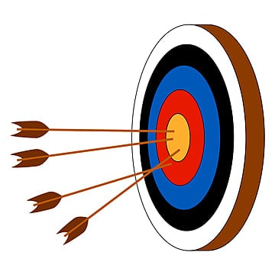
Research Outputs and Impact
How do you find the impact of international research at your university?
How do you find the impact of international research in Kansas, with Kansans?
How do we find international creative activities and performance? How do we measure arts and humanities global impact?
Notes:
Grant - We are finding gaps in our database collections at the University. We have information on students (incoming and outgoing) by all demographics, college, department, programs. We have information on all research awards. We have information on incoming scholars J-1, O, H visas, we have data on international travel (we have a mandatory registry because of insurance and compliance), we have data on current agreements and archived past expired agreements, we have data on alumni if they are part of our alumni association through self-reported measures, we have employee (faculty and staff) data (citizenship, where they receive their post-secondary degree, visa holders). We are have a gap in short term visits – delegations visiting, people visiting if not a scholar or student, we have a gap on the outcomes of research publications (international collaboration, international citations), outcomes of arts and humanities international engagement, and outcomes the focuses on international research that gets applied to Kansas or international researchers working in Kansas for Kansans. As a land grant – we want to focus on research and an engagement – we are a research one University and a Carnegie Rated Engaged University.

Slide 17
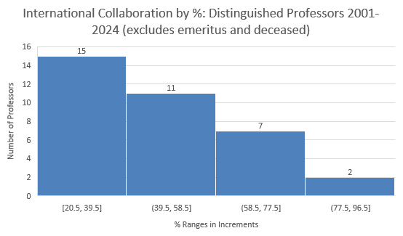
Research Impact – International Collaboration
Graphic Illustrations KSU Distinguished Professors (n= 57) International Collaborations
Excludes anyone below 20%. Excludes anyone with fewer than 100 papers as per Scopus. Exception 1 person at 97
Notes:
Grant - Scopus but also mention Web of Science – mention other measures – citations to a K-State publication from outside the US – by country, places of collaboration by Country and University, Weighted impact scores, and then information that we know is out there from sources that are not licensed by K-State – one is SciVal. Explain DP, many types of measures, for faculty, for institutions.

Slide 18
Global Engagement and Internationalization
What international data tools do you have and use at your institution?​
What would be your institution's principles for a global engagement digital tool if you had a holistic global engagement digital tool?
  What would be important for your institution to measure?

Slide 19

Global Engagement and Internationalization
Are we missing any measure or dataset?
​Thoughts, Comments, Questions???
Thank You!

