Slide 1
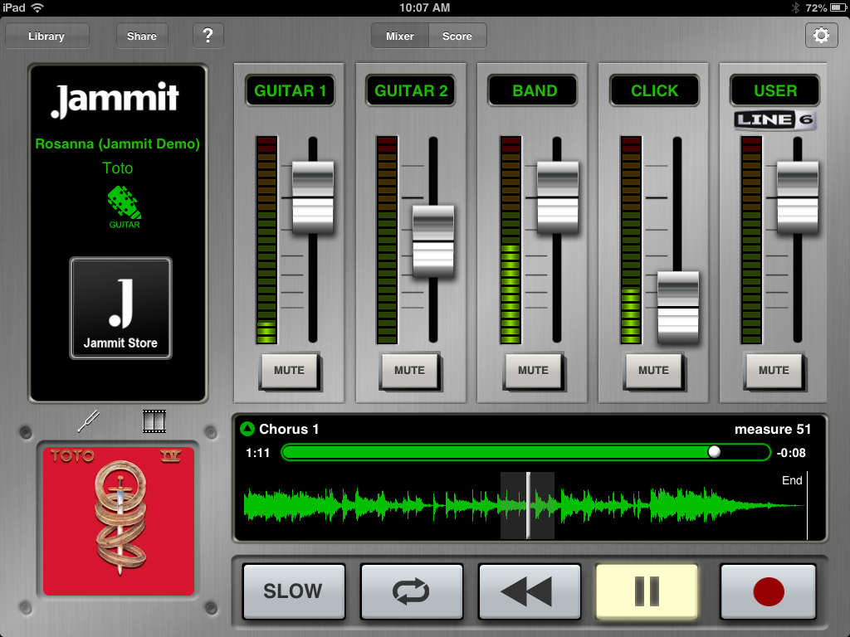
GOING GREEN: ALTERNATIVE APPROACHES TO MUSIC EDUCATION
2013 Concert Band Clinic
Kansas State University

Slide 2
Focus Questions
Where are we at in music education?
What is music for all?
Do we include music in education?
Where do we see this going?
What can we do? How can we continue moving forward?

Slide 3
Background
As of the most recent research, only 21% of American high school students participate in music in schools (Elpus & Abril, 2011).
Harris Poll in 2005 reported that 93% of Americans agree that the arts are vital in education of students 54% of whom rated it a 10 on a scale of 1-10.
Other areas included were 86% believed music education improved students attitudes and 83% believed it helped with communication; however, 62% believed other people were better suited for advocating for the arts.

Slide 4
Background (con’t)
The next question is…
What kind of arts education does the public support?
Are we as music educators consistent with the views of arts education within the public? If not, what can we do?
Williams (2011) asks this very question. His article was met with great criticism regarding his alleged views on large ensembles.

Slide 5
Where do we go from here?
Are we truly music for all?
Are we headed in this direction?
Are there ways to maintain the opportunities for our students and provide alternatives for the other 80%?

Slide 6
Absolutely!
Students who learn best in the large ensemble model should still benefit from the large ensemble.
However, the ways the public interacts with and views music has changed while we have remained relatively the same since the early 1900’s.
Reimer in Music Educators Journal (December 2012) said, “Being whole entails our active engagement in and support of all or at least most of the many ways people in our culture and others around the world actually interact with music”.

Slide 7
John Kratus
“The nature of music in the world and the nature of music in school are, then, quite different things.”

Slide 8
Alternatives
How do we proceed? All we know and have been taught is band!
Food for thought:
Class Size
Student-Centered Learning
Musical/Creative Decisions
Rethinking Concerts (Informances)
Rethinking Instrumentation
Rethinking Literacy/Notation
Lifelong Skills?

Slide 9
Alternative Examples
iPad ensembles
Songwriting/Arranging/DJ
Music and Film
Music Business
Music Technology
Music Ensembles
History of Pop Music

Slide 10
iPad Ensembles
http://vimeo.com/43682932
Other Videos
Class Size
Student-Centered Learning
Musical/Creative Decisions
Rethinking Concerts (Informances)
Rethinking Instrumentation
Rethinking Literacy/Notation
Lifelong Skills?

Slide 11
Songwriting/Arranging/DJ
MadPad
DJ Pro
Songwriting Class and Apps
Music Business
Class Size
Student-Centered Learning
Musical/Creative Decisions
Rethinking Concerts (Informances)
Rethinking Instrumentation
Rethinking Literacy/Notation
Lifelong Skills?

Slide 12
Music and Film
What are the relationships of music and film
iMovie Application and App
Class Size
Student-Centered Learning
Musical/Creative Decisions
Rethinking Concerts (Informances)
Rethinking Instrumentation
Rethinking Literacy/Notation
Lifelong Skills?

Slide 13
Music Technology
Garage Band
MadPad
KitKat Commercial
Looplabs.com
Create music for upcoming video
iMovie
Jammit
Class Size
Student-Centered Learning
Musical/Creative Decisions
Rethinking Concerts (Informances)
Rethinking Instrumentation
Rethinking Literacy/Notation
Lifelong Skills?

Slide 14
Music Ensembles
Mariachi
Country/Western
Rock
Lab
Class Size
Student-Centered Learning
Musical/Creative Decisions
Rethinking Concerts (Informances)
Rethinking Instrumentation
Rethinking Literacy/Notation
Lifelong Skills?

Slide 15
Histories
History of Pop
The Beatles
American Pop
British Pop
Etc…
Class Size
Student-Centered Learning
Musical/Creative Decisions
Rethinking Concerts (Informances)
Rethinking Instrumentation
Rethinking Literacy/Notation
Lifelong Skills?

Slide 16
Apps used today
iMovie
Free Video
Looplabs.com
Sound Cloud
DJ Pro
Jammit
MadPad
SongWriter HD
Trail Mix

Slide 17
Summary
In a recent Facebook post, I asked the question:
1)What music classes do you teach, and
2) What courses do you wish you could teach?
In many of the instances, many wished they could teach American Pop Music, Music Technology, Arranging
We have to be cognizant of not letting these become extensions or add-ons to our existing ensembles. These opportunities are to develop life-long musicians within our communities

Slide 18
Summary
We must find ways to connect the many ways our students interact with music on a daily basis with a great foundation in music education. As John Kratus once said, “Just because it’s not taught in school does not mean it’s not valuable”.

Slide 19
Thoughts, Questions?
Contact me at:
Phillip Payne
Kansas State University
232 McCain Auditorium
Manhattan, KS 66506
ppayne@k-state.edu
Clinic website:
2013 Directors' CBC Clinic Website
http://www.k-state.edu/musiceducation/eportfolio/ppayne/Phillip_Payne/2013_CBC_Clinic.html

