Slide 1
Graduate Report Template
How to use it.

Slide 2
Focus for Graduate Report
Summative demonstration of relevant learning
Useful to support future endeavor
Performance – Detailed performance program note
Music Education – Teaching/Conducting score analysis and instructional plans
Composition – Music composed, performed, and supportive information
History – Research project
Other – as developed by student and major professor

Slide 3
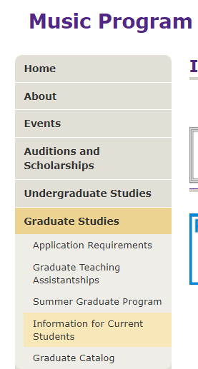
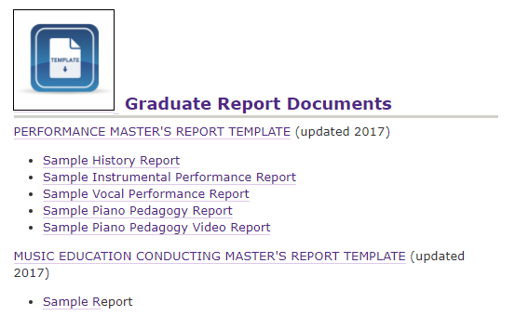
Find Templates

Slide 4
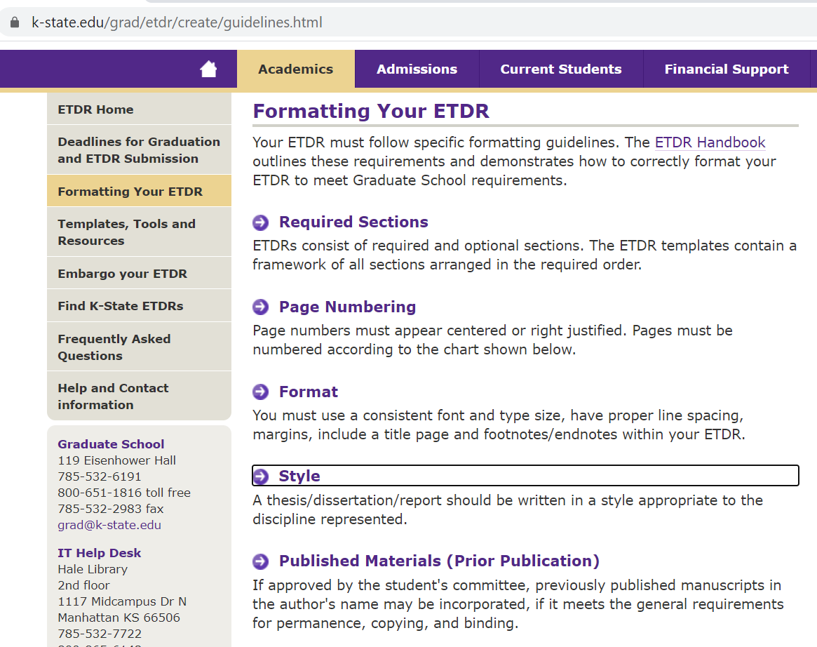

Slide 5
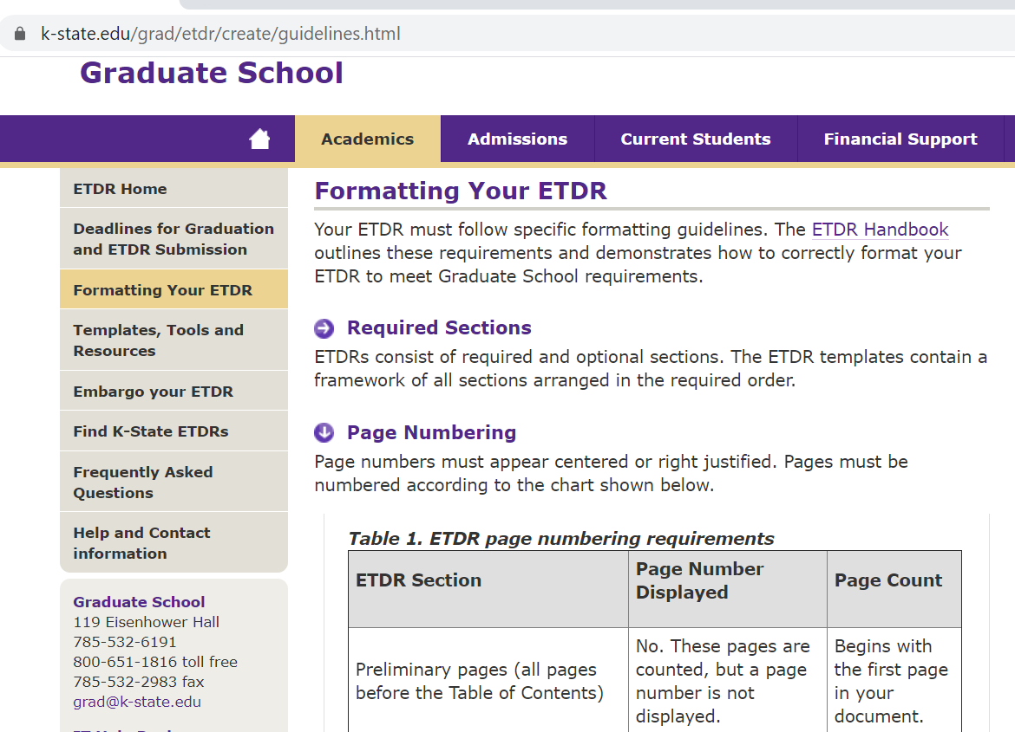

Slide 6
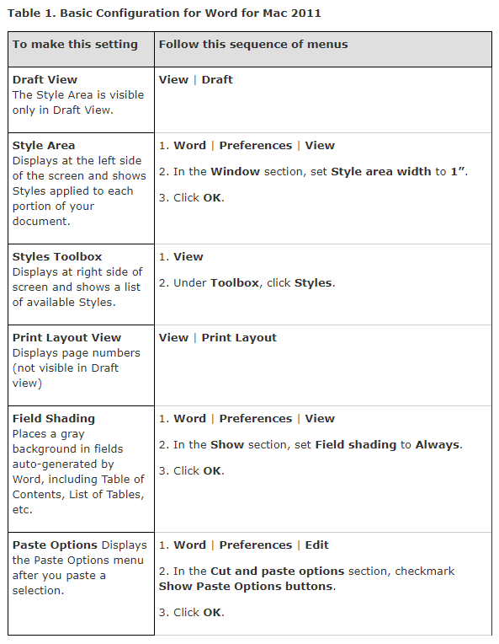
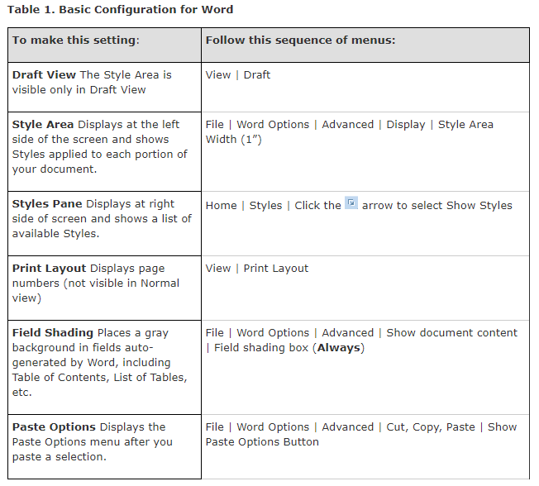
Configure Word

Slide 7
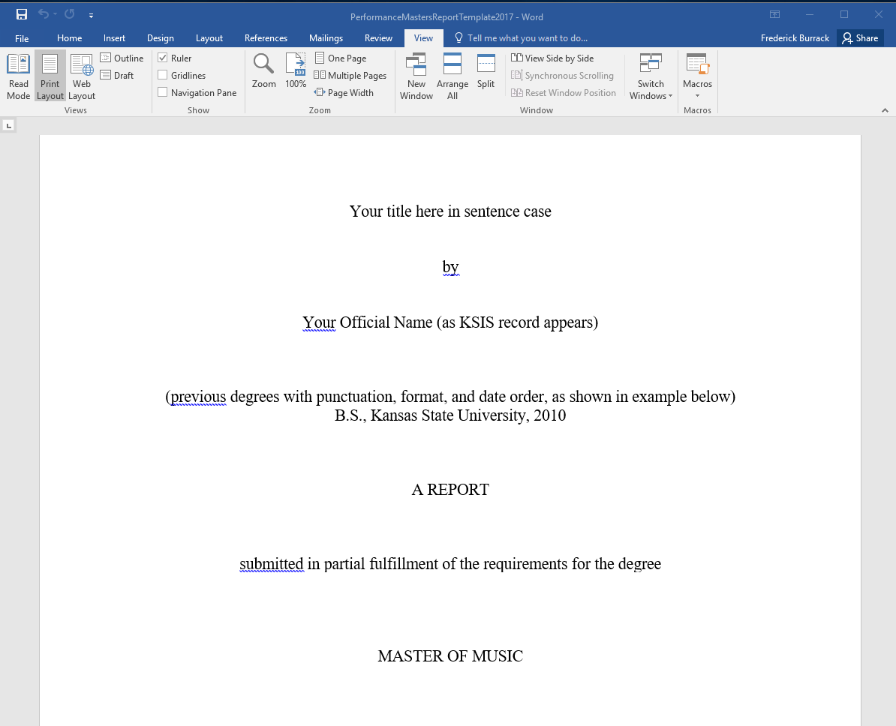
Go back to print layout

Slide 8
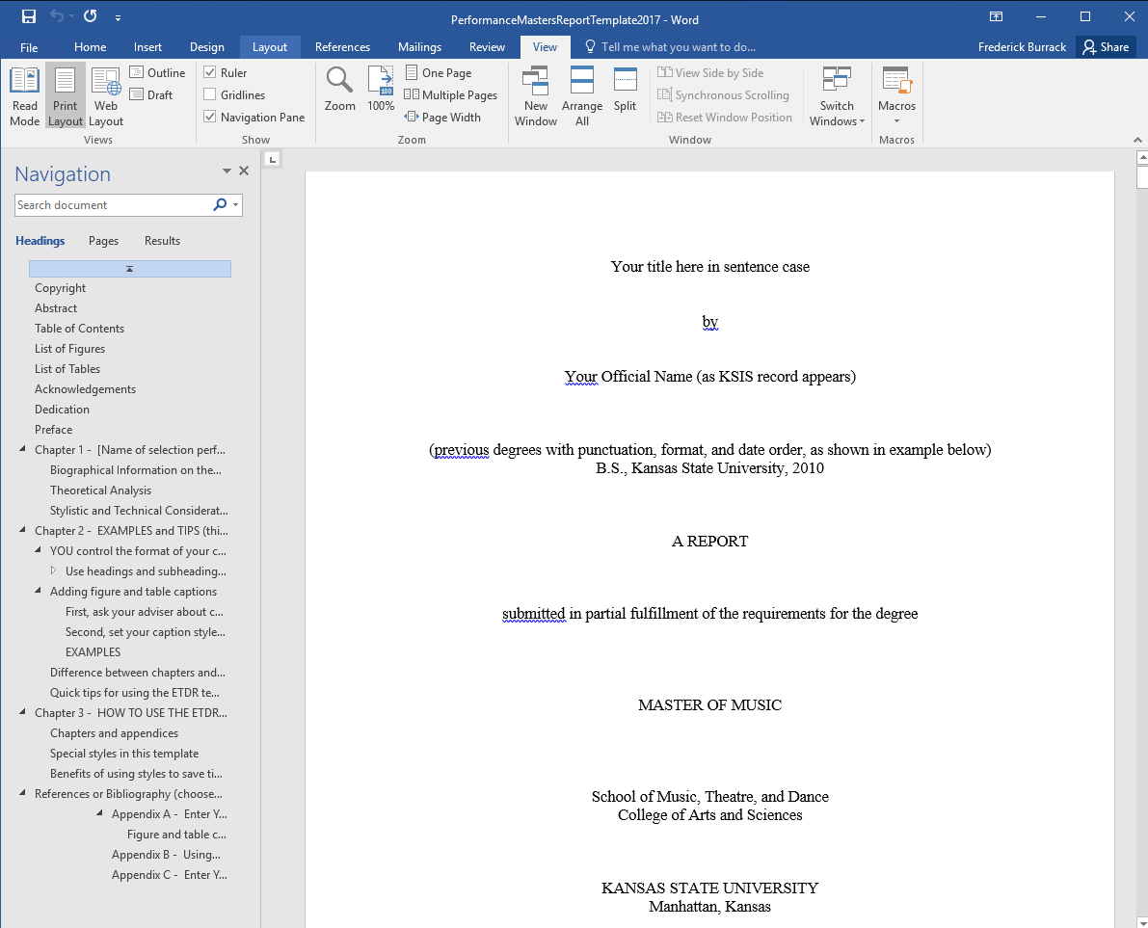
Click Navigation pane

Slide 9
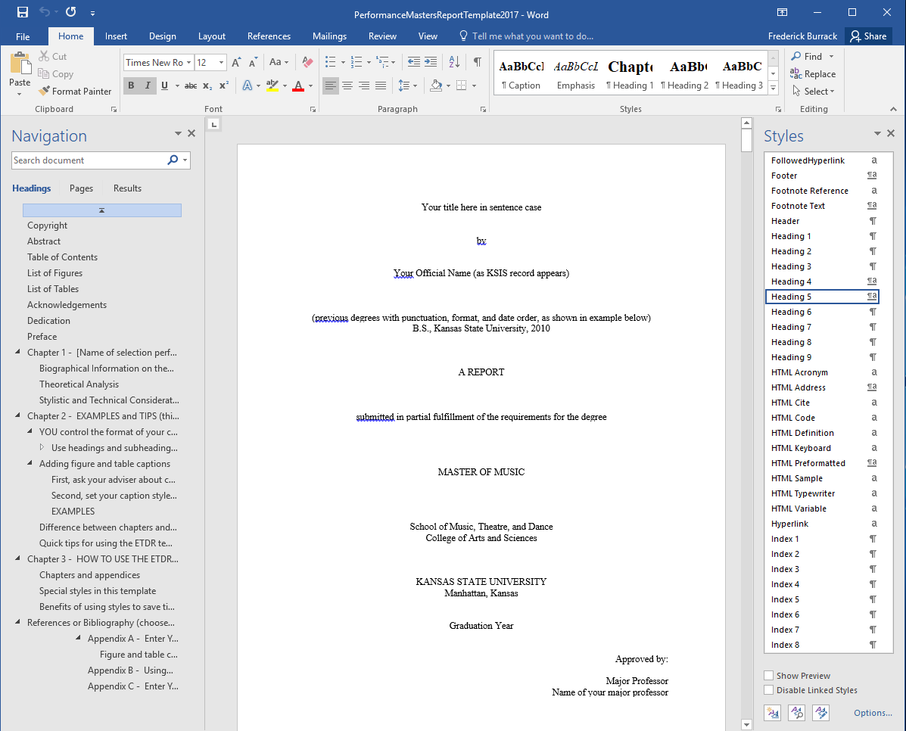
Open Styles Pane

Slide 10
Heading 1 is a Chapter Heading

Slide 11
Heading 2 is the primary heading in a chapter

Slide 12
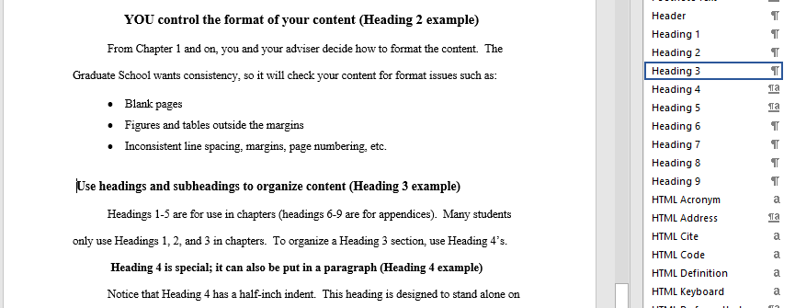
Heading 3 & 4 are subheadings

Slide 13
Suggestions
Use the TEMPLATE to write your report
Work in a single document file
Use STYLES
Use JPG or PNG for images (insert – don’t copy and paste)
Resize images – no larger than 650 pixels in width
Back-up regularly

Slide 14
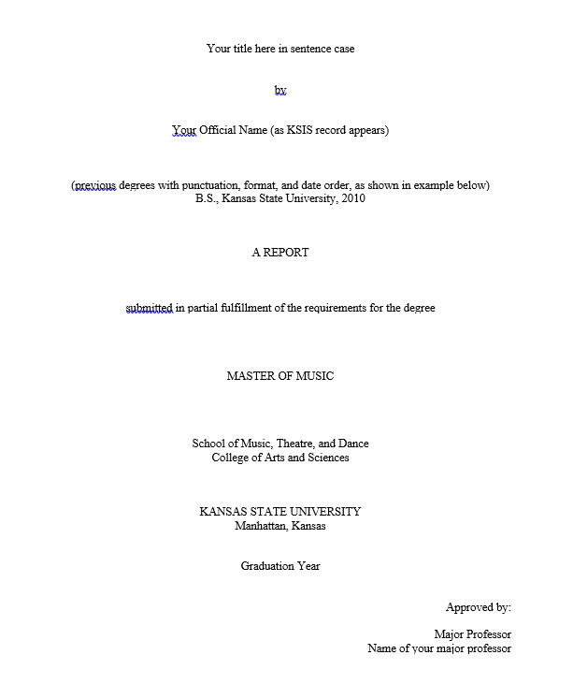
Title Page

Slide 15
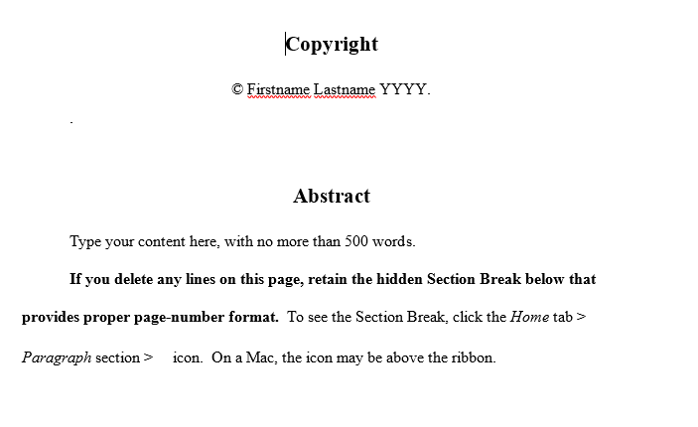
Copyright and Abstract
Title page and Abstract must be submitted with your Approval for Final Examination

Slide 16
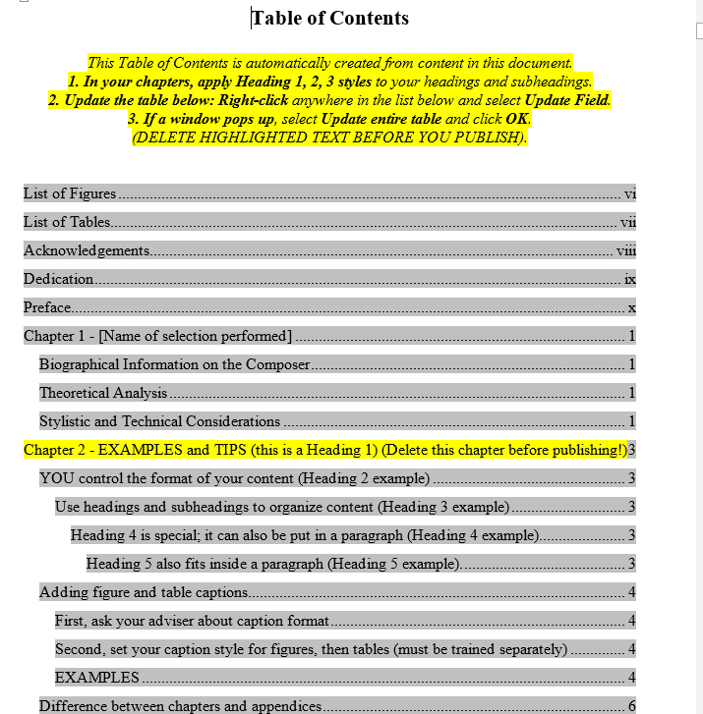
Do not type into Table of Contents and List of Figures and Table

Slide 17
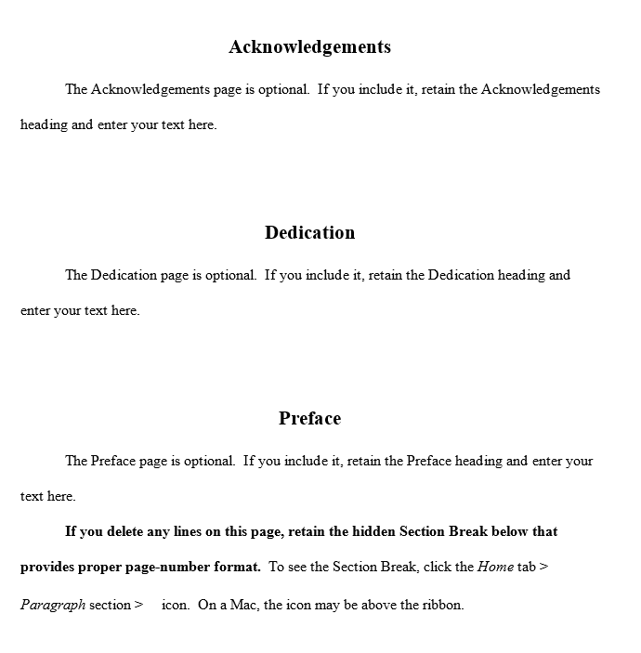
Optional Pages

Slide 18
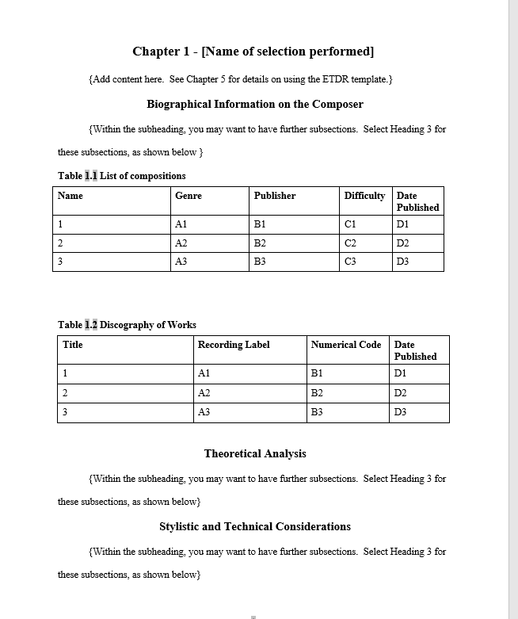
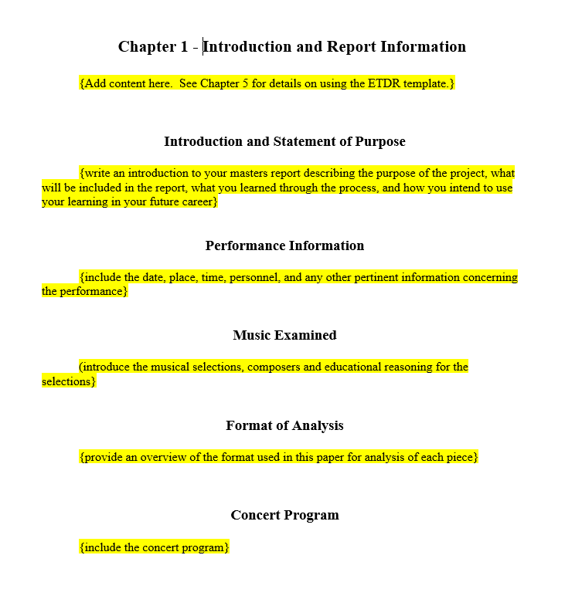

Slide 19
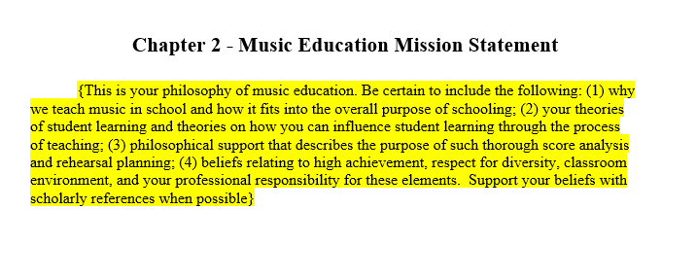
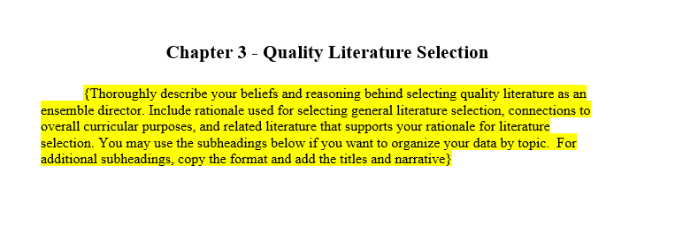

Slide 20
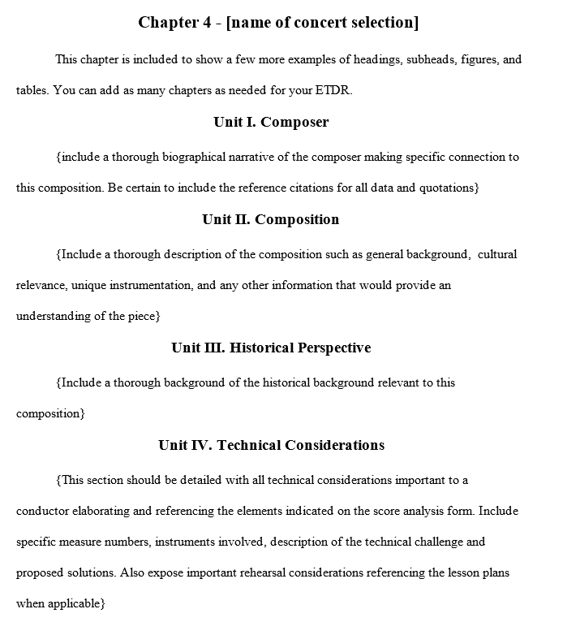
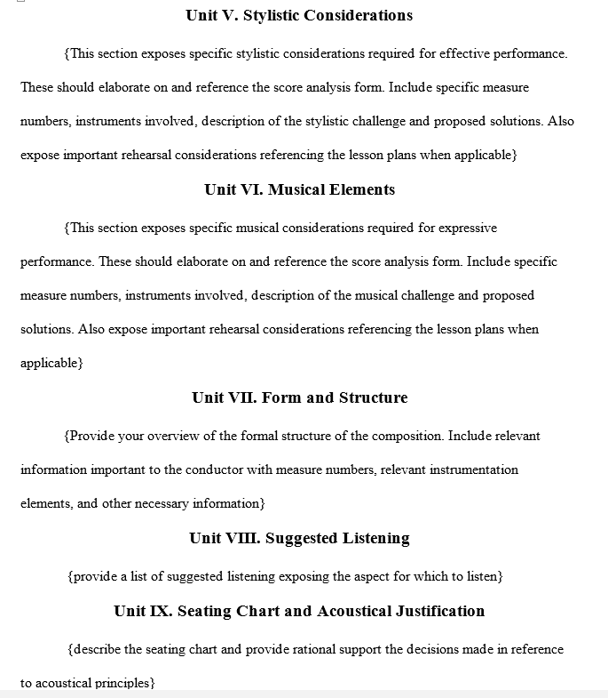

Slide 21
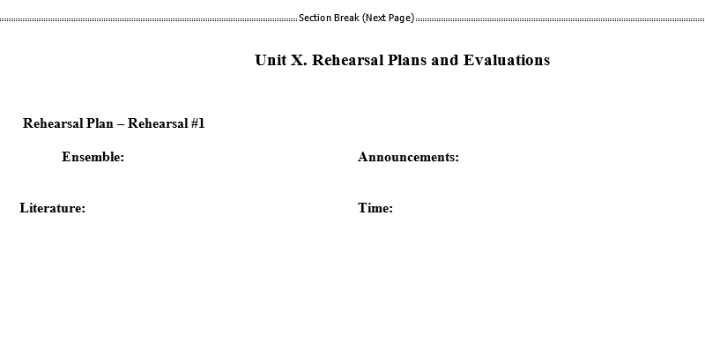
Section Breaks (Next Page) are essential for changing from vertical to horizontal

Slide 22
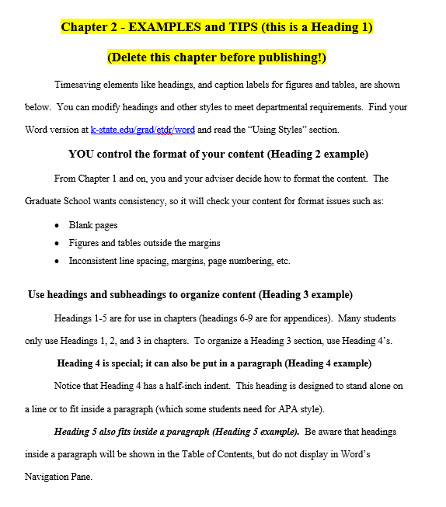
All templates follow with Examples and Tips (instructions)

Slide 23
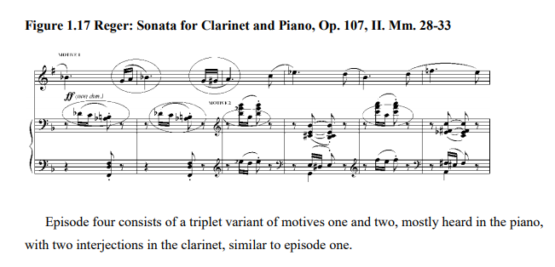
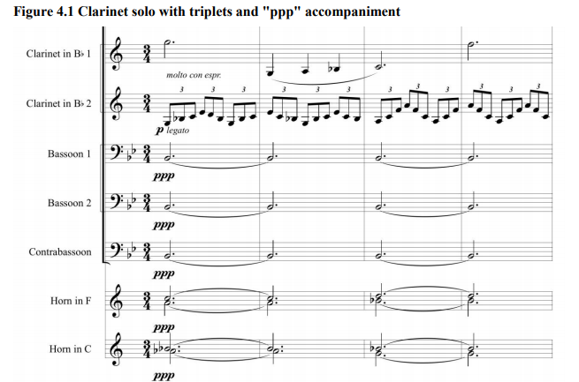
Figures

Slide 24
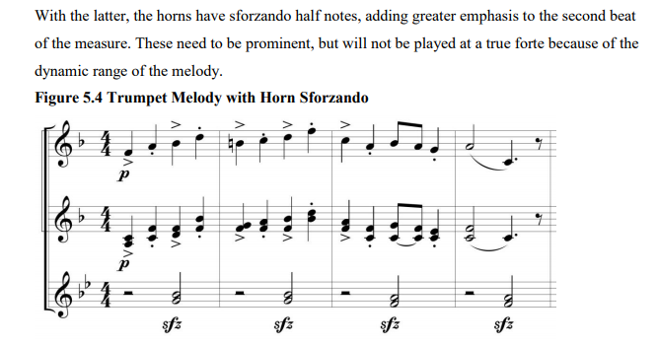
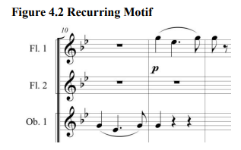
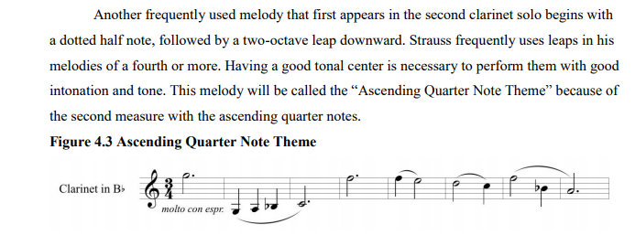
Figures

Slide 25
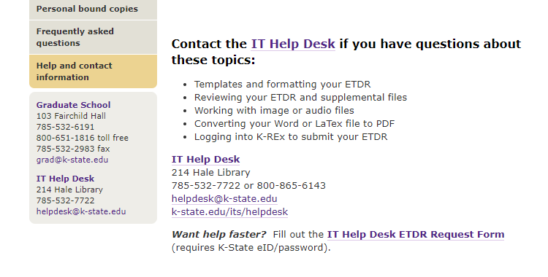
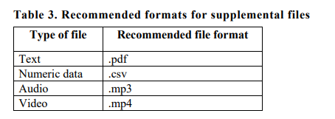
Audio and Video Files

Slide 26
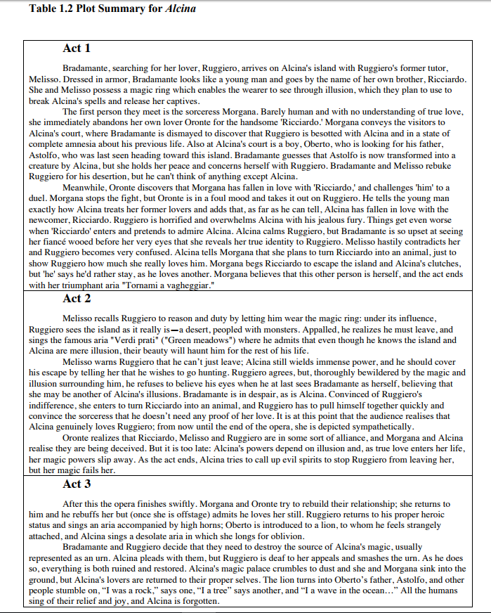
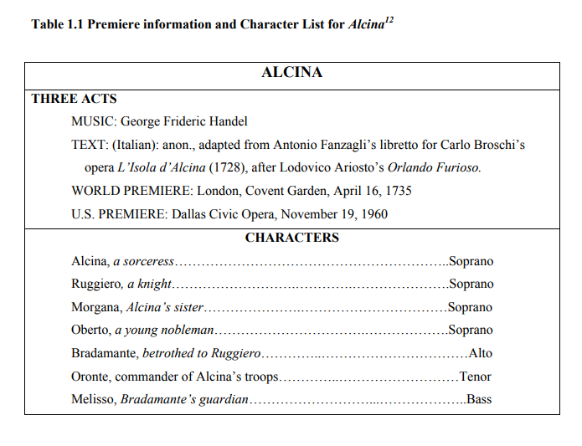
Tables

Slide 27
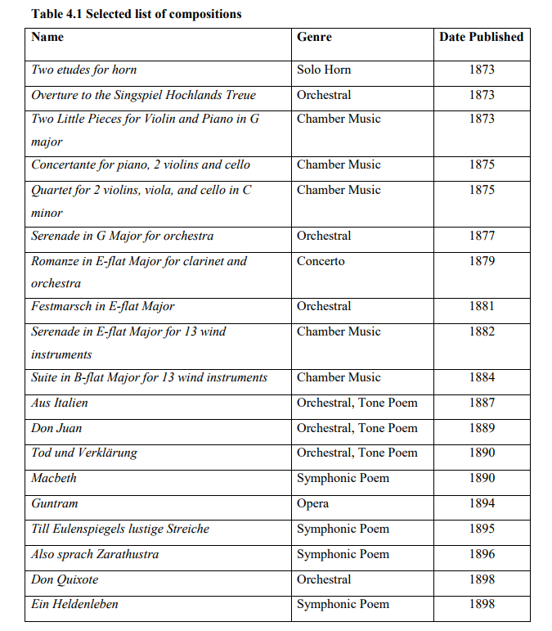
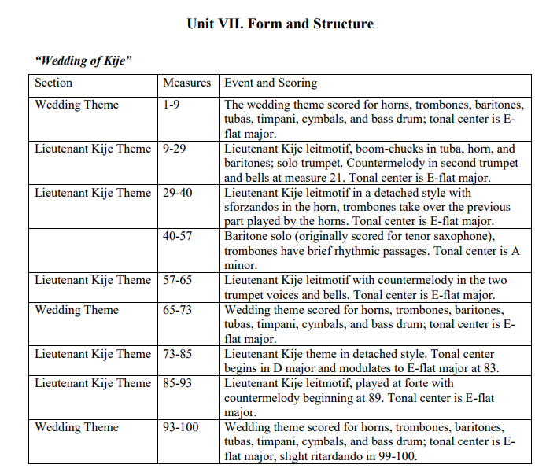
Tables

Slide 28
Adding Figure or Table caption

Slide 29
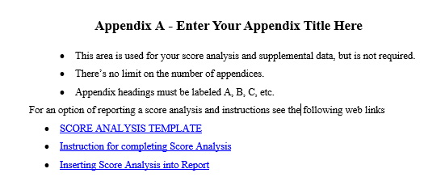
Will discuss Score Analysis Appendicies NEXT

Slide 30
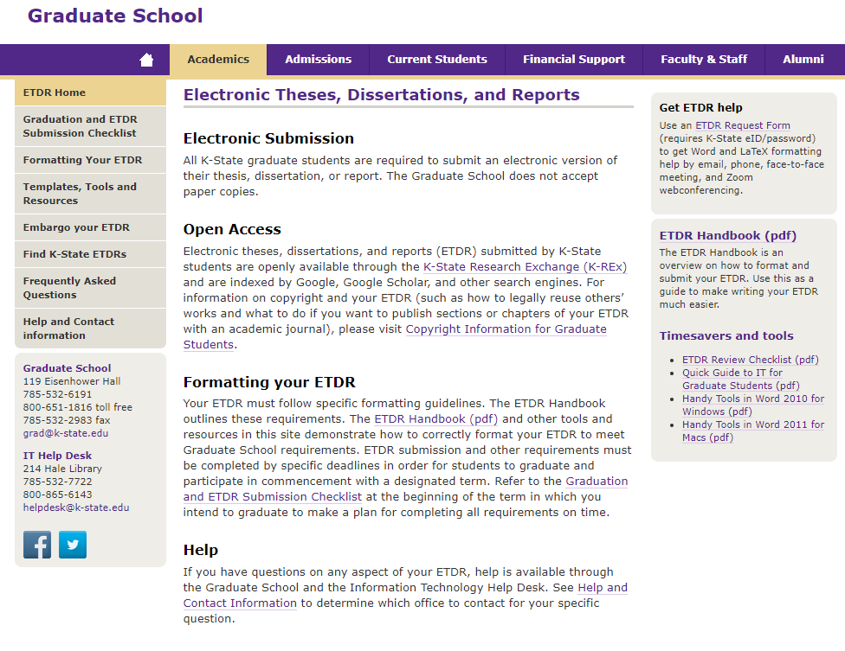

Slide 31
