Slide 1
Music and Copyright
Emily Finch
Scholarly Communication and Copyright Librarian
Ryan Otto
Scholarly Communication Librarian
Thomas Bell
Academic Services Librarian

Slide 2
DISCLAIMER
The information presented in this presentation is intended for informational purposes and should not be construed as legal advice. If you have specific legal questions pertaining to K-State, please contact the Office of General Counsel. Information received from the Scholarly Communication Librarian is not legal advice. The Scholarly Communication Librarian does not act as legal counsel to the university or any members of the university community.

Slide 3
Structure
Slides 4-9 Introductions and Class Visit Specifics.
Slides 11-23 Basics of Copyright Law
Slides 24-55 Music Copyright
Slides 56-78 Expanded Copyright Basics
Licensing and Transfers (General)
Public Licenses
Rights Map
Creative Commons Licenses
Framework for Reusing Material (VERY HELPFUL APPLIES TO ALL TYPES OF COPYRIGHTED MATERIAL)
Resources for finding public domain or public licensed images
Slides 79-82 ETDR/Authors Rights/Conclusion
ETDR Best Practices
Authors Rights tool for evaluating Journals
ETDR Help Contacts
Our Contacts

Slide 4
Emily G. Finch (she/her(s)) Your friendly neighborhood Scholarly Communication and Copyright Librarian!
Can help provide reference, consultation, and information on:
Copyright and Licensing
Plagiarism vs. Copyright and other best practices
Open Access and other Scholarly Communication Movements
Publishing
Research and Metrics
And MORE!
Other things she does around Hale:
Administrator of K-State Open Access Publishing Fund
Monograph and Special Publication Coordinator for New Prairie Press
Library Administrator of Open Alternative Textbook Initiative
Innovation Lab and other Scholarly Communication Collaborations
How do I contact her?
Copyright Consultation Form
Send her an email! Egfinch@ksu.edu
Send her an email—here works too! cads@ksu.edu

Slide 5
Copyright Services
https://www.k-state.edu/copyright/

Slide 6
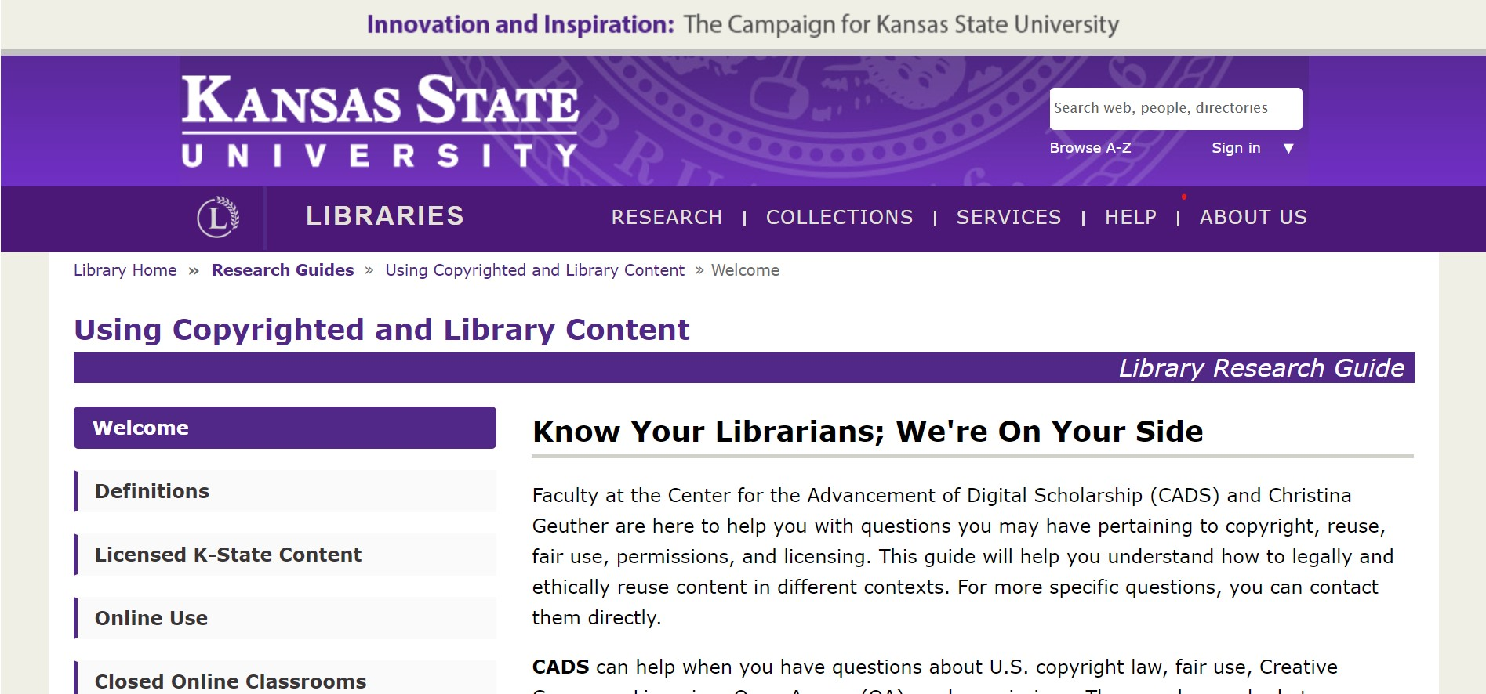
Copyright Services
http://guides.lib.k-state.edu/UsingContent

Slide 7
Ryan Otto (he/him) Scholarly Communication Librarian
Can help provide reference, consultation, and information on:
How to share your research and creative work
Understanding academic publishing and authors rights
Data Management
How K-State can help build a healthy and sustainable scholarly communication environment
How Scholars Communicate
Digital Asset Management
Other things she does around Hale:
Coordinator of the K-State Research Exchange (K-REx), the institution's digital repository
Journal and Conference Coordinator of New Prairie Press
How do I contact him?
Email Ryan: rwotto@ksu.edu
Email the Center for the Advancement of Digital Scholarship: CADS@ksu.edu

Slide 8
Thomas Bell Academic Services Librarian: (drama therapy, interior architecture and industrial design, leadership studies, and music)
About Thomas:
Thomas can meet individually with students or faculty to help with research questions and help faculty develop research assignments for students using library resources. He also can visit your undergraduate or graduate class to teach information literacy skills like finding, using and evaluating library resources. Besides assisting students in his main subject areas, Thomas also serves as the Marianna Kistler Beach Museum Librarian of Wonder and is a curator for K-State’s Consumer Movement Archives.
Research Interest:
Thomas is interested in underground and experimental rock music, especially in the pre-internet era.

Slide 9
Agenda:
Ryan and ETDR
Basics of Copyright Law
Music Copyright
Using Copyrighted Work
Bonus: Copyright Law Basics Expanded
Licensing and Transfers
Bundle of Rights
Public Licenses
Rights Map
Creative Commons Licenses
Framework for Reusing Material
Resources for finding public domain or public licensed images

Slide 10
ETDR

Slide 11
Basics of Copyright Law

Slide 12
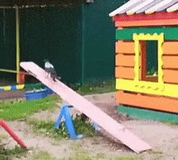
Why Copyright?
Promote the Progress of Science and Useful Arts
"To promote the progress of science and useful arts, by securing for limited times to authors and inventors the exclusive right to their respective writings and discoveries."
U.S. Constitution Article 1, Section 8, Clause 8 (Patent and Copyright Clause)
Notes:
What does this mean for copyright??
Copyright has a term before protected works enter the public domain. The clause encourages the creation of work by both protecting authors control and benefits over content for a limited time– and then chaperones its unrestricted use through its transition to the public domain.

Slide 13
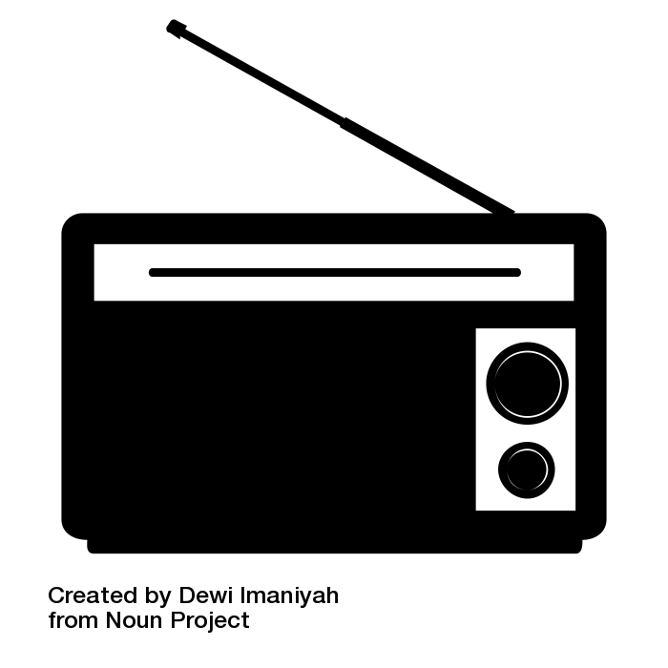
What is Copyright?
https://www.youtube.com/watch?v=2U81MTBg5tY
To Distribute Copies
To Display Works Publicly
To Reproduce & Make Copies
To Perform Works Publicly
To Perform Works Publicly by Means of Digital Audio Transmission
To Prepare Derivative Works
copy by Mahdi Ehsaei from the Noun Project; create by LAFS from the Noun Project; selling by rahmat from the Noun Project; Performing Arts by Ervin Bolat from the Noun Project; Art by Niko Caruso from the Noun Project; Radio by Dewi Imaniyah from the Noun Project
Notes:
Copyright is a form of intellectual property protection codified in title 17 of the US Code. When one retains copyright in a work they actually hold a bundle of rights– this bundle broken down includes the rights to:
(1)to reproduce the copyrighted work in copies or phonorecords;
(2)to prepare derivative works based upon the copyrighted work;
(3)to distribute copies or phonorecords of the copyrighted work to the public by sale or other transfer of ownership, or by rental, lease, or lending;
(4)in the case of literary, musical, dramatic, and choreographic works, pantomimes, and motion pictures and other audiovisual works, to perform the copyrighted work publicly;
(5)in the case of literary, musical, dramatic, and choreographic works, pantomimes, and pictorial, graphic, or sculptural works, including the individual images of a motion picture or other audiovisual work, to display the copyrighted work publicly; and
(6)in the case of sound recordings, to perform the copyrighted work publicly by means of a digital audio transmission.

Slide 14
Copyright is Automatic
Original
Creative
Fixed in a Tangible Medium
Notes:
'89

Slide 15
So, what is Registration?
Notes:
Establishs a public record of a copyright claim
• Before an infringement suit may be filed in court, registration (or refusal) is necessary for U.S. works.
• Establishes some evidence of the validity of the copyright
• Shapes statutory damages, attorneys’ fees, and costs in law suits.
• Permits a copyright owner to establish a record with the U.S. Customs and Border Protection for protection against the importation of infringing copies

Slide 16
What is Protected?
Literature
Music
Photography
Other forms of creative expression
Works MUST be:
Original
Creative
Fixed in a tangible medium of expression
Piece of paper
Recorded audio or video
Dry erase board
Etc.

Slide 17
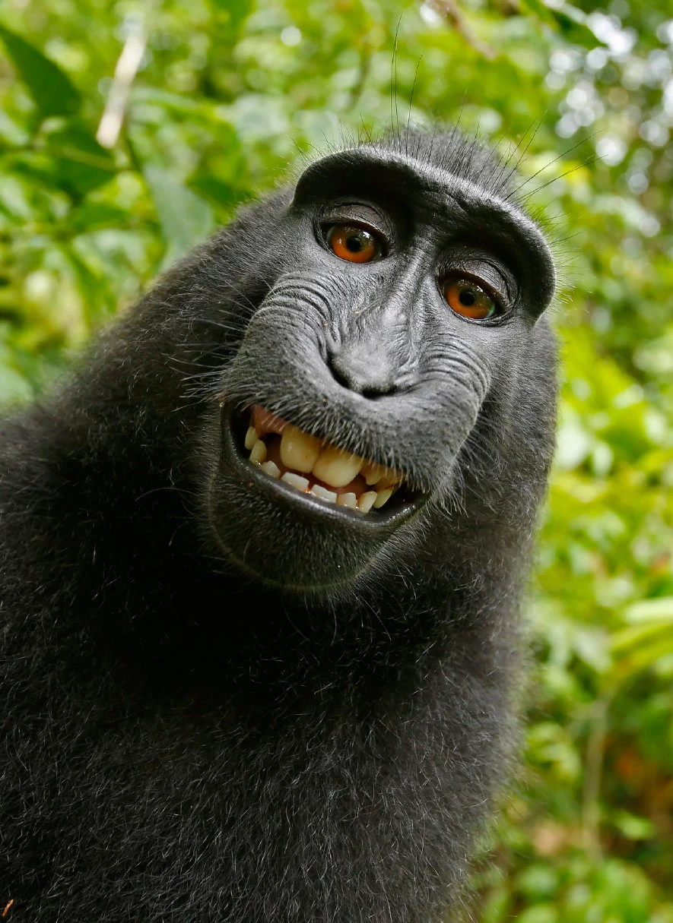
What is Not Protected?
Facts & Data
Ideas
Names, slogans, symbols, short phrases
Useful articles
AI and Non-Human created content
A selfie taken in 2011 by Naruto, a monkey in Indonesia.
Credit...David Slaters/Caters News
https://www.nytimes.com/2017/09/11/us/selfie-monkey-lawsuit-settlement.html?_r=0
Notes:
Facts & Data
Compilation of data may be
Ideas
but could fall under patent law
Names, slogans, symbols, short phrases
may fall under trademark
Useful articles
items like lamps, kitchen sinks, clothing

Slide 18
What was that about compilations?
GOOD. “Transparency: Who Is Coming to America?,” May 7, 2009. https://www.good.is/infographics/transparency-who-is-coming-to-america.
https://deepblue.lib.umich.edu/bitstream/handle/2027.42/83329/copyrightability_of_tables_charts_and_graphs.pdf?sequence=1&isAllowed=y

Slide 19
Hypothetical
What elements on the cookbook page below are covered by copyright?
Betty Crocker Cookbook, page 203

Slide 20
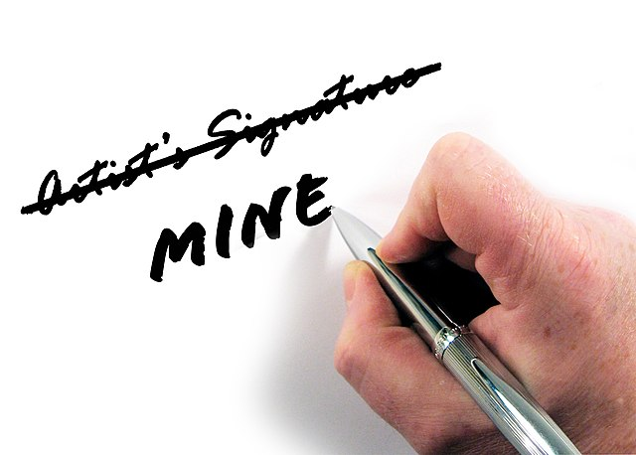
Copyright vs Plagiarism (Law vs. Ethics)
= Legal concept it’s a codified right.
Plagiarism is an ethical issue.
Credit RyanMinkoff

Slide 21
Who holds the copyright?
The first holder of the copyright is the author/creator.
In some cases, it is the creator’s employer (if the work was “made for hire”).
Routine job work.
Commissions.
Contract projects.
These authors can transfer or license any of their exclusive rights.

Slide 22
A work is “made for hire” if it…
Was prepared by an employee acting within the scope of employment OR
Is one of the nine types of works that a contract can turn into a work made for hire, and a contract was signed before the work was created.
As a contribution to a collective work.
As a part of a motion picture or other AV work.
As a translation.
As a supplementary work.
As a compilation.
As an instructional text.
As a test.
As an answer material for a test.
As an atlas
Notes:
Its important to be clear when starting any position you understand what your job considers to be work for hire since “scope of employment is vague”

Slide 23
Remember!
Reproduce
Derivatives
Display
Perform
Transmit
Distribute
sack by Magicon from the Noun Project copy by Mahdi Ehsaei from the Noun Project; create by LAFS from the Noun Project; selling by rahmat from the Noun Project; Performing Arts by Ervin Bolat from the Noun Project; Art by Niko Caruso from the Noun Project; Radio by Dewi Imaniyah from the Noun Projectc

Slide 24
Copyright & Musi©

Slide 25
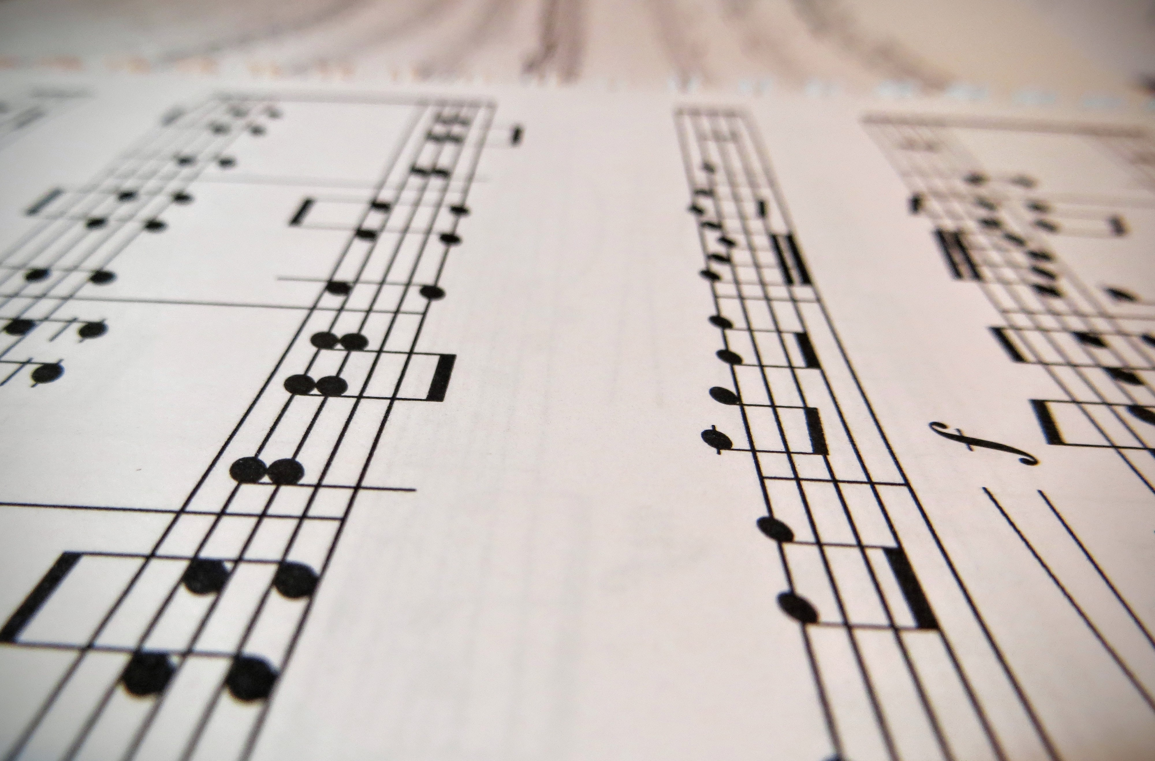
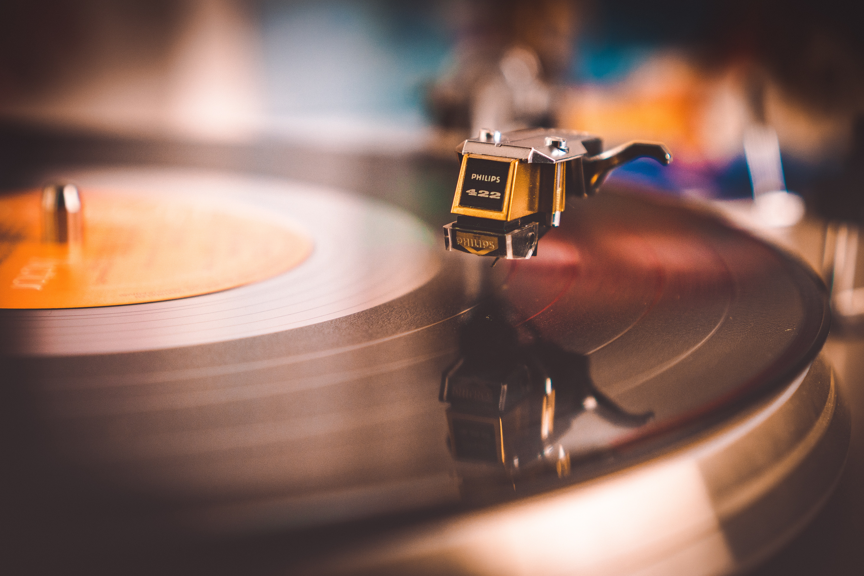
Music Rights Come in Layers
Musical Work
Composers, Lyricists, Arrangers, Writers, Music Publishers
Indicated after the © symbol.
Always considered since all uses of music require compositions.
Sound Recording
Artists, Producers, Record Companies
Indicated after the ℗ symbol.
Not all music involves a sound recordings so this may not be needed/evaluated.

Slide 26
How does this all work? Licensing!
The composer assigns the copyright in the musical work to the publisher.
The publishers license the musical work to Performance Right Organizations (ASCAP, BMI, SESAC).
The performer creates a sound recording.
The performer assigns copyright in the sound recording to a record company.
The record company licenses the recording to sell digital streaming licenses of the sound recording.

Slide 27
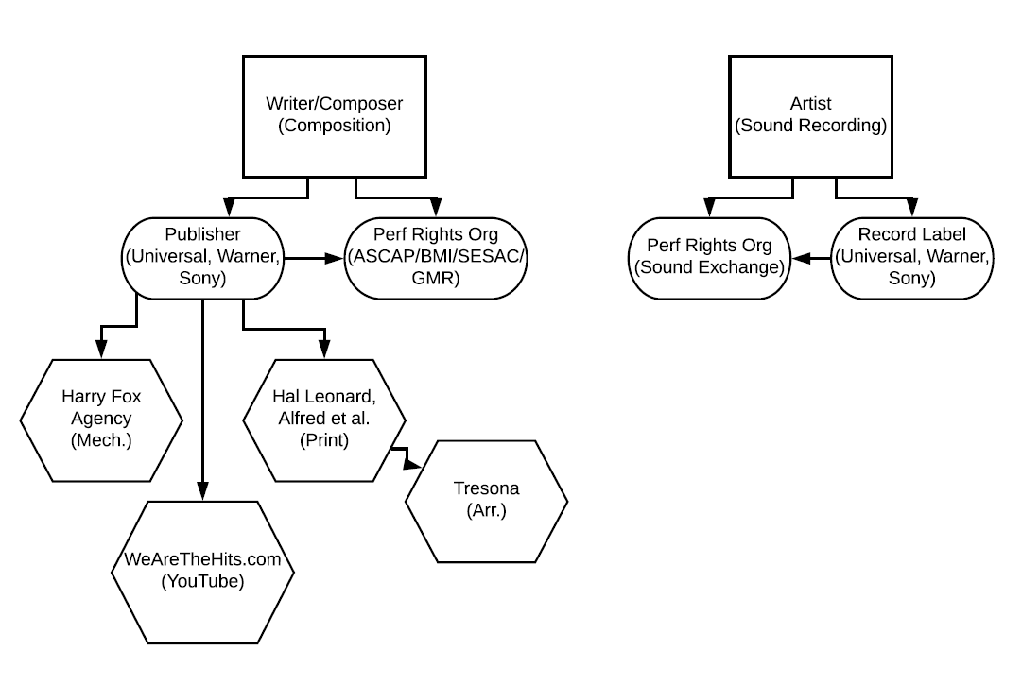
What does this look like?
Credit: Sara Benson

Slide 28
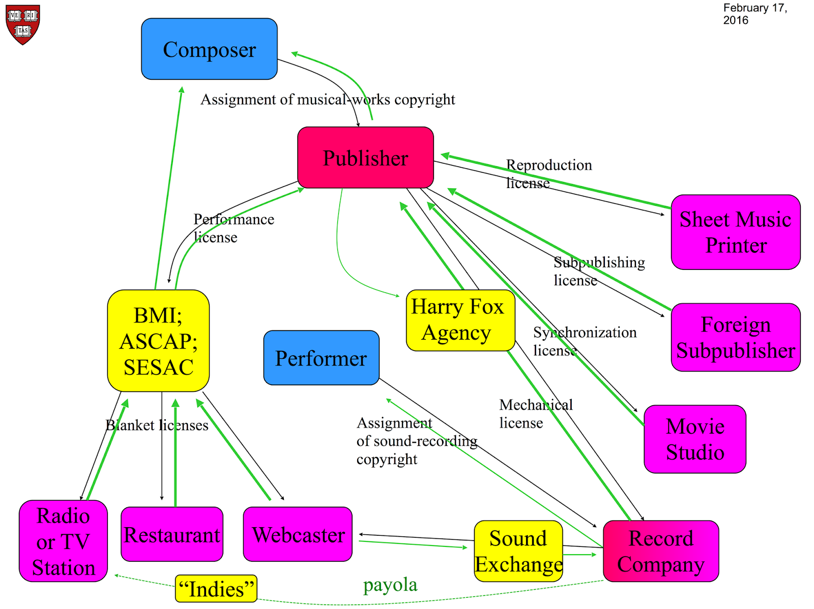
But…what does this REALLY look like?
But wait there is more!!
The publisher through Harry Fox gives Record Company a license to record the song.
The publisher can also license the sheet music (musical work) for things such as use in movies.
Performance Right Organizations sell blanket licenses of the musical work for public performance.
Credit: William W. Fisher for Copyright X

Slide 29
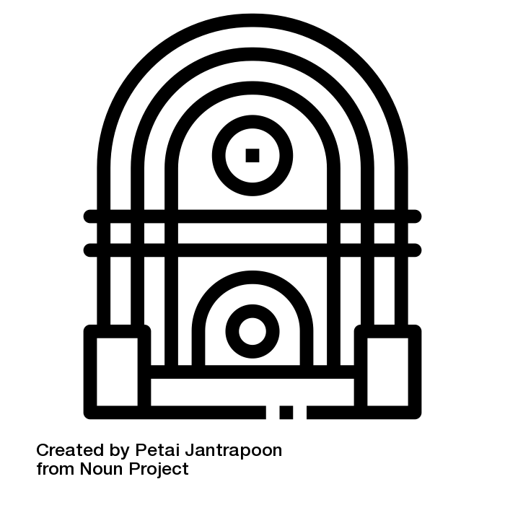
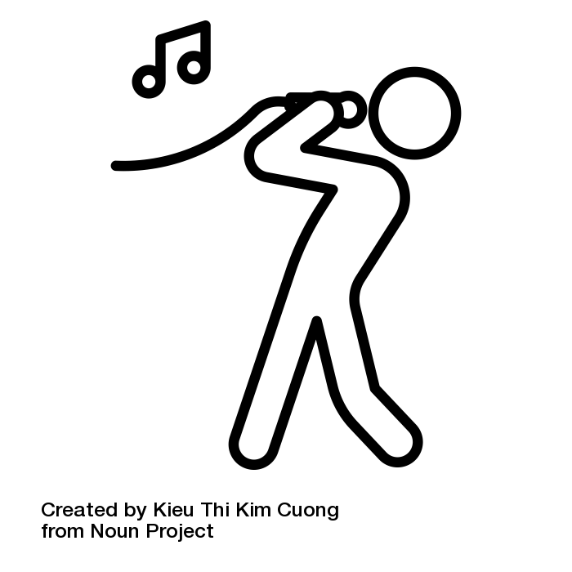
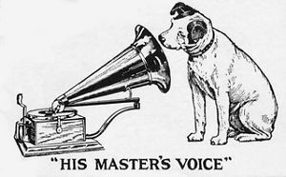
But the Licensing Doesn’t End There!
Synchronization License
Performance Rights
Jukebox License
Mechanical Rights
Arrangement/Print License
Master License
Grand Rights
Credit: grand piano by nareerat jaikaew from the Noun Project; Performing Arts by Ervin Bolat from the Noun Project;sing by Kieu Thi Kim Cuong from the Noun Project; mechanical by Juan Pablo Bravo from the Noun Project; synchronized by parkjisun from the Noun Project; jukebox by Petai Jantrapoon from the Noun Project; puzzel by Hasanudin from the Noun Project

Slide 30
Reproduction Rights
Mechanical (Reproduction) License
The right to make copies/reproduce mechanically non-dramatic musical works for distribution.
Released songs are shared subsequently on vinyl, CD, as a ringtone, as a permanent digital download, etc. OR when you want to play a composition.
Note- this is for the musical composition not the sound recording.
It is a compulsory license, the license is available to anyone who pays the statutory royalty rate [9.1 cents per composition or 1.75 cents per minute of composition] to the authorized licensor and provide statements of account to the copyright owner.
17 USC§106(1)
Exclusive Right to:
Reproduce a copyrighted work
Authorize others to reproduce a work in whole or in part.
For more information see Circular 73: https://www.copyright.gov/circs/circ73.pdf

Slide 31
Mechanical (Reproduction) License
You may:
Make and distribute phonorecords of the work for the public’s private use.
Authorize others to engage in distribution of the phonorecords.
Make a musical arrangement of the work *so long as it conforms to the style and interpretation of the original*.
You may NOT:
Reproduce or distribute a sound recording distributed publicly in phonorecords.
Distribute phonorecords for use in broadcasting, music systems, or other public use.
Change the basic melody or character of the arrangement.
Claim copyright protection in your arrangement as a derivative work.
How to get a Mechanical License?
Bypass and get direct permissions (necessary if any of your intended uses violate the above “you may not’s”).
Harry Fox Agency https://www.harryfox.com
Music Reports https://www.musicreports.com/
Mechanical Licensing Collective: https://www.themlc.com/
MLC doesn’t cover physical material, ringtones, covers or audio visual.
Note: MLC is the only provider of blanket mechanical licensing to DSPs but Harry Fox still grants individual mechanical licenses (song by song).

Slide 32
Derivative Rights
Arrangement/Print/
Folio Licenses
Note- Mechanical licenses only allow arrangement with limitations in phonorecords capturing an arrangement not printed scores, etc.
Permissions to: rearrange, display, print sheet music (notes and or lyrics).
Licenses are typically negotiated through music publishers communicating clearly terms and expectations (often a disclaimer on the physical work) but some rights management organizations exist.
Hal Leonard: https://www.halleonard.com/
17 USC§106(2)
Exclusive Right to:
Prepare derivative works based on the copyrighted work
Authorize others to prepare derivative works.

Slide 33
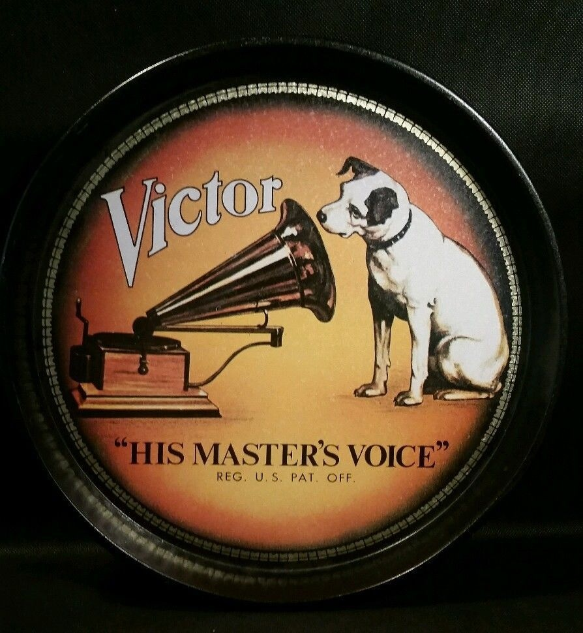
Synchronization License
Secured to synchronize a musical composition with an audiovisual work.
Negotiated directly with the music publisher.
Sometimes these may involve Master License if the licensee seeks to use a pre-recorded version of a song in a project but does not allow the user to re-record a song (create a cover or edit a song). This is the difference between © and ℗! You would need both a master license and the synchronization license in this case!
How to get synchronization and master licenses?
Work directly with publisher or record label ^depending on the above!
Use the ASCAP Repertory Search to help identify these entities: https://www.ascap.com/repertory/about
Prices often set on an individual basis.
Communicate clearly your needs and use and then subsequently the terms and expectations when drafting an agreement.
Note- If you were sharing a cover of a song on YouTube---the mechanical license you secure would only cover the audio, the audiovisual component of your project would require a sync license—which are not compulsory!

Slide 34
Distribution Rights
BONUS LICENSE?
Distribution License
Allows licensees to distribute copyrighted music or sound recordings in return for a fee or royalty.
Where music is interesting is that distribution deals used to involve the distributor paying for manufacturing costs acting as an intermediary between record labels and retail outlets. Digital music has changed this.
Distribution is often wrapped in larger bundles of licenses.
The above shift has led to the birth/popularity of indie labels as the market shifts.
17 USC§106(3)
Exclusive Right to:
Distribute copies or phonorecords.
Sale
Transfer of ownership
Rental
Lease
Lending
Authorize others to distribute copies or phonorecords.
It is a “license” and it isn’t. It’s a right under copyright that can be licensed away (happens in book publishing, etc. too!)

Slide 35
Public Performance Rights
Public Performance License
To “perform” a work means to recite, render, play, dance, or act it, either directly or by means of any device or process or, in the case of a motion picture or other audiovisual work, to show its images in any sequence or to make the sounds accompanying it audible. (17 USC 101)
Four Types of Public
Public Places (Concert Hall, Zoo, Store, Restaurant, etc.)
Semi-Public Places (“substantial persons outside of the normal circle of acquaintances or family.” Examples: Private Club, University, Music School)
Transmissions, communications, displays to the public/semi-public (TV, radio, transmission to a place open to the public)
Transmitted by “any device or process” regardless if public actually received.
17 USC§106(4)
Exclusive Right to:
Authorize the public performance of their work.
§101 includes live and recorded/transmitted performances.

Slide 36
Public Performance License
Exempted Performances
Under §110
§110(1): Face-to-face teaching by instructors
§110(2): Displays and performances in distance learning (The TEACH Act of 2002)
§110(3): nondramatic literary or musical works or dramatico-musical works of a religious nature in the course of religious services or assemblies
§110(4) non-profit performances of a non-dramatic literary or musical work before a live audience for “educational, religious, or charitable purposes and not for private financial gain”

Slide 37
Public Performance License
How to Secure Public Performance Rights?
Performance Rights Organizations/Societies
ASCAP (American Society of Composers, Authors and Publishers) https://www.ascap.com/
BMI (Broadcast Music, Inc.) https://www.bmi.com/
SESAC (Society of European Stage Authors and Composers) https://www.sesac.com/
What do PRO’s do?
Issues performance licenses. For music whether live, broadcasting, transmission, played off analog material.
Monitor public performances of music and enforce royalty collection.
Issue Blanket Licenses: licenses that allow music users to perform any or all works in the PRO’s repertory/collection as much or as little as they like—paying an annual fee. Per “program licenses” are blanket licenses issued to a radio or TV broadcaster at a per program level.

Slide 38
Grand License
Note: the law does not define grand or small rights.
What are Grand Performing Rights? What are “Small” Rights?
Small rights
Non-dramatic works
Standalone portions or arrangements of dramatic works may be considered small rights issues.
Example: An orchestral performance of a song/select songs from Sweeny Todd with no dialogue or stage action
GRAND RIGHTS
Dramatic or dramatico-musical works
Compositions from dramatico-musical works.
works that tell a story
commissioned for us in extra musical contexts—choreography, stage action, in a play.
Works like Opera, Ballet, Musical, Pantomime
If a nondramatic work is used in a dramatic context this becomes a grand rights issue.
Example: Concert performance of the music from Rent

Slide 39
Grand License
Note: the law does not define grand or small rights.
How to get a Grand License?
Grand rights can only be licensed for use by the copyright holder—either the copyright holder (composer or publisher). *PRO’s may have musical compositions from the aforementioned in their repertory for nondramatic public performances.*
But wait...what is a Theatrical License?​
No not a bonus license. "Theatrical rights" encompass the rights related to the protections that come with grand rights/grand licenses theatrical licenses- between users and the owner of copyrighted compositions for use in plays, musical dances, operas, narration, choreography, and other dramatic performances-are the same as grand licenses just a different name!​
BONUS LICENSE?
Theater by Jino from the Noun Project

Slide 40
Jukebox License
Jukebox History
Jukeboxes can…
only perform non-dramatic musical work as activated by inserting coins or tokens.
be in establishments with no charge for admission
showcase lists of titles accessible to the public
allow for patrons to chose works played.
Copyright Act of 1909 Jukeboxes exempted from paying public performance fees unless a fee was charged for admission at the establishment housing them.
Copyright Act of 1976 Compulsory license established for operators of jukeboxes (coin operated phonorecord players) because of profits/popularity/growth.
Copyright Act of 1993 Repealed § 116 of 1976 Act and replaced it with a voluntary licensing scheme between copyright holders and jukebox operators grant PROs the right to negotiate licenses for music played on jukeboxes with the Amusement and Music Operators of America (AMOA) a trade group representing jukebox owners.

Slide 41
Display Right
BONUS LICENSE?
Display License
It is a “license” and it isn’t. It’s a right under copyright that can be licensed away!
Examples:
Karaoke?
Lyrics in a gallery installation.
Lyrics in a piece of artwork.
17 USC§106(5)
Exclusive Right to:
Display work publicly.
Authorize others to display works publicly.
**NOTE: Only applies to music and lyrics not sound recordings.

Slide 42
Public Performance via Digital Audio Transmission Right
Digital Performance License
DRPA Three Tiers
Non-Subscription exempt from requirements to pay license fees—but will need to pursue public performance rights.
Non-Interactive Internet transmissions (webcasters, satellite radio broadcasters, cable broadcasters) to pay statutory license established by the Copyright Board.
Modified by DMCA in 1998 which framed the statutory license.
Interactive Transmissions require the negotiation of a license agreement with the copyright holder.
17 USC§106(6)
Exclusive Right:
For controlling the public performance of sound recordings via digital audio transmission.
Internet radio.
Established in 1995 by the Digital Performance Right in Sound Recordings Act (DPRA).

Slide 43
What was that about Sound Recordings?
Duration of Copyrights in Sound Recordings
Classics Protection and Access Act part of the 2018 Music Modernization Act: Until 2018 sound recordings made prior to Feb. 1972 were not covered by federal law and it was up to to state law to govern protections.
Unpublished Recordings | Copyright Expires 2/15/2067
Published Pre-1923 | Recordings enter the PD on 1/1/2022
Published 1923-1946 | 100 years (five years after the general 95- year term)
Published 1947-1956 | 110 years (15 years after the general 95-year term)
Published 1957- February 1972 | Copyright expires 2/15/2067
February 1972-1978 without Notice | Public Domain
February 1972-1978 with Notice | 95 years from publication 2068 at earliest.
1978-March 1989 without Notice or subsequent registration | Public Domain
1978-March 1989 with Notice | Life of the author +70 OR Works for Hire 95 years after publication or 120 after creation (2049 at earliest).
After March 1989 | Life of the author +70 OR Works for Hire 95 years after publication or 120 after creation.

Slide 44
Performer’s Rights 17 USC §1101
§ 1101. Unauthorized fixation and trafficking in sound recordings and music videos​
(a) Unauthorized Acts. - Anyone who, without the consent of the performer or performers involved —​
(1) fixes the sounds or sounds and images of a live musical performance in a copy or phonorecord, or reproduces copies or phonorecords of such a performance from an unauthorized fixation,​
(2) transmits or otherwise communicates to the public the sounds or sounds and images of a live musical performance, or​
(3) distributes or offers to distribute, sells or offers to sell, rents or offers to rent, or traffics in any copy or phonorecord fixed as described in paragraph (1), regardless of whether the fixations occurred in the United States, shall be subject to the remedies provided in sections 502 through 505, to the same extent as an infringer of copyright.​
A Release, Waiver or Sound Recording Agreement is required to satisfy § 1101. ​
Use of Name, Image and Likeness​
Control of Copyright​
Payment of Royalties​

Slide 45
Remember!
These are the six exclusive rights of copyright owners!​
It doesn't matter what the copyrightable object is—though some may not apply or apply at first glance these are the rights that belong to a copyright owner
Each can be licensed or transferred via license​
Exclusively​
Nonexclusively​
With custom terms
But music copyright terminology and practices can make this look more complicated....​
sack by Magicon from the Noun Project copy by Mahdi Ehsaei from the Noun Project; create by LAFS from the Noun Project; selling by rahmat from the Noun Project; Performing Arts by Ervin Bolat from the Noun Project; Art by Niko Caruso from the Noun Project; Radio by Dewi Imaniyah from the Noun Project

Slide 46
Tying it All Together
Remember these are industry licenses and popular terms, custom licenses involving the exclusive right can also be drafted. This is to illustrate the industry terms/practices!
Exclusive Right Music Industry Practice/Terms/Tools Reminders
The physical reproduction of non-dramatic musical works for distribution.
Musical Composition ONLY not sound recording.
Statutory/compulsory license-- Harry Fox Agency/ Music Reports or Mechanical Licensing Collective (only offers blanket)
Slides 29 and 30
NOTE: Other general reproduction rights/licenses exist (ex: copies of scores with no adaptation would be possible with specific licenses to that right)
Mechanical (Reproduction License)
Reproduce
If you are rearranging a score—this is the license needed. Mechanical Licenses only cover recorded performances and do not allow real rearrangement.
Permission to rearrange, print sheet music, etc.
Example: Adapting the score to a new instrument or for an age level.
Folio- to compile arrangements "Greatest Hits of "X Artist".
NOTE: Printing copying and distributing scores involves reproduction and display rights. Many of these licenses will be compound featuring multiple rights involved this is what creates muddled names in arrangement/print/folio licenses (Most commonly enveloped under the term "Print Rights").
Slide 31
Arrangement/Print/Folio Licenses
When using musical compositions in conjunction with an audiovisual work (you cover Adele and add a homemade music video or make a documentary and add arrangements) you need a Synchronization License.
If you are using the artists recording (and musical composition) in conjunction with audiovisual works (music is needed for films Adele's Skyfall for the James Bond movie) a master license is needed for the recording.
Remember the difference between © and ℗!
Slide 32
Derivatives
&
Synchronization License
Master License

Slide 47
Tying it All Together
Remember these are industry licenses and popular terms, custom licenses involving the exclusive right can also be drafted. This is to illustrate the industry terms/practices!
Exclusive Right Music Industry Practice/Terms/Tools Reminders
Distribution Licenses where more standardized before digital music in the retail realm when manufacturing was outsourced.
They still exist but function directly as a factor of a copyright owners exclusive right to distribute via sale/loan/rent of their material.
Often wrapped in larger bundles of licenses (ex: a record store may be a licensed distributor of "x label" and also has a public performance license for that music via blanket license —playing it in store).
Sometimes the wording "distribution license" exists but it isn't a compulsory license or music specific term; it just refers to licensing and terms established pertaining specifically to this exclusive right.
Slide 33.
BONUS LICENSE?
Distribution License
Distribute
BONUS LICENSE?
NOTE: Only applies to music composition/lyrics not sound recordings.
If you are using the score or lyrics to a piece in a gallery installation/art piece etc. You would need to secure permissions and a license of the exclusive right to display works to do so.
A good example is Karaoke—which for these institutions is likely a right bundled in a larger public performance context with rights holders/publishers/composers.
Sometimes the wording "display license" exists but it isn't a compulsory license or music specific term; it just refers to licensing and terms established pertaining specifically to this exclusive right.
Slide 40.
Display License
Display Publicly

Slide 48
Tying it All Together
Remember these are industry licenses and popular terms, custom licenses involving the exclusive right can also be drafted. This is to illustrate the industry terms/practices!
Exclusive Right Music Industry Practice/Terms/Tools Reminders
Ask yourself is this a dramatic work or a nondramatic work!
Performance Rights Organizations offer blanket licenses for their entire repertory. (Now a bar in Aggieville can allow live bands to sing covers, play music over speakers, etc.)
PROs also collect royalties for publishers/artists.
If a blanket license isn't needed PROs often issue program licenses for use in one radio/TV broadcasted show.
For individuals/individual songs (not blanket)—a "general music license" a term frequently applied to negotiating individual/special use cases of compositions/sound recordings across the bundle of six exclusive rights, would be negotiated with the proper copyright holder (artist or record label).
Slide 34-36.
Blanket License
Public Performance Rights/License
Ask yourself is this a dramatic work or a nondramatic work!
If this is a dramatic work—blanket licenses and PRO's don’t apply if you are performing a musical/theatrical work!
Some PRO's may have individual songs you may be able to perform Wicked's "Popular" at a restaurant but there could be no costuming, choreography, other aspects of the performance.
If you are turning RENT into a ballet or around its lyrics and composition or performing a concert of the music from Into the Woods or writing a musical based on a narrative blended with one of Adele's album —you need grand rights/license because you are adding your work to an artist's existing work which could alter the creators meaning and the works integrity or are performing a work that tells a story that could be muddled.
Grand preforming rights/licenses are coordinated through the creator or the creator's publisher—whoever retains copyright in the work used.
Slide 34,35,37-38.
Grand Rights/License
Perform Publicly
Remember!
Theatrical Licenses are Grand Rights/License
Theatrical License

Slide 49
Tying it All Together
Remember these are industry licenses and popular terms, custom licenses involving the exclusive right can also be drafted. This is to illustrate the industry terms/practices!
Exclusive Right Music Industry Practice/Terms/Tools Reminders
There are special rules/functions/laws for jukeboxes their use to publicly perform music.
Amusement and Music Operators of America a trade group represents jukebox owners.
The Jukebox License Office acts as the clearinghouse for obtaining permissions required.
Slide 39.
Perform Publicly...
Continued
Jukebox License
This right is often referred to as the "Digital Performance Right/License" it just refers to licensing and terms established pertaining specifically to this exclusive right.
An exclusive right established in 1995 by the Digital Performance Right in Sound Recording Act (DPRA).
Three Tiers which may require either:
Public performance rights to support transmission.
Payment for a statutory/compulsory license (statutory license under sections 112(e) or 114(d)(2), or both) defined in 1998 by the Digital Millenium Copyright Act (DMCA) and ruled over by the Copyright Royalty Board.
Independent negotiation with the copyright holder.
Current Licensing Fees: https://www.copyright.gov/licensing/fees.html
Slide 41
BONUS LICENSE?
Perform Works Publicly by Means of Digital Audio Transmission
Digital Performance Right/License?

Slide 50
Framework - U.S. Copyright
Does it have copyright protection?
Does it have an existing license that covers my use?
Can I rely on an exemption, such as fair use?
Do I need to seek permission or purchase a license?
Rights
Permission
Exemption
License

Slide 51
Do any user’s rights apply?
Exemption
Fair use (107)
Reproduction by libraries and archives (108)
First sale (109)
Exemption of certain performances and displays (110) TEACH Act (110 (2))
Classroom use
Religious use (for nondramatic literary or musical works or of dramatico-musical works of a religious nature)
Non-profit use (for nondramatic literary or musical works)
Homestyle
Notes:
Students- Fair Use
Instructors, Teachers, Faculty- Fair Use and TEACH Act
This exemption allows transmissions embodying a performance or display of a work to be communicated to the public without the copyright owner's consent in certain circumstances. Under current law, there are three important limitations on such communication: (1) it must be done through a single receiving apparatus of a kind commonly used in private homes (hence the term “homestyle” ); (2) there must be no direct charge for seeing or hearing the transmission; and (3) the transmission must not be further transmitted to the public.

Slide 52
Four Fair Use Factors
THE PURPOSE AND CHARACTER OF YOUR USE
transformativeness, commerciality, bad faith, illustrative purposes (including education)
THE NATURE OF THE COPYRIGHTED WORK
creative/factual, unpublished
THE AMOUNT AND SUBSTANTIALITY OF THE PORTION TAKEN, AND
THE EFFECT OF THE USE UPON THE POTENTIAL MARKET
substitute/complement
amount, “heart of the work,” necessary to purpose
Exemption

Slide 53
Illustrative Purposes Looking Closer at 17 USC § 107
Exemption
“purposes such as criticism, comment, news reporting, teaching (including multiple copies for classroom use), scholarship, or research”
Favorable to academic uses, but difficult to apply.

Slide 54
Fair Use Tool
Exemption
https://librarycopyright.net/resources/fairuse/index.php

Slide 55
Copyright Law Basics Expanded
This is related more to traditional print publishing using images and creative commons licensed content.
The copyright workflow is very important and used across the various formats of copyrighted material (including music)!

Slide 56
Let's Talk Licenses and Transfers
Contracts/agreements that permits authority to own, do, or use something.
Authors can transfer or license any of their exclusive rights, including portions of those rights.​
Copyrights can also pass by “operation of law,” e.g., probate, bankruptcy, and corporate dissolution.​
Does transferring a physical object transfer copyright in that object?--No.
agreement by Nhor from the Noun Project transfer byBismillah from the Noun Project

Slide 57
Breaking Up the Bundle
Copyright is actually a bundle of rights, the exclusive rights mentioned earlier.
Licenses do not need to allow the transfer of all exclusive rights, they set requirements, limitations, and terms for the rights transferred
1) To reproduce and make copies
2) To prepare derivative works
3) To distribute copies
4) To perform the work publicly​
5) To display the copyrighted work publicly​
6) To perform the copyrighed work by means of a digital audio transmission
Wood by Jugalbandi from the Noun Project

Slide 58
Public Licenses
The rightsholder is the licensor, and everybody else is the licensee.
CC licenses last until the work enters the public domain at the end of the copyright term.
(Unless termination rights are exercised)

Slide 59
Rights Map
P
U B
L
I
C
D
O
M
A
I
N
Some Rights Reserved
FREE FOR ALL TO USE
Time Passes or CC0
All Rights Reserved
Notes:
Attribution
Derivative Works
Share Alike
Non-Commercial

Slide 60
Attribution Others can copy, distribute, display, perform and remix your work if they credit your name as requested by you.
Derivative Works Others can only copy, distribute, display or perform verbatim copies of your work.
Share Alike Others can distribute your work only under a license identical to the one you have chosen for your work.
Non-Commercial Others can copy, distribute, display, perform or remix your work but for non-commercial purposes only.
CC0 License To relinquish all rights and designate work to the public domain.
Public Domain mark used to indicate things ALREADY in the public domain.
Notes:
Attribution
Derivative Works
Share Alike
Non-Commercial

Slide 61
Using Copyrighted Works

Slide 62
Framework - U.S. Copyright
Does it have copyright protection?
Does it have an existing license that covers my use?
Can I rely on an exemption, such as fair use?
Do I need to seek permission or purchase a license?
Rights
Permission
Exemption
License

Slide 63
Framework - U.S. Copyright
Does it have copyright protection?
OR
Rights

Slide 64
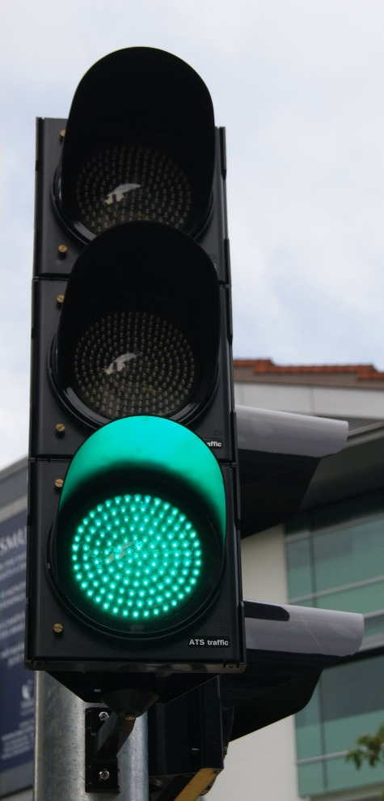
Public Domain
All works published before 1925*
Works published between 1925 and 1989
Works created after 1989*
Currently the Duration of Copyright is:
70 years after death of the author
"work for hire“ 120 years after creation or 95 years after publication, whichever is shorter
Images courtesy of Jacklee at Wikimedia Commons.

Slide 65
Public Domain Tools
https://copyright.cornell.edu/publicdomain
https://librarycopyright.net/resources/digitalslider/index.html

Slide 66
Framework - U.S. Copyright
Does it have copyright protection?
Does it have an existing license that covers my use?
License

Slide 67
Does it have an existing license that covers my use?
Read all terms and agreements
Contract and license will outweigh exemptions
Be aware of end dates
“Open Access” or Free to use but check license specifics
REMEMBER: Free to use does not mean you do not need to cite!

Slide 68
Framework - U.S. Copyright
Does it have copyright protection?
Does it have an existing license that covers my use?
Can I rely on an exemption, such as fair use?
Exemption

Slide 69
Do any user’s rights apply?
Fair use (107)
Reproduction by libraries and archives (108)
First sale (109)
Exemption of certain performances and displays (110) TEACH Act (110 (2))
Classroom use
Religious use (for nondramatic literary or musical works or of dramatico-musical works of a religious nature)
Non-profit use (for nondramatic literary or musical works)
Homestyle
Notes:
Students- Fair Use
Instructors, Teachers, Faculty- Fair Use and TEACH Act
This exemption allows transmissions embodying a performance or display of a work to be communicated to the public without the copyright owner's consent in certain circumstances. Under current law, there are three important limitations on such communication: (1) it must be done through a single receiving apparatus of a kind commonly used in private homes (hence the term “homestyle” ); (2) there must be no direct charge for seeing or hearing the transmission; and (3) the transmission must not be further transmitted to the public.

Slide 70
Four Fair Use Factors
THE PURPOSE AND CHARACTER OF YOUR USE
transformativeness, commerciality, bad faith, illustrative purposes (including education)
THE NATURE OF THE COPYRIGHTED WORK
creative/factual, unpublished
THE AMOUNT AND SUBSTANTIALITY OF THE PORTION TAKEN, AND
THE EFFECT OF THE USE UPON THE POTENTIAL MARKET
substitute/complement
amount, “heart of the work,” necessary to purpose

Slide 71
Illustrative Purposes Looking Closer at 17 USC § 107
“purposes such as criticism, comment, news reporting, teaching (including multiple copies for classroom use), scholarship, or research”
Favorable to academic uses, but difficult to apply.

Slide 72
Fair Use Tool
https://librarycopyright.net/resources/fairuse/index.php

Slide 73
Framework - U.S. Copyright
Does it have copyright protection?
Does it have an existing license that covers my use?
Can I rely on an exemption, such as fair use?
Do I need to seek permission or purchase a license?
Permission

Slide 74
Seeking Permissions
Determine who to contact.
Contact the author/publisher.
Use the work only in accordance with the permissions agreed upon or don't use the work if permissions are denied or the permitted use is incompatible with your work.
If you need help determinging ownership you could try:
Searching the Copyright Office catalogs and other records.
*Costly* Have the Copyright Office help by searching for you!
Notes:
Look for clues: copyright notice, place and date of publication, author and publisher (examine the object itself for clues)
if uncertain about your proposed use and request permissions.

Slide 75
Want to Avoid Some of This?
Find openly licensed work with clear terms that encourage your use!
https://commons.wikimedia.org/w/index.php?search=&title=Special:MediaSearch&go=Go&type=image&haslicense=attribution

Slide 76
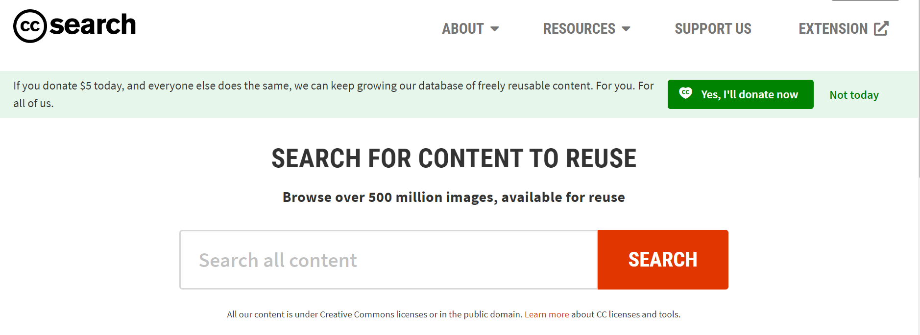
Want to Avoid Some of This?
Find openly licensed work with clear terms that encourage your use!
https://search.creativecommons.org/

Slide 77
Want to Avoid Some of This?
Find openly licensed work with clear terms that encourage your use!
https://www.google.com/imghp?hl=en

Slide 78
Copyright and Your ETDR
Tips and Reminders

Slide 79
Best Practices in your Report, Thesis, or Dissertation
Cite everything.
When using other's material ask yourself do you need this specific figure/image to complete my scholarly objective?
Frequently consult this material CADS curated on Reusing Content.
As you explore opportunities to publish all or parts of your ETDR consider the terms of the publisher's contract?
Consider how this could affect the submission of your ETDR.
Notes:
Cite everything. This ensures you don't run into issues with plagiarism but also helps future users of your schoalrship distinguish what is your original work.
When using other's material ask yourself do you need this specific figure/image to complete my scholarly objective?
Ask yourself if you can find it or something similar/usable enough that is in the public domain or publicly licensed. Consider how this would affect your fair use claim.
Frequently consult this material CADS curated on Reusing Content.
As you explore opportunities to publish all or parts of your ETDR consider the terms of the publishers contract, what if anything are you licensing away or are you transfering ownership of the work completely?
Consider how this effects your ETDR and the timeline to submit your ETDR—does publishing parts of your ETDR prior to submission make it difficult to submit?

Slide 80
Authors Rights Tools
https://v2.sherpa.ac.uk/romeo/
1st: Use Sherpa Romeo to review publishers' policies. 2nd Confirm with the journal's posted policies.

Slide 81
ETDR HELP
Questions about these topics:
•Graduation procedures, requirements and deadlines
•ETDR fees
•Embargo (request for delayed publication in K-REx)
•Commencement
Questions about these topics:
•Templates and formatting your ETDR
•Reviewing your ETDR and supplemental files
•Working with image or audio files
•Converting your Word or LaTeX file to PDF
•Logging into K-REx to submit your ETDR
Graduate School
119 Eisenhower Hall
785-532-6191 or 800-651-1816
grad@k-state.edu
IT Help Desk
Students Should Fill out the ETDR Request Form
785-532-7722 or 800-865-6143
helpdesk@k-state.edu

Slide 82
Questions?
Emily G. Finch
Assistant Professor
Scholarly Communication and Copyright Librarian
egfinch@ksu.edu
CADS@ksu.edu
Thomas Bell
Associate Professor
Academic Services Librarian
Drama Therapy | Interior Architecture and Industrial Design| Leadership Studies |Music
thosbell@k-state.edu
(785) 532-3366
Ryan Otto
Associate Professor
Scholarly Communication Librarian
CADS@ksu.edu
rwotto@ksu.edu

