Slide 1
Music Copyright
Ryan Otto (he/him)
Scholarly Communication Librarian – Associate Professor
Gwen Sibley (she/her)
Scholarly Communication Librarian – Assistant Professor

Slide 2
DISCLAIMER
The information presented in this presentation is intended for informational purposes and should not be construed as legal advice. If you have specific legal questions pertaining to K-State, please contact the Office of General Counsel. Information received from the Scholarly Communication Librarian is not legal advice. The Scholarly Communication Librarian does not act as legal counsel to the university or any members of the university community.

Slide 3
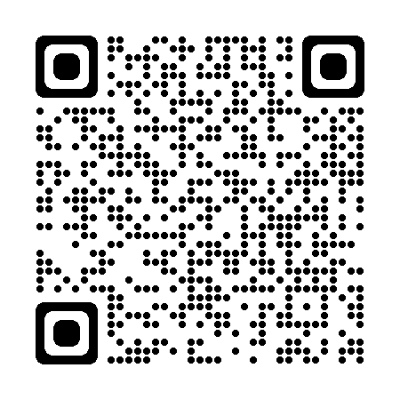
Copyright Services
https://www.k-state.edu/copyright/

Slide 4
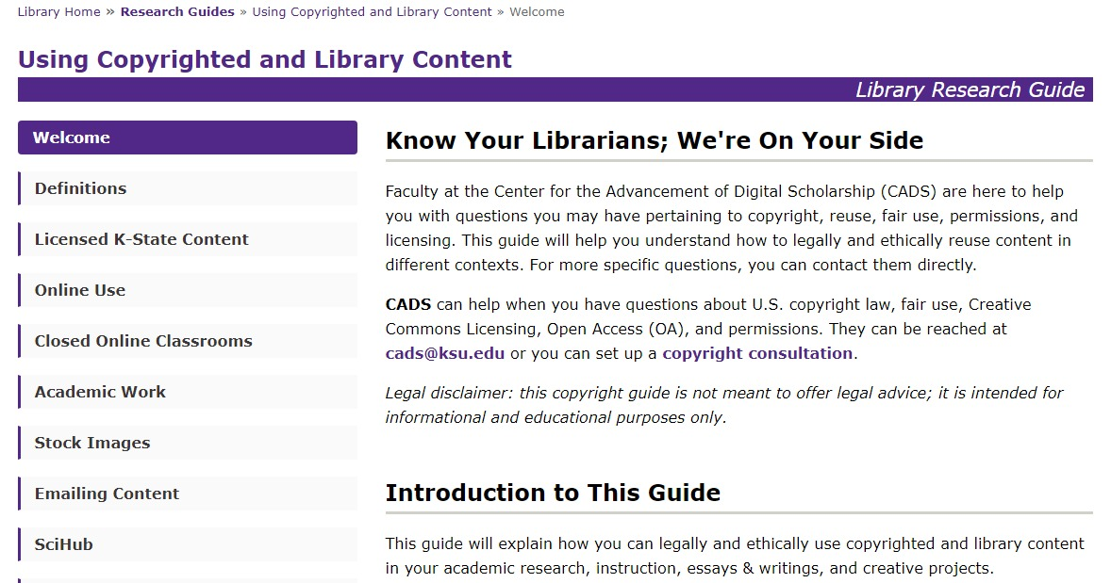
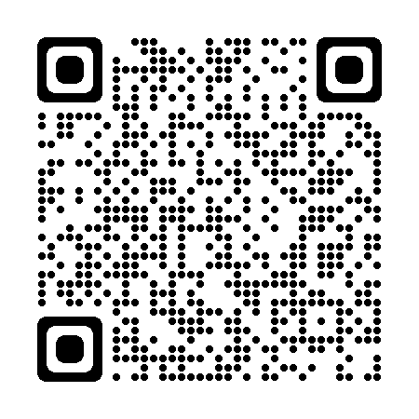
Resources
https://www.k-state.edu/copyright/
https://guides.lib.k-state.edu/UsingContent

Slide 5
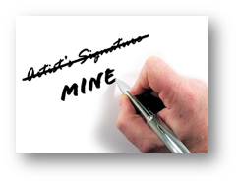
Copyright (Law) vs. Plagiarism (Ethics)
Copyright is a legal concept it’s a codified right with legal penalties.
Plagiarism is an ethical issue with academic or professional penalties.
Credit RyanMinkoff

Slide 6
Why Copyright?
Promote the Progress of Science and Useful Arts
How?
"To promote the progress of science and useful arts, by securing for limited times to authors and inventors the exclusive right to their respective writings and discoveries."
U.S. Constitution Article 1, Section 8, Clause 8 (Patent and Copyright Clause)

Slide 7
What is Copyright?
It’s a Bundle!

Slide 8
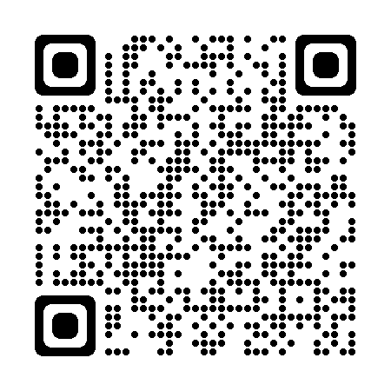
What is Copyright?
To Reproduce & Make Copies
To Distribute Copies
To Display Works Publicly
Bundle of Rights
To Prepare Derivative Works
To Perform Works Publicly
To Perform Works Publicly by Means of Digital Audio Transmission
https://www.youtube.com/watch?v=2U81MTBg5tY
Notes:
Copyright is a form of intellectual property protection codified in title 17 of the US Code. When one retains copyright in a work they actually hold a bundle of rights– this bundle broken down includes the rights to:
(1)to reproduce the copyrighted work in copies or phonorecords;
(2)to prepare derivative works based upon the copyrighted work;
(3)to distribute copies or phonorecords of the copyrighted work to the public by sale or other transfer of ownership, or by rental, lease, or lending;
(4)in the case of literary, musical, dramatic, and choreographic works, pantomimes, and motion pictures and other audiovisual works, to perform the copyrighted work publicly;
(5)in the case of literary, musical, dramatic, and choreographic works, pantomimes, and pictorial, graphic, or sculptural works, including the individual images of a motion picture or other audiovisual work, to display the copyrighted work publicly; and
(6)in the case of sound recordings, to perform the copyrighted work publicly by means of a digital audio transmission.

Slide 9
What’s Not Protected
Facts & Data
Ideas
May fall under patent(s)
Names, slogans, symbols, short phrases
May fall under trademark
Useful articles
AI and Non-Human created content
A selfie taken in 2011 by Naruto, a monkey in Indonesia.
Credit...David Slaters/Caters News
Notes:
Facts & Data
Compilation of data may be
Ideas
but could fall under patent law
Names, slogans, symbols, short phrases
may fall under trademark
Useful articles
items like lamps, kitchen sinks, clothing

Slide 10
What’s Protected?
Examples
Works MUST be:
Literature
Music
Photography
Forms of creative expression
Original
Creative
Fixed in a tangible medium of expression
Piece of paper
Recorded audio or video
Building
Etc.

Slide 11
Copyright is Automatic
Original
Creative
And Fixed

Slide 12
So, what is Registration?
Notes:
Establishs a public record of a copyright claim
• Before an infringement suit may be filed in court, registration (or refusal) is necessary for U.S. works.
• Establishes some evidence of the validity of the copyright
• Shapes statutory damages, attorneys’ fees, and costs in law suits.
• Permits a copyright owner to establish a record with the U.S. Customs and Border Protection for protection against the importation of infringing copies

Slide 13
Hypothetical
What elements on the page may be covered by copyright?
What included on the page is creative expression?
How might these same questions be applied to scholarly works?

Slide 14
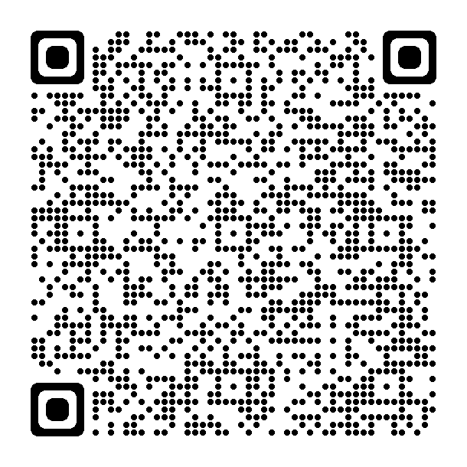
What was that about compilations?
GOOD. “Transparency: Who Is Coming to America?,” May 7, 2009. https://www.good.is/infographics/transparency-who-is-coming-to-america.
https://deepblue.lib.umich.edu/bitstream/handle/2027.42/83329/copyrightability_of_tables_charts_and_graphs.pdf?sequence=1&isAllowed=y

Slide 15
Who Owns Copyright?
or
Creator’s employer if the work was “made for hire”
The First owner is Author/Creator
These authors can transfer or license any of their exclusive rights.
Notes:
At the beginning of any project and before signing any contracts for content make sure ownership is clear to all involved parties.

Slide 16
Works are “made for hire” if:
Was prepared by an employee acting within the scope of employment OR
Is one of the nine types of works that a contract can turn into a work made for hire, and a contract was signed before the work was created.
As a contribution to a collective work.
As a part of a motion picture or other AV work.
As a translation.
As a supplementary work.
As a compilation.
As an instructional text.
As a test.
As an answer material for a test.
As an atlas
For more information on “Work for Hire” visit:
https://www.copyright.gov/circs/circ30.pdf
Notes:
Its important to be clear when starting any position you understand what your job considers to be work for hire since “scope of employment is vague”

Slide 17
Let's Talk Licenses and Transfers
Contracts/agreements that permits authority to own, do, or use something.
Rights holders can transfer or license any of their exclusive rights, including portions of those rights.​
Copyrights can also pass by “operation of law,” e.g., probate, bankruptcy, etc.
Does transferring a physical object transfer copyright in that object?--No

Slide 18
Public Licenses
Rights holder - Licensor
Everybody else - Licensee
Public, or open licenses last until the work enters the public domain at the end of the copyright term.
(Unless termination rights are exercised)

Slide 19
Rights Map
FREE to
ALL
SOME Rights Reserved
Public Doman
ALL Rights Reserved
Time Passes or Creative Commons 0

Slide 20
Features of the Six Licenses
Attribution Others can copy, distribute, display, perform and remix your work if they credit your name as requested by you.
No Derivative Works Others can only copy, distribute, display or perform verbatim copies of your work.
Share Alike Others can distribute your work only under a license identical to the one you have chosen for your work.
Non-Commercial Others can copy, distribute, display, perform or remix your work but for non-commercial purposes only.

Slide 21
Framework - U.S. Copyright
Does it have copyright protection?
Does it have an existing license that covers my use?
Can I rely on an exemption, such as fair use?
Do I need to seek permission or purchase a license?
Rights
License
Exemption(s)
Permission

Slide 22
1. Does it have copyright protection?
Original
Creative
And Fixed
OR
Rights

Slide 23
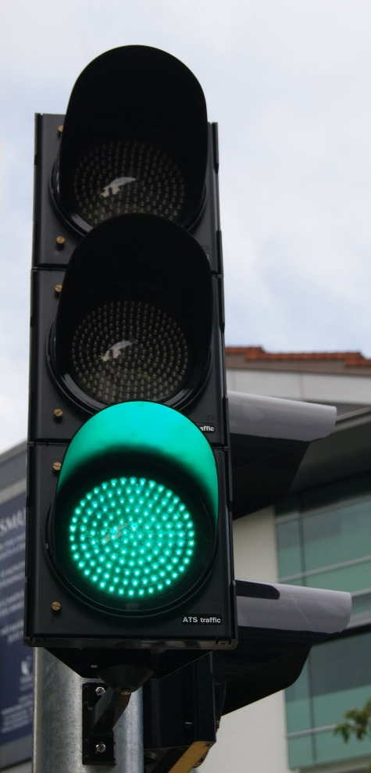
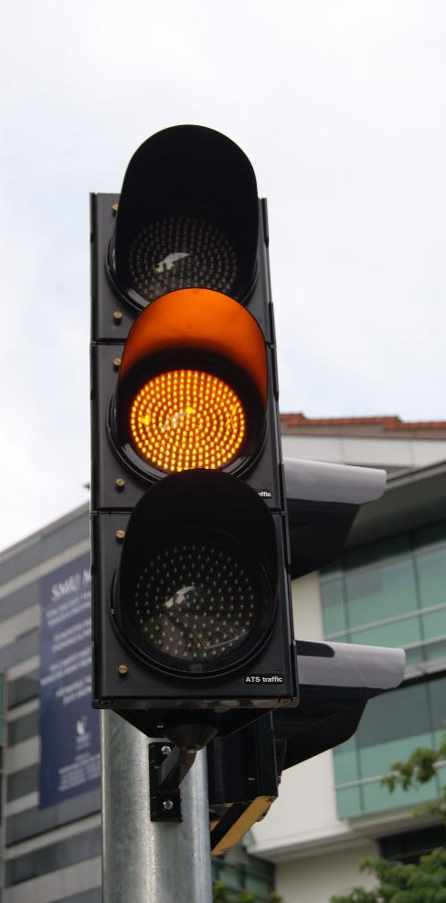
Public Domain
All works published from 1926*
Works published between 1926 and 1989
Works created after 1989*
Images courtesy of Jacklee at Wikimedia Commons.

Slide 24
Public Domain Tools
https://copyright.cornell.edu/publicdomain
https://librarycopyright.net/resources/digitalslider/index.html

Slide 25
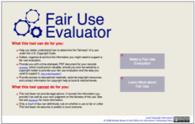
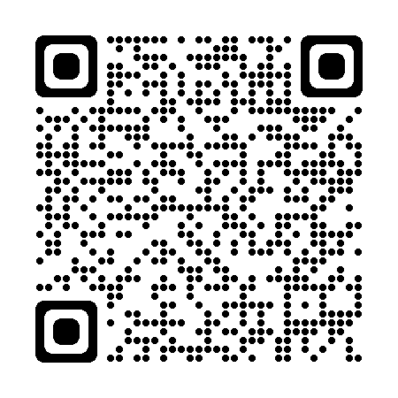
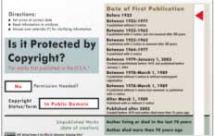
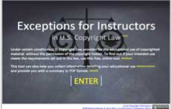
Helpful Tools
The Copyright Genie
Fair Use Evaluator
Public Domain Slider
Exceptions for Instructors eTool
https://librarycopyright.net/resources/

Slide 26
Framework - U.S. Copyright
Does it have copyright protection?
Does it have an existing license that covers my use?
Can I rely on an exemption, such as fair use?
Do I need to seek permission or purchase a license?
Rights
License
Exemption(s)
Permission

Slide 27
2. Does it have an existing license that covers my use?
Read all terms and agreements
Contracts and licenses will outweigh exemptions
Revenge of the End User Agreements/Terms of Service
Some company executive, somewhere - *laughs maniacally* “MUAHAHAHA”
Be aware of end dates
It might be free to use or “open access” but check license specifics
REMEMBER: Free to use does not mean you do not need to cite!

Slide 28
3. Do any user’s rights, such as fair use, apply?
Fair use (107)
Reproduction by libraries and archives (108)
First sale (109)
Exemption of certain performances and displays (110)
Section 110(1): Face-to-face teaching
Section 110(2) – TEACH Act: Mediated instructional activities transmitted via digital networks. A.K.A. online courses.

Slide 29
Fair Use Basics
Purpose
Nature
Amount
Transformativeness, Not-for-Profit/Profit, Use is for "criticism, comment, news reporting, teaching, (including multiple print copies for classroom use), scholarship or research"…or not?
Effect
Published/unpublished, factual/creative, consumable?
Limited and Reasonable. Not the “heart of the work.”
How much will the use harm the market for the work?

Slide 30
Illustrative Purposes Looking Closer at 17 USC § 107 (fair use)
“purposes such as criticism, comment, news reporting, teaching (including multiple copies for classroom use), scholarship, or research”
Favorable to academic uses, but difficult to apply.

Slide 31
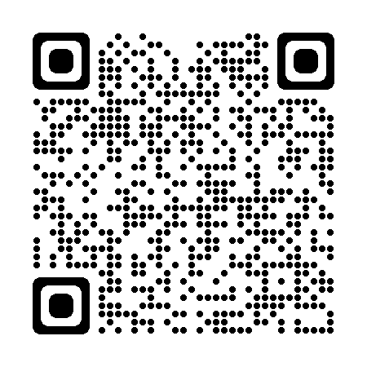
Fair Use Evaluator Highly Recommend Learning More About Fair Use and How to Use It

Slide 32
Framework - U.S. Copyright
Does it have copyright protection?
Does it have an existing license that covers my use?
Can I rely on an exemption, such as fair use?
Do I need to seek permission or purchase a license?
Rights
License
Exemption(s)
Permission
Reevaluate
Don’t use

Slide 33
ETDR HELP
Questions about these topics:
Graduation procedures, requirements and deadlines
ETDR fees
Embargo (request for delayed publication in K-REx)
Commencement
Questions about these topics:
Templates and formatting your ETDR
Reviewing your ETDR and supplemental files
Working with image or audio files
Converting your Word or LaTeX file to PDF
Logging into K-REx to submit your ETDR
Graduate School
119 Eisenhower Hall
785-532-6191 or 800-651-1816
grad@k-state.edu
IT Help Desk
Students Should Fill out the ETDR Request Form
785-532-7722 or 800-865-6143
helpdesk@k-state.edu

Slide 34
What Questions do You Have?
https://www.k-state.edu/copyright/

