Slide 1



Overview: Learning Progressions
What is a Learning Progression ?
Why is a Learning Progression important?
Kansas State Department of Education
ASSESSMENT LITERACY PROJECT
ASSESSMENT LITERACY PROJECT
1

Slide 2

What is a Learning Progression?
A set of en route building blocks
  Subskills and bodies of enabling knowledge
  Which students need to master to achieve a more distant curricular aim
Kansas State Department of Education
ASSESSMENT LITERACY PROJECT
ASSESSMENT LITERACY PROJECT
2

Slide 3

Let’s take a moment to think simply of learning progressions in terms of a basketball game. There are many parts to the game starting with dribbling the ball,
Kansas State Department of Education
ASSESSMENT LITERACY PROJECT
ASSESSMENT LITERACY PROJECT
4
Notes:
Cindy—cannot get photos to enlarge.

Slide 4

Passing the ball
Kansas State Department of Education
ASSESSMENT LITERACY PROJECT
ASSESSMENT LITERACY PROJECT
3

Slide 5

Shooting the ball and playing the game,
Kansas State Department of Education
ASSESSMENT LITERACY PROJECT
ASSESSMENT LITERACY PROJECT
5

Slide 6

And any good player needs to follow the game plan put together by the coach as well as…
Kansas State Department of Education
ASSESSMENT LITERACY PROJECT
ASSESSMENT LITERACY PROJECT
6

Slide 7

Be able to make the strategic adjustments created within the game.
Kansas State Department of Education
ASSESSMENT LITERACY PROJECT
ASSESSMENT LITERACY PROJECT
7

Slide 8

In the end, the coach, players, school and community have the societal expectation of a winning game. The same ideas work for understanding learning progressions.
Kansas State Department of Education
ASSESSMENT LITERACY PROJECT
ASSESSMENT LITERACY PROJECT
8

Slide 9
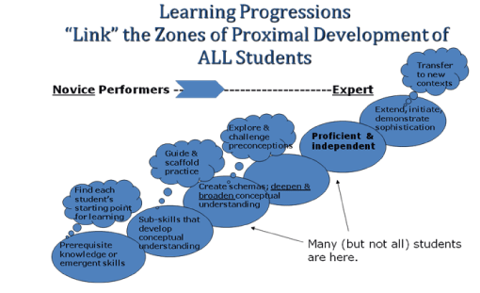
Conceptual View of Learning Progressions
Kansas State Department of Education
ASSESSMENT LITERACY PROJECT
ASSESSMENT LITERACY PROJECT
9
Notes:
A different example using a conceptual view of learning progressions (Hess, 2008) is one of overlapping learning zones along a continuum of learning.

Slide 10
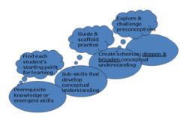
Novice
At the lower end of the progression are “novice” performers (at any grade level), who may (or may not) demonstrate the necessary prerequisite skills or understanding that is needed to be successful (e.g., essential skills/concepts that can be built upon over time).
Kansas State Department of Education
ASSESSMENT LITERACY PROJECT
ASSESSMENT LITERACY PROJECT
10

Slide 11
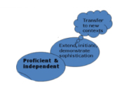
Expert
At the other end of the continuum are “expert” performers. Learning progressions descriptors help to “unpack” how learning might unfold for most students over time, moving from novice to expert performance
Kansas State Department of Education
ASSESSMENT LITERACY PROJECT
ASSESSMENT LITERACY PROJECT
11

Slide 12
Learning Progressions Construct Similarities
Let’s look a little deeper into Learning Progressions. According to Michael T. Battista, there are common characteristics of the LEARNING PROGRESSIONS construct. Within the research literature, descriptions of the LEARNING PROGRESSIONS construct possess both differences and similarities. Let’s take a moment to first look at similarities:
Kansas State Department of Education
ASSESSMENT LITERACY PROJECT
ASSESSMENT LITERACY PROJECT
12

Slide 13

Research Based
LEARNING PROGRESSIONS "are based on research syntheses and conceptual analyses” (Smith et al., 2006, p. 1); "Learning progressions should make systematic use of current research on children’s learning " (NRC, 2007, p. 219).
Kansas State Department of Education
ASSESSMENT LITERACY PROJECT
ASSESSMENT LITERACY PROJECT
13

Slide 14

Anchored
LEARNING PROGRESSIONS "are anchored on one end by what is known about the concepts and reasoning of students. … At the other end, learning progressions are anchored by societal expectations. … [LEARNING PROGRESSIONS also] propose the intermediate understandings between these anchor points that contribute to building a more mature understanding" (NRC, 2007, p. 220).
Kansas State Department of Education
ASSESSMENT LITERACY PROJECT
ASSESSMENT LITERACY PROJECT
14

Slide 15
Organized
LEARNING PROGRESSIONS focus on core ideas, conceptual knowledge, and connected procedural knowledge, not just skills. LEARNING PROGRESSIONS organize "conceptual knowledge around core ideas" (NRC, 2007, p. 220). LEARNING PROGRESSIONS "Suggest how well-grounded conceptual understanding can develop" (NRC, 2007, p. 219).
Kansas State Department of Education
ASSESSMENT LITERACY PROJECT
ASSESSMENT LITERACY PROJECT
8

Slide 16
Multiple Sequences
LEARNING PROGRESSIONS "recognize that all students will follow not one general sequence, but multiple (often interacting) sequences" (NRC, 2007, p. 220).
Kansas State Department of Education
ASSESSMENT LITERACY PROJECT
ASSESSMENT LITERACY PROJECT
16

Slide 17
Differences
Differences: There are several differences in how the learning progressions construct is used in the literature.
Kansas State Department of Education
ASSESSMENT LITERACY PROJECT
ASSESSMENT LITERACY PROJECT
17

Slide 18

Time Spans
LEARNING PROGRESSIONS differ in the time spans they describe. Some progressions describe the development of students' thinking over a span of years; others describe the progression of thinking through a particular topic or instructional unit.
Kansas State Department of Education
ASSESSMENT LITERACY PROJECT
ASSESSMENT LITERACY PROJECT
18

Slide 19
Grain Size
LEARNING PROGRESSIONS differ in the grain size of their descriptions. Some are appropriate for describing minute-to-minute changes in students' development of thought, while others better describe more global progressions through school curricula.
Kansas State Department of Education
ASSESSMENT LITERACY PROJECT
ASSESSMENT LITERACY PROJECT
19

Slide 20





Different Audiences
LEARNING PROGRESSIONS differ in the audience for which they are written. Some LEARNING PROGRESSIONS are written for researchers, some for standards writers, some for assessment developers (formative and summative), and some for teachers.
Kansas State Department of Education
ASSESSMENT LITERACY PROJECT
ASSESSMENT LITERACY PROJECT
20

Slide 21
Learning Progressions
Differ in how they describe student learning.
Focus on numerically "measuring" student progress
While others focus on describing the nature or categories of students' cognitive structures and reasoning
Kansas State Department of Education
ASSESSMENT LITERACY PROJECT
ASSESSMENT LITERACY PROJECT
21

Slide 22

Overview
Kansas State Department of Education
ASSESSMENT LITERACY PROJECT
ASSESSMENT LITERACY PROJECT
22

Slide 23
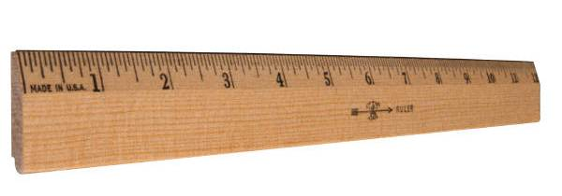
The most important rule regarding this conceptual view is that long-term memory is not about a collection of skills and knowledge, but connections among skills and knowledge built upon over time.
Kansas State Department of Education
ASSESSMENT LITERACY PROJECT
ASSESSMENT LITERACY PROJECT
23

Slide 24
What a Learning Progression is Not
It is not unerringly accurate.
It is not necessarily suitable for all students.
It is not the one and only way for students to master the targeted curriculum.
It is not necessarily better just because it is complex.
Kansas State Department of Education
ASSESSMENT LITERACY PROJECT
ASSESSMENT LITERACY PROJECT
24

Slide 25
Why Learning Progressions are Important
By identifying the component knowledge and skills that constitute a curricular outcome, teachers can have a better idea of what to teach and test and when to teach and test it.
Learning Progressions can help teachers design instructionally sensitive tests that more specifically identify points of student misunderstanding and guide the teacher in designing effective re-teaching lessons.
Kansas State Department of Education
ASSESSMENT LITERACY PROJECT
ASSESSMENT LITERACY PROJECT
25

Slide 26

Rubric/Scoring Guides
Teachers can design learning progressions for scoring guides or rubrics. For example, a scoring guide or rubric for an open-ended question might be organized in a sequence to represent to goal.
Kansas State Department of Education
ASSESSMENT LITERACY PROJECT
ASSESSMENT LITERACY PROJECT
26

Slide 27
A Scoring Progression Rubric
0 No response.
1 Student does respond but response is off- topic or inaccurate and incomplete.
2 Response is accurate but incomplete.
3 Response is both accurate and complete.
Kansas State Department of Education
ASSESSMENT LITERACY PROJECT
ASSESSMENT LITERACY PROJECT
27

Slide 28
Constructing a Learning Progression:
Key Point #1
“Thoughtful, well-intentioned educators can undertake task analyses for an identical curricular outcome, yet end up with strikingly different learning progressions. Happily, almost any carefully conceived learning progression is more likely to benefit students than teachers' off-the-cuff decision making.”
        --W. James Popham, Ph.D.
Kansas State Department of Education
ASSESSMENT LITERACY PROJECT
ASSESSMENT LITERACY PROJECT
28

Slide 29
Constructing a Learning Progression:
Key Point #2
Learning Progressions should contain only those subskills and bodies of enabling knowledge that represent the most significant building blocks of the targeted outcome to be mastered.
Kansas State Department of Education
ASSESSMENT LITERACY PROJECT
ASSESSMENT LITERACY PROJECT
29

Slide 30
Constructing a Learning Progression:
Key Point #3
“Isolating and sequencing the building blocks underlying students' attainment of a challenging curricular aim requires rigorous cerebral effort.”
        -- W. James Popham, Ph.D.
Kansas State Department of Education
ASSESSMENT LITERACY PROJECT
ASSESSMENT LITERACY PROJECT
30

Slide 31

Simplicity vs. Complexity
Finally, a learning progression is not necessarily better just because it is complex. As a matter of fact, if the learning progression is too complex it is not likely to be used at all. And that defeats the purpose for it.
Kansas State Department of Education
ASSESSMENT LITERACY PROJECT
ASSESSMENT LITERACY PROJECT
31

Slide 32
Summary
A learning progression represents the best thinking of a teacher or teachers about the component knowledge content and skill development needed for the student to master a particular curricular outcome or aim.
It helps the teacher see the order in which the component parts should be taught.
It is a useful tool to know when to test and how to construct test items that are instructionally sensitive.
Kansas State Department of Education
ASSESSMENT LITERACY PROJECT
ASSESSMENT LITERACY PROJECT
32

Slide 33

For More Information
Learning Progression
Activities
Glossary
and
Resources
Kansas State Department of Education
ASSESSMENT LITERACY PROJECT
ASSESSMENT LITERACY PROJECT
33

