Slide 1



Power Transfer
Gregg Hadley, PhD
Charlie Griffin, M.S.

Slide 2
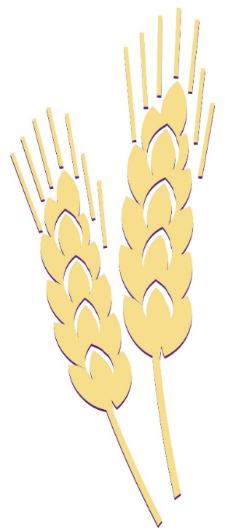
Tug of War

Slide 3
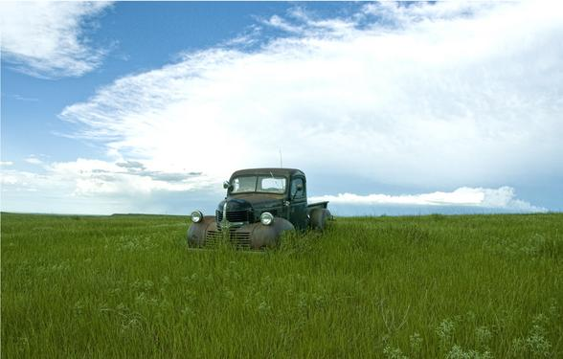
“Don’t Put Me Out to Pasture” – Mom and Dad

Slide 4
“I Am Just a Hired Hand” – Daughter and Son

Slide 5
“Don’t Forget to Send the Checks!” – Mom and Dad

Slide 6
“You Want Me to do What?” – Daughter and Son

Slide 7
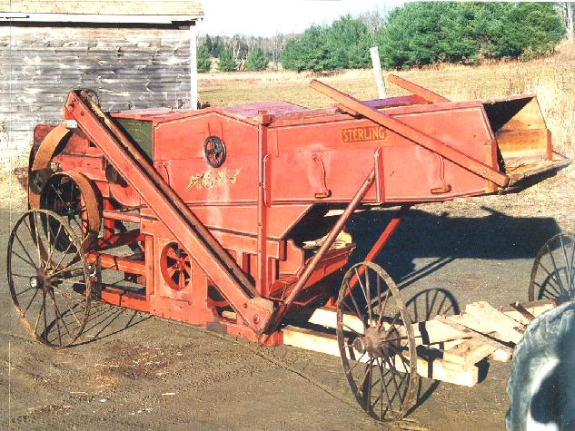
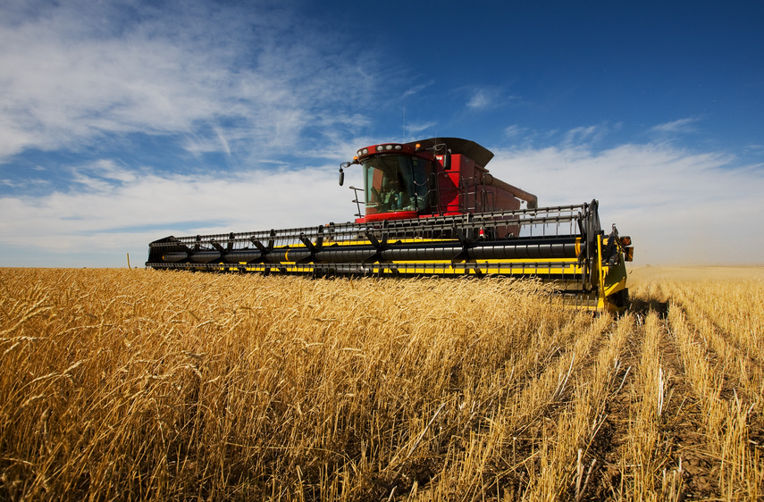
“The Times Have Changed.” – Daughter and Son

Slide 8
“It’s My Money!” – Mom and Dad

Slide 9
Tug of War

Slide 10
Generally Speaking
Next Generation
Youth
Recent education
More energy
More risk tolerant
Latest methods and technology
Energy abundance
Dreams and aspirations
Current Generation
Wisdom
Farming experience
More wealth
Less risk tolerant
Tied and true
Wealth abundance
Dreams and aspirations

Slide 11
Talk About Your Dreams and Aspirations
They May Be More Similar Than You Thought,
and Can Become a Shared Vision!

Slide 12
With a Common Vision, the Differences become Compliments
Next Generation
Youth
Recent education
More energy
More risk tolerant
Latest methods and technology
Energy abundance
Dreams and aspirations
Current Generation
Wisdom
Farming experience
More wealth
Less risk tolerant
Tied and true
Wealth abundance
Dreams and aspirations

Slide 13
Instead of a Tug of War…

Slide 14
Power Transfer Planning
Incredibly important
How do we divide the work, management and leadership responsibilities?
  How should they change over time?
  When should they change?
Disagreements over power transfer is a common reason for failed succession

Slide 15
Typical Career Progression
Worker
Manager
Leader

Slide 16
The Power Transfer Planning Process
1) Determine your shared vision

Slide 17
The Power Transfer Planning Process
2) List the skills, attributes, experience and training of both the current and next generation.

Slide 18
The Power Transfer Planning Process
3) List and categorize all of the work, management and leadership activities on your operation.

Slide 19
The Power Transfer Planning Process
4) Divvy the work, management and leadership experience as dictated by the skills, attributes, experience and training
  The current generation and the next generation should have some work, management and leadership power and responsibilities
  Initially, the current generation will have relatively more management and leadership responsibility
  The next generation will gain more management and leadership responsibility over time
    Time based decision
    Performance based decision
    Make sure all understand the plan

Slide 20
Once the Power Transfer Plan has been Created
Revisit the plan at a family business meeting on a semiannual or annual basis
Discuss any shortfalls in expectations
Reward those who have earned increase power with it!

Slide 21
In Closing
Having a plan for power transfer is important
Many farm successions fail due to power transfer issues
Work, management, and leadership responsibilities should be allocated based on skills, attributes, experience and training
Over time, the next generation should gain increased management and leadership responsibilities
Discuss the power transfer process at family business meeting

