Slide 1
Rural Business Succession Planning
Strengthening Rural Families Education Series
Gregg Hadley, PhD
Assistant Director – Agriculture, Natural Resources and Community Development
K-State Research and Extension
ghadley@ksu.edu
(785) 532-5838

Slide 2
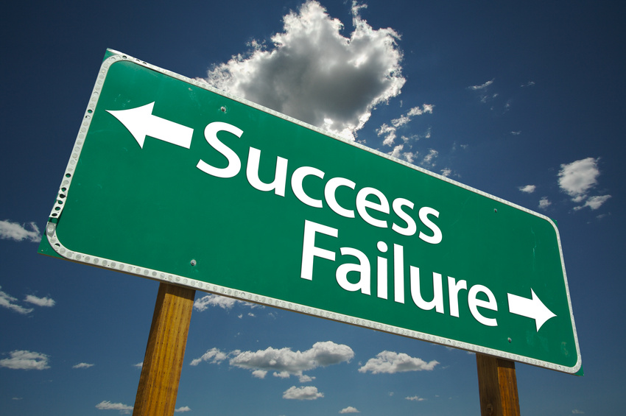
Our Goal
Notes:
Our goal is to have your family business - whether it be a farm, ranch, agribusiness or main street business – successfully transfer and be prosperous for another generation!

Slide 3
An Ongoing Family Business & A Happy Family
Notes:
What does success look like: a successful, multigenerational family business and the ability for the family to still gather and enjoy each other’s company as family members should.

Slide 4
“It’s Complicated!”
Grandma and Grandpa
(The Past Generation)
The Brothers’ and Sisters’ Kids (The Future)
Mom and Dad
(The Current Generation)
The Brothers’ and Sisters’
Spouses
Farming Brother and Sister (The Next Generation)
Non-Farming
Brother and Sister
Notes:
However, it isn’t always simple. There are many different players in succession planning. Some will have different perspectives of the farm. Some will refer to it as the elder that must be maintained, cherished, and respected. Others in the family may see it as a child that needs careful nurturing to become something great in the future. Others may merely see it as a collection of assets that can be used to generate wealth. Others may see it as a boat anchor that keeps the family boat from moving forward in life. Some may see the farms as a mistress that steals time away from family members.

Slide 5
Succession Planning Steps
Who should be involved?
How will we work together to develop a succession plan?
What are our vision, mission and long term goals for our family business?
What does this mean for the business?
Where do I fit in?
Will this work?
How do we transfer the business assets?

Slide 6
Preparing to Plan
Who should be involved?
How will we work together to develop a succession plan?

Slide 7
Developing the Plan
What are our vision, mission and long term goals for our family business?
What does this mean for the business?
Where do I fit in?
Will this work?
How do we transfer the business assets?

Slide 8
Succession Planning Steps
Who should be involved?
How will we work together to develop a succession plan?
What are our vision, mission and long term goals?
What does this mean for the business?
Where do I fit in?
Will this work?
How do we transfer the business assets?

Slide 9
Who’s At The Table?
Notes:
Who should be involved, or, in other words, who should be at the table.

Slide 10
Grandma and Grandpa
(The Past Generation)
The Brothers’ and Sisters’ Kids (The Future)
Mom and Dad
(The Current Generation)
The Brothers’ and Sisters’
Spouses
Farming Brother and Sister (The Next Generation)
Non-Farming
Brother and Sister
Notes:
Some say only blood relatives should be at the table, I say all, including the in-laws, need to be at the table. It has been my experience that those who aren’t invited to the table often to farm more damage to succession planning.

Slide 11
Other People
Communication specialists
Conflict management experts
Counselors
Mediators
Financial analysts
Lawyers
Succession planning facilitator

Slide 12
Succession Planning Steps
Who should be involved?
How will we work together to develop a succession plan?
What are our vision, mission and long term goals for our family business?
What does this mean for the business?
Where do I fit in?
Will this work?
How do we transfer the business assets?

Slide 13
Planning Together
What is the purpose of our succession planning?
What obstacles are in our way?
How will we work together while planning?

Slide 14
Succession Planning Team Agreement Document

Slide 15
An Agreement That States…
Our shared values
Our planning vision
Our planning mission
Our planning goals
Our planning obstacles
Our planning rules

Slide 16
Shared Values
Diversity
Accountability
Commitment
Respect
Empowerment
Integrity
Fun
Passion
Balance
Collaboration
Quality
Innovation
Consistency

Slide 17

Planning Vision
At then end of our planning, we want to see…
Notes:
A short statement that explains what outcomes your family would like to see as a result of planning together.

Slide 18
Planning Mission
A short description about how your family will achieve the shared vision
  “We will achieve our vision by…”
Notes:
A short description that describes how you will achieve the desired outcomes.

Slide 19

Planning Goals
Notes:
The goals your family must achieve to realize your planning vision.

Slide 20


Planning Obstacles
Pet
Peeves
Notes:
In order to come together as a planning team, and to have a successful succession, it is important to talk about all of the obstacles you must overcome to be successful. Obstacles may include time contraints, pet peeves, or even skeletons in the closet. If they aren’t dealt with near the beginning, they may come up near the end or during an intensive part of the planning., In either situation, they can be quite damaging to the process and the succession.

Slide 21

Planning Rules
Notes:
Based on the values, vision, mission, goals and obstacles – the team is ready to determine the rules they will follow when planning.

Slide 22
Succession Planning Steps
Who should be involved?
How will we work together to develop a succession plan?
What are our vision, mission and long term goals for our family business?
What does this mean for the business?
Where do I fit in?
Will this work?
How do we transfer the business assets?

Slide 23




Family Business Strategic Planning
Values
Mission
Vision
Mission

Slide 24
Succession Planning Steps
Who should be involved?
How will we work together to develop a succession plan?
What are our vision, mission and long term goals for our family business?
What does this mean for the business?
Where do I fit in?
Will this work?
How do we transfer the business assets?

Slide 25
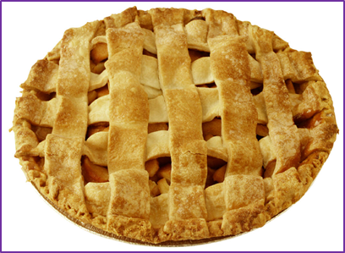
Strategic Plan Implementation
Increasing the pie
  Take advantage of under utilized capacity?
  Improve efficiency?
  Expand present operations?
  Add on new operations?
How?
When?

Slide 26
Write It Down

Slide 27
Succession Planning Steps
Who should be involved?
How will we work together to develop a succession plan?
What are our vision, mission and long term goals for our family business?
What does this mean for the business?
Where do I fit in?
Will this work?
How do we transfer the business assets?

Slide 28
Where Do I Fit In?

Slide 29
Who Does What?
Inventory the work, management and leadership needs of the future family business
Inventory the knowledge, skills, likes and dislikes of the family members
Who would be best/worst for what?

Slide 30
Some Even Suggest…

Slide 31
Work, Management and Leadership Responsibilities
Important to discuss the work, management and leadership roles
  Who’s the boss?
  How will this change over time?
  When will this change over time?

Slide 32
Write It Down

Slide 33
Succession Planning Steps
Who should be involved?
How will we work together to develop a succession plan?
What are our vision, mission and long term goals for our family business?
What does this mean for the business?
Where do I fit in?
Will this work?
How do we transfer the business assets?

Slide 34
Assessing the Plan
Take your family business plan to experts for feedback
  Operations specialists
  Management specialists
  Risk specialists
  Financial analysts

Slide 35
Succession Planning Steps
Who should be involved?
How will we work together to develop a succession plan?
What are our vision, mission and long term goals for our family business?
What does this mean for the business?
Where do I fit in?
Will this work?
How do we transfer the business assets?

Slide 36
Estate Plan
Once you have your family business plan analyzed
  Show it to your estate planning attorney
  Request that an estate plan be developed that complements your family business plan

Slide 37
Things Just Don’t End With The Business and Estate Plan
Notes:
Review the plan at least annually at a family business meeting

Slide 38
Questions?

