Slide 1
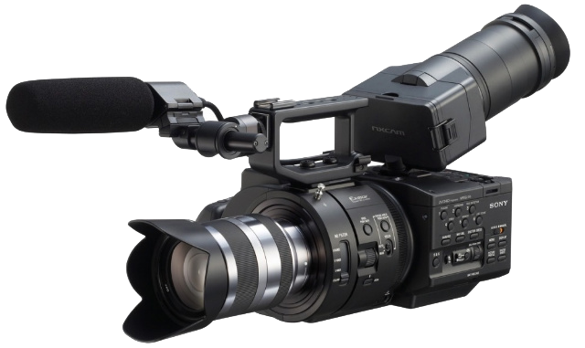
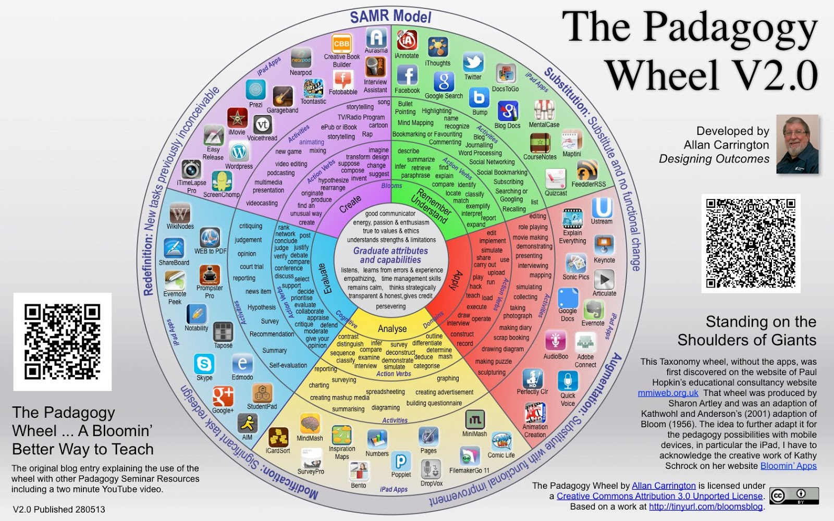
Video Use Pedagogy
Presentation by
Brent Anders M.Ed.,
Senior Electronic Media Coordinator
Kansas State University

Slide 2
Uses of video
To capture classroom presentation (for later review by instructor, student, and/or use as flipped-classroom)
To show/explain concepts
To motivate/grab attention and focus
To provide a case study/scenario
Student created content (process as well as product)
To bring in guest lectures/presenters
For live, online presentation/interaction

Slide 3
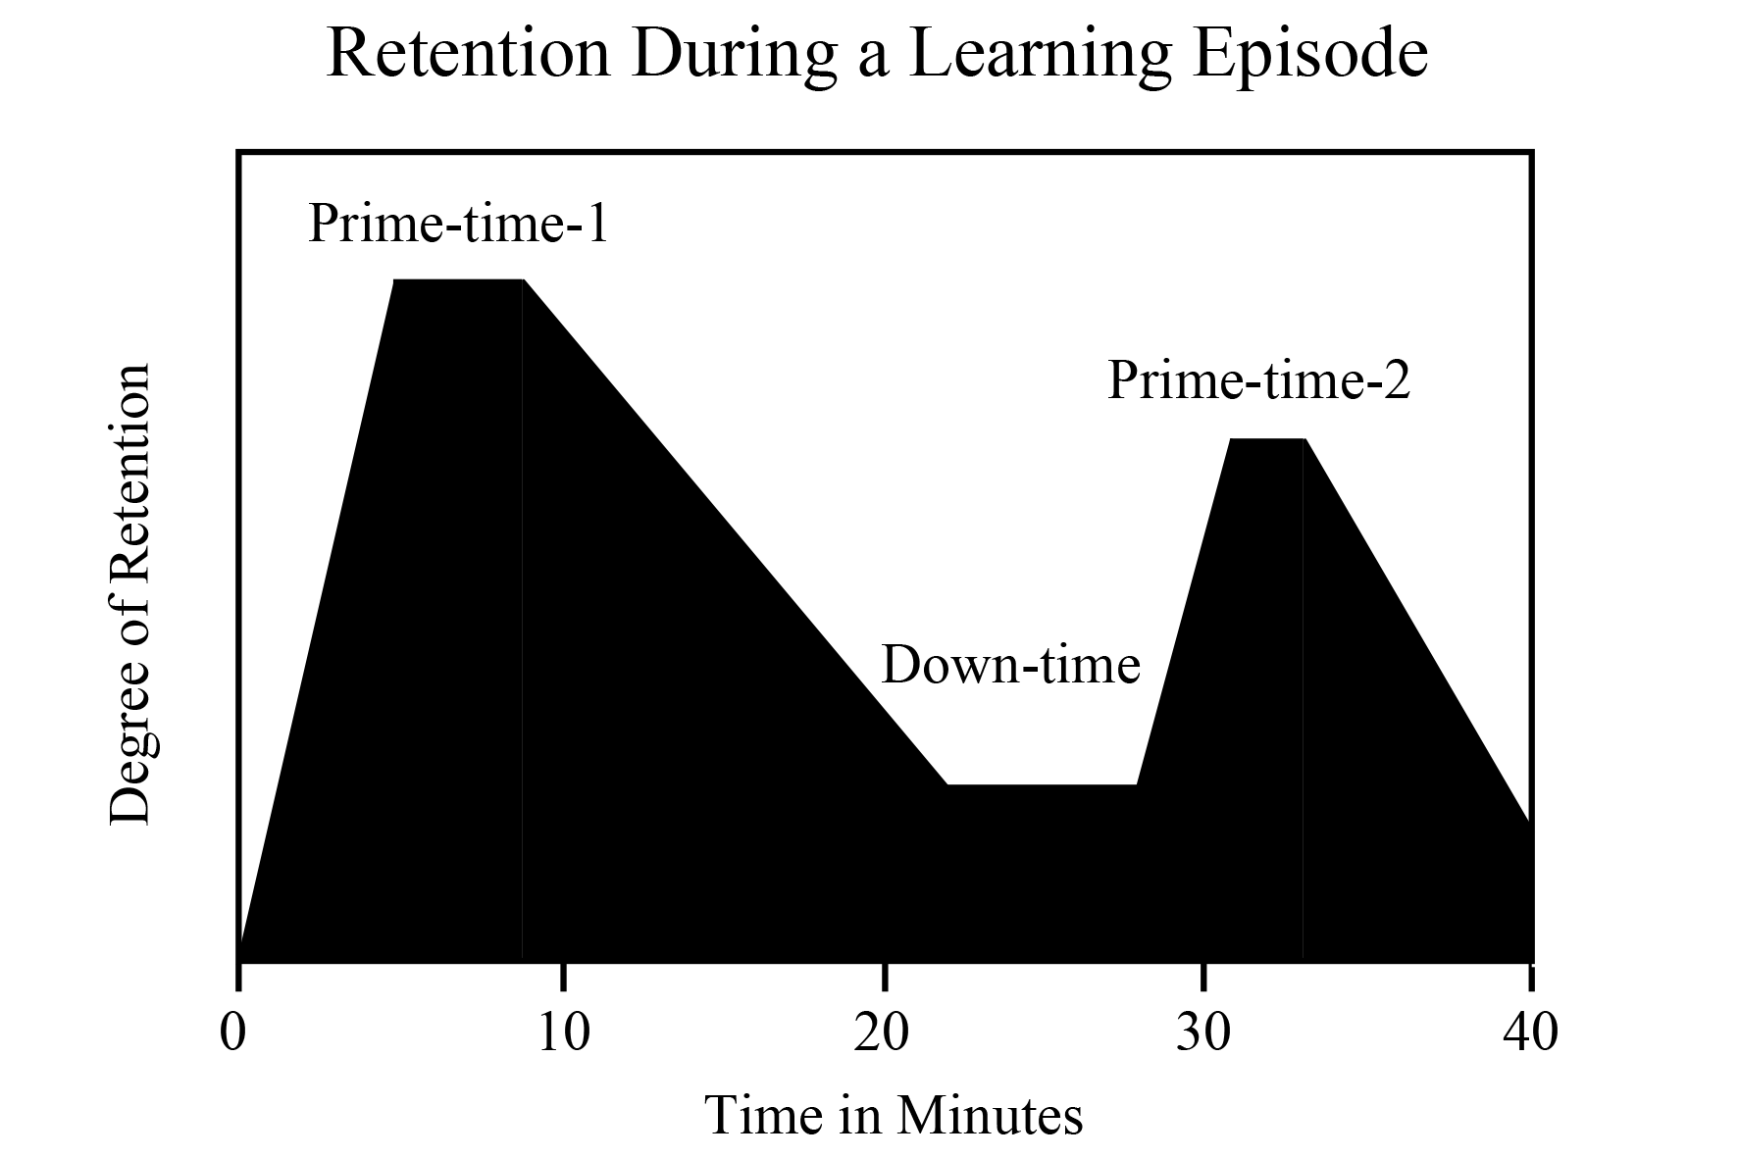
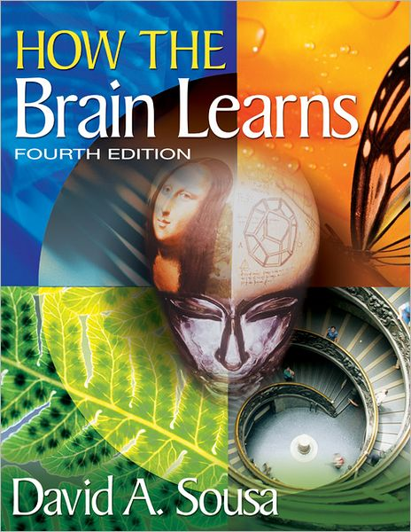
“How the Brain Learns,” by David Sousa

Slide 4
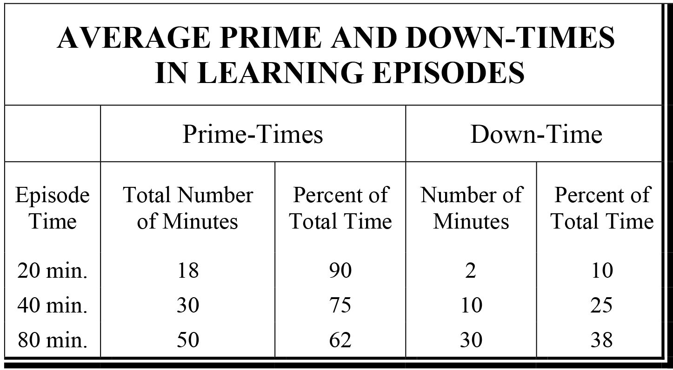
“How the Brain Learns,” by David Sousa

Slide 5
15 minute chunking
“In his meta-analysis of attention spans in lectures, Bligh (2000) proposes approximately twelve minutes as the optimum period of time in which students can be expected to focus on one idea or subtheme. In terms of planning our time, then, it might be useful to think about ways of “chunking” lectures into a series of fifteen-minute expositions interspersed with a number of linking or bridging activities” (Brookfield, 2006)
“What’s the Use of Lectures?” by Bligh, D. A. as cited by “The Skillful Teacher” by Stephen D. Brookfield

Slide 6
Questions
?
REVIEW
Multiple uses for video (both in class and student creation)
15 minute chunking appears to be the most recommended size

