Slide 1
Update and Progress Report on Higher Education
Joint Meeting of House and Senate Education Committees
January 22, 2014

Slide 2
Board of Regents
Nine Member Board Appointed by the Governor and Confirmed by the Senate
Current Board Members
  Shane Bangerter – Dodge City, 2013
  Ann Brandau-Murguia – Kansas City, 2013
  Mildred Edwards – Wichita, 2010
  Tim Emert – Independence, 2010
  Fred Logan (Chair) – Leawood, 2011
  Ed McKechnie – Arcadia, 2010
  Robba Moran – Hays, 2011
  Helen Van Etten – Topeka, 2013
  Kenny Wilk (Vice-Chair) – Lansing, 2011

Slide 3
Board of Regents Responsibilities
Govern six state universities and Coordinate 32 public institutions
  6 State Universities and 1 Municipal University
  19 Community Colleges
  6 Technical Colleges
Administer
  State Student Financial Aid
  Adult Education Programs
  GED
  Career Technical Education Programs
  Kan-ed Distance Learning Program
Regulate
  Private & Out-of-State Institutions

Slide 4
Student Enrollment in Kansas Public Higher Education
(Fall Headcount)
Source: KHEER
Notes:
NOTE: This is a presentation of 2013 data (2014 numbers will be available in October 2014).
KHEER = Kansas Higher Education Enrollment Report, collected by KBOR

Slide 5
Academic Year Enrollment
Source: KHEDS Academic Year Collection
Notes:
32 Institutions In KBOR Sectors 1-4

Slide 6
State Appropriations for Higher Education
Source: Governor's Budget Office
Notes:
NOTE: This is presenting what the Legislature appropriated; we are currently in Fiscal Year 2014.
Source: Governor's Budget Report (FY 2007-FY 2014), Schedules 2.2, 3.2, 4.2, 5.2, Board of Regents
Source: Governor's Comparison Report (FY 2014), Schedules 2.2, 3.2, 4.2, 5.2, Board of Regents
“Other Higher Education Programs” includes: Adult Basic Education, Student Financial Assistance, Debt Services, Nursing Grants, and (FY 2013 and 2014 only) the Governor’s High School Tech Ed Assistance Program.

Slide 7
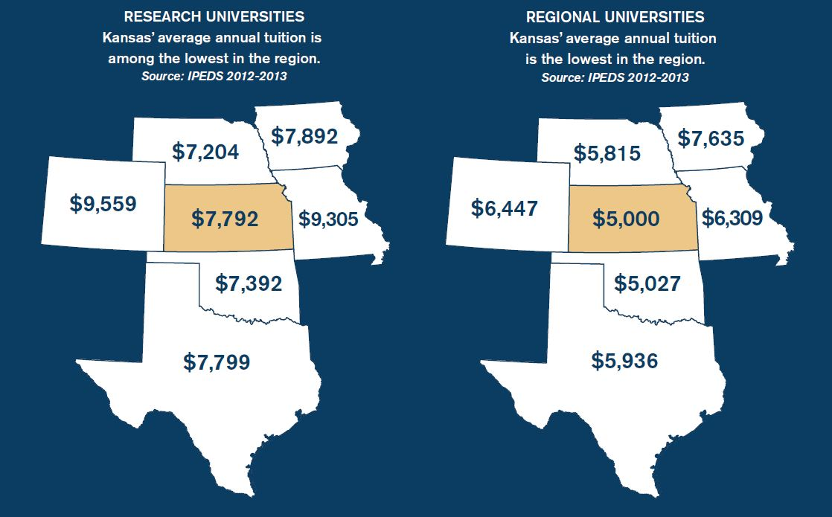

Slide 8
2012 Educational Debt
Public University Graduates
Source: College InSight
Notes:
NOTE: This data is provided to us by College InSight; 2012 numbers will be available in late-October 2013.
(True Citation: The Institute for College Access & Success, College InSight)
Numbers:
2011 Education Debt - University Graduates - Public
Kansas $22,589 (62%)
Colorado $22,054 (56%)
Oklahoma $20,490 (53%)
Missouri $22,590 (67%)
Nebraska $22,222 (60%)
Nation $23,065 (57%)
2012 Education Debt - University Graduates – Public
Kansas - $23,046 (57%)
Colorado - $23,987(52%)
Oklahoma - $22,374 (52%)
Missouri - $22,824 (66%)
Nebraska - $23,982 (61%)
Nation - $24,443 (58%)

Slide 9
2014 Legislative Issues
Authority To Enter A MHEC Interstate Reciprocity Agreement for Online Education
Authority to Participate in MHEC Property Insurance Program
Authority to Utilize Education Building Fund for Short Term Debt Service
Proposal to Streamline Procurement Process for Architectural and Engineering Services
Resolution in Support of Board Regents’ Strategic Plan
Carryover Bill - ESU Apartment Sale and
Land Exchange – KU/KU Endowment (HB 2396)

Slide 10
Foresight 2020
KBOR Strategic Goals
Increase higher education attainment – 60% percent of adult population with a postsecondary certificate/credential, associate, or bachelor degree by 2020
Improve alignment of higher education with needs of the economy
Ensure state university excellence

Slide 11
Board Initiatives to Advance
Foresight 2020
Accelerating Opportunities for Kansans
Retention and Graduation Rates
Focus on Numbers of Graduates
Attract Adults Near Completion
Transfer and Articulation
Increased Emphasis on Technical Education
Collaboration with Commerce and Labor
Focus on University Research

Slide 12
Number of adult education participants and percentage of participants transitioning
Enrollment in Adult Education Programs
Adult Education Students Transitioning to Postsecondary
Within Three Years
Trend Reversed: the number of Kansans enrolled in adult education is the highest it has been since 2004, due to the introduction of enrollment targets, updated performance-based funding policies, and a new vision focused on college and career readiness.

Slide 13
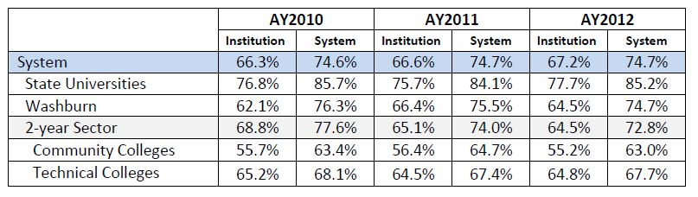
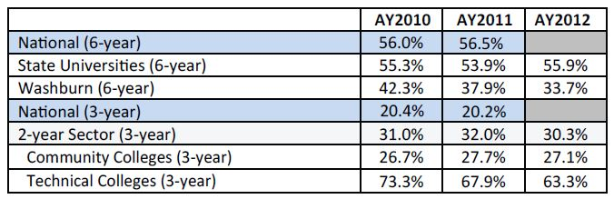
Retention Rates
Graduation Rates
Notes:
FOR ANDY: Across the state, institutions are actively working to address retention rates with strategies such as early alert systems, supplemental instruction, and enhanced advising strategies. Financial aid programs and new living communities have also been established. Additionally, significant student engagement and course redesign is underway, including freshman seminar courses taught by senior faculty.
Twenty-five (25) institutions, including all six state universities, chose to include retention rates as one of the six selected indicators in their 2014 Performance Agreements, which govern the next three years.

Slide 14
Higher Education in Kansas
32 public higher education institutions
In 2013, 258,934 students enrolled
Awarded 42,130 degrees (AY2013)
  10,595 certificates system wide
  9,283 associate degrees system wide
  15,970 bachelor’s degrees
  4,934 master’s degrees
  1,348 doctoral degrees
Source: KHEDS AY2013
Notes:
NOTE: This is a presentation of academic year 2012-2013 data.
KHEDS = Kansas Higher Education Data System, collected by KBOR
The number of degrees awarded in 2013 increased almost 4% (3.7%) over the previous year (2012).
In 2013, there were over 12% (12.5%) more degrees awarded than in 2010.

Slide 15
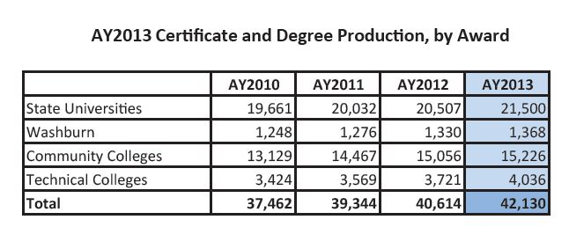
Number of certificates and degrees awarded
In AY2013, the Kansas postsecondary system awarded 42,130 credentials – putting the state above goal projections which outline the number that will need to be awarded annually to increase to 60 percent the number of Kansas adults who have a certificate, associate or bachelor’s degree by 2020.
AY2013 Certificate and Degree Production
Notes:
FOR ANDY: Of the 42,130 credentials awarded, 25% were certificates, 22% were associate degrees, 38% were bachelor’s degrees, 12% were master’s degrees, and 3% were doctoral degrees.

Slide 16
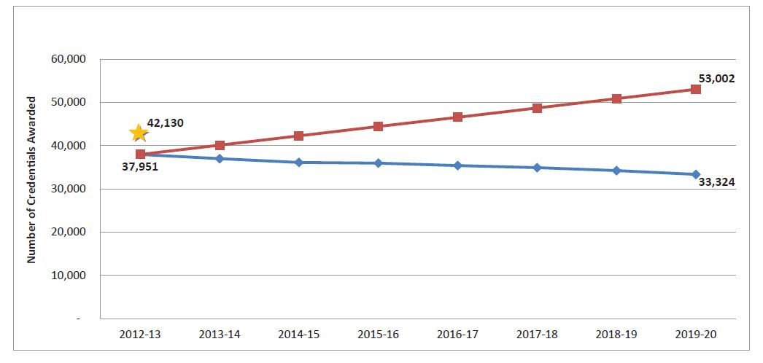
Attainment Model Pathway

Slide 17
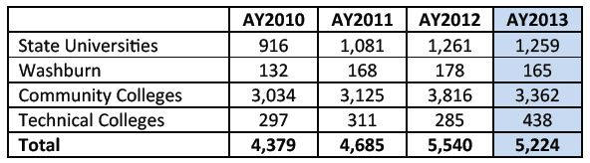
Number of adults returning to college to complete a certificate or degree
Adults with Some College Credit but No Degree Returning
Improvement: While there was a decrease in AY2013, there has been a 37.4 percent increase since AY2010 in this student population at the state universities, a 47.5 percent increase at the technical colleges, and a 10.8 percent increase at the community colleges.
Notes:
FOR ANDY: Recruiting these students is a key strategy to meeting our 60% goal by 2020.

Slide 18
University Engineering Initiative Act
Goal: increase the combined number of engineering graduates at the three research universities to 1,365 annually by 2021 (from a baseline of 875 in 2008).
19% increase in engineering enrollments (since 2008)
$15M in scholarships for engineering students (AY2013)
Last year, there were a total of 1,017 engineering graduates:
Kansas State University: 471
University of Kansas: 338
Wichita State University: 208
Notes:
More information about the University Engineering Initiative Act is available on our website: kansasregents.org/university_engineering_initiative

Slide 19
Kansas Nursing Initiative
Goal: Established in 2006, the higher education system was charged with increasing the number of nursing students by 250 per year
The state’s nursing programs now admit a combined annual average of 437 additional students, surpassing the Legislature’s intended goal by 75 percent.
Improvements to facilities has resulted in a strong nursing education infrastructure:
  218 new full-time faculty and 217 new part-time faculty
  27 new human patient simulators
Notes:
More information about the Kansas Nursing Initiative is available on our website: kansasregents.org/kansas_nursing_initiative

Slide 20
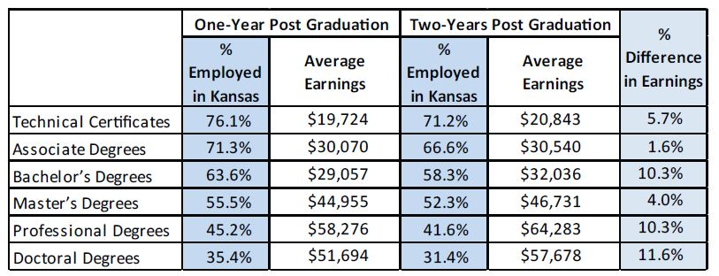
Percent of graduates employed in Kansas and
Average wages earned by graduates
Research conducted Donna Ginther, Professor of Economics and the Director of the Center for Science Technology & Economic Policy at the Institute for Policy & Social Research at the University of Kansas, links Kansas postsecondary data with current labor data, provided by the Kansas Department of Labor.
Notes:
FOR ANDY: As you see here, employment rates in Kansas fall with the level of degree. This is because graduates at the bachelor’s, master’s, professional and doctoral levels are more in demand in the national market. Additionally, you see here that salaries increase more rapidly for bachelor’s and advanced degrees than technical certificates or associate degrees. This is consistent with the researcher's expectations.
For this year’s reporting, Dr. Ginther improved her methodology by excluding students who are continuing on with their education full-time and therefore are not available for full-time employment. Because of this major change, we are not comparing these findings to the results published last year and instead consider this baseline data.

Slide 21
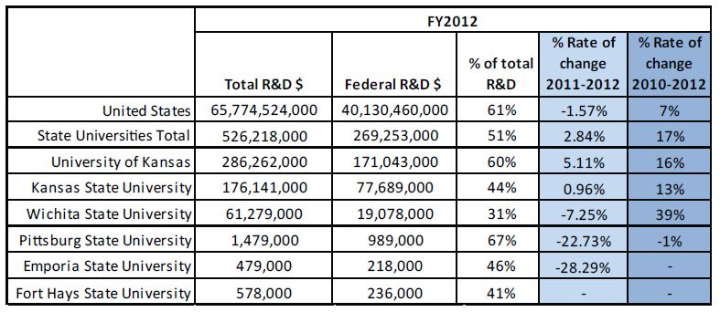
Increase in proportion of federal research dollars awarded
Federal Research & Development Dollars Awarded,
Percent of Total, and Percent Rate of Change

Slide 22
Study of Freshmen Admitted As Exceptions To Qualified Admissions
Retention Rates of Those Meeting QA
  2010 to 2011 = 6072 of 7609 (80%) Resident
  1422 of 1851 (77%) Non-Res
  2011 to 2012 = 6124 of 7647 (80%) Resident
  1439 of 1871 (77%) Non-Res
  2012 to 2013 = 6403 of 8019 (80%) Resident
  1517 of 2015 (75%) Non-Res

Slide 23
Study of Freshmen Admitted As Exceptions To Qualified Admissions
Retention Rates of Exceptions to QA
  2010 to 2011 = 256 of 457 (56%) Resident
  2011 to 2012 = 226 of 447 (51%) Resident
  2012 to 2013 = 271 of 488 (56%) Resident
  148 of 259 (57%) Non-Res

Slide 24
Study of Transfers Admitted As Exceptions To Qualified Admissions
Retention Rates of Transfers Who Met QA
  2011 to 2012 = 4469 of 6186 (72%) Resident
  2368 of 2937 (81%) Non-Res
  2012 to 2013 = 4470 of 5900 (76%) Resident
  2150 of 2743 (78%) Non-Res

Slide 25
Study of Transfers Admitted As Exceptions To Qualified Admissions
Retention Rates of Transfer Exceptions
  2011 to 2012 = 305 of 573 (53%) Resident
  150 of 257 (58%) Non-Res
  2012 to 2013 = 346 of 632 (55%) Resident
  175 of 298 (59%) Non-Res

Slide 26
Study of Students Admitted As Exceptions To Qualified Admissions
Graduation Rates of Those Meeting QA
  2011 (2005) = 4790 of 8150 (59%) Resident
  2012 (2006) = 4661 of 8148 (57%) Resident
  2013 (2007) = 4851 of 8195 (59%) Resident
Graduation Rates of Exceptions
  2011 (2005) = 116 of 462 (25%) Resident
  2012 (2006) = 108 of 515 (21%) Resident
  2013 (2007) = 131 of 497 (26%) Resident

Slide 27
Study of Students Admitted As Exceptions To Qualified Admissions
Credit Hours Passed in AY 13
  Freshmen Meeting QA = 91%
  Freshmen Exceptions = 72%
  Transfer Meeting QA = 87%
  Transfer Exceptions = 71%

