Slide 1
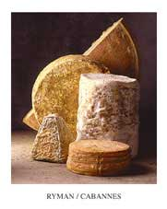
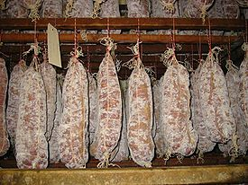
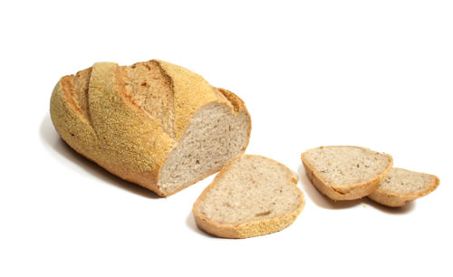
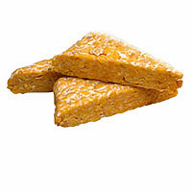
Microbiology of Fermented Foods
Principles
Microorganisms
Starter Cultures
Fermented Foods

Slide 2
Fermentation Principles
Spoilage versus Fermentation: a matter of control
Left to their own fate, perishable foods (meat, milk, fruits and vegetables) perish because growth of micro-organisms is not controlled
In fermentation, conditions are controlled so that only certain microorganisms can grow (only those that bring about positive changes).

Slide 3
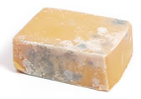
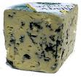
Spoilage versus Fermentation:
a matter of control
Exert control by:
Acidity and pH
Temperature
Moisture
Salt
Substrate availability

Slide 4
General properties of fermented foods
Enhanced preservation
Enhanced nutritional value
Enhanced functionality
Enhanced organoleptic properties
Unique
Increased economic value

Slide 5
Fermented foods industry: past and present
Traditional
Modern
Small scale (craft industry)
Large scale (in factories)
Non-sterile medium
Heat-treated medium
Exposed and open
Closed and contained
Manual
Automated
Insensitive to time
Time-sensitive
Exposure to contaminants
Contaminants excluded
Varying quality
Consistent quality
Safety a minor concern
Safety a major concern

Slide 6
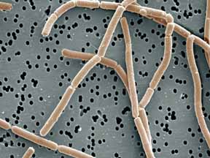
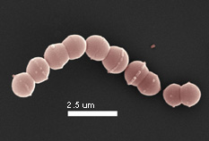
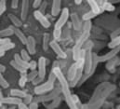
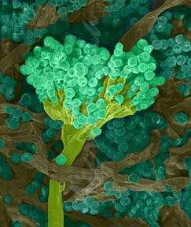
Microorganisms involved in fermented foods
Lactic acid bacteria
Other bacteria
(Lactobacillus, Streptococcus)
(Propionibacterium, Brevibacterium)
Fungi
Yeast
(Aspergillus, Penicillium)
(Saccharomyces)

Slide 7
Initiating food fermentations
natural fermentation
requires selection
wine, sauerkraut, soy sauce
backslopping
relies on use of a previous batch
sausage, sour dough bread, beer, kefir
starter cultures
defined strains in concentrated form
cheese, yogurt, sausage, wine, beer, bread

Slide 8
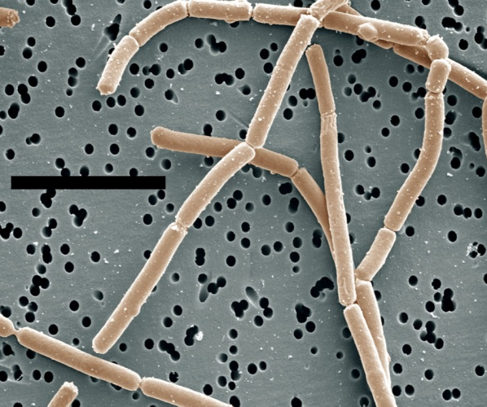
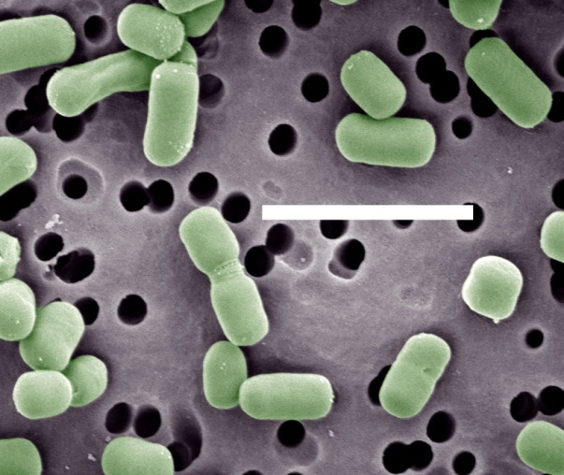
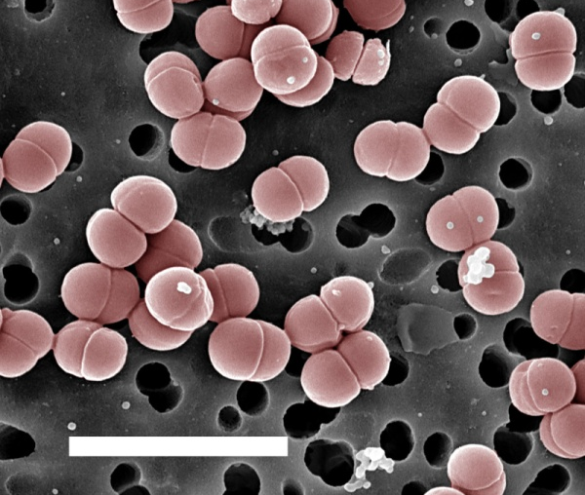
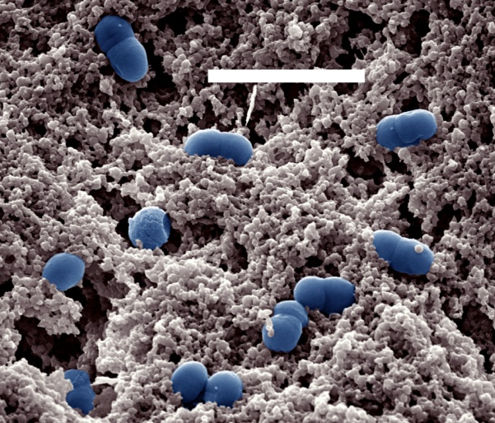
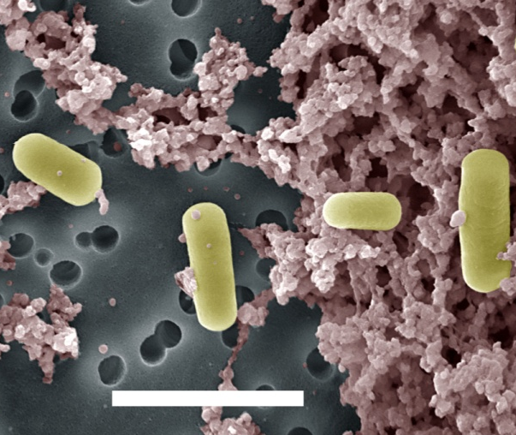
Lactic acid bacteria
A
B
C
5.0 µm
D
E
F
1.0 µm
A, Lactobacillus delbrueckkii subsp. bulgaricus; B. Lactobacillus brevis; C, Pediococcus pentosaceus; D, Lactococcus lactis; E, Lactobacillus helveticus; F, Streptococcus thermophilus

Slide 9
Common characteristics of lactic acid bacteria
Fermentative
Low mol% G + C
Non-sporeforming
Gram positive rods and cocci
Facultative anaerobes
Catalase negative
Non-motile
Acid-tolerant

Slide 10
Nutritional requirements of lactic acid bacteria
Require sugars for energy
Require pre-formed amino acids
Some strains require complex nutrients
Some strains require anaerobiois

Slide 11
Fermentative pathways in lactic acid bacteria
Glucose
Homofermentative
Heterofermentative
lactate
(L or D)
lactate
acetate
CO₂
ethanol

Slide 12
Genera of lactic acid bacteria
Aerococcus
Carnobacterium
Enterococcus
Lactobacillus
Lactococcus
Leuconostoc
Oenococcus
Pediococcus
Streptococcus
Tetragenococcus
Vagococcus
Weissella

Slide 13
Lactic acid bacteria important in fermented foods
Lactobacillus
Lactococcus
Leuconostoc
Oenococcus
Pediococcus
Streptococcus
Tetragenococcus

Slide 14
Phylogeny of lactic acid and other Gram positive bacteria
Lactobacillus delbrueckii
Staphylococcus aureus
Lactobacillus johnsonii
Lactobacillus gasseri
Bacillus subtilis
Tetragenococcus halophilus
Lactobacillus plantarum
Pediococcus pentosaceus
Listeria monocytogenes
Lactobacillus brevis
Lactobacillus casei
Enterococcus faecalis
Clostridium botulinum
Vagococcus salmoninarum
Carnobacterium funditum
Aerococcus viridans
Streptococcus thermophilus
Streptococcus pneumoniae
Lactococcus lactis
Lactococcus cremoris
Oenococcus oeni
Weissella cibaria
Leuconostoc mesenteroides

Slide 15
Habitats of lactic acid bacteria
Genus
Dairy
Meat
Vegetable
Fruit
Lactococcus
+
-
-
-
Streptococcus
+
-
-
-
Leuconostoc
+
-
+
+
Oenococcus
-
-
-
+
Lactobacillus
+
+
+
+
Pediococcus
-
+
+
-
Tetragenococcus
-
-
+
-

Slide 16
General functions of LAB in fermented foods
Ferment sugars, reduce pH
Synthesis of flavor compounds
Texture changes
Production of antimicrobial substances

