Slide 1
Example: How to calculate nutrition information

Slide 2
Step 1: Identify the ingredients in your recipe and the serving size of your recipe
You are making peanut butter cups with shredded coconut
The recipe makes 30 peanut butter cups
  2 cups of milk chocolate chips
  2 tablespoons of shortening
  ½ cup butter
  ½ cup crunchy peanut butter
  1 cup confectioner’s sugar
  1 cup of shredded coconut

Slide 3
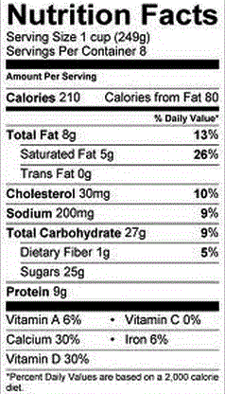
Step 2: Calculate the nutrition per serving of chocolate chips
For 2 cups of chocolate chips, this bag of chocolate contains:
  A serving is 1 cup
    210 Calories
    8g fat
    30 mg cholesterol
    27 g carbohydrates
    1 g fiber
    25 g sugar
    9 g protein

Slide 4
Step 3: Calculate the nutrition per serving of chocolate chips
To determine the calories for the chocolate chips in the new peanut butter cup recipe, multiply the number of calories for one serving of chocolate by the amount needed in the recipe:
210 Calories (per cup) x 2 (2 cups needed for the recipe) = 420 calories for 2 cups of chocolate chips

Slide 5
Step 4: Repeat this procedure each of the following nutrients for each ingredient:
Calories
Fat
Cholesterol
Carbohydrates
Fiber
Sugar
Protein

Slide 6
Step 5: Determine the final nutrition information
To do this, add the total of each nutrient for each ingredient. For example:
  Total Calories for 2 cups of chocolate chips = 420
  Total Calories for 2 tablespoons shortening = 60
  Total Calories for ½ cup butter = 80
  Total Calories for ½ cup crunchy peanut butter = 200
  Total Calories for 1 cup confectioner’s sugar = 60
  Total Calories for 1 cup of shredded coconut = 170
  420+60+80+200+60+170 = 990 total Calories
Notes:
Note that the numbers for everything except the chocolate are simulated and not to be considered nutritionally accurate.

Slide 7
Step 6: Determine the final nutrition information
Divide 990 Calories by 30 (the recipe serving size)
The total number of Calories per peanut butter cup is 33 Calories.
Notes:
Note that the numbers for everything except the chocolate are simulated and not to be considered nutritionally accurate.

Slide 8
Step 7: Repeat steps 5 and 6 for each nutrient
Fat
Cholesterol
Carbohydrates
Fiber
Sugar
Protein
**Note that the numbers for everything except the chocolate are simulated and not to be considered nutritionally accurate.

