Slide 1
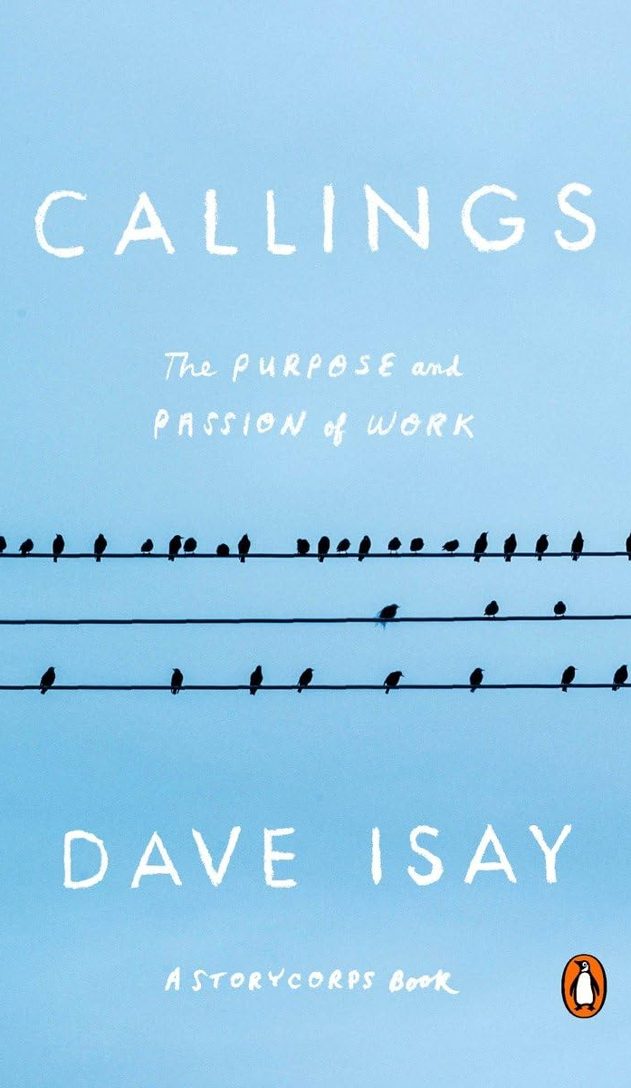
K-State First Book Scholarship
K-State First Book Scholarship
K-State First Book Awards celebrate the common experiences shared at K-State with the common book. The award winners work hard to expand the consideration of new ideas, values and concepts in the classroom and in the university community and use creative applications of the themes from the common book of the year.
AMOUNT
$1000
DUE DATE
December 11, 2026, by 11:59 PM
TELL US ABOUT YOUR EXPERIENCE
Tell us about your experience with the Callings book. This can be shared through a non-fiction essay, creative writing, music, video, visual art, performance art, or some other medium. Reflections on an Evening with Dave Isay or Find Your Callings events would count!
APPLICATIONS
Submit applications at www.k-state.edu/first/book

Slide 2
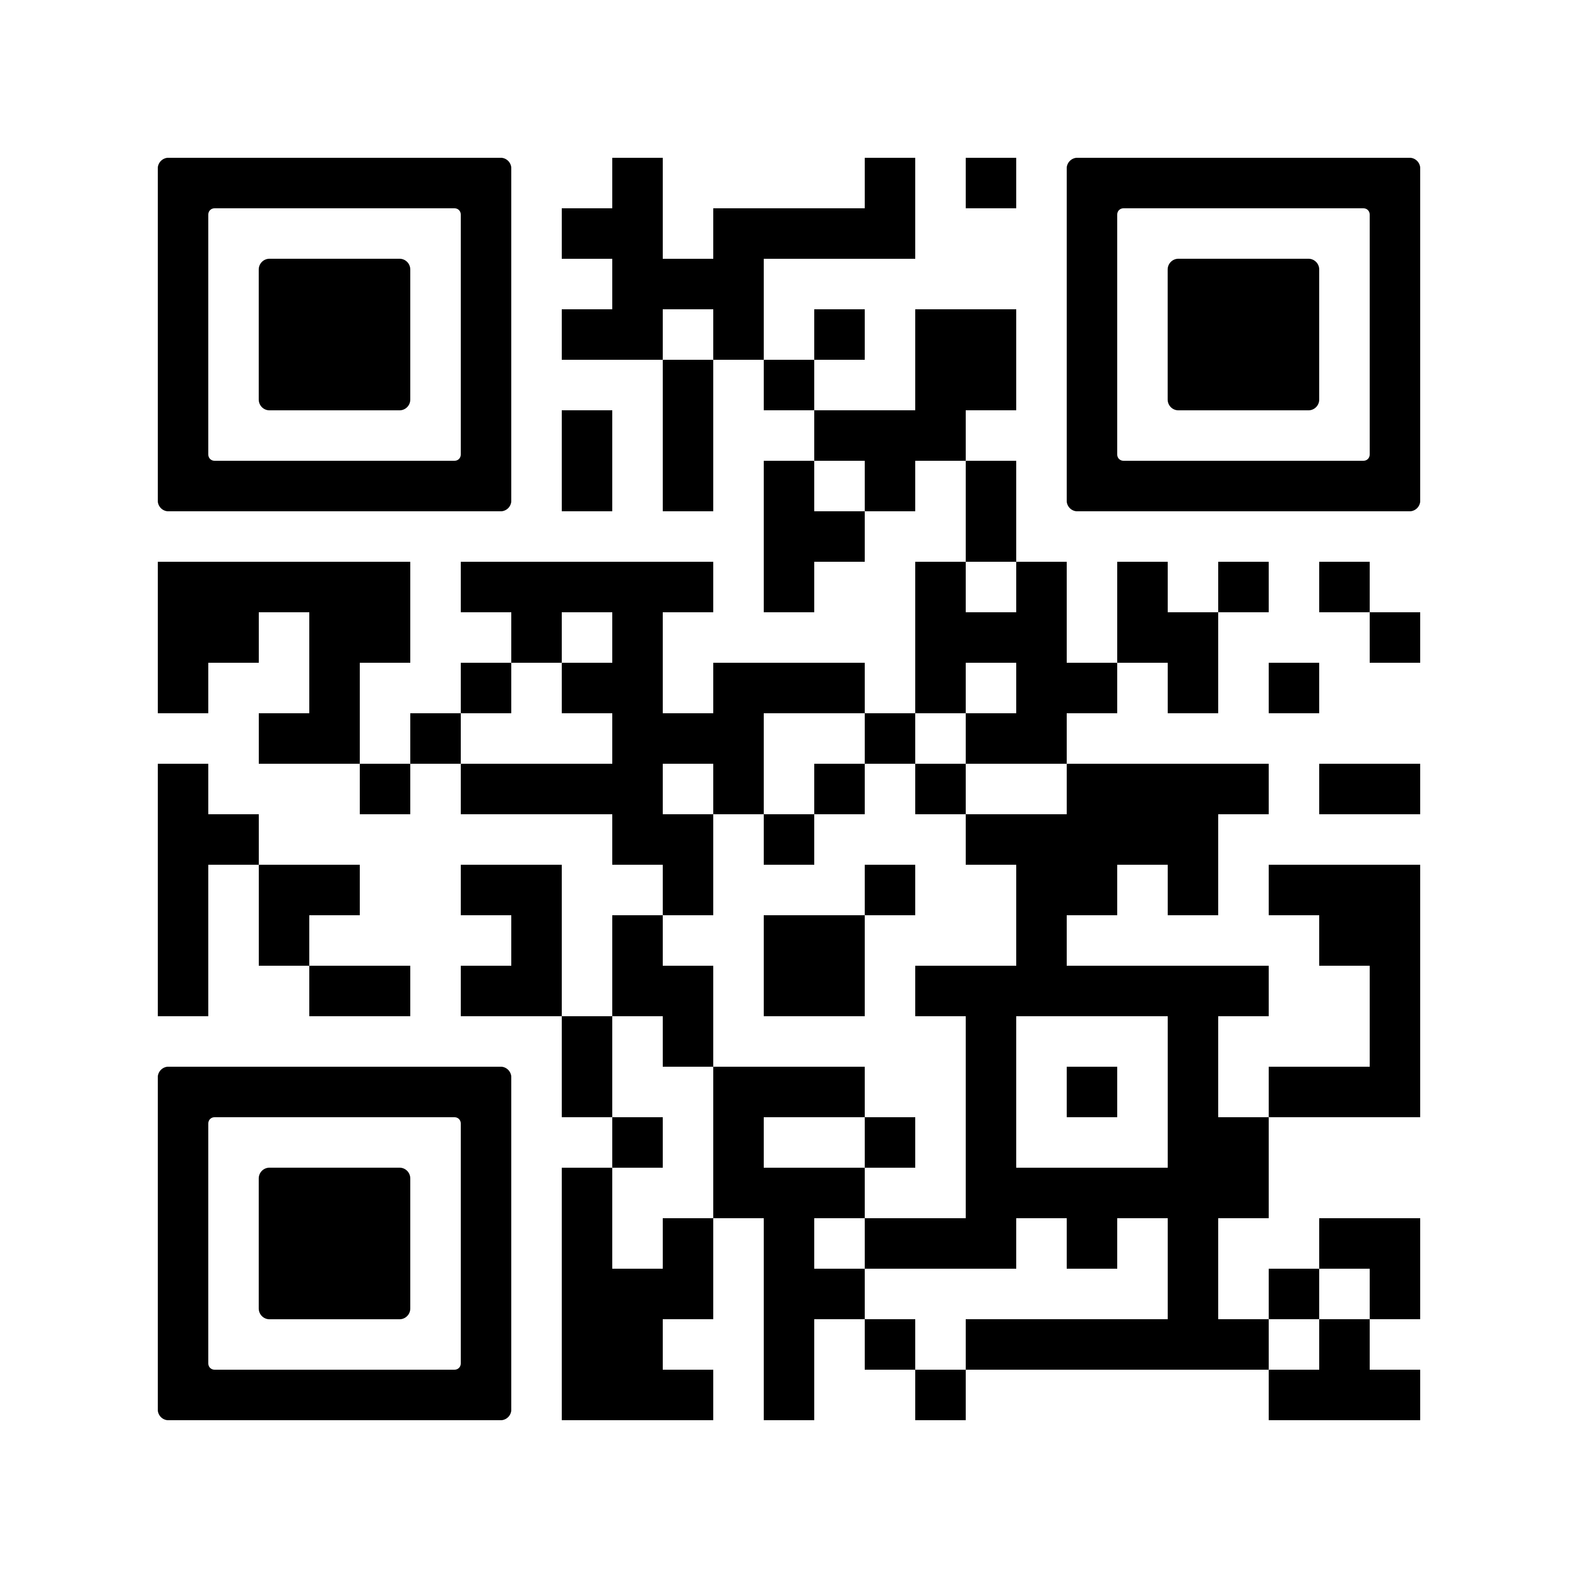
Ask Dave Isay a Question
Share your question for the Q&A:
Visit https://tinyurl.com/ksfb2026isay OR
Click on the QR code to submit your question

Slide 3
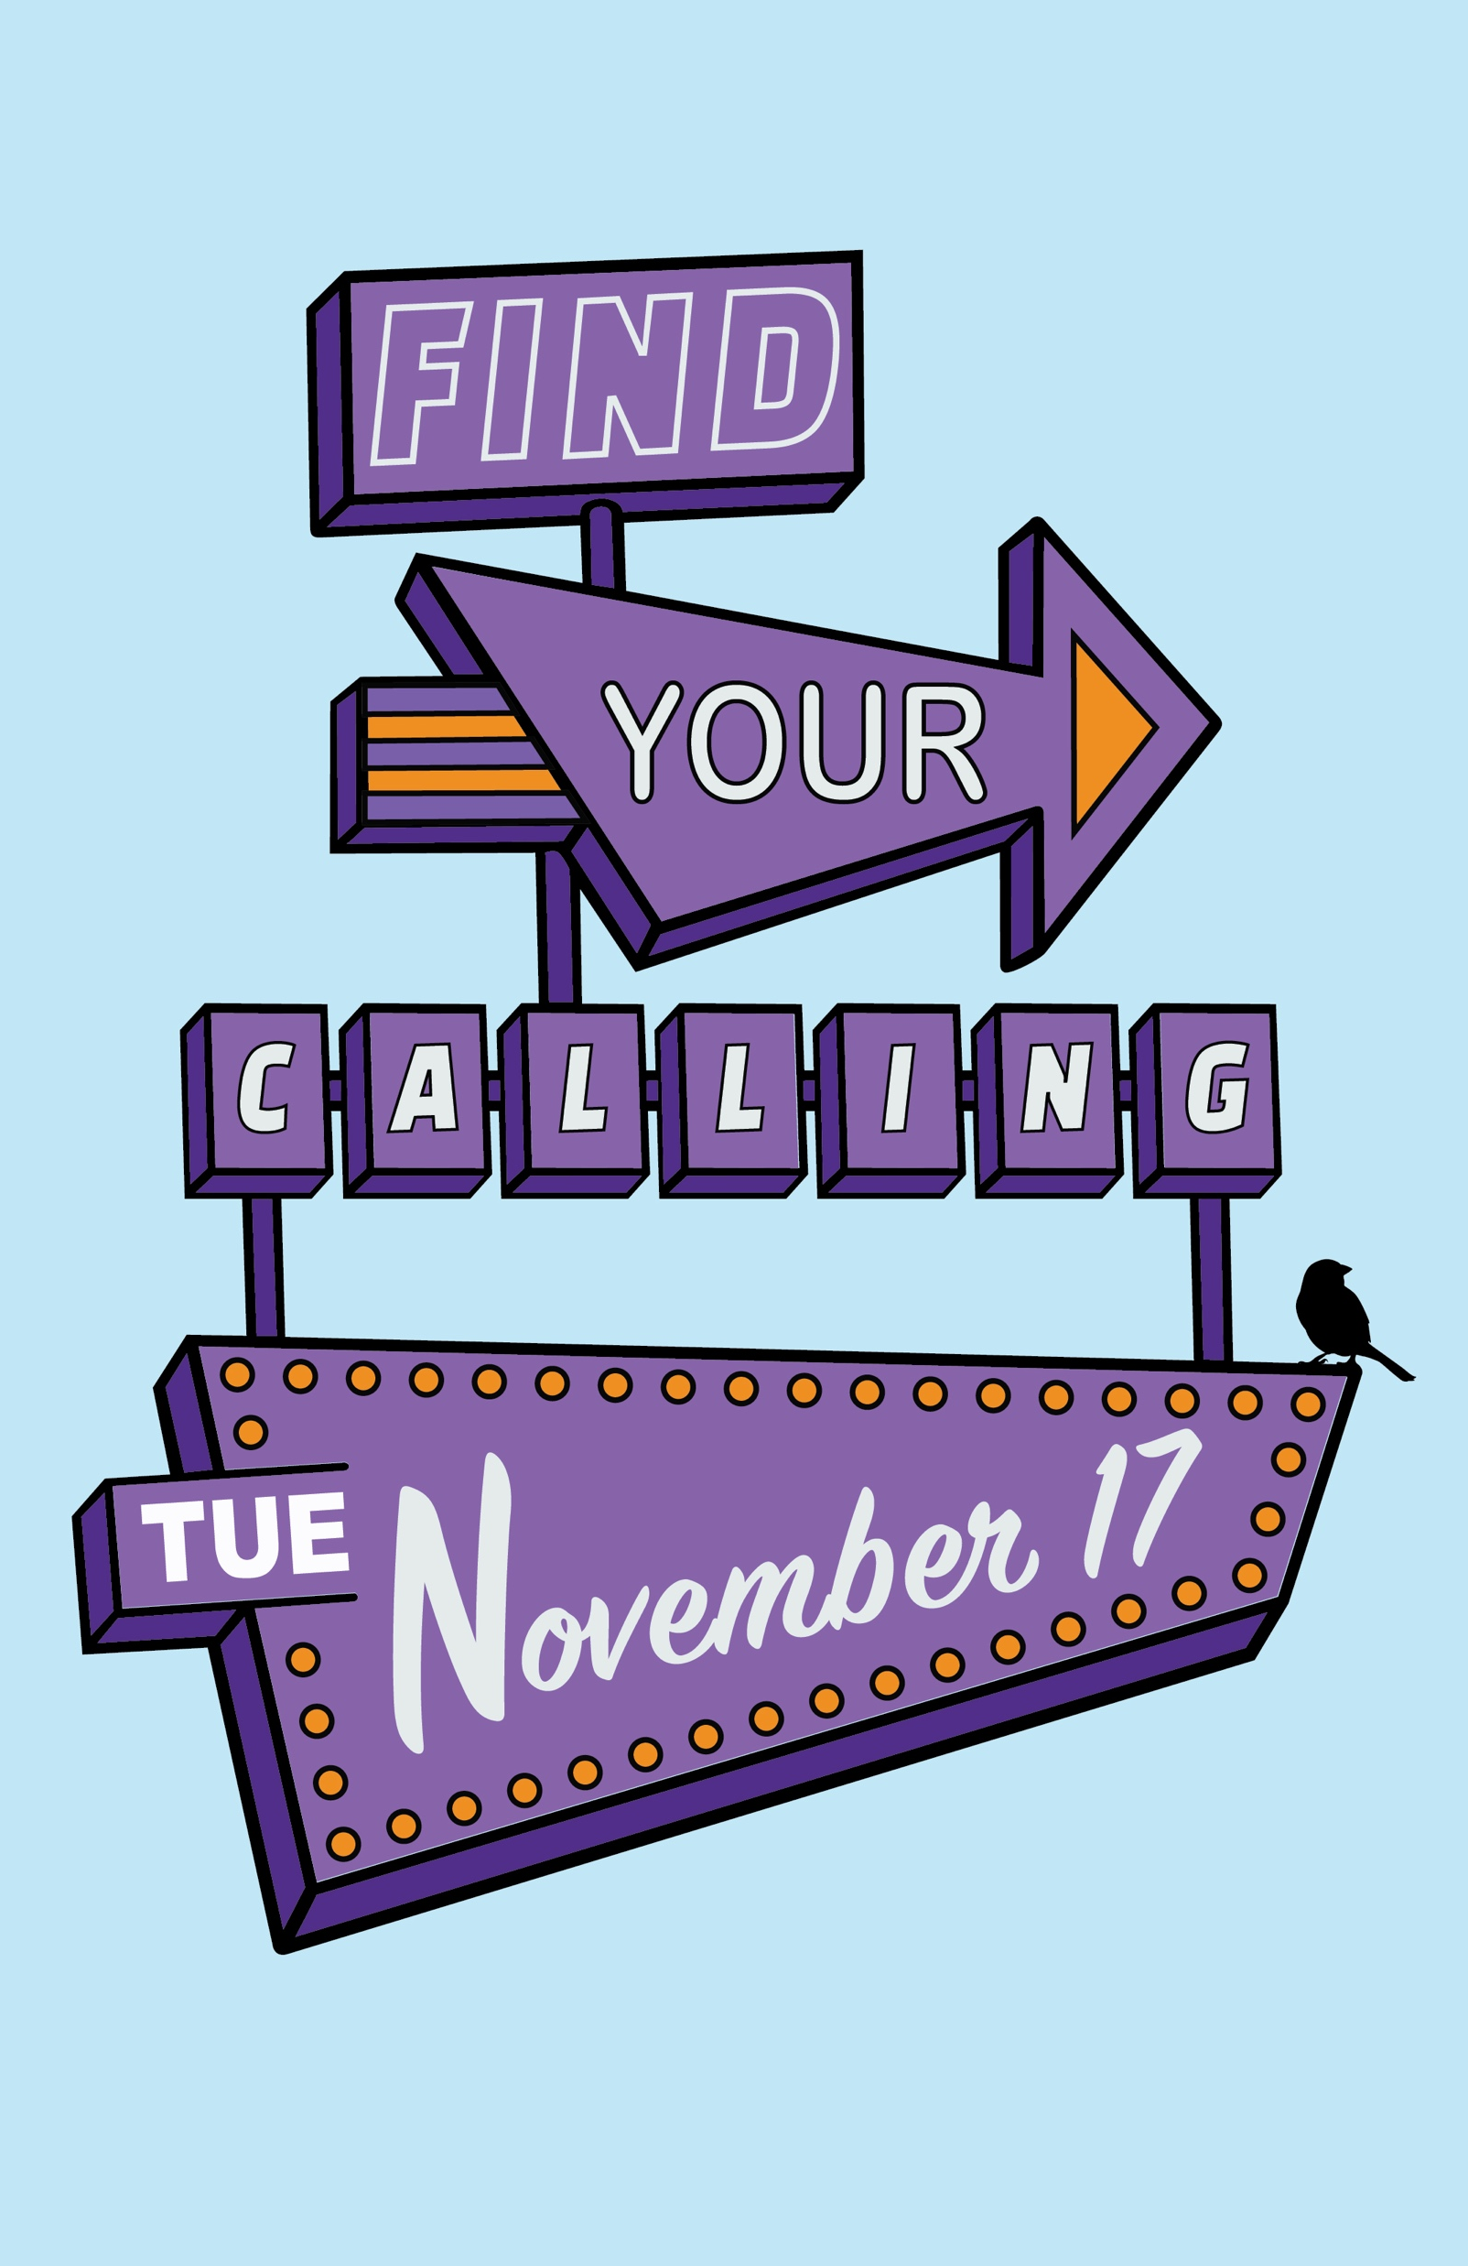
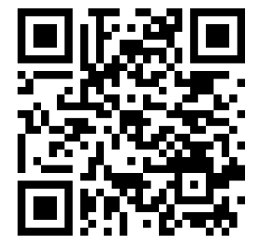
Attend Find Your Calling
Attend K-State First Book Dialogues: Find Your Calling
Join us for an engaging discussion where students, staff, and faculty come together to share their favorite moments from our 2026 common read, Callings, and explore how we find meaning and passion in the work we do.
DATE
Tuesday, November 17, 6:30-8:30 PM
LOCATION
Student Union, Ballroom
FIND YOUR CALLING
Whether you're looking to meet new people, deepen existing friendships, or simply engage in thoughtful dialogue about how we find meaning and passion in the work we do, this event offers a welcoming environment to connect and learn. Come ready to listen, share, and be part of the conversation.
RSVP
Register with the QR code or at https://cglink.me/2pS/r394948

