Slide 1
COST SHARE & EFFORT BASICS
Kansas State University – Sponsored Programs Accounting
Last updated March 2015

Slide 2
What is cost share?
Federal Government definition in 2 CFR 200.29 "Cost sharing or matching means the portion of project costs not paid by Federal funds."
K-State definition of cost share is the matching portion of an award that is made up of salaries and benefits paid by K-State from a non-grant project. Non-salary match is referred to as “hard $ match” and paid from a “M” account set up by Sponsored Programs Accounting.

Slide 3
Why is cost share included in an award proposal?
Mandatory: Required by sponsor to be included in the proposal. Must be reported to sponsor.
Voluntary Committed: PI includes a promise of a certain level of effort in the proposal. Must be reported to Sponsored Programs and recorded for future reference.
Voluntary Uncommitted: Not required to be tracked or reported.

Slide 4
Why are effort reports required?
2 CFR 200.430 Compensation-personal services.
(i) Standards for Documentation of Personnel Expenses (1) Charges to Federal awards for salaries and wages must be based on records that accurately reflect the work performed. These records must:
(i) Be supported by a system of internal control which provides reasonable assurance that the charges are accurate, allowable, and properly allocated;
(ii) Be incorporated into the official records of the non-Federal entity;
(iii) Reasonably reflect the total activity for which the employee is compensated by the non-Federal entity, not exceeding 100% of compensated activities . . .

Slide 5
Effort Example
Example assumptions:
1. Professor K has only one sponsored research project.
2. Professor K has 10 % of her salary directly charged to the grant’s FIS account.
3. Cost share was committed in the grant proposal.
Department could report up to 60% of Professor K’s salary as cost share.
Total effort on sponsored project 70%
Less direct charged salary 10%
Equals K-State’s share of effort (cost share) 60%

Slide 6
How do I know how much effort to report on the cost share spreadsheet each quarter?
Million $ Question!

Slide 7
What percentage to report?
Talk to the PI
Report as budgeted (call SPA if unsure of budgeted amount)
Per 2 CFR 200.430 (viii) Budget estimates . . . alone do not qualify as support for charges to Federal awards, but may be used for interim accounting purposes, provided that:
(A) The system for establishing the estimates produces reasonable approximations of the activity actually performed;
(B) Significant changes in the corresponding work activity . . . are identified and entered into the records in a timely manner. Short term (such as one or two months) fluctuation between workload categories need not be considered as long as the distribution of salaries and wages is reasonable over the longer term; and
(C) The non-Federal entity's system of internal controls includes processes to review after-the-fact (i.e. K-State effort reports signed by an individual directly aware of and with first-hand knowledge of all effort being reported) interim charges made to a Federal awards based on budget estimates. All necessary adjustment must be made such that the final amount charged to the Federal award is accurate, allowable, and properly allocated.

Slide 8

DON’T
STRESS!
The percentage of effort that you report will eventually be certified as correct when the PI signs their effort report. If the percentage is not reasonable or reflective of their actual work, it is the PI’s responsibility to notify you or my office to revise the effort reported.

Slide 9
Cost Share Life Cycle
STEP 1
PI proposal budget
STEP 7
Dept coordinates signatures and returns effort reports to SPA
STEP 8
SPA retains effort reports for future potential audit
STEP 2
Transmittal with cost share included
STEP 3
SPA send Coversheets when requesting quarterly cost share reporting
STEP 4
Dept reports % effort on spreadsheet
STEP 5
SPA converts % to $ for financial reporting to sponsor
STEP 6
SPA sends effort reports to dept to be certified

Slide 10
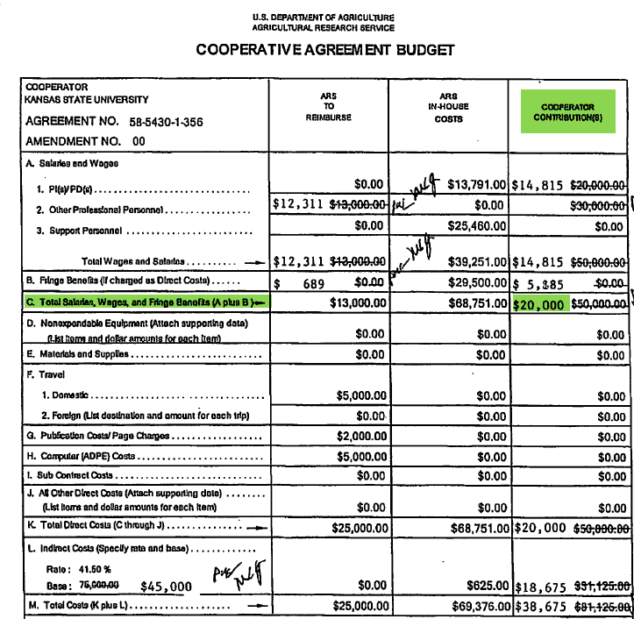
STEP 1: Proposal Budget

Slide 11
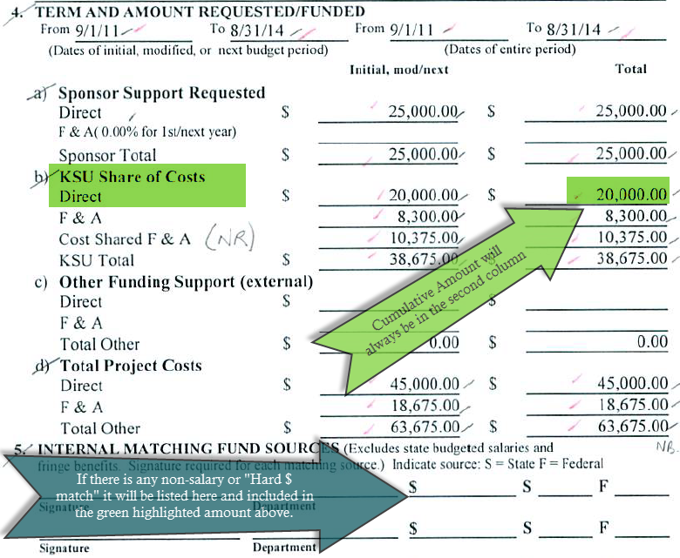
STEP 2: Transmittal Sheet

Slide 12
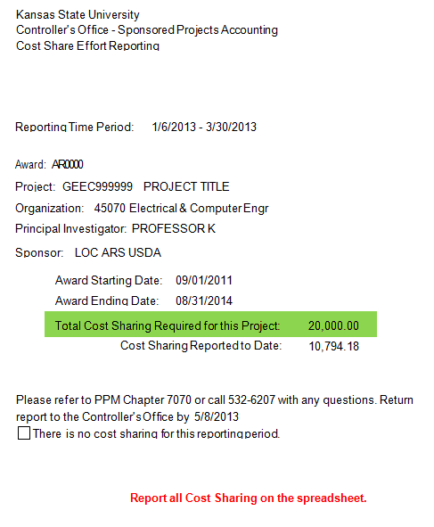
STEP 3: Cost Share Coversheet

Slide 13
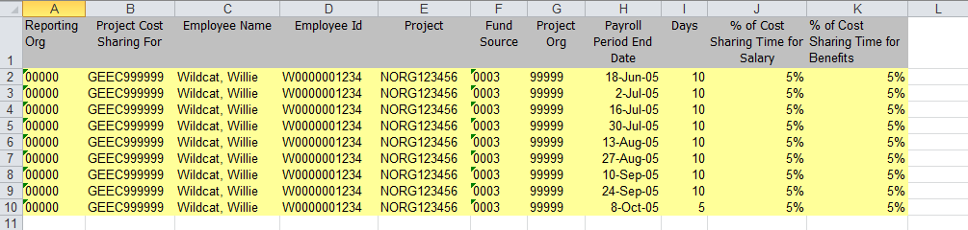
STEP 4: Dept reports percentage effort to SPA

Slide 14
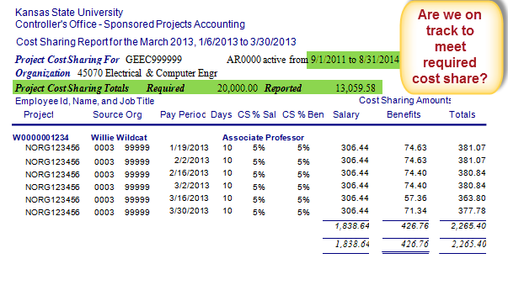
STEP 5: SPA converts % to $ for financial reporting

Slide 15
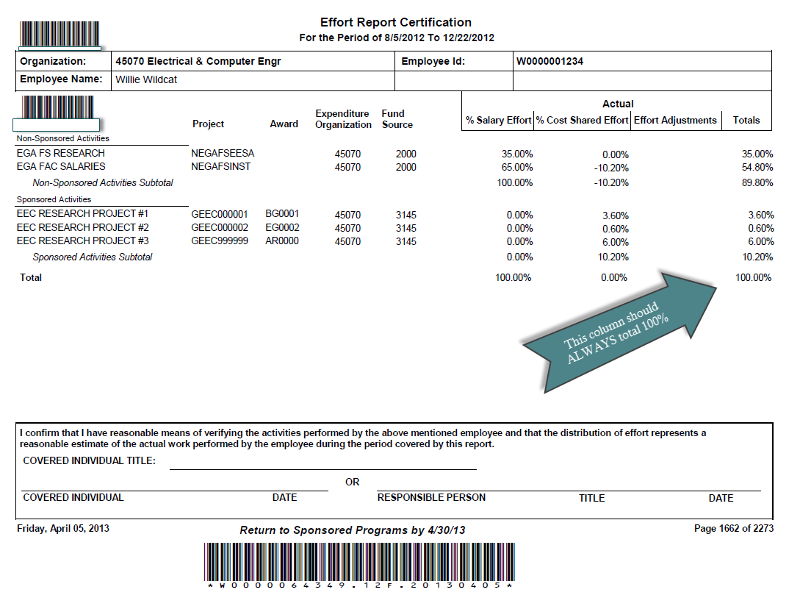
STEP 6: SPA sends effort reports to depts for certification

Slide 16
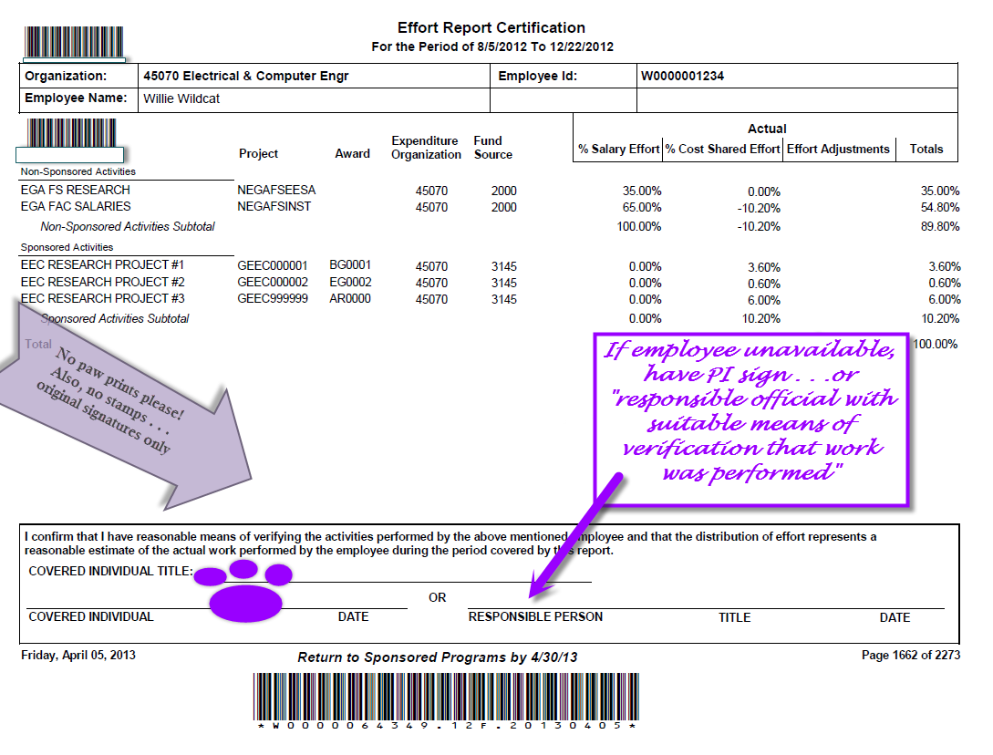
STEP 7: Depts send out for signatures and return to SPA

Slide 17
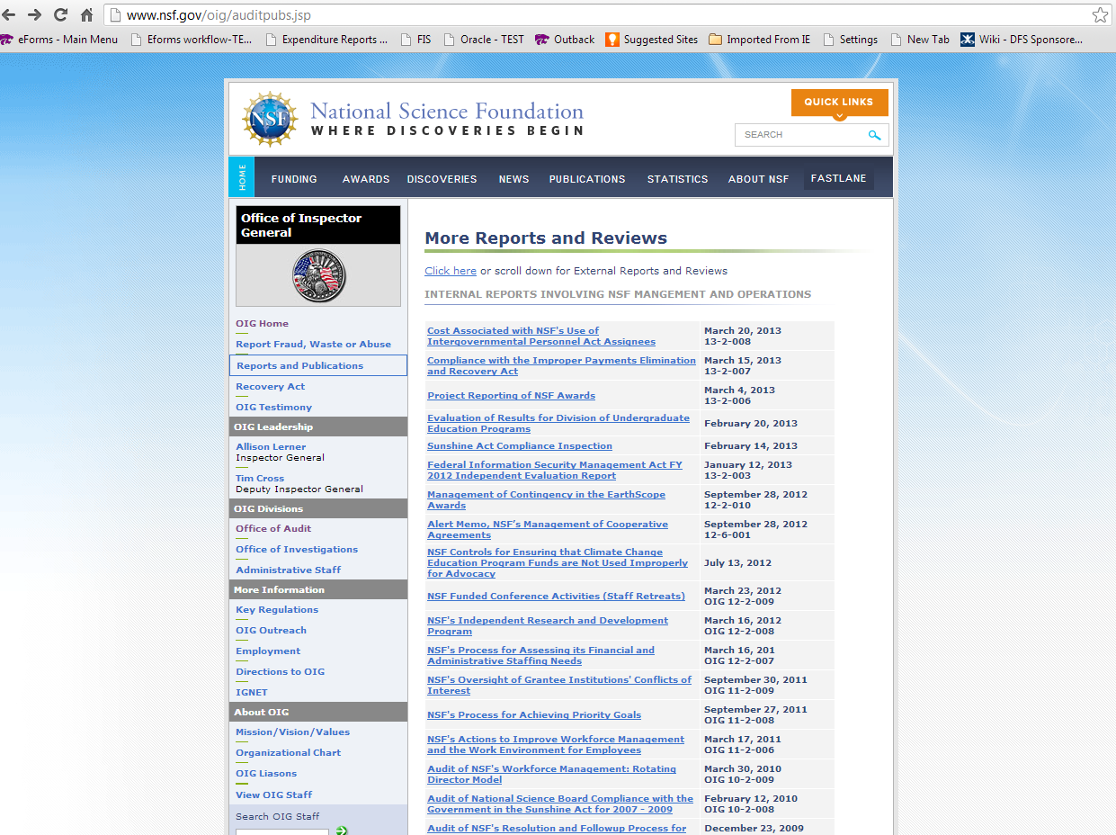
STEP 8: SPA retains for future potential audits

Slide 18
Cost Share Life Cycle
STEP 1
PI proposal budget
STEP 7
Dept coordinates signatures and returns effort reports to SPA
STEP 8
SPA retains effort reports for future potential audit
STEP 2
Transmittal with cost share included
STEP 3
SPA send Coversheets when requesting quarterly cost share reporting
STEP 4
Dept reports % effort on spreadsheet
STEP 5
SPA converts % to $ for financial reporting to sponsor
STEP 6
SPA sends effort reports to dept to be certified

Slide 19

Why the lag between the end of the semester and when effort reports are certified?
Cost share is reported at the end of a quarter. The cost share must be fully reported and processed before effort reports can be produced.
For example: Spring 2013 Effort Report will include the Apr-Jun 2013 Cost Share. Apr-Jun cost share will be due first full week in Aug. Then effort reports can be sent out.

Slide 20
What If I Make a Mistake?!?
Top 3 Things To Check:
Double check required amounts – compare transmittal to cost share reports from SPA
Check required vs reported amts on the completed cost share reports from SPA each quarter. Are you on track to meet the required amount?
Check grant number, employee id & percentages on spreadsheet. Errors in other columns will likely be flagged in the validation process.

Slide 21
1. Double check required amounts – compare transmittal to cost share reports from SPA

Slide 22
2. Check required vs reported amts on the completed cost share reports from SPA.

Slide 23
3. Check grant number, employee id & percentages on spreadsheet. Errors in other columns will likely be flagged in the validation process.

Slide 24
Late Cost Share or Revisions
PPM Chapter 7070.075 - Late Cost Share Transfers
Changes or additions to cost sharing are considered transfers. These are considered a late transfer 90 days after the original cost share was due OR if the effort report due date has passed. Late cost share transfers will be allowed only in limited circumstances. For late transfers, the Late Cost Share Transfer Justification Form must be completed, signed and submitted to the Sponsored Projects Accounting Office for approval. In addition, the spreadsheet needs to be submitted via e-mail.

Slide 25
Cost Share Resources
http://www.k-state.edu/finsvcs/sponsoredprograms/costshare/
http://www.ecfr.gov/
Questions?
Contact Laura Hohenbary or Olga Volok at
532-6207

