Slide 1
Outstanding Obligations List
Division of Financial Services – Sponsored Programs
March 2014

Slide 2
What is an Outstanding List?
A list of all expenses that have been incurred on a sponsored project BUT have not yet posted to FIS.

Slide 3
Why is an Outstanding List Important?
Sponsors give us reporting deadlines. Sponsored Programs will use the Outstanding List, as reported to us by the department, in order to meet reporting deadlines for either a final financial report or final invoice. If you forget to add items to an Outstanding List, it is possible that a sponsor will not accept a revised final report. In that case, your department would be responsible for those expenses left off of the original Outstanding List.
DON’T GET STUCK WITH UNREIMBURSABLE EXPENDITURES!

Slide 4
If department does not provide an Outstanding List by the stated timeline . . .
Sponsored Programs will have to final report only those expenditures that have posted to FIS as of the final reported date. Anything that posts after that date will be the responsibility of the department and would need to be moved to a departmental account.

Slide 5
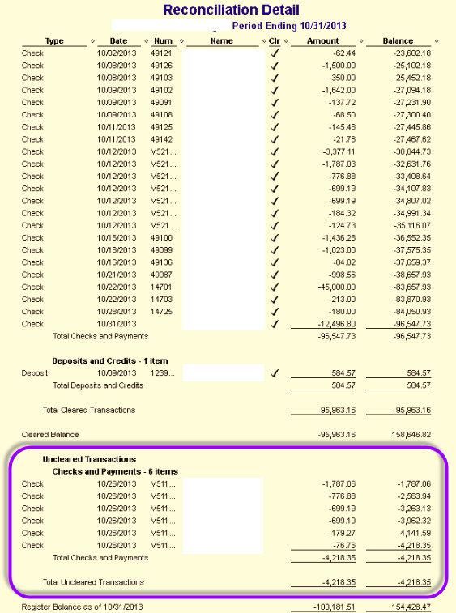
What should be included on the Outstanding List?
Uncleared Transactions on your department’s shadow system

Slide 6
What should be included on the Outstanding List?
Uncleared Transactions on your department’s shadow system
Uncleared Transactions are those that have not yet posted to FIS

Slide 7
What should be included on the Outstanding List?
Any invoices, payroll, or transfer of payments that have not yet been posted to your department’s shadow system.

Slide 8
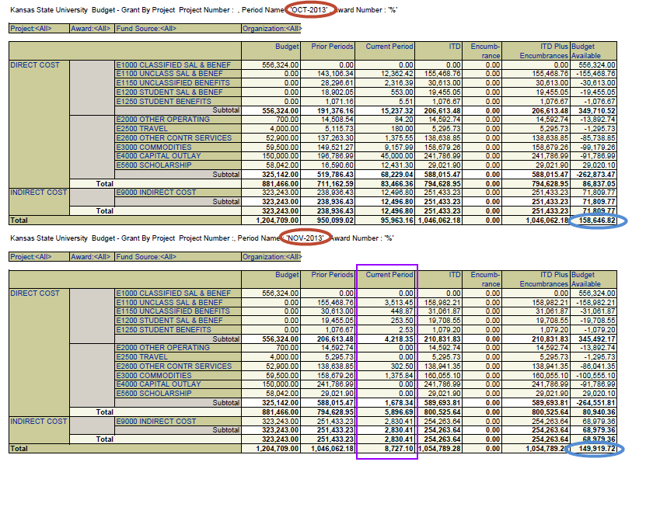
FIS Report: Budget - Grant by Project
Award End Date: 10/31/2013
FIS at award end date
Final FIS balance including all OS items
Outstanding (OS) items can post to FIS over multiple months (this example posts OS in just 1 month).
All OS items should post to FIS within 90 days of the award end date BUT all need to be included on your OS List when due to DFS-Sponsored Programs (30 or 60 days).

Slide 10
Bringing the pieces of the puzzle together . . .
The uncleared transactions listed on the shadow system reconciliation detail posted to FIS in November 2013 and were all payroll transactions. These OS items were included on the OS list.
In November 2013, there were also transactions that posted to FIS that were non-payroll and were not yet listed in the shadow system. These would have been invoices that were in the departmental business office but had not yet been entered into the shadow system as of 10/31/13. During November, the OS list was completed and all OS posted to both the shadow system and FIS. This will not always happen within 30 days as in this example, but should happen within 60 days when done correctly.

Slide 11
Close-out tips
90-120 days prior to award end date
Remind PI
Will award be completed by end date? Time extension needed?
30-60 days prior to award end date
Remind PI
Purchase all supplies or services prior to end date
Forward all invoices to departmental business office
Plan for employees paid on award project to be paid elsewhere

Slide 12
New version of Outstanding List: http://www.k-state.edu/finsvcs/sponsoredprograms/ spa_forms/index.html
Questions? Contact Sponsored Programs at 2-6207

