Slide 1
Cost Transfers
Division of Financial Services – Sponsored Programs
March 2014

Slide 2
PPM: http://www.k-state.edu/policies/ppm/7000/7055.html
Current policy written in 2009 as a result of an NSF desk audit. Cost transfers are often one of the first things an auditor will review to see how frequently they occur. This can be an indication to an auditor that proper financial procedures are not in place or are not being followed.

Slide 3
Regular review of financial accounts
Principal Investigators and/or their delegate should regularly review the financial status of sponsored project accounts and prepare and submit transfers to correct errors on a timely basis.

Slide 4
Late transfers
Transfers onto a sponsored project are late when they are processed 90 days after the original transaction date.
Transfers off of a sponsored project have no time limit. If you become aware that a charge does not belong to a sponsored project, it should be transferred off immediately.

Slide 5
Payroll transfers
Transfers must be prepared and submitted within 90 days after the effective date of the paycheck and prior to being certified on an Effort Report. Once salaries have been certified on an Effort Report, changes to the assignment of those costs may call into question the validity and integrity of the original certification. Allocation of the payroll costs, including cost sharing, should be carefully considered and adjusted prior to Effort Report certification.

Slide 6
Non-Payroll transfers
Transfers of costs to a sponsored project must be prepared and submitted within 90 days after the end of the month in which the transaction was originally recorded. A complete explanation of the need for the transfer must be documented on the transfer of payment form. Explanations such as “to correct a clerical error” are not adequate.

Slide 7
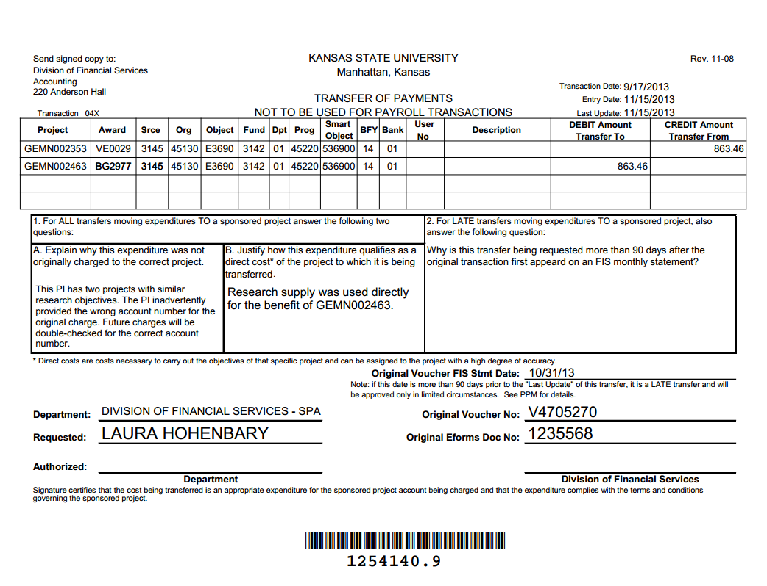

Slide 8
Examples of Acceptable Cost Transfer Explanations
A clerical error was made when the original payment document was prepared. The account number 123456 was inadvertently entered as 132456.
This PI has two projects that involve the study of wildcats and their eating habits. The PI inadvertently provided the wrong account number for the original charge. Future charges for this PI will be double-checked for the correct account number.
A review of the monthly statements for this account by the PI revealed an error in charging payroll. The personnel specialist had not been notified by the PI that a graduate student had been assigned to this project.

Slide 9
More Examples of Acceptable Cost Transfer Explanations
Receipt of the official award was delayed by the sponsor. The project started prior to the date an account was established.
The sponsor assigned a new award number to the new budget period of the project, therefore a new FIS account was set up. This transfer moves costs to the new FIS number.
A change in the personnel specialist position within the department caused a delay in changing payroll funding to accurately reflect employees assigned to this project.

Slide 10
Examples of Incomplete or Unacceptable Cost Transfer Explanations
To correct a clerical error
To move to correct project
Costs must be transferred to another sponsored project due to overspending
Costs need to be transferred to use up unspent funds before the sponsored project ends
The late transfer is needed due to workloads that prevented administrative staff/PI from doing account reviews until now
Costs were charged to sponsored project X until sponsored project Y was set up in FIS
The PI was unavailable at the time of the original charge so costs were charged to sponsored project X in the meantime

Slide 11
Do NOT use a grant account as a “holding” account for an unallowable charge
Grants are invoiced on a regular basis.
Do NOT charge to a grant account KNOWING that you are eventually going to transfer it elsewhere. The sponsor of the originally charged grant will be invoiced and will reimburse us for this unallowable cost.

Slide 12
Overdraft Accounts
Set up an Overdraft account when department or college has received verbal or written notification that an award is forthcoming and believes the risk is minimal. Charges for that research can be charged to the proper account from the beginning so that transfers are not needed when awarded. Do NOT charge to a grant account KNOWING that you are eventually going to transfer it elsewhere.
PPM Chapter 7010.140:
http://www.k-state.edu/policies/ppm/7000/7010.html
Caution: Department assumes financial risk if grant is not awarded.

