Slide 1
INDIRECT COSTS
What are they?
What are the different types (TDC, MTDC, TFFA)?
How are they calculated?
Presented by: Laura Hohenbary – DFS Sponsored Programs
September 2013

Slide 2
Review September Newsletter
http://www.k-state.edu/finsvcs/
sponsoredprograms/training_newsletters/index.html

Slide 3
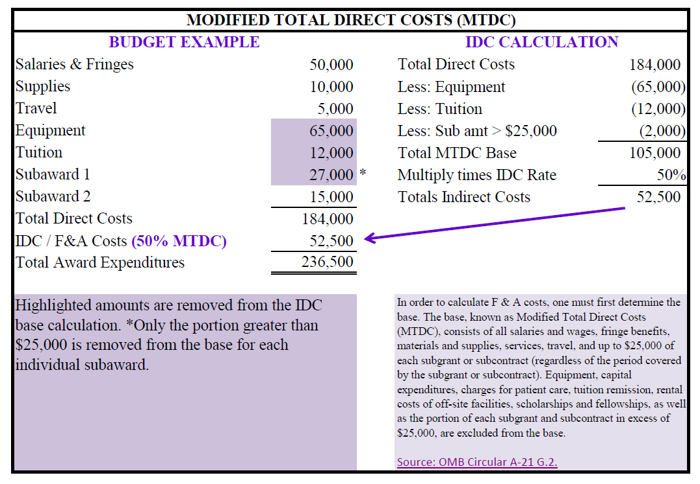
MTDC calculation

Slide 4
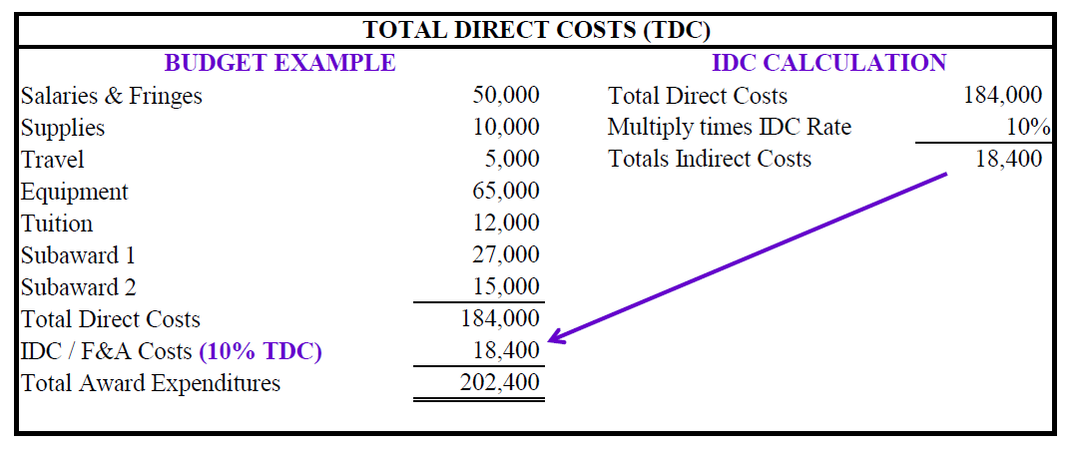
TDC calculation

Slide 5
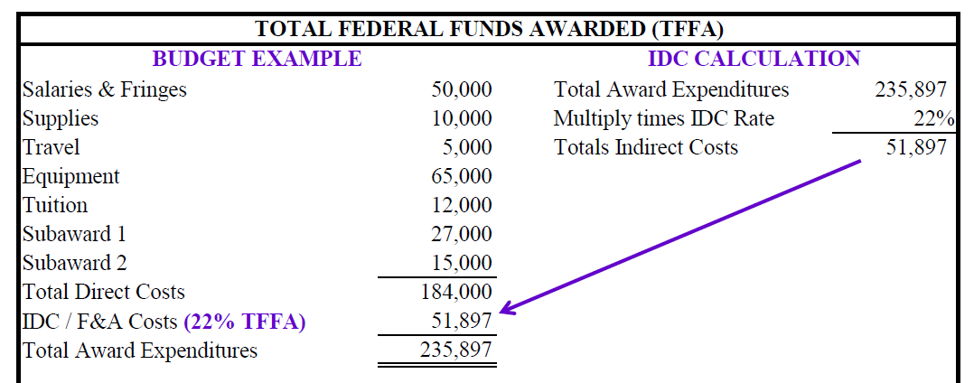
TFFA calculation

Slide 6
F&A Proposal & Rate Agreement
Cognizant agency – US Dept of Health & Human Services
Links to our current rate agreement:
http://www.k-state.edu/research/
preaward/indirect.htm
http://www.k-state.edu/research/forms/
preaward/
KSU_F&A_Agrmt_dated_Sep_10_2012.pdf

Slide 7
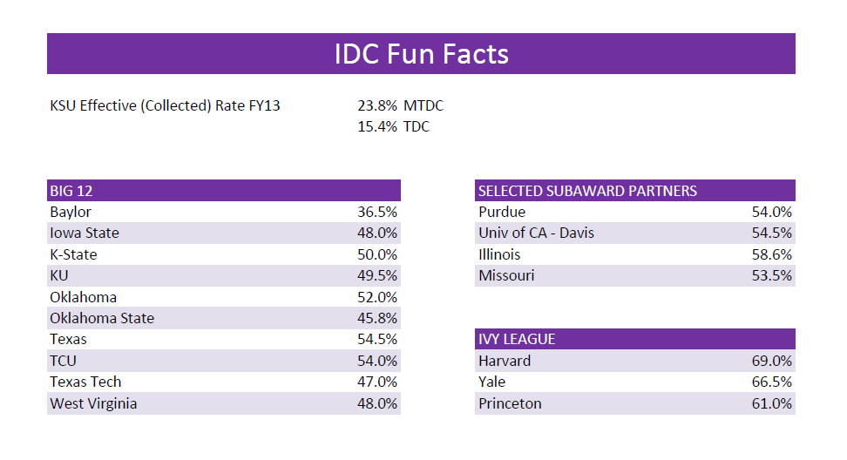

Slide 8
Questions?

